Slide 1
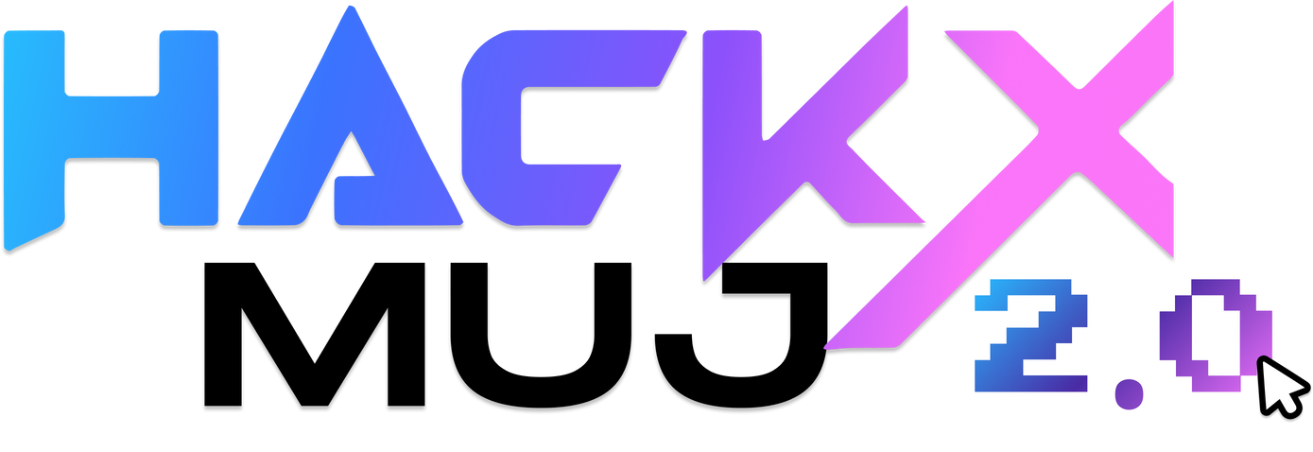



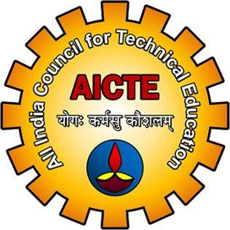
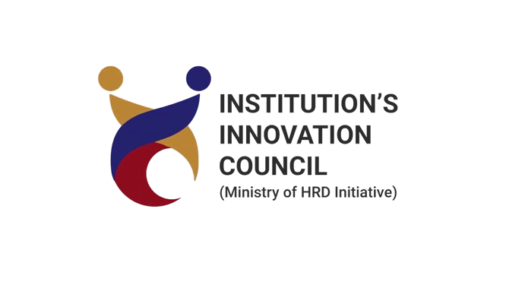
Round 1 Idea Submission
Eroor 404
Aradhya Khandelwal(L), Stuti Saxena, Vikrant Sharma, Divyansh Nagar
EdTech
Adaptive Learning Platforms for Neurodiverse Students

Slide 2

Eroor 404
ICARUS
“Adaptive focus enhancing platform.”
Objective: Web extension designed for neurodivergent students (ADHD) to improve study focus through:
Saccades intervals (eye movement technique)
Pomodoro technique (focused work intervals)
Line spacing adjustments (reduce visual clutter)
How It Works:
Tracks time on productive vs. distracting websites.
Points system: +100 points for every 10 mins of productive work, -25 points for distractions.
ML analysis generates weekly reports, sent to parents/teachers.
Innovation:
Combines focus techniques, gamified rewards, and ML-driven behavior analysis.
Reports provide actionable insights for improving attention.

Slide 3
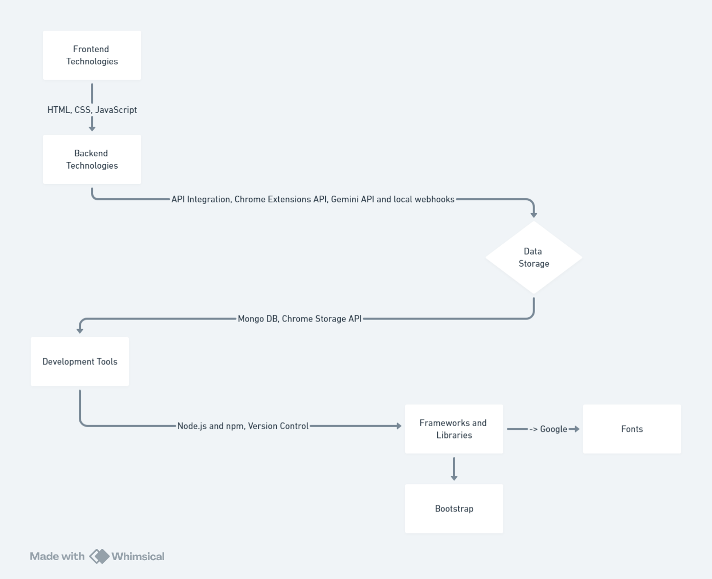
Eroor 404
TECHNICAL APPROACH

Slide 4
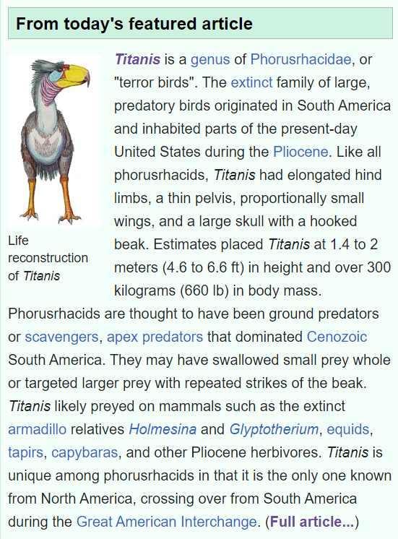
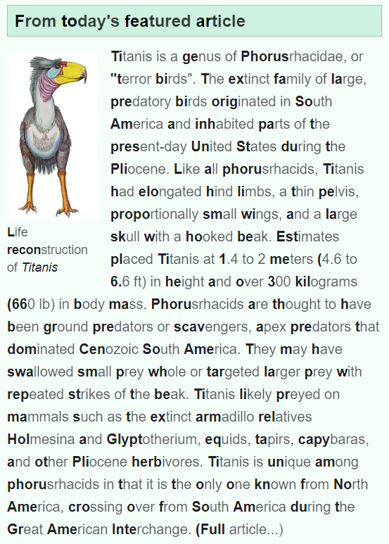
Eroor 404
WHAT IT DOES?
Icarus

Slide 5
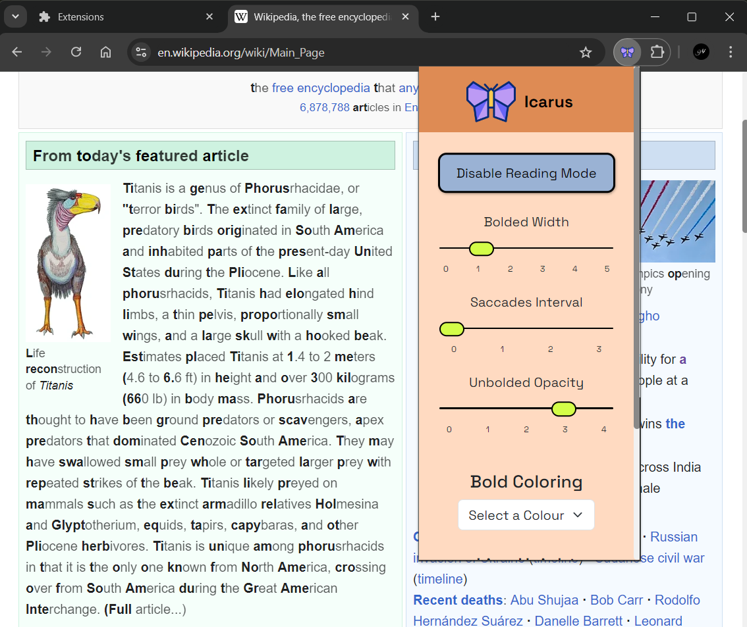
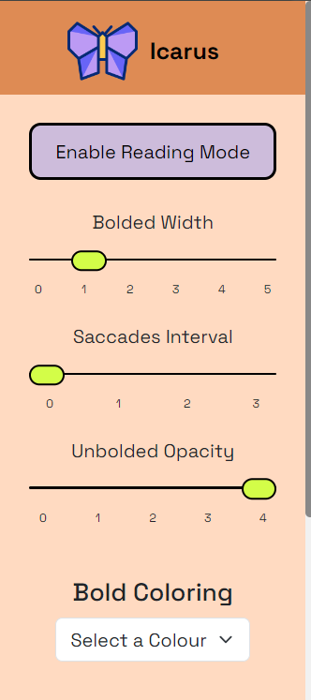
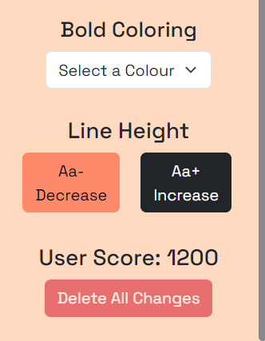
Eroor 404
METHODOLOGY
EGHH! The text is eww!!
LOGIC
USER
wait ! what’s this?
What's this score? We’ll see in next slide

Slide 6
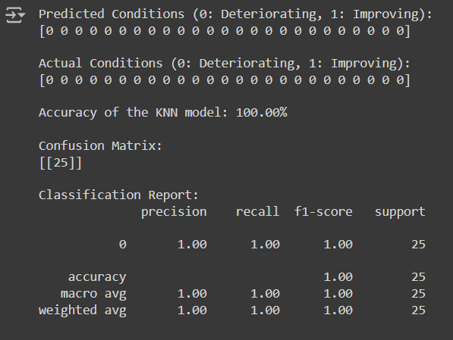
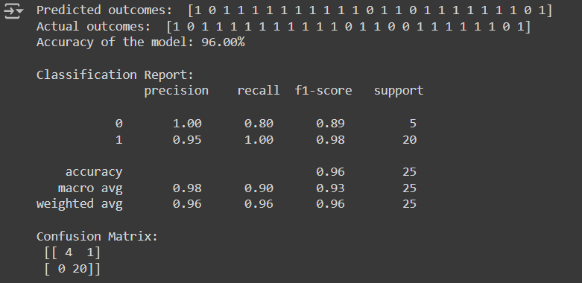
Eroor 404
METHODOLOGY
The score depicts that neurodiverse state of the student through an ML model.
Fig 1 : KNN model (near zero accuracy)
Fig 2 : KSVM model (96% accuracy)

Slide 7
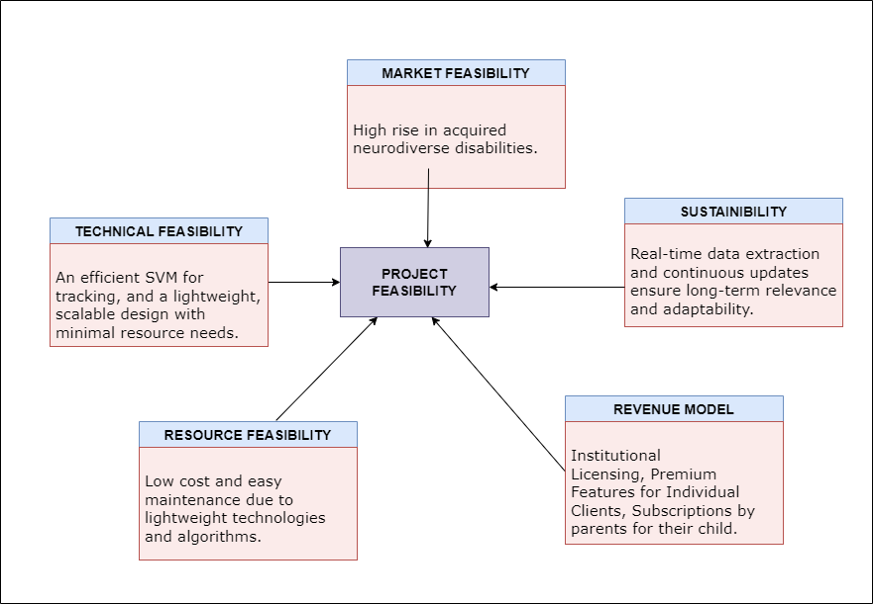
Eroor 404
FEASIBILITY AND VIABILITY

Slide 8
Eroor 404
IMPACT AND BENEFITS
Potential Impact on Target Audience
For Students (ADHD):
Enhances focus during study sessions.
Provides personalized, data-driven learning insights.
Raises awareness of individual focus patterns.
For Parents & Educators:
Delivers weekly reports on student performance.
Facilitates a supportive learning environment.
Benefits of the Solution
Social:
Creates an inclusive learning environment tailored to neurodivergent students.
Improves communication among students, parents, and educators.
Economic:
Boosts academic performance, improving long-term career prospects and employability.
Educational:
Enables personalized teaching using behavioral analytics, ensuring students receive tailored support.

Slide 9
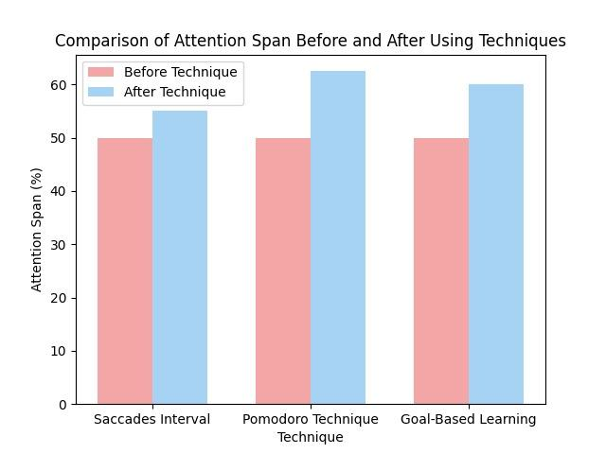
Eroor 404
CONCLUSION
Enhances focus and attention through customizable text formatting techniques.
Summarizes content using the Gemini API and provides real-time attention tracking.
Achieved 96% accuracy in predicting attention improvement through ML-based analysis.
Future developments include:
Resolving technical challenges in webhooks and Gemini API.
Adding live dashboards and improved machine learning models.
Impact: Potential to benefit both neurodiverse students and those affected by modern media distractions.

