Slide 1


Fare Anomaly Detection System
SparkLab Hackathon
Date: 24 Feb 2025 – 28 Feb 2025
Team Name: Group 5
Team Member & Role:
Vikrant Chavan– Backend, Anomaly Detection, Data Processing, Visualization, and Streamlit Integration

Slide 2




Ride-hailing services frequently encounter challenges such as fraudulent fare manipulations, incorrect billing, and pricing anomalies. These issues can stem from system glitches, deliberate user exploitation, or inconsistencies in data processing.
Real-world Impact:
Overcharging Incidents: In December 2024, an NRI was charged Rs 2,800 for a 10-minute cab ride from Mumbai Airport, highlighting instances of significant overcharging in the transportation sector. financialexpress.com
Erosion of Trust: In December 2024, taxi drivers in Victoria, Australia, were found to be overcharging passengers up to $200 for short trips, leading to a decline in consumer confidence and trust in transportation services. theguardian.com
These incidents result in financial losses for consumers and damage the reputation of service providers, emphasizing the need for robust fare monitoring and anomaly detection systems.
Problem Statement

Slide 3



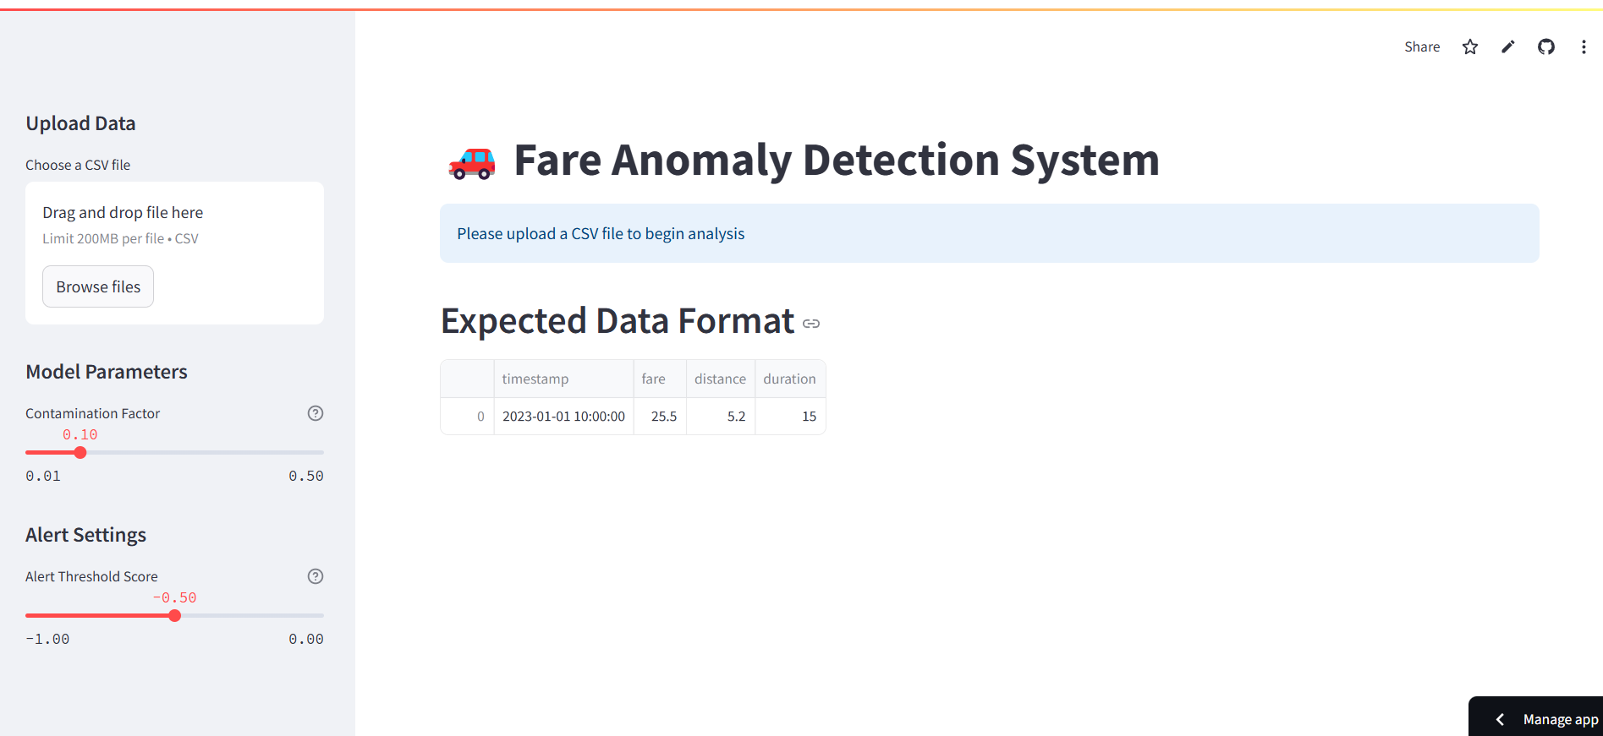

My Solution:
An AI-powered Fare Anomaly Detection System
Detects fraudulent and irregular fare charges.
Uses Isolation Forest (ML) to classify normal vs. anomalous fares
Provides an interactive dashboard to analyze fare anomalies.
Alerts high-risk anomalies based on severity thresholds

Slide 4
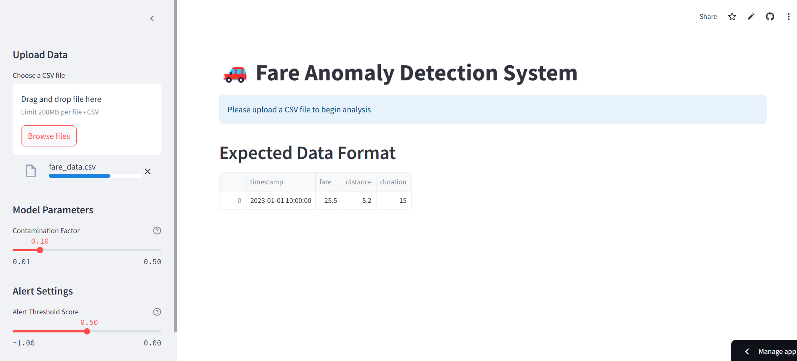

Demo:
Upload ride fare data (CSV)

Slide 5
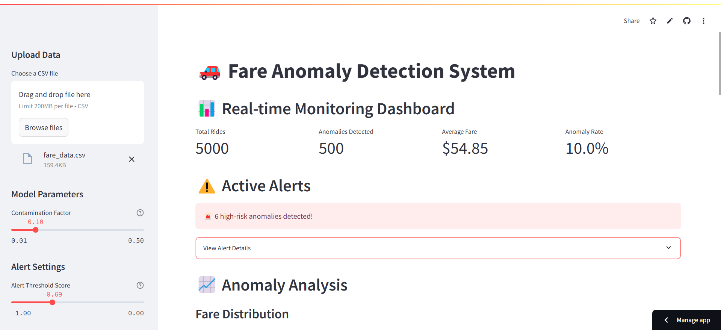
Demo:
Data is processed & cleaned automatically. The ML model detects anomalies.

Slide 6
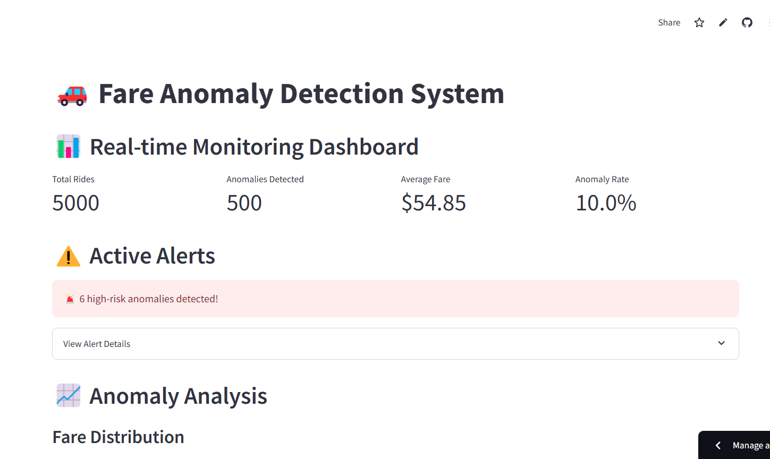
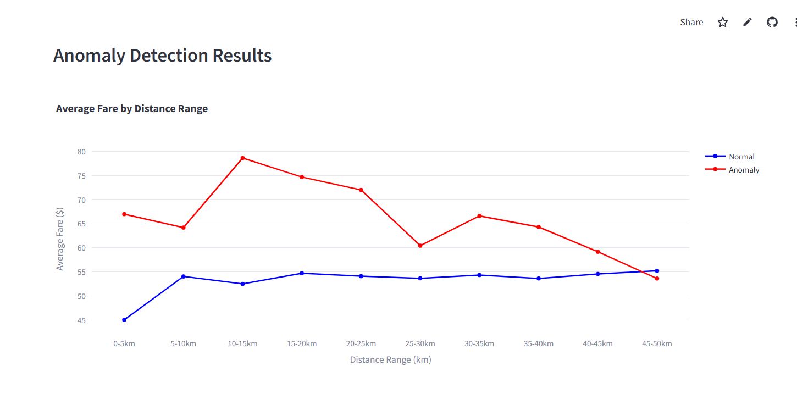
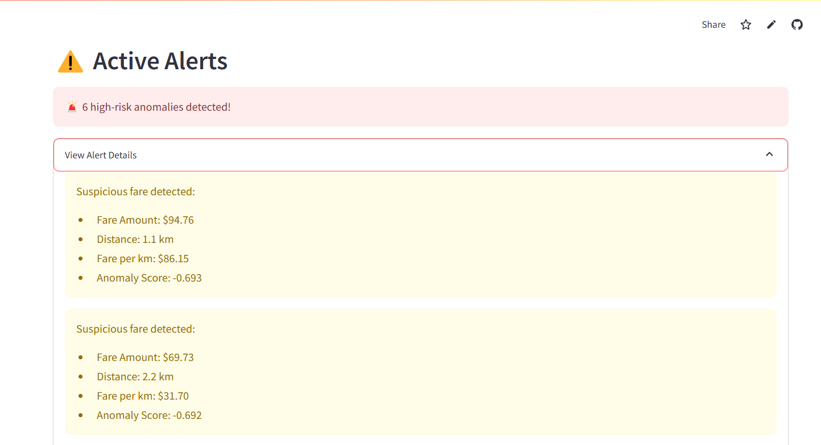
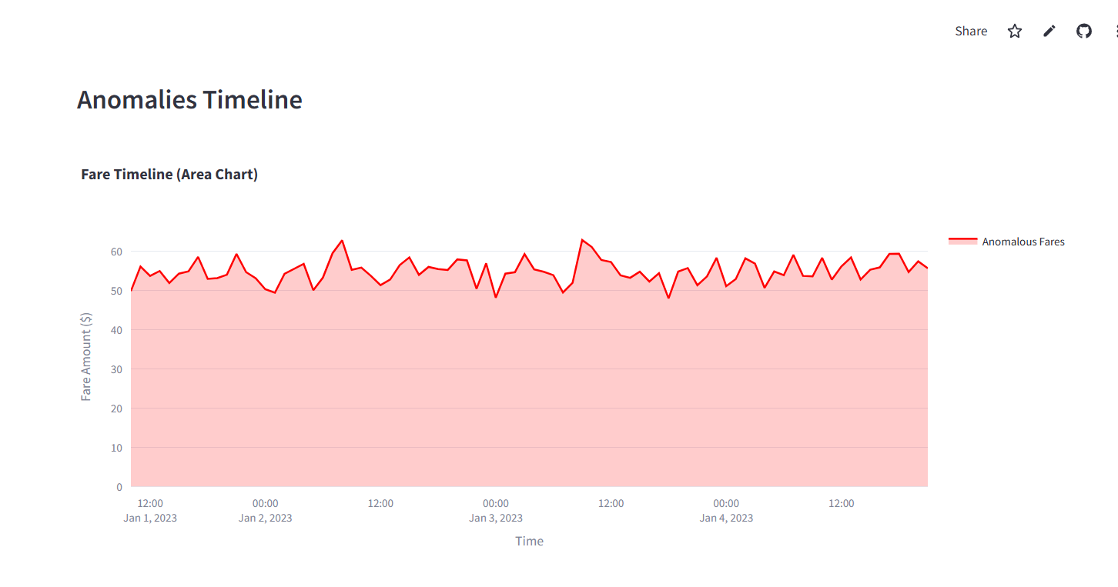
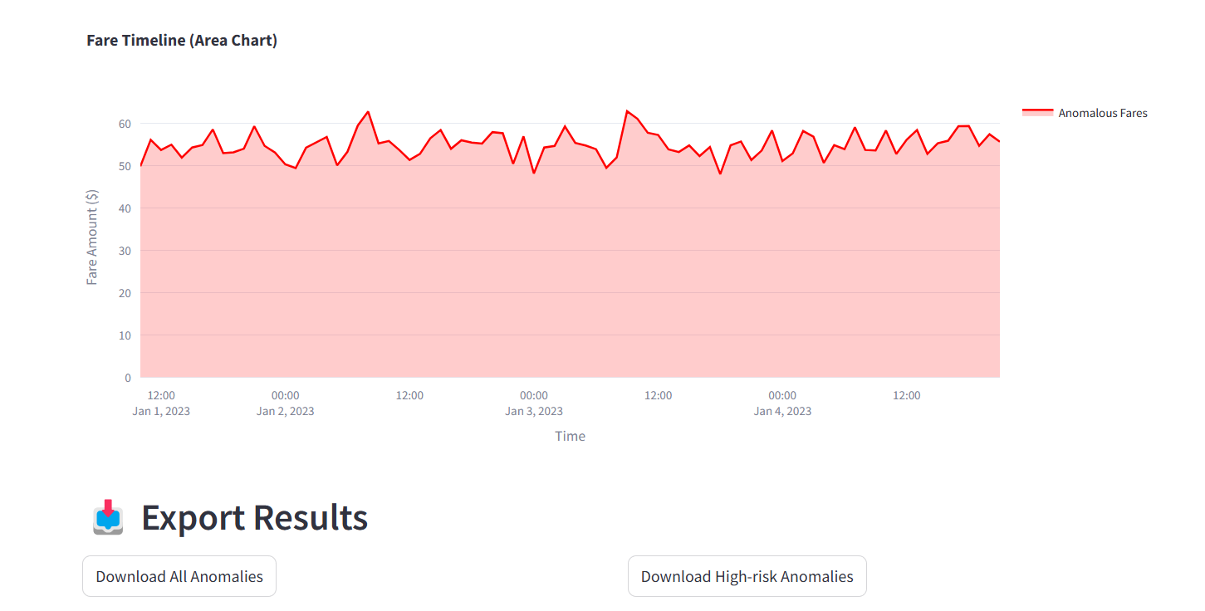
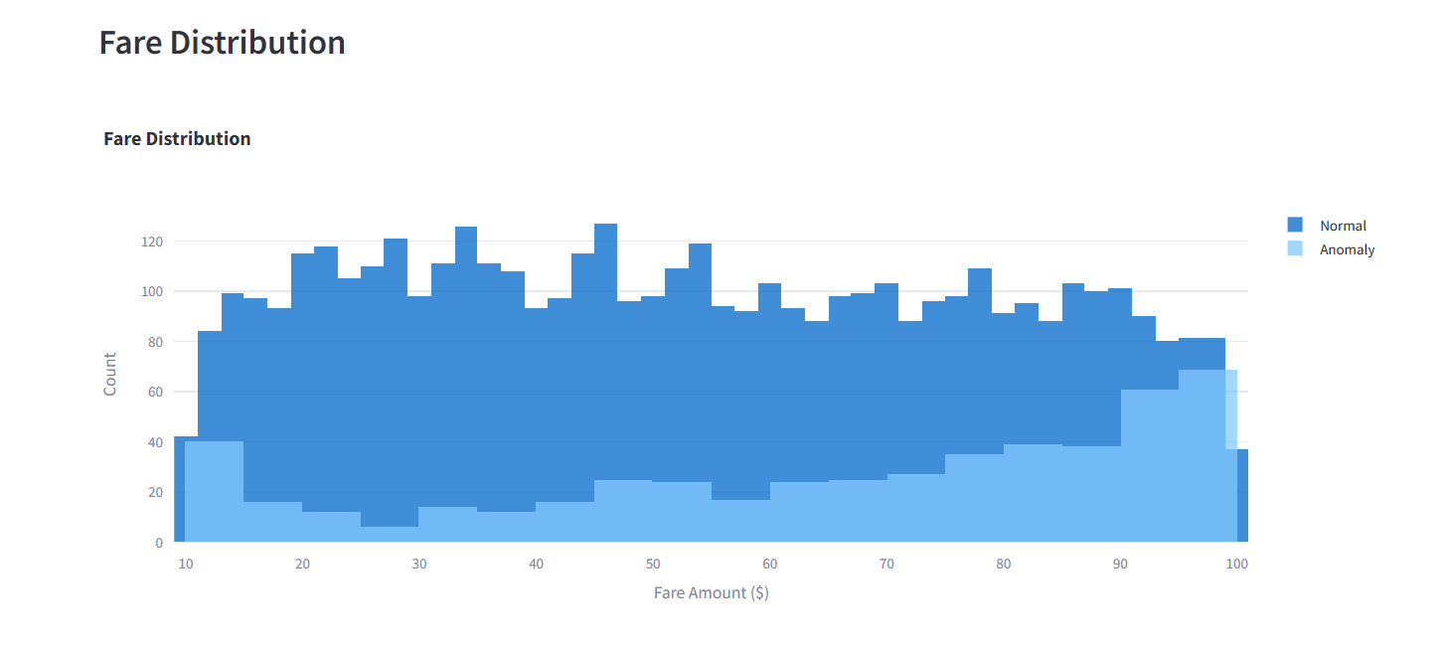

Demo:
Dashboard displays
metrics, alerts & visualizations
Download flagged anomalies for further investigation

Slide 7


Core Functionalities
Anomaly detection (ML-powered)
Dynamic fare analysis dashboard
High-risk alerts & severity scoring
Data export for further investigation

Slide 8




Python - Backend & ML Model
Tech Stack
Streamlit - Web App UI
Scikit learn - Isolation forest algorithm
Pandas - Data Processing
Plotly - Data Visualization

Slide 9


Impact: Who Benefits?
Taxi Aggregators – Prevent Fare Fraud
Delivery & logistics firms – Detect pricing anomalies.
Customers – Ensure transparent pricing.

Slide 10






Future Scope
Integrate real-time API for live anomaly detection.
Expand to other transport models (bus, flights, freight).
Enable predictive insights for dynamic fare optimization.

Slide 11



Conclusion
Contact:
vikchavan@deloitte.com
GitHub: https://github.com/vikrantchavan18/Fare_anomaly_streamlit_app.git
Application Website:
https://fare-anomaly-app.streamlit.app/

