Slide 1

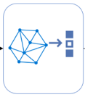
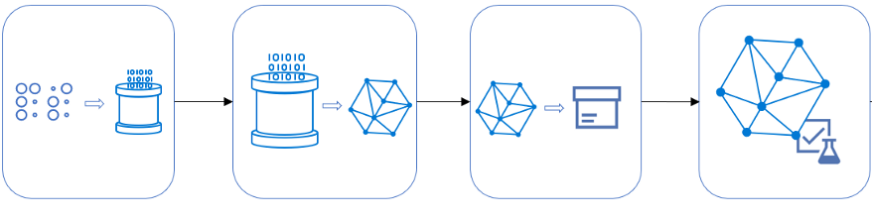



Model training and usage, database ingestion, file archival
Packaged Python functionality
a. Ingest, prepare data
b. Train model- versioned & packaged code
c. Store the model and analytical-insights
d. Validate model-performance with logging
Ingest reports into BigQuery
Archive file on GCS
File uploads
on GCS
Cloud Function monitors ‘create object` audit-logs on GCS

