Slide 1

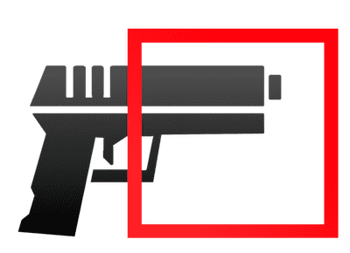


Slide 2







Flask app
knife
CCTV
Kafka Producer
Detect object with YOLOv5
Image upload
Docker 🐳 container
Kafka
Consumer
Flask app
Event alert:
Email
SMS
Push Notif
WUPHF! Notifier
Docker 🐳 container

