Slide 1
OneView's PI-09 Hackathon
GitInsights
Your guiding light towards better software design and architecture
Rupesh Shantamurty, Divya C Nambiar, Avinash Upadhya, Vikrant Mah Dhimate
August 21, 2019

Slide 2
Overview and WorkFlow

Slide 3
Problems addressed
Do you feel that the software that you work on should have been architected differently ?
This should have been designed like this instead of the current design ?
Which modules are the trouble makers in my software ?
Where should I start changing my software?
Do I have enough justification to start making design level changes ?

Slide 4
Our Solution - GitInsights
Analyzes the trends during software development
Decision to redesign / re-architect can be taken based on certain trends like :
Most modified modules ( if lines of code changed is more than double of lines of code in the module) → Demo target we generated a heat map of the modules modified
Most frequently changed modules
Changes to a module requires changes to many other modules→ loose / tight coupling between modules
More trends , yet to identify

Slide 5
How it will help?
Git Insights will extend git-stats with deeper lever of analytics in addition to which it
will have an interactive dashboard
Help to filter specific commits between date range with the help of interactive dashboard
Help developers in project segregation and devolution
Help developers be more aware of Number of classes, LoC and RM wise distribution of code base and commits
Help developers to develop higher-quality and optimized code
Git-stats
commit per day/month/year
Top n authors by commit with LoC Details
File count trend, LoC trend etc.

Slide 6
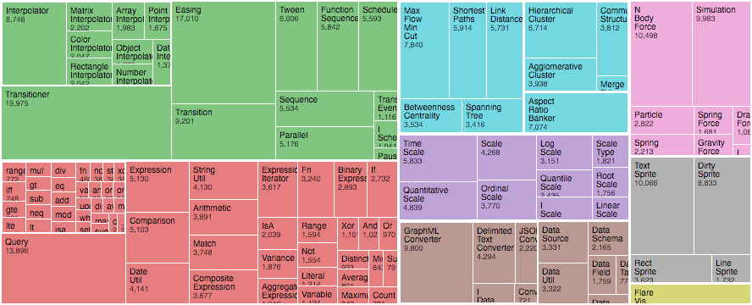
Project High Level Design
Flask Micro Service
File System Handler
Git Operation Handler
User Interface
(REST Based)
Git
Repository
Response Generator
T
N Analytics
Engine
Response

Slide 7
Development Workflow
D3 Dynamic,
interactive graphs
Git Repository
Git-python
Presubmit
Presubmit
Auto Rebase
D3 Visualization
Library
Gate
Gate
Local Git Repository
Post-gate Tests
Post-gate Tests
REST Request
process
Git Commit/RM/LoC Analysis
REST Response
D3 for interactive visualizations
Flask Microservice
Shell script for automation
Analyse commits in specific period
Get detailed information for commit,user etc.
Find frequently changed areas/RMs/Projects
User Interface
Automation
Analytics

Slide 8
Demo

Slide 9
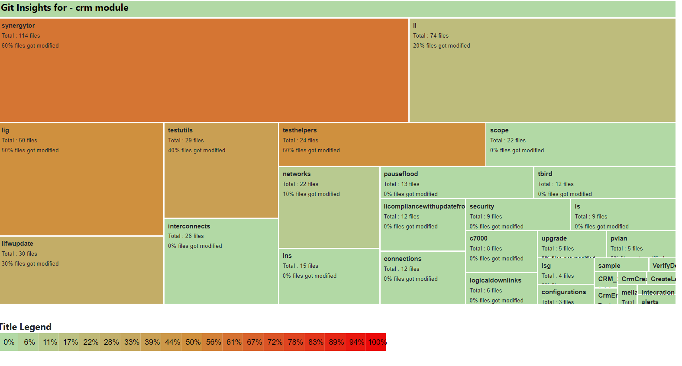
Git Insights :

Slide 10
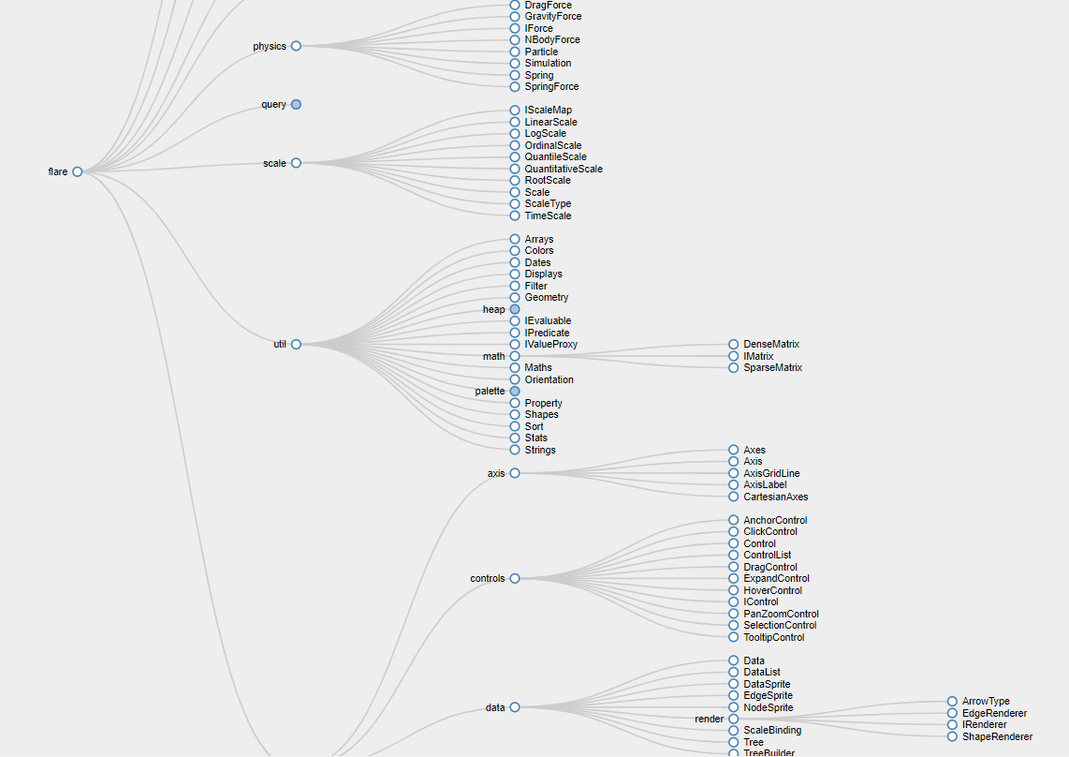
Git Insights : (Avinash has this with hardcoded json)

Slide 11
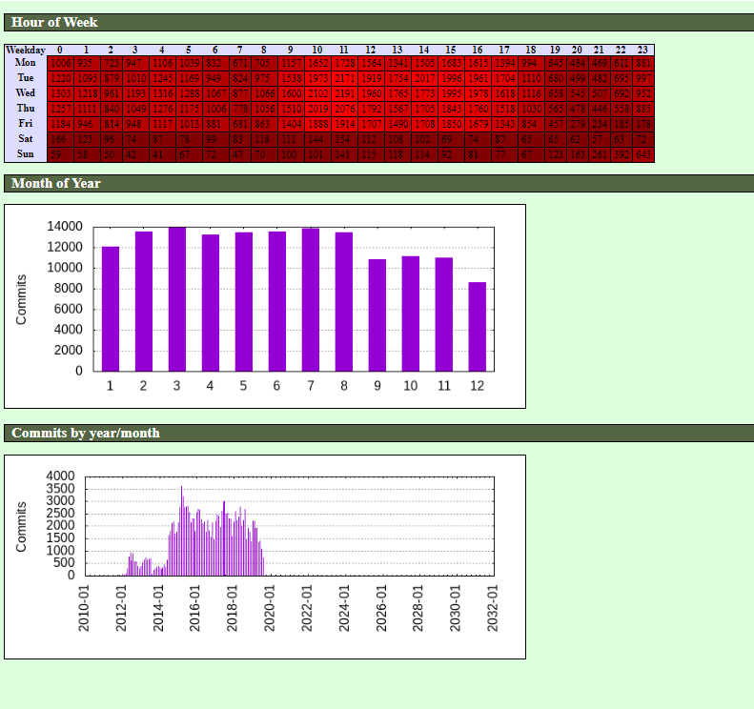
Git Stats :

Slide 12
Deployment
Git Insight Demo:
Link: http://15.212.161.114:443/

Slide 13
Summary & Planned Improvements

Slide 14
Git Insights Summary and Next steps
Summary
Dashboard shows a heat-map of the
modified packages
Next Steps
Frequency analysis view
Display most linked modules
Prior art search & disclosure

Slide 15
Thank you

