Slide 1

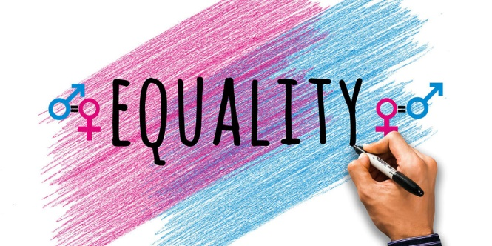
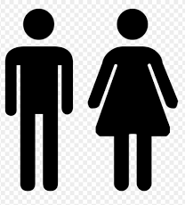
IWD : Hackathon
Woman Empowerment and Equality
VoiceEQ
Each for Equal
Machine Learning to improve women participation – Voice based modelling.

Slide 2
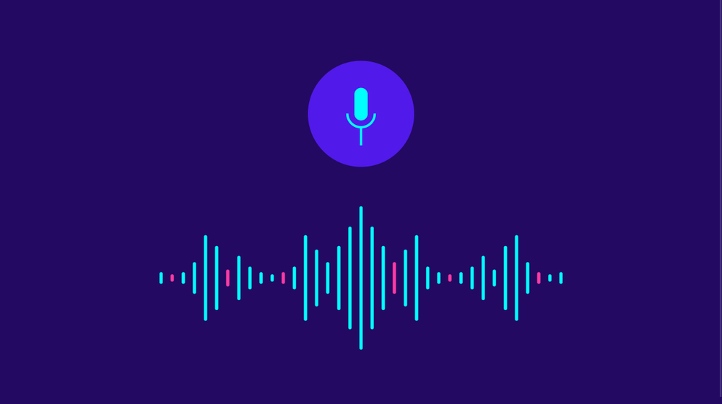



Problem
Have you ever been in a meeting, said something, and been ignored?
Studies have shown that women face bias when they speak up in the workplace.
Regardless of whether it’s conscious or unconscious, that bias has real consequences.
Women on average speak less than men in meetings:
These risks aren’t just perceived, they’re proven.
First step toward erasing gender bias in the workplace is making it known.
This hackathon idea helps to get more granular details in this area….

Slide 3
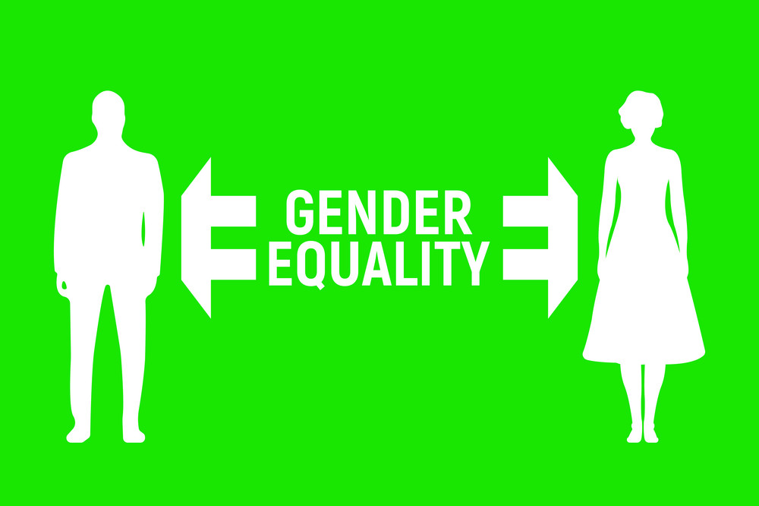
Idea
Application records the voice of different people in a meeting/conversation.
It converts conversation into dataset having multiple features.
It find out participation on gender basis.

Slide 4
Technical Details
This application mainly uses below apis/techniques :
Voice Recorder :
pyaudio, wave
2. Voice Extractor:
Using tuner, seeware, warbler
3. Voice Recognizer:
Used dataset from Kaggle for training (~3500 samples with 25 features)
Tried with Nearest Neighbors', 'SVM', 'Decision Tree', 'Random Forest‘ and
'Neural Net' for better accuracy.
4. Visualization:

Slide 5
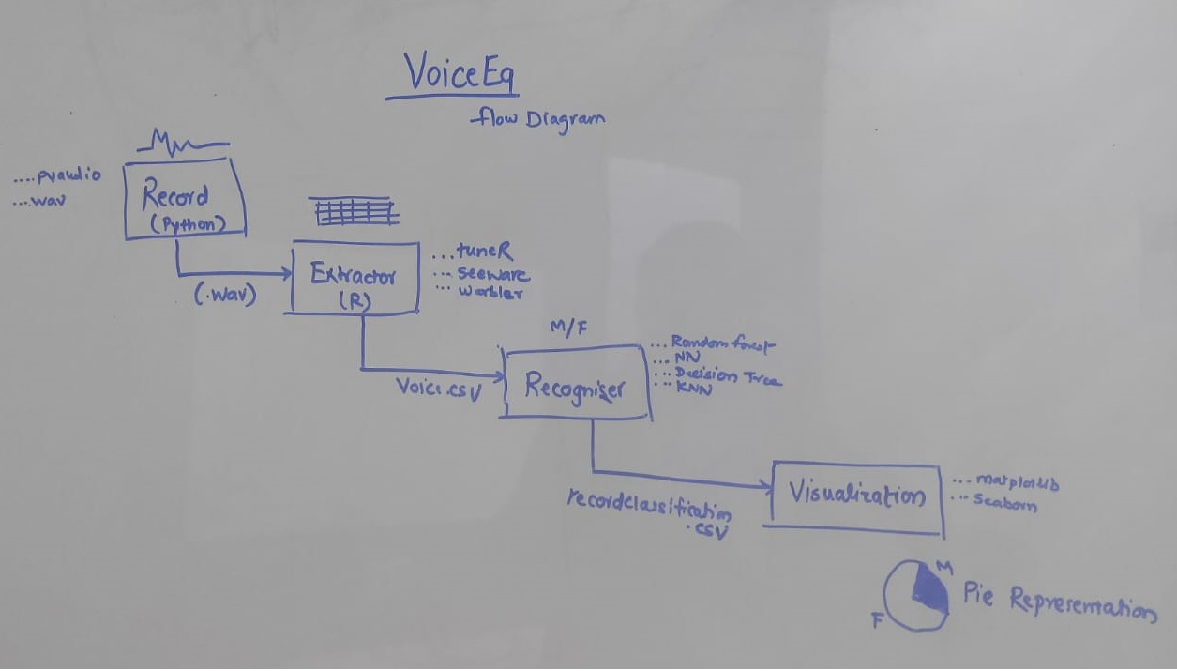
Architecture

Slide 6

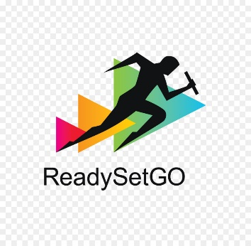
Demo
Execute
RecordAndExtracttoCSV.ipynb : Record and extract
getAttributes.r : Convert wav to csv
RecognizeGender.ipynb : Identify voice
Percentage participation

Slide 7
Sources
https://www.getapp.com/blog/gender-diversity-apps-equality-workplace/
https://www.payscale.com/career-news/2016/09/5-ways-make-sure-women-heard-meetings

Slide 8

Thank You...!!

