Slide 1
Math in Data Science
Functions, Variables, Equations, and Graphs
Statistics
Data summaries and descriptive statistics, central tendency, variance, covariance, correlation
Basic probability: basic idea, expectation, probability calculus, Bayes’ theorem, conditional probability
Probability distribution functions: uniform, normal, binomial, chi-square, Student's t-distribution, central limit theorem
Sampling, measurement, error, random number generation
Hypothesis testing, A/B testing, confidence intervals, p-values
ANOVA, t-test
Linear regression, regularization
Linear Algebra
Basic properties of matrix and vectors: scalar multiplication, linear transformation, transpose, conjugate, rank, determinant
Inner and outer products, matrix multiplication rule and various algorithms, matrix inverse
Special matrices: square matrix, identity matrix, triangular matrix, idea about sparse and dense matrix, unit vectors, symmetric matrix, Hermitian, skew-Hermitian and unitary matrices
Matrix factorization concept/LU decomposition, Gaussian/Gauss-Jordan elimination, solving Ax=b linear system of equation
Vector space, basis, span, orthogonality, orthonormality, linear least square
Eigenvalues, eigenvectors, diagonalization, singular value decomposition

Slide 2
Calculus
Functions of a single variable, limit, continuity, differentiability
Mean value theorems, indeterminate forms, L’Hospital’s rule
Maxima and minima
Product and chain rule
Taylor’s series, infinite series summation/integration concepts
Fundamental and mean value-theorems of integral calculus, evaluation of definite and improper integrals
Beta and gamma functions
Functions of multiple variables, limit, continuity, partial derivatives
Basics of ordinary and partial differential equations
Discrete Math
Sets, subsets, power sets
Counting functions, combinatorics, countability
Basic proof techniques: induction, proof by contradiction
Basics of inductive, deductive, and propositional logic
Basic data structures: stacks, queues, graphs, arrays, hash tables, trees
Graph properties: connected components, degree, maximum flow/minimum cut concepts, graph coloring
Recurrence relations and equations
Growth of functions and O(n) notation concept

Slide 3
Optimization and Operation Research Topics
Basics of optimization, how to formulate the problem
Maxima, minima, convex function, global solution
Linear programming, simplex algorithm
Integer programming
Constraint programming, knapsack problem
Randomized optimization techniques: hill climbing, simulated annealing, genetic algorithms

Slide 4
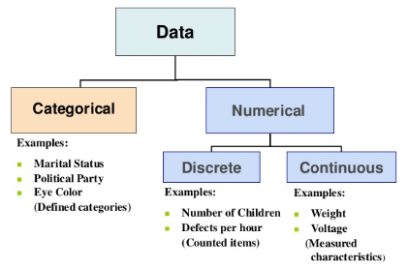
Data
Data is the collected information(observations) we have about something or facts and statistics collected together for reference or analysis.

Slide 5
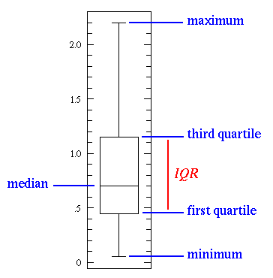

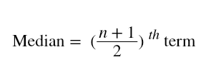
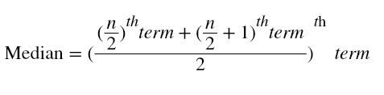
Mean: The mean is equal to the sum of all the values in the data set divided by the number of values in the data set i.e the calculated average.
Median: The median is the middle value for a dataset that has been arranged in order of magnitude.
Mode: The mode is the most commonly occurring value in the dataset. The mode can, therefore sometimes consider the mode as being the most popular option.
For Example, In a dataset containing {13,35,54,54,55,56,57,67,85,89,96} values. Mean is 60.09. Median is 56. Mode is 54.

Slide 6
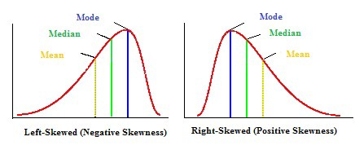
Measures of Asymmetry

Slide 7
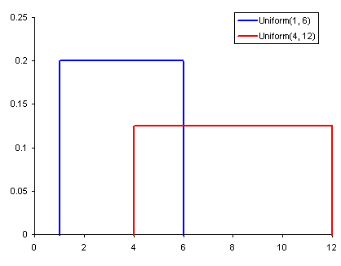
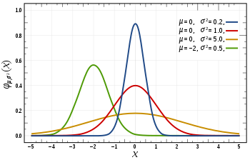
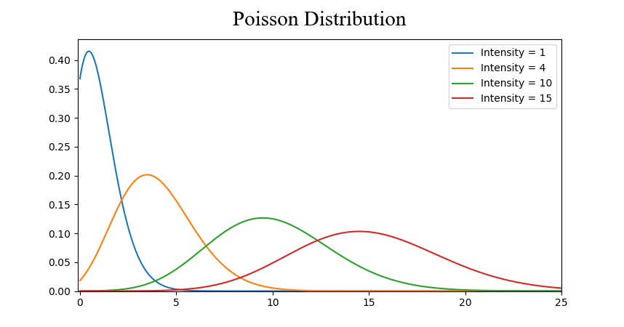
Uniform Distribution
Normal Distribution
Poisson Distribution

Slide 8
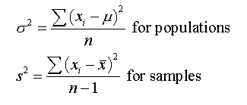
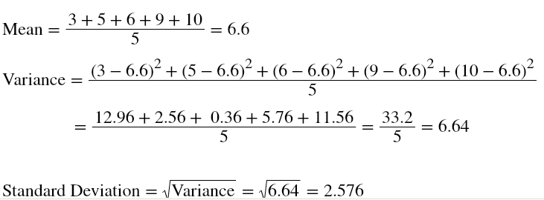
Measures of Variability(Dispersion)
Range: The difference between the largest and the smallest value of a data, is termed as the range of the distribution.
Variance: Variance measures how far is the sum of squared distances from each point to the mean i.e the dispersion around the mean.
Standard Deviation: The square root of the variance is the standard deviation.

Slide 9
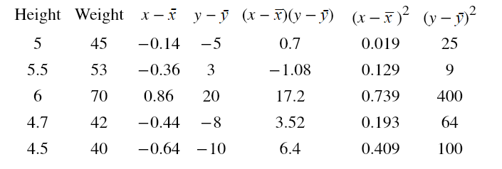
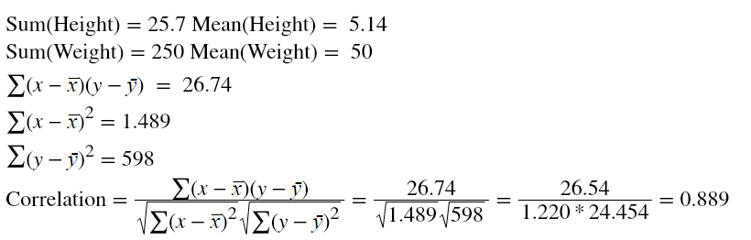
Correlation: Correlation gives a better understanding of covariance. It is normalized covariance. Correlation tells us how correlated the variables are to each other. It is also called as Pearson Correlation Coefficient.

Slide 10
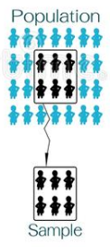
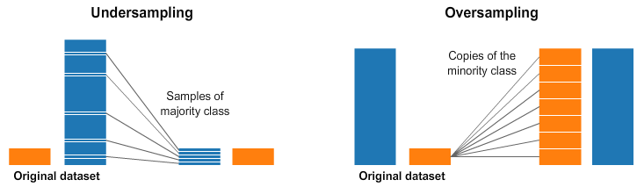
Population or Sample Data
Population: Collection of all items (N) and it includes each and every unit of our study. It is hard to define and the measure of characteristic such as mean, mode is called parameter.
Sample: Subset of the population (n) and it includes only a handful units of the population. It is selected at random and the measure of the characteristic is called as statistics.
Over and Under Sampling

Slide 11
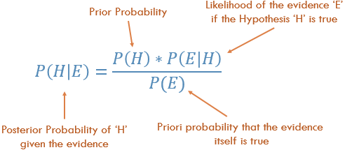
Bayesian Statistics

Slide 12
Some of the important ML Algorithms to Start with -
Naive Bayes
Linear Regression
Logistic Regression
Neural Networks
K-Means clustering
Decision Trees

