Slide 1







IWD : Hackathon
Social Cause (women and children safety)
Shake for Help
Just shake when you are in danger zone or at any unknown place or missed route.
Divya Nambiar
Vikrant Dhimate
Viren Koradiya

Slide 2




Do you feel unsafe during some circumstances or with some unknown people?
Are you getting robbed? Need help? Can’t type message or call? But want to inform?
Then not to worry, Now here is a safe way!!
just shake your phone.

Slide 3
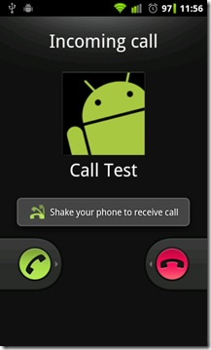
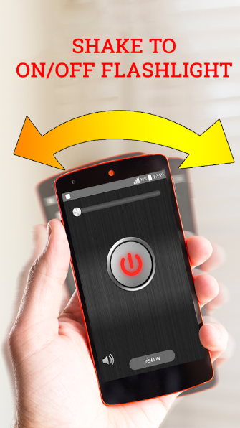

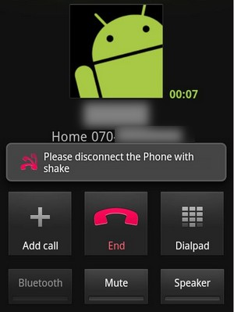
Idea
We use mobile shake and touch features for many things like unlock the phone, power off, torch on/off, caller tune silent, songs pause/resume… then why can’t it be used for personal/Child/Women safety.
This is one a small attempt and use case demo, which can be expanded for making calls/sending emails along with sms.

Slide 4

Introduction
ShakeForHelp is an application that lets you send SMS to your emergency contacts
when you are not at safe place or you can call/send sms. It sends sms along with current
location information, so that people can trace then location and reach for help.
It’s very simple android application having simple user interface.
You just need to fill your mobile number and emergency contacts.

Slide 5


Setup
https://github.hpe.com/vikrant-mah-dhimate/UtilityGarage
Copy apk from github and install it.Update mobile number and emergency contacts.
Keep internet and Gps signal on..
Shake your mobile

Slide 6
Technical Details
This application mainly uses below apis/techniques :
Shake Listener : capture a shake and then implement…
Tune accelerometer, sensor manager & shake detector variables.
Motion sensors are useful for monitoring device movement, such as tilt, shake, rotation, or swing.
All of the motion sensors return multi-dimensional arrays of sensor values for each SensorEvent. For example, during a single sensor event the accelerometer returns acceleration force data for the three coordinate axes

Slide 7
Sources
https://developer.android.com/guide/topics/sensors/sensors_motion
http://jasonmcreynolds.com/?p=388

Slide 8

Thank You...!!

