Slide 1


Design Review Presentation
AI-Driven Adaptive Transaction Batching for Cardano Decentralized Exchanges.
Student Name(s):
Vikranth Sai,
Ganesh,
Sowmya
Department:
Data Science
23P61A67F1, 23P61A67F0,
23P61A67H8
College:
Vignana Bharathi Institute of Technology
Hall Ticket No(s):
Academic Year:
[2026 – 2027]
Guide Name:
Ms. B. Mamatha

Slide 2
Introduction
Project Background :
Cardano is built on the extended UTXO (eUTXO) model. A decentralized-exchange liquidity pool lives in a single UTXO that can be consumed only once per block, so a hundred users cannot swap against it independently: one succeeds and the rest fail. DEXs therefore rely on off-chain batchers that collect many swap orders and settle them in one transaction. The batchers deployed today fire on fixed rules, every M orders or every T seconds, and never read the chain before deciding.
2

Slide 3
Introduction
Problem Statement :
Static batchers trigger on constants, so they are mistimed by construction: too early, and the fixed transaction cost is spread over few users; too late, and every order waits. A submitted batch also locks the pool UTXO until it confirms, so a mistimed batch blocks everyone behind it. Cardano fees are deterministic, so waiting costs time, not money. The quantity to optimise is therefore confirmation latency and per-user cost. No existing batcher learns when to submit and how many orders to include.
3

Slide 4
Introduction
Need for the study :
A pool UTXO admits one batch per block, so every order queues behind the batch in flight.
Fixed M / T triggers cannot adapt to arrival bursts or to uncertain confirmation time.
Cardano fees are fixed: a bad batching decision costs latency, not gas.
Batch size is capped by per-transaction limits (16,384 B, 14 M memory): about 20–40 orders.
Premise checked on 388,781 mainnet blocks: median fill is 3.0%, so concurrency is the binding constraint.
4

Slide 5
Introduction
Project Objectives :
Collect and verify 92 days of Cardano mainnet block data (388,781 blocks).
Build a simulator that replays real blocks against tuned static baselines.
Forecast next-block capacity as a defensive input (LightGBM).
Decide WAIT or SUBMIT(n) with a constrained optimizer under hard protocol limits.
Train an RL (DQN) agent and wrap it in a safety shield.
Minimise confirmation latency and per-user cost without expiring orders.
Demonstrate a settled swap on a minimal Aiken DEX on the preprod testnet.
5

Slide 6
Introduction
Scope of the project:
An off-chain, server-side batcher: no website, no browser extension and no wallet code. It reads recent blocks and the order queue, forecasts capacity, and chooses WAIT or SUBMIT(n) under hard per-transaction (Gate A) and per-block (Gate B) limits. It is evaluated by replaying real mainnet blocks in a discrete-event simulator against tuned static batchers, and demonstrated on the Cardano preprod testnet. Wallet changes, protocol changes and mainnet deployment are out of scope.
6

Slide 7
Research Paper 1
Methodology
Paper Title:
Formal specification of an extended UTXO ledger with datums, redeemers and validator scripts, verified in Agda.
The Extended UTXO Model (eUTXO).
Key Contributions
Author(s):
Adds expressive, stateful smart contracts to the UTXO model with deterministic, local validation.
Chakravarty et al.
Year:
Advantages
2020
Deterministic fees and predictable, locally scoped validation with strong formal guarantees.
Journal / Conference:
Limitations
Financial Cryptography & Data Security (FC) Workshops.
A shared pool lives in one UTXO consumable once per block: a concurrency bottleneck for DEXs.
[1]
7

Slide 8
Research Paper 2
Methodology
Paper Title:
Orders posted as individual UTXOs are aggregated by a batcher into one deterministic pool-state update.
Concurrent & Deterministic Batching on the UTXO Ledger.
Key Contributions
Author(s):
A decentralized batching scheme that resolves pool contention without incentivized off-chain agents.
H. Nguyen Quang (MELD)
Year:
Advantages
2021
Amortizes the fixed cost across users and avoids failed transactions from UTXO contention.
Journal / Conference:
Limitations
MELD Technical Report.
The batching policy is static and rule-based; it ignores block fullness and latency.
[2]
8

Slide 9
Research Paper 3
Methodology
Paper Title:
Analyzes the eUTXO concurrency problem for AMM-style DEXs and implements a concurrent DEX prototype.
A Concurrent DEX on Cardano.
Key Contributions
Author(s):
Shows how contention arises when many users hit one pool and demonstrates a working solution.
P. Bruhwiler
Year:
Advantages
2021
A concrete, implementable design for scalable swaps on a UTXO blockchain.
Journal / Conference:
Limitations
B.Sc. Thesis, University of Bern.
Focuses on correctness and concurrency, not on batch timing or size under load.
[3]
9

Slide 10
Research Paper 4
Methodology
Paper Title:
Game-theoretic analysis of EIP-1559: variable-size blocks and a burned base fee.
Transaction Fee Mechanism Design: An Economic Analysis of EIP-1559.
Key Contributions
Author(s):
Shows how demand-responsive base fees price block space on account-based chains such as Ethereum.
T. Roughgarden
Year:
Advantages
2020
A clear economic model of congestion pricing under variable demand.
Journal / Conference:
Limitations
Proc. ACM Economics & Computation (EC), 2021.
Does not apply to Cardano's deterministic fees: there, congestion costs latency, not money.
[4]
10

Slide 11
Research Paper 5
Methodology
Paper Title:
DeepRM casts multi-resource task packing as an RL problem trained in a simulator.
Resource Management with Deep Reinforcement Learning.
Key Contributions
Author(s):
Learns scheduling policies that match or beat hand-tuned heuristics and adapt to load.
Mao et al.
Year:
Advantages
2016
Adapts to changing conditions and needs no hand-crafted heuristics.
Journal / Conference:
Limitations
Proc. ACM HotNets.
Built for datacenter jobs: unaware of block limits and eUTXO batching.
[5]
11

Slide 12
Literature Comparison
Paper | Method | Dataset | Advantages | Limitations
eUTXO Model | Formal eUTXO spec (Agda) | Formal model (no dataset) | Deterministic, verified validation | Single-UTXO concurrency bottleneck
MELD Batching | Deterministic order batching | eUTXO swap orders | Resolves contention, amortizes cost | Static, not congestion-aware
Concurrent DEX | Concurrent DEX prototype | Cardano testnet DEX | Scalable concurrent swaps | No congestion-aware batching
EIP-1559 | Fee-mechanism analysis | Ethereum fee model | Models congestion pricing | Inapplicable to Cardano's fixed fees
DeepRM | Deep RL scheduling | Cluster job traces (sim.) | Learns adaptive scheduling | Not blockchain-aware
B.Tech Final Year Project — Design Review
12

Slide 13
Research Gap & Proposed Work
Research Gap
Limitations in existing studies :
Missing features :
Fixed M-orders or T-seconds triggers, blind to the chain.
Queue state and block data are never read before submitting.
Optimised for fees (the Ethereum view), not latency.
Congestion-aware, forecast-driven batching.
Hard enforcement of per-tx and per-block limits.
Protection against poison orders and outages.
Unsolved problems :
Performance issues :
Adapting batch size and timing to forecast block capacity.
Knowing when to wait for a better batch.
Learning a submission policy from replayed real blocks.
A mistimed batch holds the pool lock and delays every order behind it.
Static rules starve early orders when arrivals slow down.
13

Slide 14
Research Gap & Proposed Work
Proposed Work
Proposed methodology :
Expected improvements :
Collect 92 days of mainnet blocks; derive the fill series.
Replay them in a simulator with a pool lock.
Forecast next-block fill with LightGBM.
Decide WAIT / SUBMIT(n): optimizer + DQN agent.
Lower per-user cost than the best tuned static batcher.
Latency close to greedy, with no order expiry.
No capacity-limit violation, by construction.
Fairer waiting times across users.
Technologies to be used :
Expected outcome :
Python 3.12: simulator, policies, daemon
LightGBM, PyTorch: forecaster and DQN
Gymnasium: RL environment
Aiken (Plutus V3): order and pool validators
PyCardano, Koios, Blockfrost: chain access
Cardano preprod: live demonstration
A server-side batcher that decides when to submit and how many orders to include.
Reproducible simulator results with paired statistics.
A settled swap on the preprod testnet.
14

Slide 15
Conclusion
Summary of Literature Review :
Research Gap Identified
eUTXO gives deterministic fees but a single-UTXO concurrency bottleneck.
Batching is mandatory; existing batchers use static, congestion-blind rules.
RL can learn scheduling policies, but none targets Cardano batching.
No congestion-aware, learning-based batcher optimises latency and per-user cost under Cardano transaction and block limits.
Important Observations
Expected Contribution of the Proposed Work
Cardano fees are deterministic: delay costs time, not money.
Measured: median block fill is 3.0%; concurrency, not congestion, binds.
Capacity binds in only about 1 block in 180.
An adaptive batcher (forecaster, constrained optimizer, shielded RL agent) proven in simulation on real mainnet blocks and demonstrated on a preprod DEX.
15

Slide 16
References
[1] M. Chakravarty, J. Chapman, K. MacKenzie, O. Melkonian, M. Peyton Jones and P. Wadler, "The Extended UTXO Model," in Financial Cryptography and Data Security Workshops (FC), 2020.
[2] H. Nguyen Quang (MELD), "Concurrent & Deterministic Batching on the UTXO Ledger," MELD Technical Report, 2021.
[3] P. Bruhwiler, "A Concurrent DEX on Cardano," B.Sc. thesis, University of Bern, 2021.
[4] T. Roughgarden, "Transaction Fee Mechanism Design: An Economic Analysis of EIP-1559," in Proc. ACM EC, 2021.
[5] H. Mao, M. Alizadeh, I. Menache and S. Kandula, "Resource Management with Deep Reinforcement Learning," in Proc. ACM HotNets, 2016.
[6] G. Angeris and T. Chitra, "Improved Price Oracles: Constant Function Market Makers," in Proc. ACM AFT, 2020.
16

Slide 17
Modules of the System
M1 Chain Data Collector
Polls mainnet blocks from Koios / Blockfrost and derives the block-fill time series (dataset D1).
M2 Congestion Forecaster
LightGBM predicts the fill of the next three blocks; a moving average is kept as the reference.
M3 + M4 Order Queue and Adaptive Policy
Tracks pending orders; chooses WAIT or SUBMIT(n) with the optimizer (P2) or the shielded DQN agent (P3).
M5 Batch Builder & Submitter
Re-checks Gate A, builds and signs the batch transaction, submits it, and records the outcome.
M6 Simulator & Evaluation
Replays real blocks with a pool lock, expiry and rollbacks; runs baselines and paired statistics.
M7 On-chain DEX (demo)
Minimal Aiken order and pool validators on the Cardano preprod testnet.

Slide 18
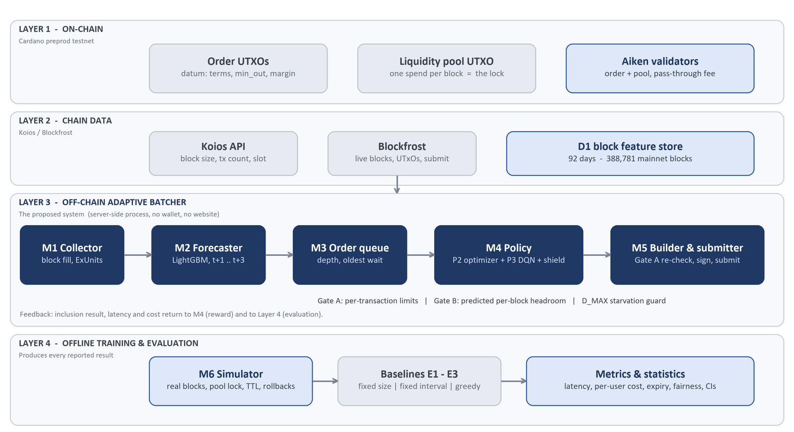
System Architecture :

Slide 19
Merits of the Proposed System
Congestion-aware: decisions use the forecast and queue state instead of constant triggers.
Hard safety: Gate A and Gate B are enforced structurally, so an infeasible batch is never proposed.
Explainable: the optimizer is a deterministic O(|Q|) rule that also shields the RL agent.
Lower cost: about 19% less cost per user than greedy batching at matched load.
Robust: poison-order quarantine, API failover, rollback depth and uniform clearing.
Reproducible: paired episodes, bootstrap confidence intervals and run manifests.

Slide 20
Expected Outcomes
The system is expected to give a Cardano DEX operator a batcher that decides when to submit and how many orders to include, instead of firing on constants. Replayed against 92 days of real mainnet blocks, the constrained optimizer is expected to lower per-user cost against the best tuned static batcher at comparable latency, never violate a protocol capacity limit and keep waiting times fair. The shielded RL agent is expected to stay safe under load it was not trained on, and a swap settled on the preprod testnet demonstrates the end-to-end path. On today’s lightly loaded chain the gain is cost and fairness rather than tail latency, and the project reports it that way.

Slide 21
Technologies Used
Language: Python 3.12
Forecasting: LightGBM
Reinforcement learning: DQN (PyTorch, Gymnasium)
Simulator: discrete-event replay of mainnet blocks
On-chain: Aiken (Plutus V3) validators
Chain access: Koios, Blockfrost, PyCardano
Network: Cardano preprod testnet
Quality: pytest, ruff, CI secret scan

Slide 22
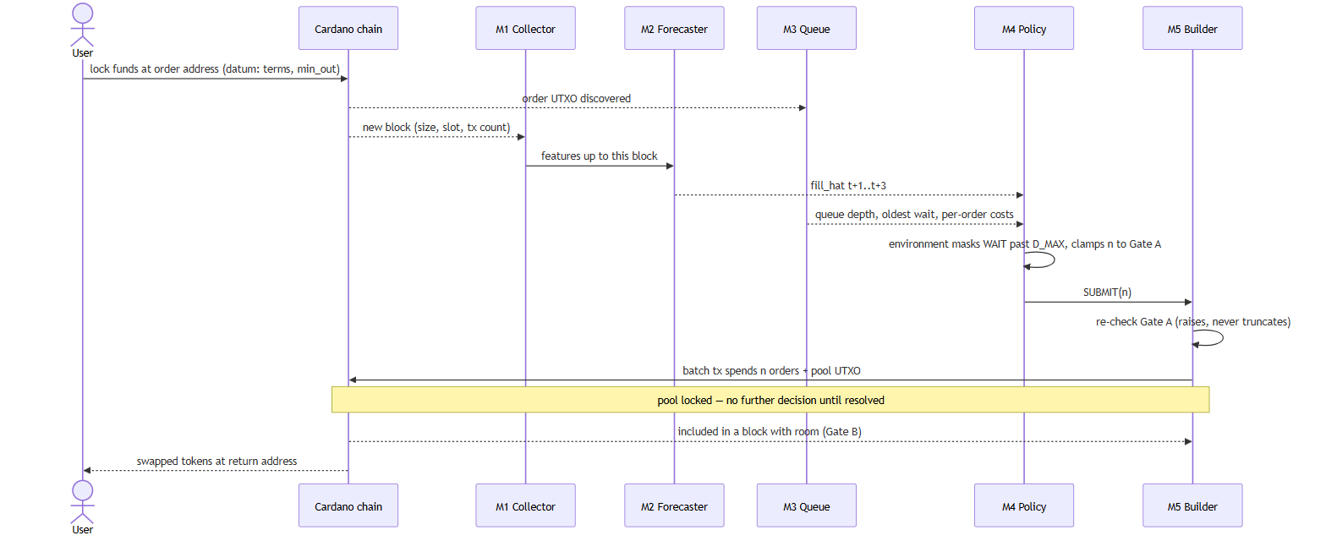
Control Flow (Sequence Diagram) :
22

Slide 23
Algorithms :
Existing Algorithms
Proposed Algorithms
E1 Fixed size: submit when M orders have gathered.
E2 Fixed interval: submit every T seconds.
E3 Greedy: submit everything, every block.
E4 Moving average: mean of recent fill as the forecast reference.
Common flaw: constant triggers; the chain is never read.
P1 Forecaster: LightGBM predicts block fill for t+1 to t+3.
P2 Constrained optimizer: forecast-then-optimize under Gate A / Gate B, with a D_MAX starvation guard.
P3 RL agent: masked DQN over WAIT / SUBMIT(n) buckets.
Safety shield: forced submit at D_MAX; out-of-range states go to P2.
Chaining + uniform clearing: several batches per decision point; one fair price per direction.
23

Slide 24
Datasets :
Primary Dataset :
Secondary Dataset :
D2 Order stream: simulated Poisson arrivals with a fitted daily shape and bursts.
Order fields: size, ExUnits, min_out, margin, arrival time.
D4 Testnet logs: measured size, ExUnits and fee of real batch transactions on preprod.
Use: trains and evaluates the policies; calibrates Gate A.
D1 Block history: 92 days, 388,781 mainnet blocks from Koios / Blockfrost.
Fields: height, slot, body size, fill%, tx count, memory and step ExUnits.
Split: chronological 70 / 15 / 15; checksummed and resumable.
Limits: 16,384 B and 14 M memory per transaction.
24

Slide 25
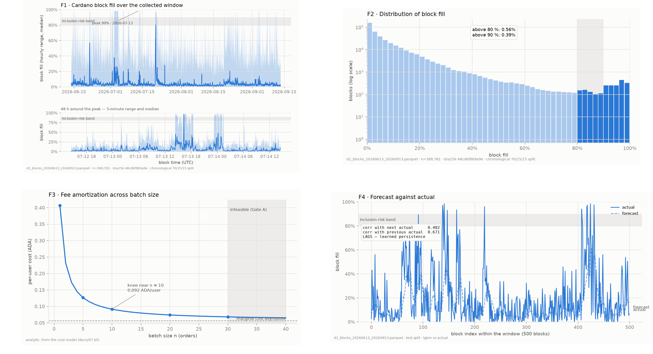
Sample Datasets :
25

Slide 26
Coding (Sample Code) :
1. Batch Optimizer (P2) :
2. Safety Shield :
def decide(obs):
if obs.pool_locked or queue_empty:
return WAIT
n_a = gate_a_max(obs) # tx limits
if obs.oldest_wait >= D_MAX:
return SUBMIT(n_a) # fairness
n = min(n_a, gate_b_max(obs))
if n == 0:
return WAIT
if n < N_MIN and quieter_block_ahead:
return WAIT # amortise
return SUBMIT(n)
def decide(obs):
if obs.pool_locked:
return WAIT
if oldest_wait >= D_MAX:
return SUBMIT(gate_a_max) # forced
if out_of_range(obs):
return clamp(P2.decide(obs))
return clamp(DQN.decide(obs))
src/batcher/policy/optimizer.py (simplified excerpt)
src/batcher/policy/shield.py (simplified excerpt)
Hard limits first: Gate A (per tx) and Gate B (per block).
Past D_MAX the oldest order forces a submission.
Waits only when a quieter block is forecast.
A forced submission always uses the Gate A maximum.
Out-of-range states are handed to P2.
Every action is clamped to legal limits.

Slide 27
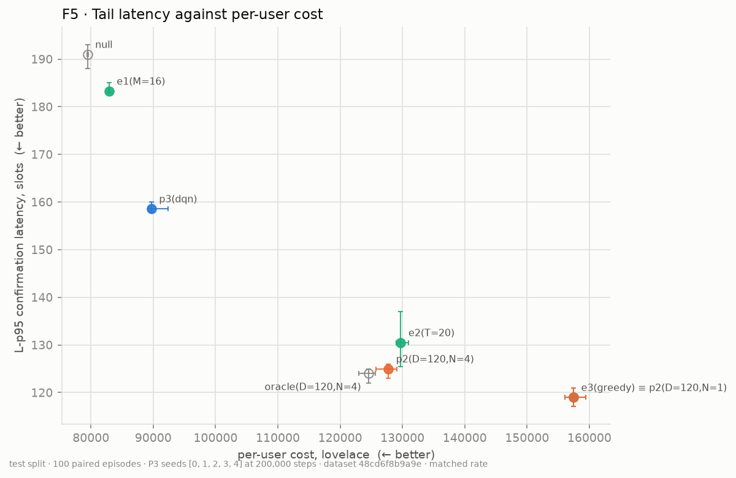
Results :
Latency vs. Cost :
Measured Outcomes :
Premise: median block fill is 3.0%; only 0.56% of 388,781 blocks exceed 80%.
Forecast: LightGBM MAE 0.046 against 0.052 for the moving average.
Cost: P2(N=4) uses 19% less per user than greedy at matched load.
Latency: P2 60.9 s mean against 63.4 s for the best tuned fixed interval.
Safety: the shield cuts heavy-load expiry from 35.7% to 0.
Testnet: a batch settled on preprod, fee 322,697 lovelace.
Greedy and P2(N=1) coincide; P2(N=4) gives up about 5 s for 19% lower cost.
DQN trades latency for cost: p95 158.6 s against 125.0 s for P2(N=4).

Slide 28
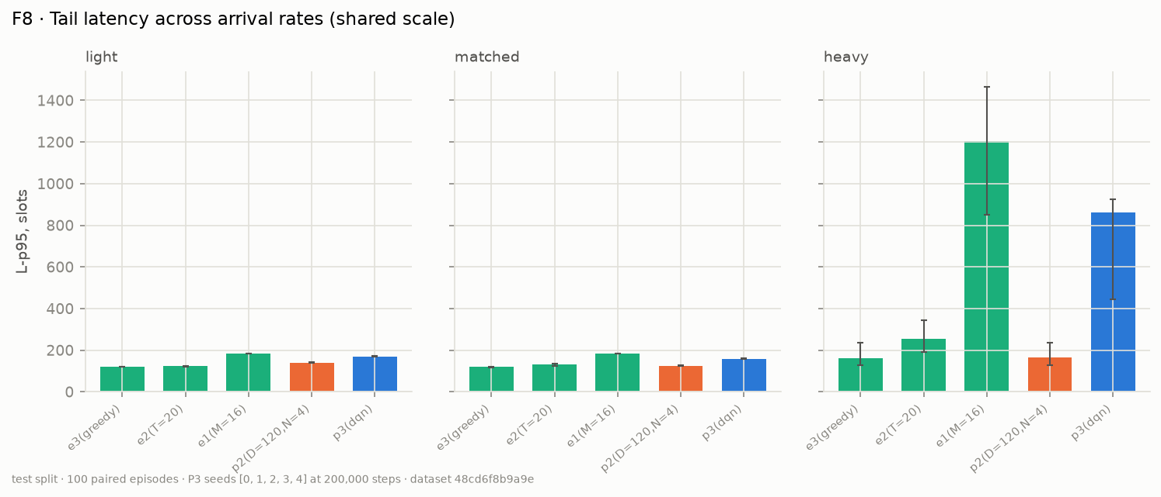
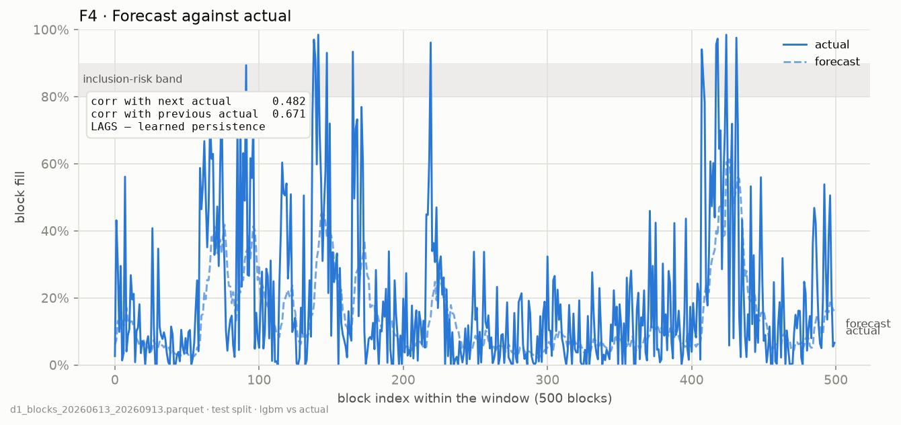
Results (contd.) :
Robustness by Load :
Forecast Quality :
Heavy load p95: fixed-size E1 1,203 s, DQN 863 s; P2 holds 164.5 s.
Greedy (162 s) matches P2: the adaptive gain is cost, not tail latency.
LightGBM MAE 0.046 against 0.052 (moving average); direction 74.2% against 71.0%.
A perfect oracle forecast adds little: capacity binds in about 1 block in 180.

