Slide 1

SMART INDIA HACKATHON 2026
• Problem Statement ID – 26173
• Problem Statement Title – iTantra — Indian Multilingual TTS & STT Aided Neural Transceiver Radio Access for Low Bitrate Links
• Theme – SMART AUTOMATION
• PS Category – Software
• Team ID –
• Team Name (Registered on portal) – Taraket

Slide 2
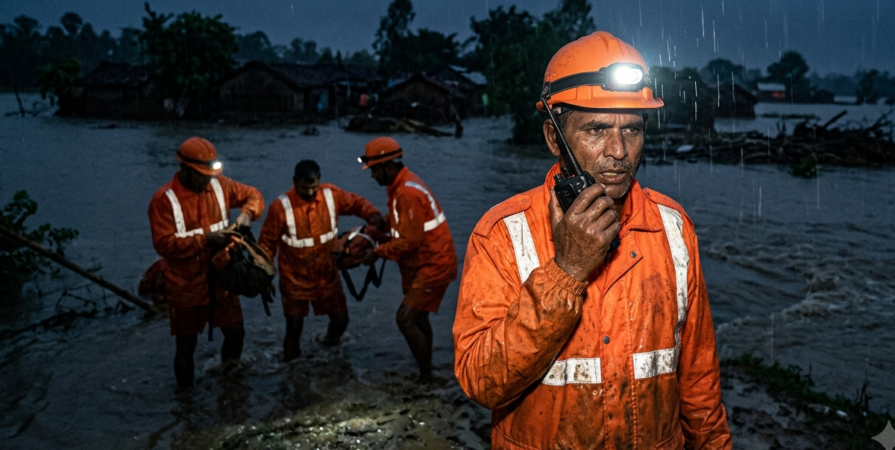
iTantra: Speech Across Radio Links
That Could Never Carry a Voice
Taraket
Real-world issue: When the towers go down, all that is left is a handheld radio far too narrow to carry a voice.
THE COMPLETE LOOP · SPEECH IN, SPEECH OUT
PROBLEM v/s iTANTRA
PHONE A speaks
हमें तुरंत मदद चाहिए
Audio is too heavy
45-byte text frames
Typing shuts people out
Press and just speak
Why important: The thinnest voice call needs 6,000 bps. The radio gives 300. No codec closes a twenty-fold gap.
ON-DEVICE STT
speech becomes a sentence
No network, no service
Fully offline, on device
45 BYTES ON THE AIR
Bluetooth · Wi-Fi · LoRa, 2–15 km
LOCATE
Our solution: The phone hears it, sends 45 bytes, and speaks it again at the far end. 2,133× smaller.
Where is the caller?
An arrow and a siren
ON-DEVICE TTS
the sentence becomes speech
PHONE B hears
the same words, spoken aloud
TEN LANGUAGES, TEN SCRIPTS
English · हिन्दी · বাংলা · मराठी · తెలుగు · தமிழ்
ગુજરાતી · ಕನ್ನಡ · മലയാളം · ଓଡ଼ିଆ
The words spoken are the words heard.
AS AUDIO
96,000 bytes
43 min to send
AS iTANTRA
45 bytes
1.2 s to send
2,133× smaller · one 3-second sentence on a 300 bps radio
No towers. No bandwidth. One radio.

Slide 3
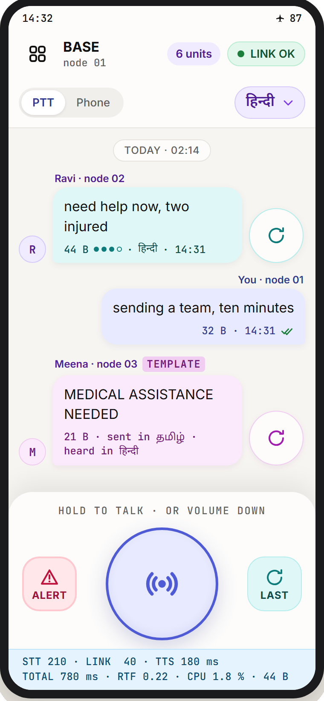
TECHNICAL APPROACH
Taraket
METHODOLOGY & PROCESS
THE APPLICATION
TECHNOLOGIES USED
1
LISTEN
energy gate, then a 400 ms endpoint
RUNTIME
sherpa-onnx 1.13.7 over ONNX Runtime · Kotlin, Compose · Room log
2
RECOGNISE
Conformer STT on device, ten languages
SPEECH TO TEXT
AI4Bharat IndicConformer, int8 · one ~189 MB model per language
COMPRESS
the sentence packs to ~45 bytes
TEXT TO SPEECH
Piper and Mimic 3 VITS voices, 20–60 MB each · espeak-ng phonemiser
3
TRANSPORT
Bluetooth RFCOMM · BLE · Wi-Fi · 3-hop relay · serial to LoRa is the deployment path
4
TRANSMIT
encrypt, frame, send over BT · Wi-Fi · LoRa
SECURITY
AES-256-GCM, key shared by QR · CRC-16 · 64-entry replay window
5
SPEAK
normalise → VITS, play from clause one
LOCATE — FINDING WHO CALLED
6
ALERT
full volume, wakes a locked handset
ARROW · which way
bearing from both positions,
taken against the compass
SIREN · how close
beeps 620 → 1480 Hz,
faster as you close in
Detailed Report GitHub
The latency strip is permanent, not a debug view.
Beyond 15 m the arrow leads. Inside it, follow the sound.
A position is sent only while being located, inside an authenticated frame.

Slide 4
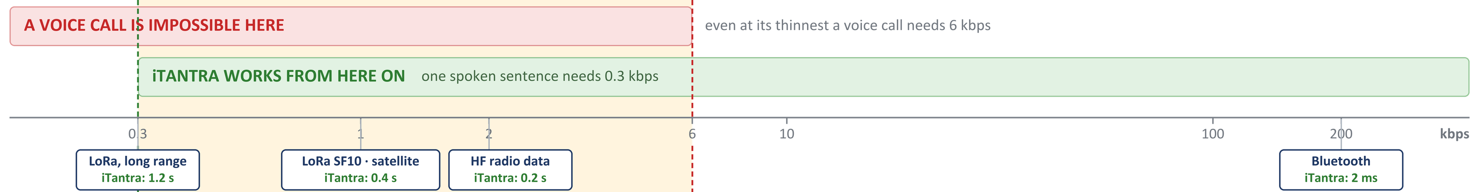
FEASIBILITY AND VIABILITY
Taraket
THE RADIOS THAT SURVIVE A DISASTER CANNOT CARRY A VOICE but every one of them can carry iTantra
THE GAP · no voice call possible, but iTantra works
Every radio that survives a disaster sits inside it.
Above 6 kbps you already have coverage.
FEASIBILITY — CAN WE BUILD IT?
VIABILITY — WILL IT LAST?
RISKS — AND THE ANSWER
Nothing to invent · every model open-source, already ONNX
Deployable today
runs on handsets the team already owns
Noise wrecks accuracy
→ denoising; WER reported at four SNRs
Runs on the phone · no server, no SIM, no cloud
Scales by drop-in
a new language is a pack, not new code
Digits, callsigns misheard
→ domain lexicon; text shown before it sends
Entry-tier target · a 4 GB handset, bought in week one
Nothing to run
open source: no cloud bill, no licence fee
The phone throttles
→ soak-tested; sustained figures only
float32
4× bigger
int8, per language
~189 MB
Nothing to learn
press and talk — literacy not required
A fake alert is injected
→ AES-256 per group, plus a replay window
2.5× faster, under 1.5 % WER cost

Slide 5
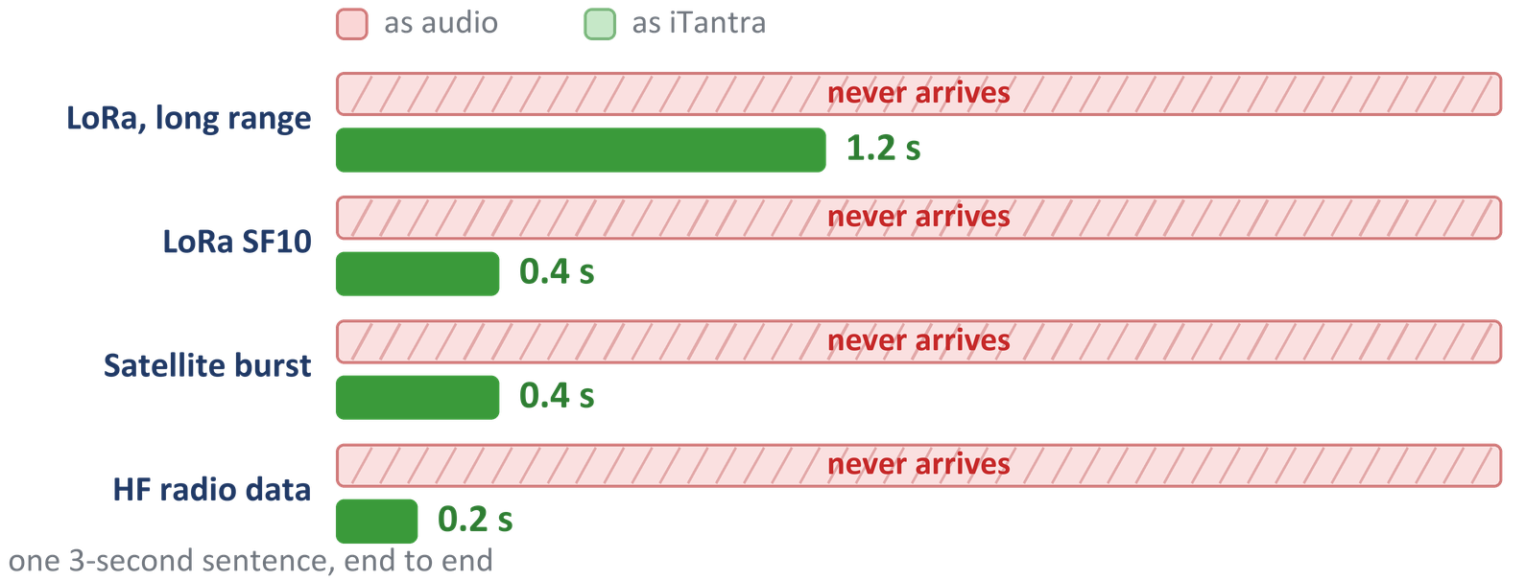
IMPACT AND BENEFITS
Taraket
WHO IT REACHES
WHAT CHANGES
ON THE RADIOS THAT SURVIVE
Ten languages, ten scripts. No typing, no network, no training.
Relief teams
past the last standing tower
1
1
SOCIAL
no literacy needed to raise an alarm
Border posts
on HF and narrowband links
2
2
ECONOMIC
no airtime, no cloud, no new hardware
WHAT ISRO SCORES US ON
IMPACT
BENEFITS
40 %
ACCURACY
Fishermen at sea
beyond every cellular tower
3
3
STRATEGIC
indigenous, open-source, auditable
WER < 12 % clean, < 22 % in a vehicle · critical words < 6 %
20 %
LATENCY
Interior crews
mining, railways, forests
4
4
LOCATE
an arrow and a siren lead to the caller
800–1200 ms speech to speech · RTF < 0.30, sustained
20 %
EFFICIENCY
A fisherman, a soldier in gloves, a village elder. Press one button and speak.
< 30 MB installer · < 2 % idle CPU · > 8 h standby
The app exports its own scorecard — checkable, not claimed.

Slide 6
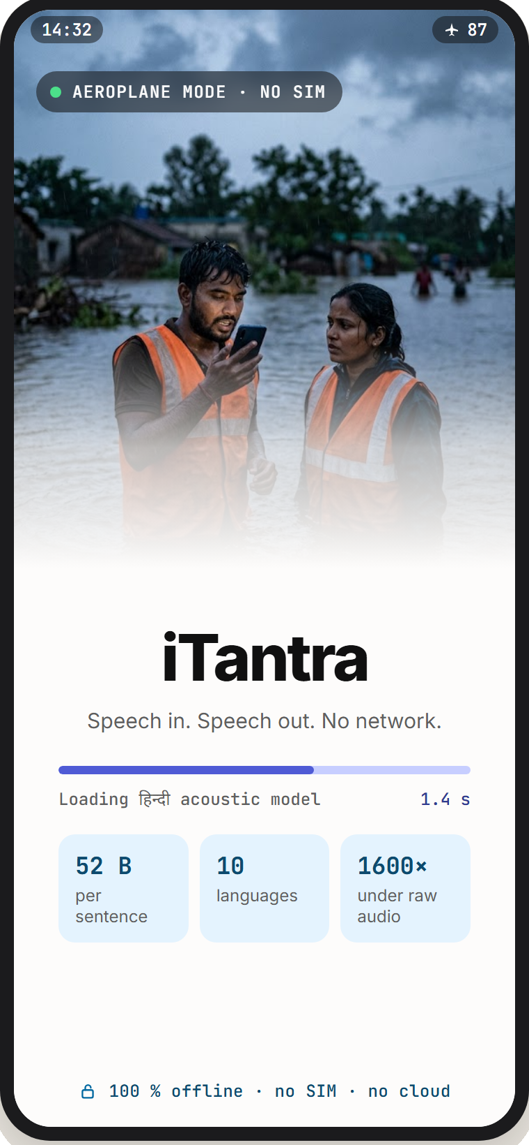
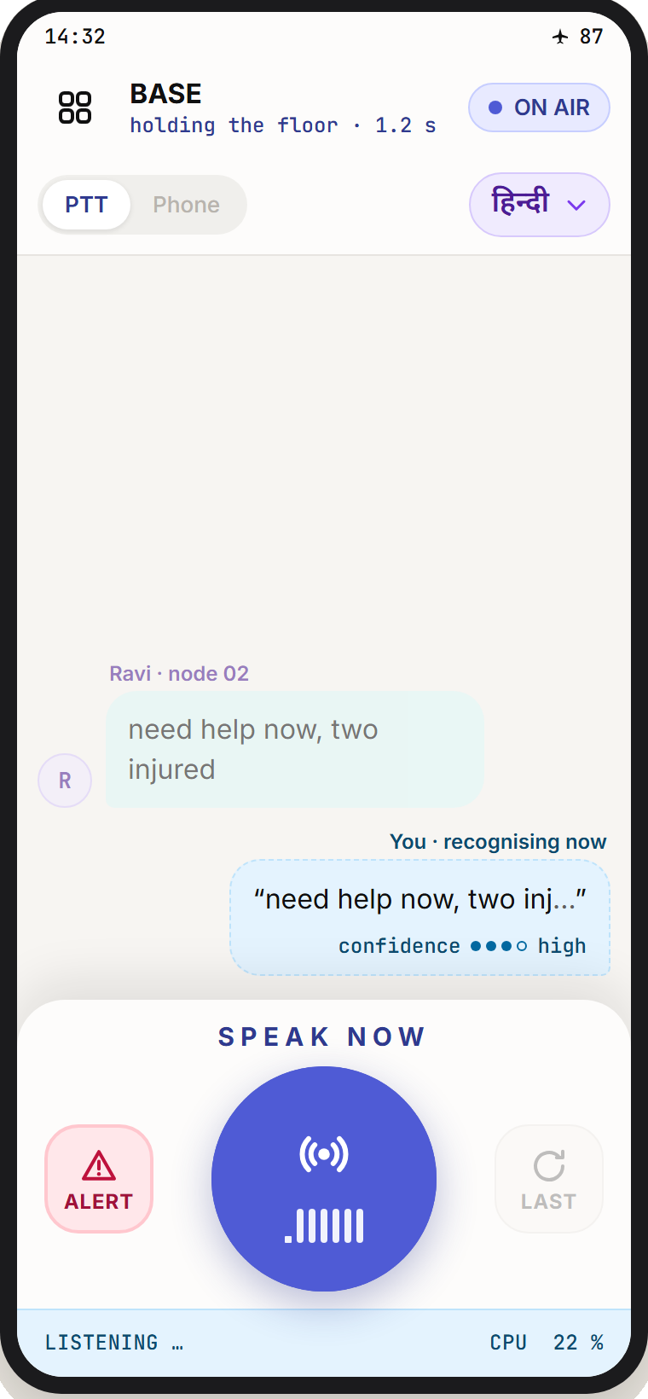
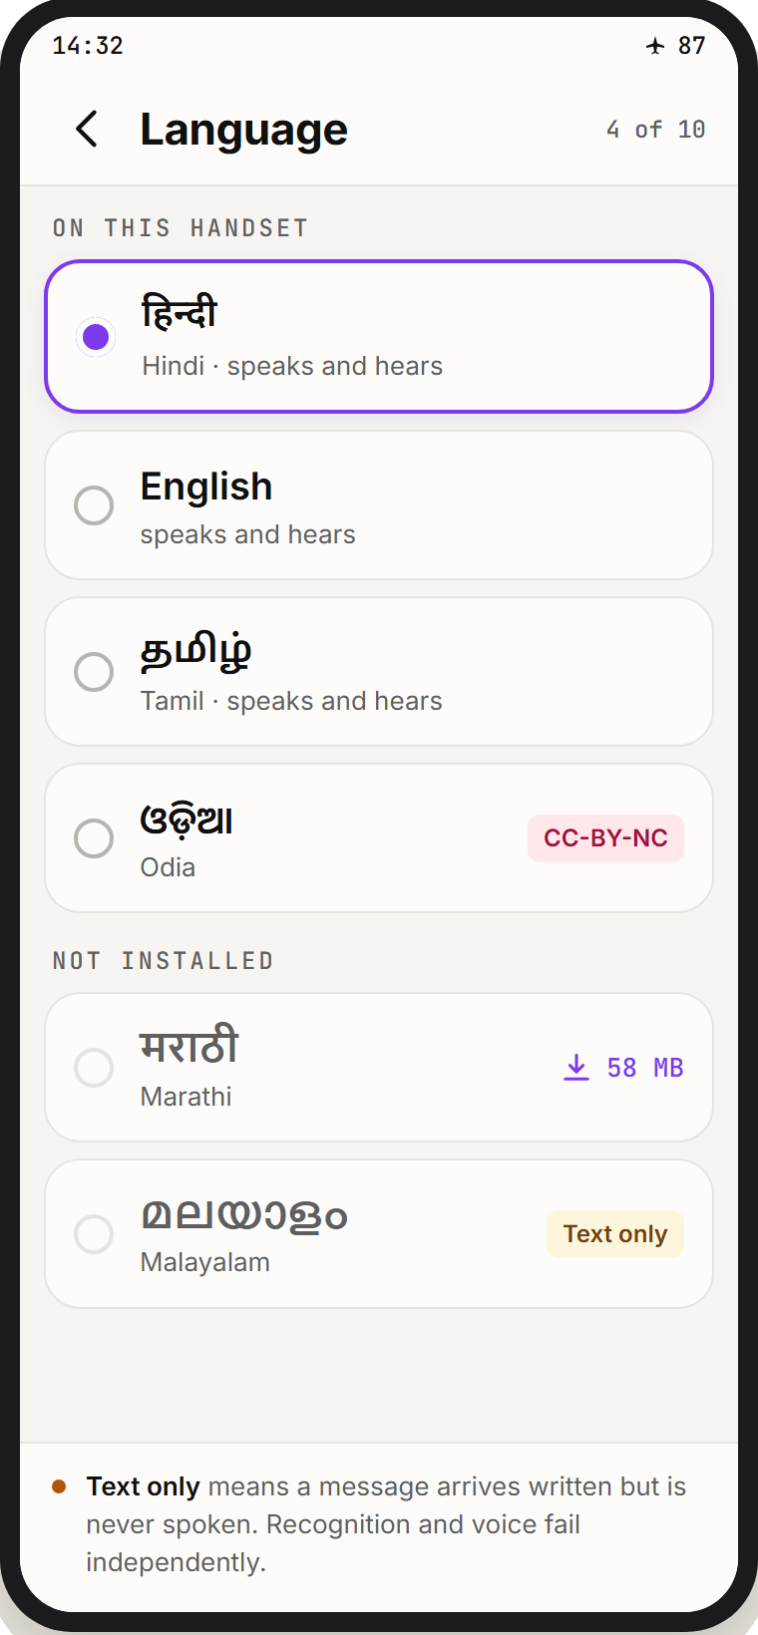
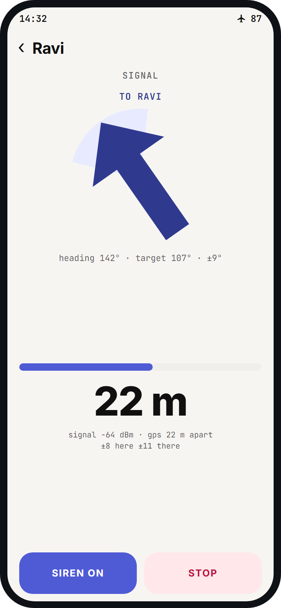
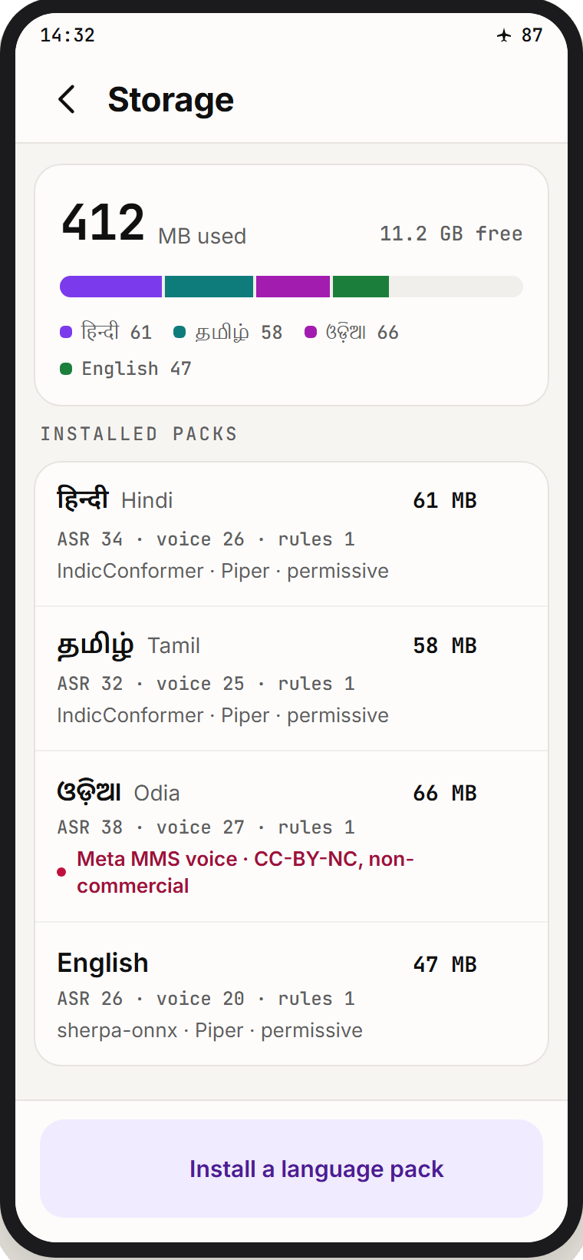
RESEARCH AND REFERENCES
Taraket
the runtime
hears ten languages
speaks them back
phonemises the text
measures accuracy
the encoder
the synthesiser
k2-fsa /
sherpa-onnx
AI4Bharat
IndicConformer
rhasspy /
Piper VITS
espeak-ng
IndicSUPERB
& Kathbath
Conformer
VITS
Apache-2.0
STT models
MIT voices
GPL-3.0, disclosed
WER benchmark
arXiv:2005.08100
arXiv:2106.06103
LINK
LINK
LINK
LINK
LINK
LINK
LINK
UI / UX
COMPLIANCE
No proprietary voice SDK anywhere. Every model runs on the device and nothing calls the network at runtime. espeak-ng (GPL-3.0) and Meta MMS (CC-BY-NC) are disclosed, not buried.
Detailed Report
GitHub
Cold start, no SIM
Mic open, 44 bytes
Own script, always
An arrow to the caller
Packs on demand
Full reference list and licence audit in the technical document.

