Slide 1
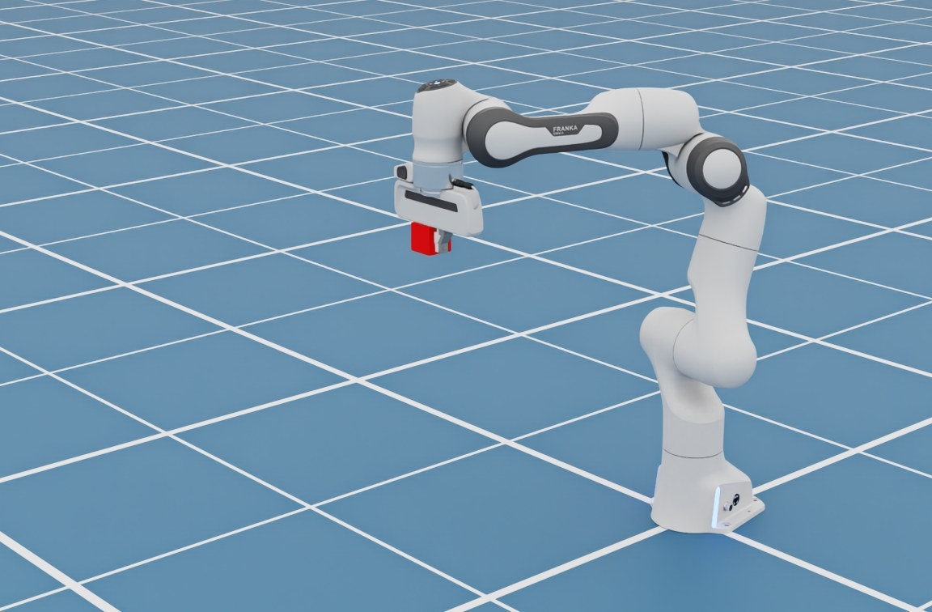
Robot Kinematics
TOPIC 3
From “put your hand there” to seven joint angles
Notes:
This is a Franka Panda, a common research arm with 7 joints. Kinematics is the geometry of motion: how joint angles relate to where the hand ends up. No forces yet, just geometry.

Slide 2
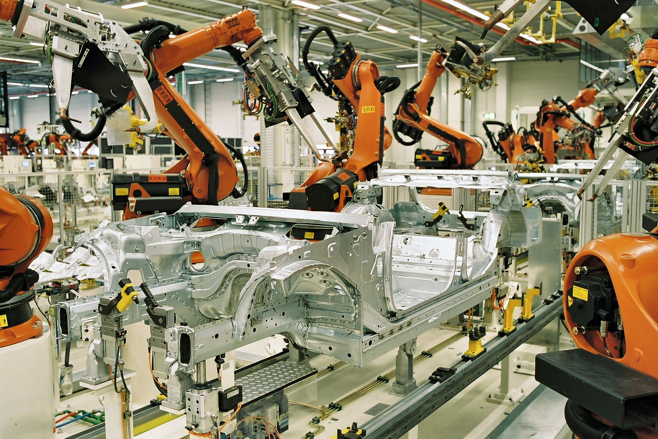
Arms that put a tool exactly there
Car factories: welding torches on every seam
Surgery: instrument tips moved by a surgeon
Same question each time: how should the joints move?
Photo: BMW Werk Leipzig · CC BY-SA 2.0 de · Wikimedia Commons
Notes:
Welding robots on a car body line follow seams to the millimetre. Surgical robots turn the surgeon's hand motion into instrument-tip motion. In both, someone specifies where the tool must be, and the robot must work out the joint angles.

Slide 3
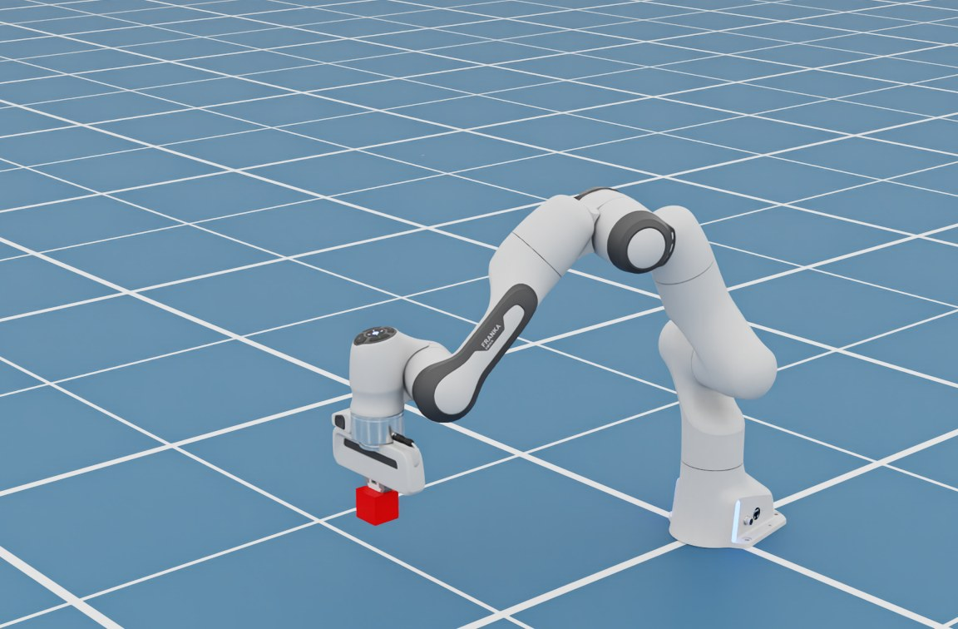
Two directions of one question
Forward kinematics
Joint angles
7 numbers
Hand position
where it ends up
Easy: one answer
Inverse kinematics (IK)
Hand target
the red cube
Joint angles
?
Hard: none, one, or many answers
Notes:
Forward kinematics: give me the joint angles and I tell you where the hand is. One answer, simple trigonometry. Inverse kinematics is the reverse and is what we actually need: we know where the hand should go and ask which joint angles get it there. There may be no answer (too far), one, or infinitely many. The demo solves IK continuously as the cube moves.

Slide 4
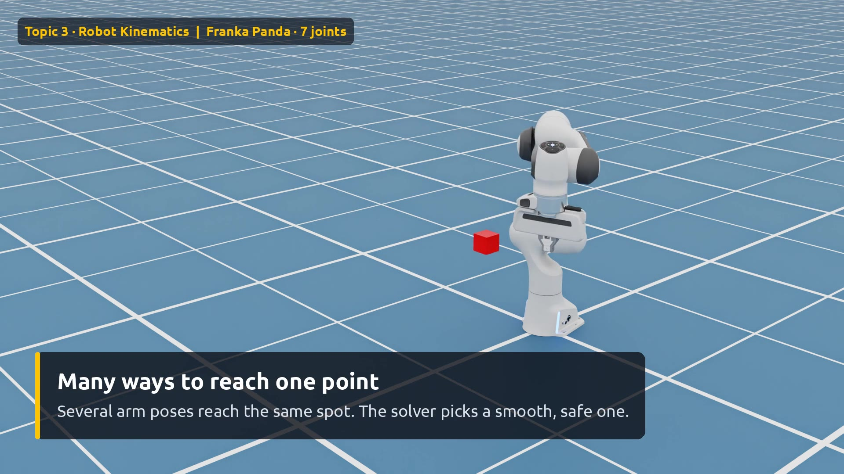
Demo: follow the red cube
Watch for
0:00 Cube = hand goal
0:03 Only WHERE is given
0:11 IK re-solved 60× a second
0:18 Many poses, one point
0:24 Cube leaves the workspace
0:30 Arm stretches, stops
0:35 Back in reach
Click the video to play
Notes:
Play the video. Point out that we never tell the robot any joint angle, only where the cube is. Around 0:25 the cube moves about 1.15 m away, beyond the roughly 0.85 m reach: the arm stretches as far as it can and waits. When the cube returns, tracking resumes instantly.

Slide 5
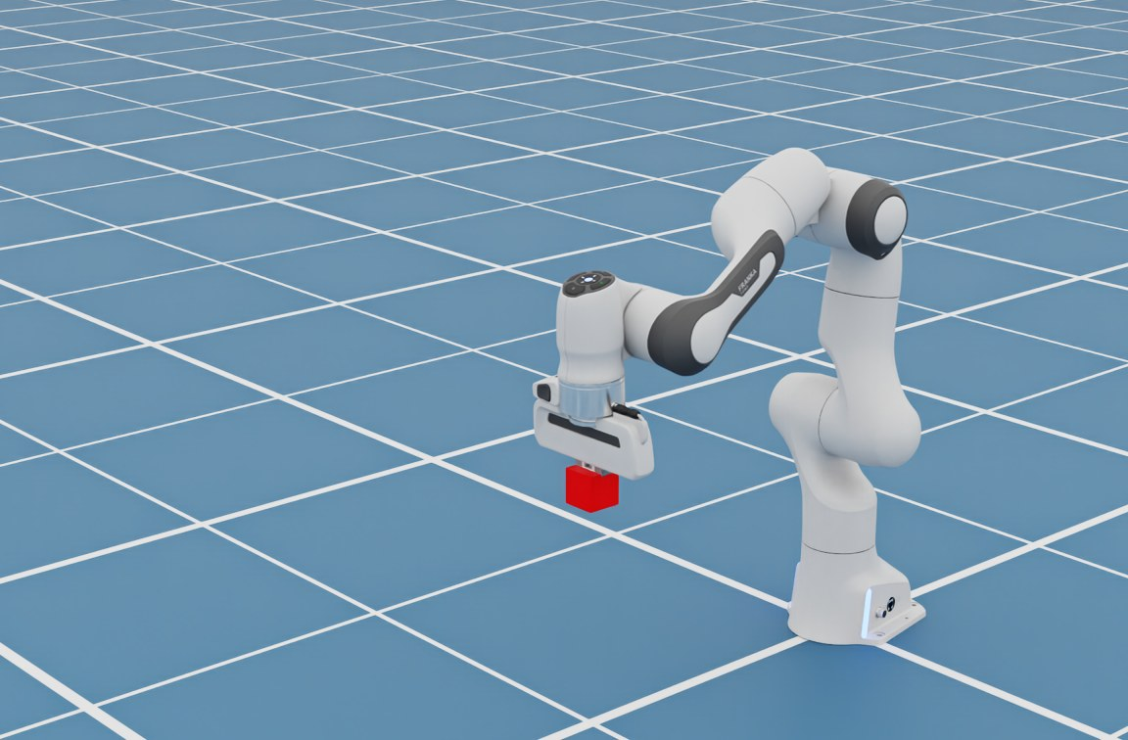
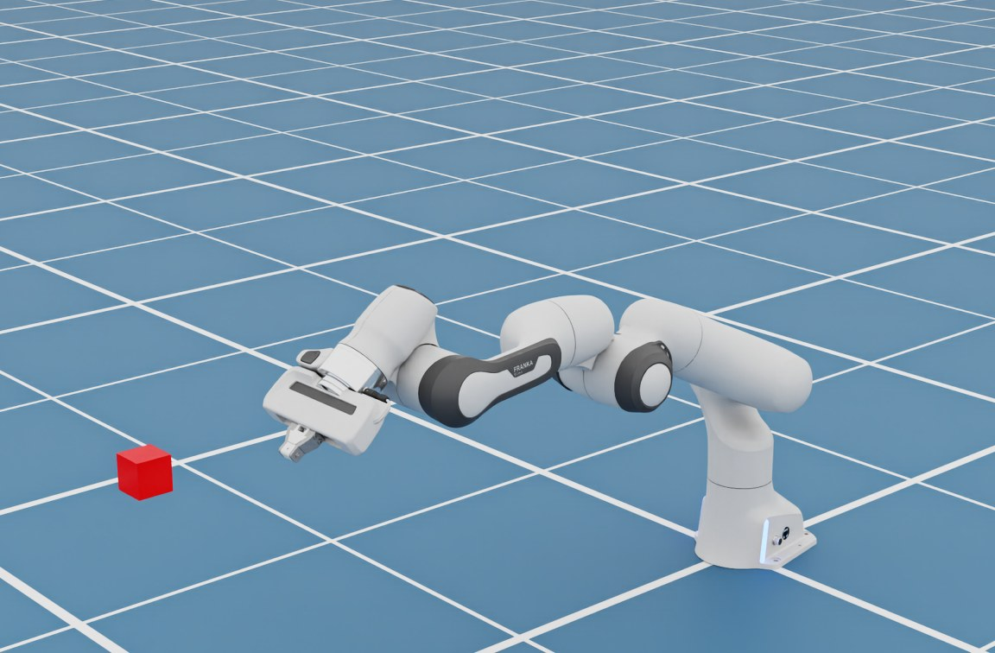
One controller, every target
1
Near
2
Far and high
3
Low and wide
4
Out of reach
Notes:
Same code, very different arm shapes. Nobody programmed these poses; IK found them. The last frame is the interesting failure: the target is outside the workspace, so the best the arm can do is point at it.

Slide 6
Three numbers to remember
7
0.85 m
60×
joints: one more than needed, so many poses fit one target
reach: the edge of the workspace
per second the solver updates the joint targets
Notes:
6 joints are enough to place a hand anywhere in reach with any orientation; the 7th gives the robot a choice of elbow position, which helps avoid joint limits and obstacles. The workspace is everything the hand can reach. The solver (RMPflow in cuMotion) re-solves 60 times a second, which is why it can chase a moving target.

Slide 7
Say WHERE. Kinematics works out HOW.
TAKEAWAY
Inverse kinematics turns a target into joint angles, as long as it is within reach.
Notes:
Recap: forward is easy, inverse is the useful one. Reachability limits what is possible. Next topics build on this: planning adds obstacles, contact adds forces.

