Slide 1
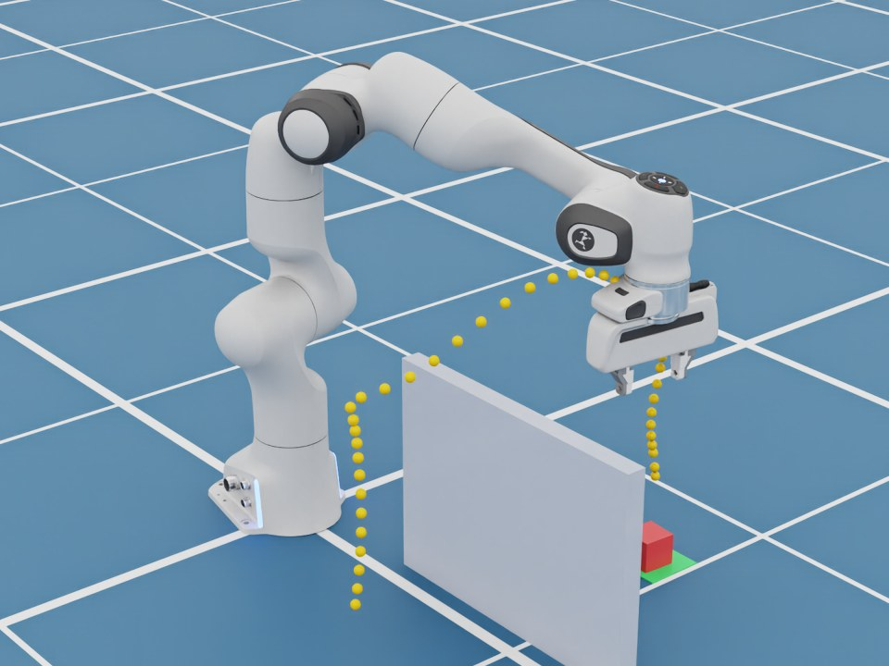
Collision Checking & Motion Planning
TOPIC 7
Getting from A to B without hitting anything
Notes:
Last topic answered where the joints should be for one target. Now: how do we move from here to there when something is in the way?

Slide 2
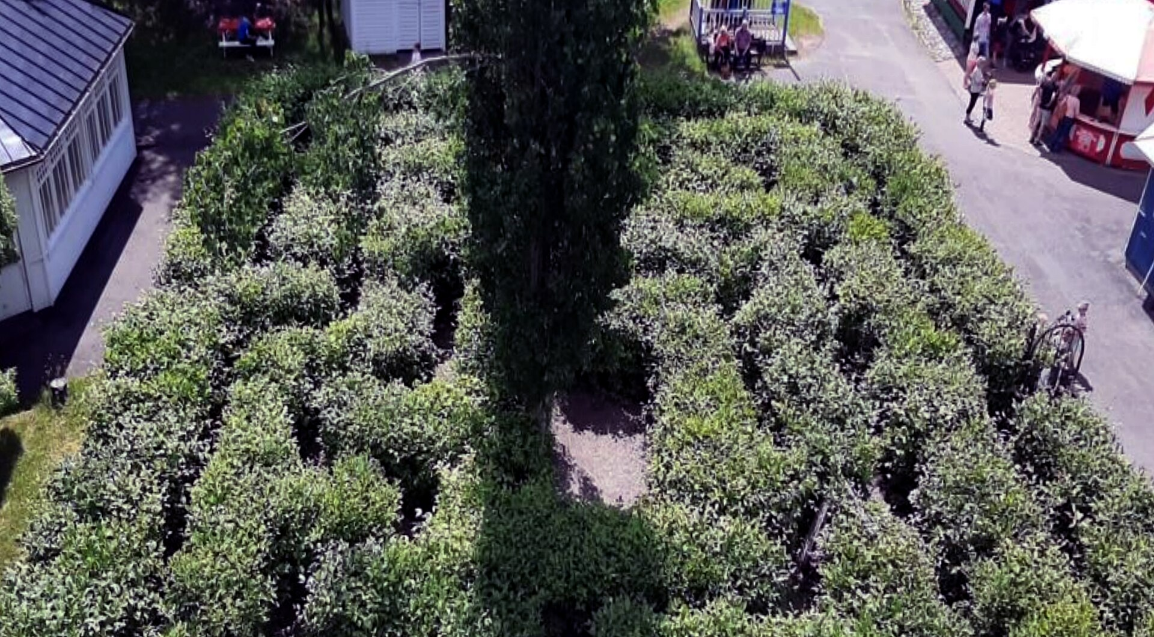
Like finding your way through a maze
Know where the walls are
Check each step before taking it
Pick a route that gets there safely
Photo: Juustila · CC BY-SA 4.0 · Wikimedia Commons
Notes:
A maze is a good mental model. You need a map of the walls, a way to tell whether a step hits a wall, and a strategy to choose a route. A robot arm does the same, except its 'body' is a chain of links that all must avoid obstacles.

Slide 3
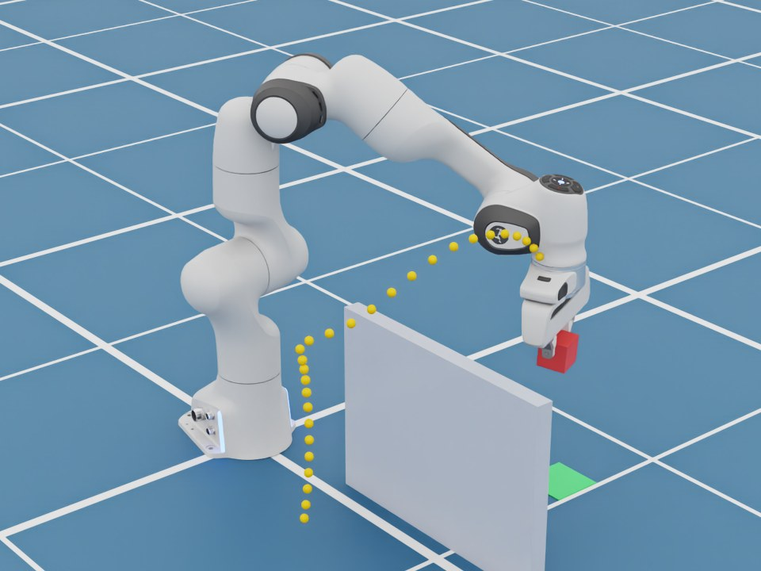
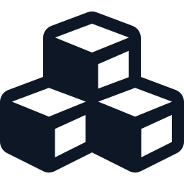


How the robot plans
1 Model the world
Robot and obstacles as simple shapes
2 Check collisions
Do any shapes overlap? Thousands of checks a second
3 Choose a path
Safe, smooth, and short
Notes:
Step 1: the planner keeps a model of the robot's links and every obstacle, usually as spheres and boxes. Step 2: collision checking tests whether any of those shapes overlap for a candidate pose. It is cheap and runs thousands of times per second. Step 3: the planner picks a motion that stays collision-free. In the demo we used RMPflow, a reactive planner: obstacles push the arm away, the goal pulls it in.

Slide 4
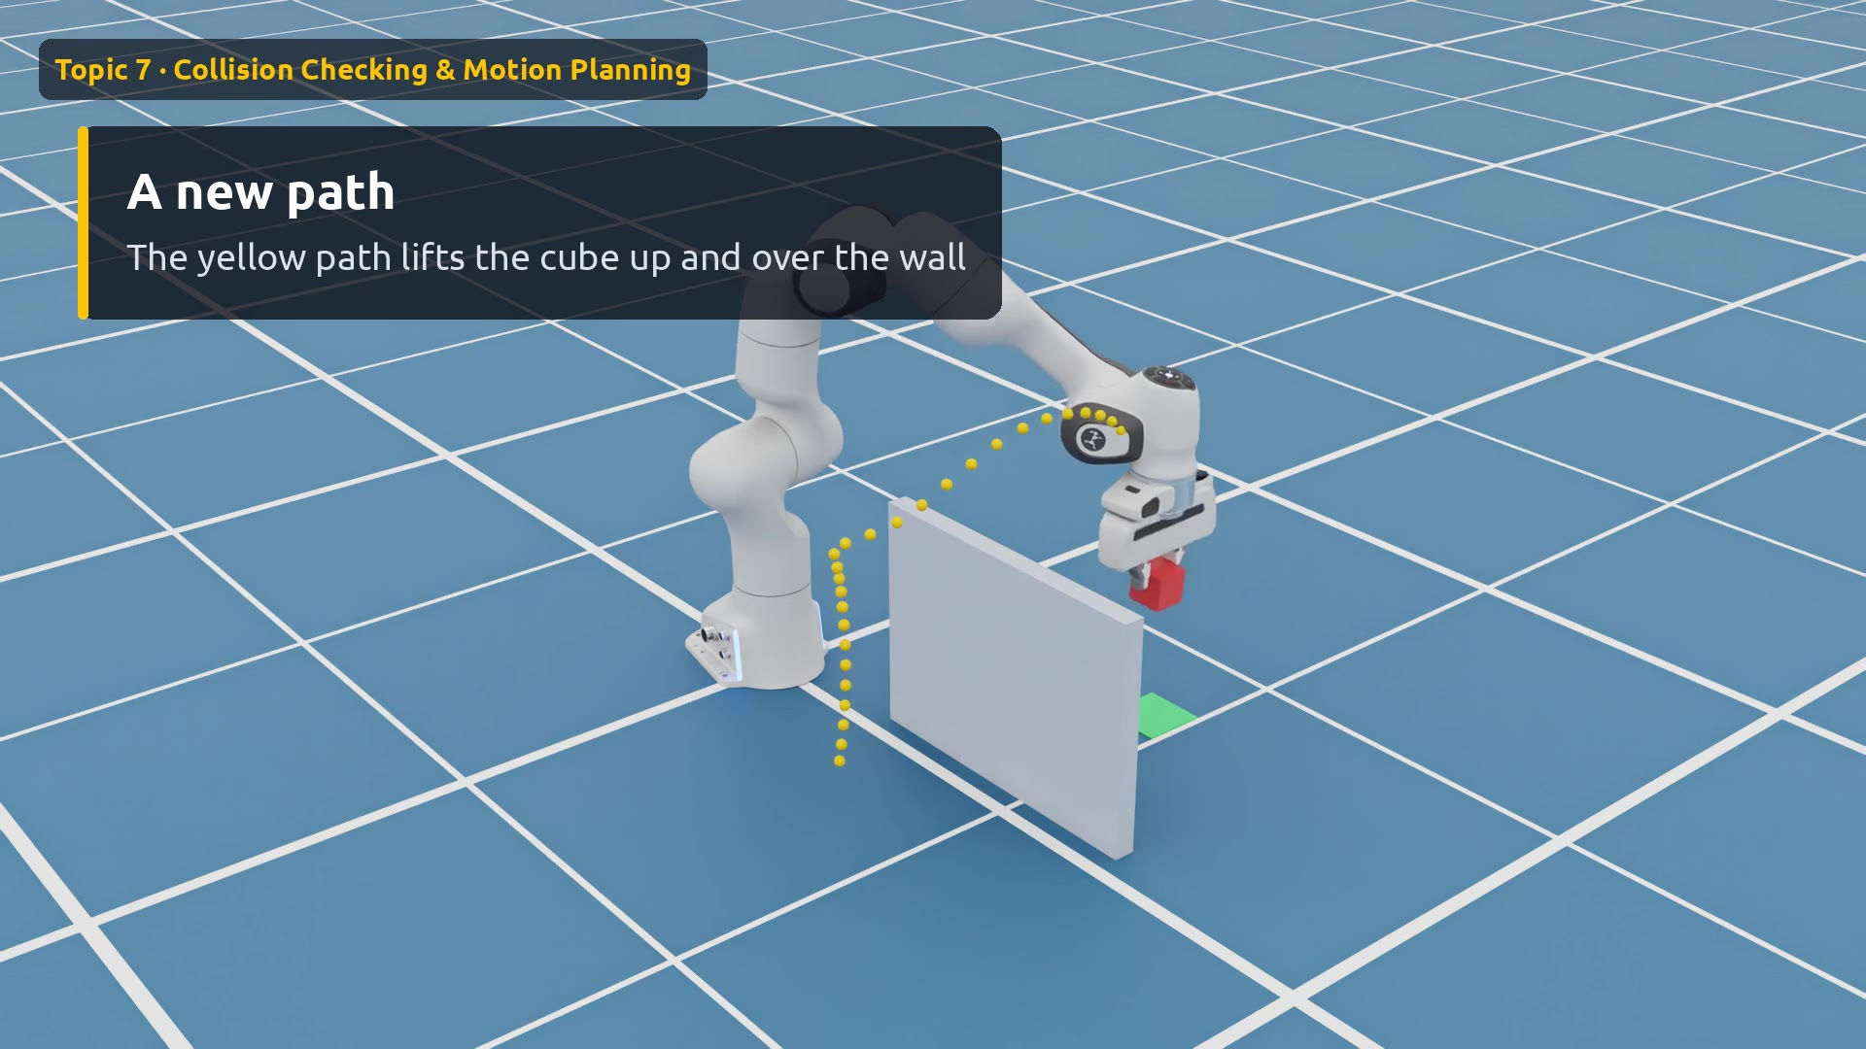
Demo: same task, add a wall
Watch for
0:00 The task
0:03 No obstacle
0:11 Now add a wall
0:15 Up and over
0:20 Same task, new route
Click the video to play
Notes:
First take: no wall, the blue dots trace a low, direct path. Second take: a wall appears between the cube and the green pad. Nothing else changes in the code, only the world model. The yellow path lifts up and over.

Slide 5
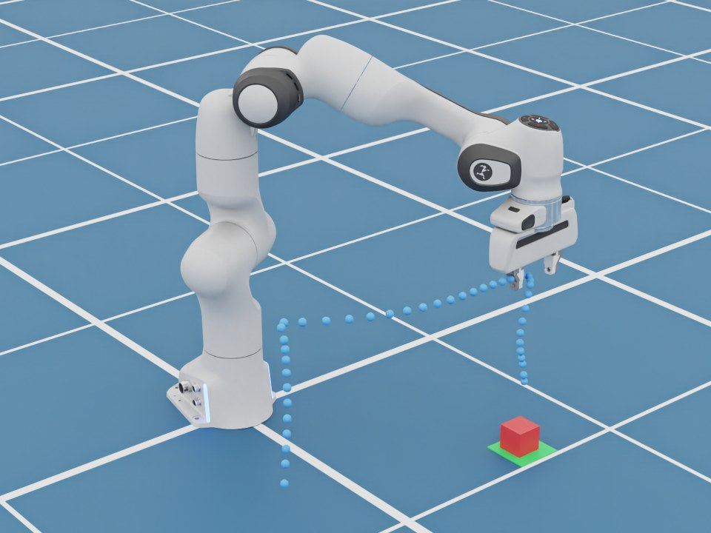
Same start, same goal, different route
1
No wall
2
Wall
Low and direct (blue)
Up and over (yellow)
Notes:
Side by side: the dotted lines are the gripper's path while carrying the cube. Collision checking changed how the robot moved, not what it did. Both runs place the cube on the green pad.

Slide 6
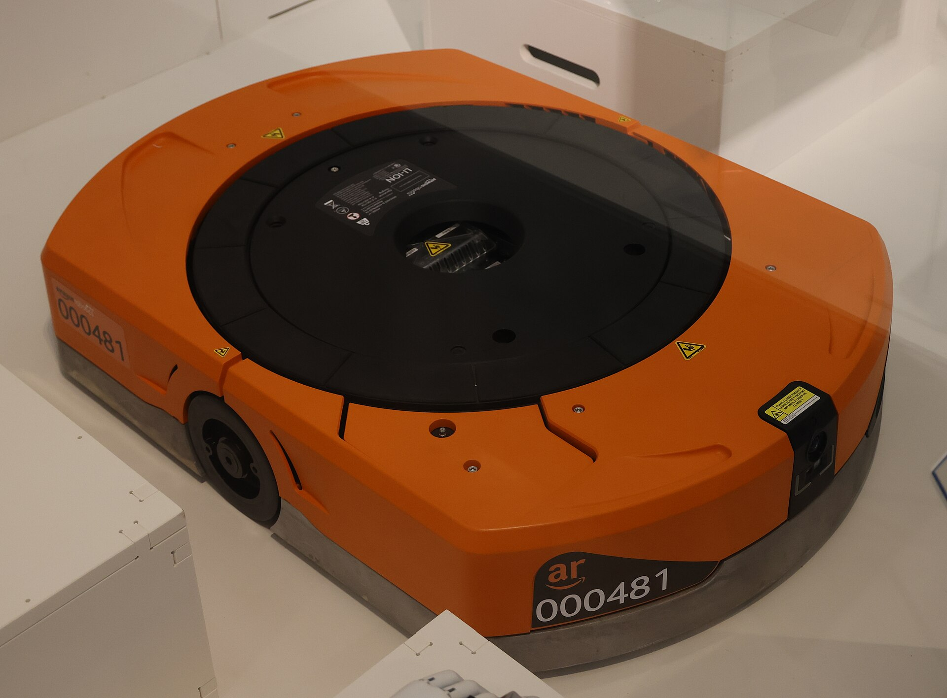
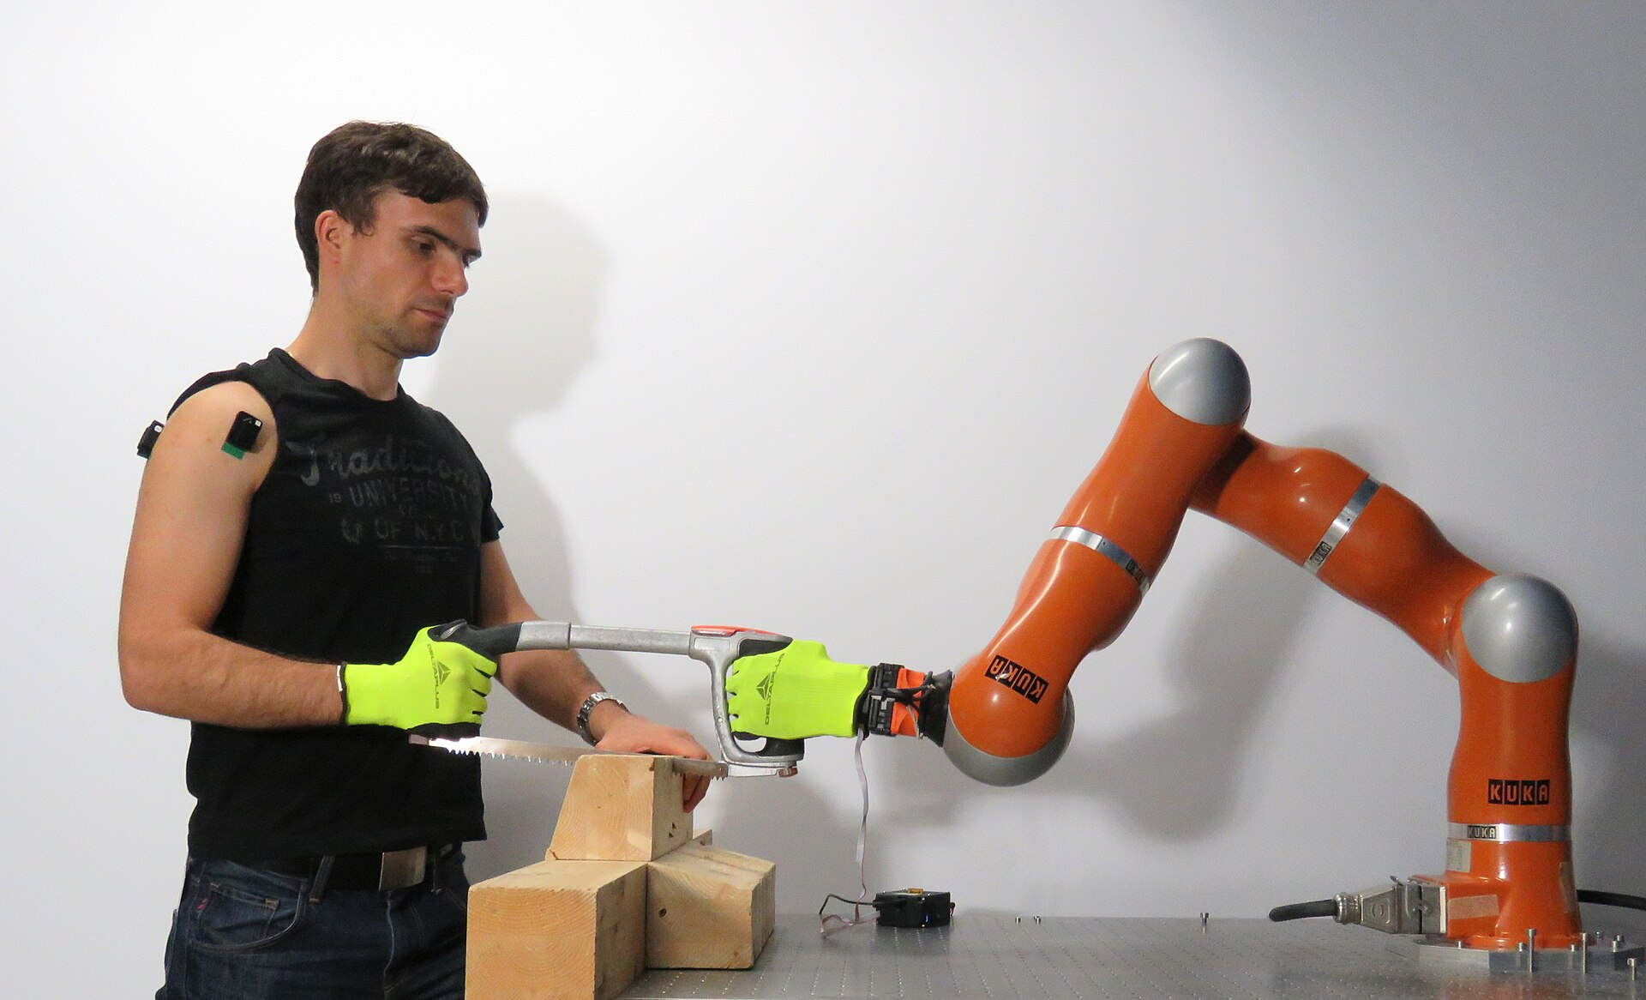
Where planning matters
Warehouses: robots share busy floors
Next to people: obstacles that move
Photo: Geni · CC BY-SA 4.0 · Wikimedia Commons
Photo: Luka Peternel · CC BY-SA 4.0 · Wikimedia Commons
Notes:
Warehouse drive units plan paths among each other. Collaborative robots must re-plan constantly because people move. A limitation worth mentioning: when we raised the wall to 42 cm, our reactive planner got stuck behind it and gave up. Reactive planners are fast but can get trapped; global planners (RRT, or GPU planners like cuRobo) search the whole space and find a way out, at more compute cost.

Slide 7
Collision checking changes HOW, not WHAT
TAKEAWAY
Know the obstacles, check every move, pick a safe path.
Notes:
Recap: model the world, check collisions, choose a path. Tall obstacles show the trade-off between fast reactive planners and slower global ones.

