Slide 1
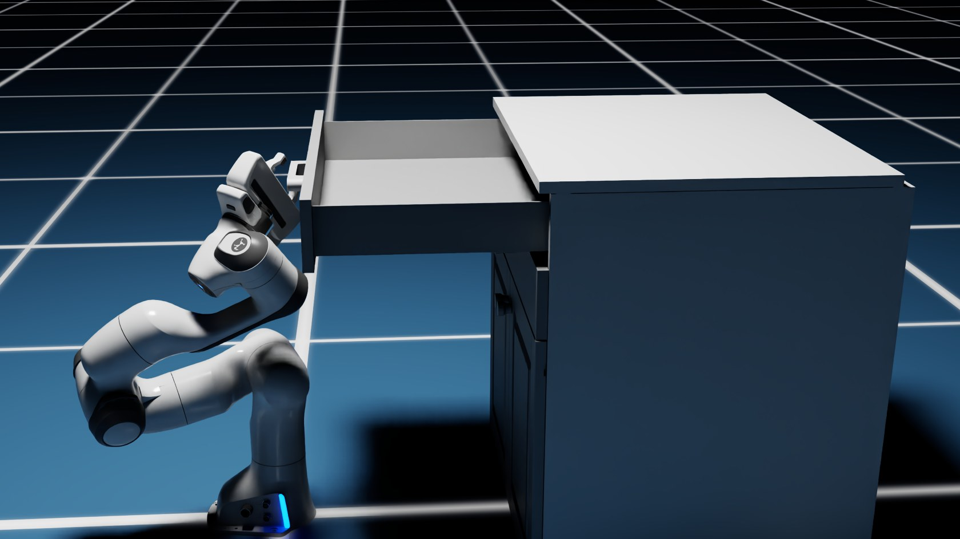
Learning Manipulation Policies
TOPIC 14
Robots that learn a skill instead of following a script
Notes:
Everything so far was engineered by hand: IK, planners, grip forces. Now a different approach: let the robot learn the whole skill from experience.

Slide 2
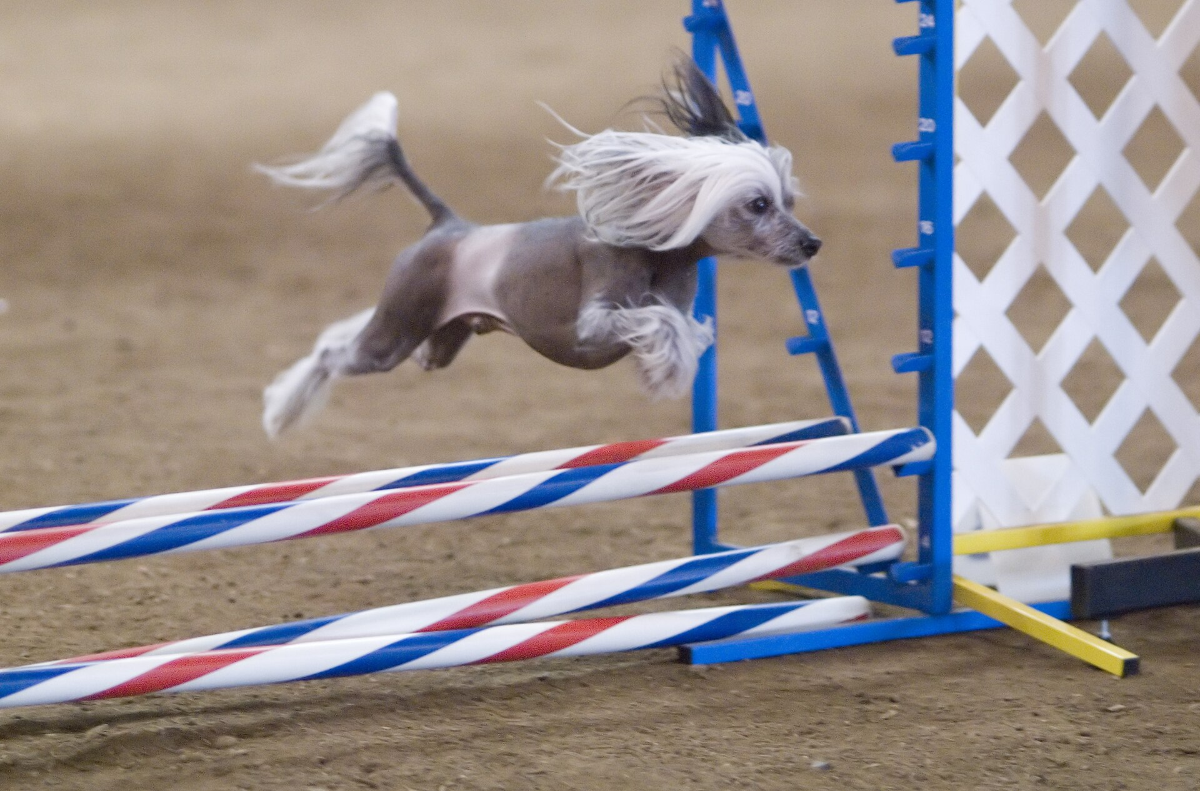
Learning by reward
Try something
Get a treat when it works
Repeat until it's second nature
Photo: Ron Armstrong from Helena, MT, USA · CC BY 2.0 · Wikimedia Commons
Notes:
Nobody explains the physics of jumping to an agility dog. It tries, gets a treat when it clears the bar, and improves. Reinforcement learning trains robots the same way, just with a score instead of a treat, and millions of tries in simulation.

Slide 3
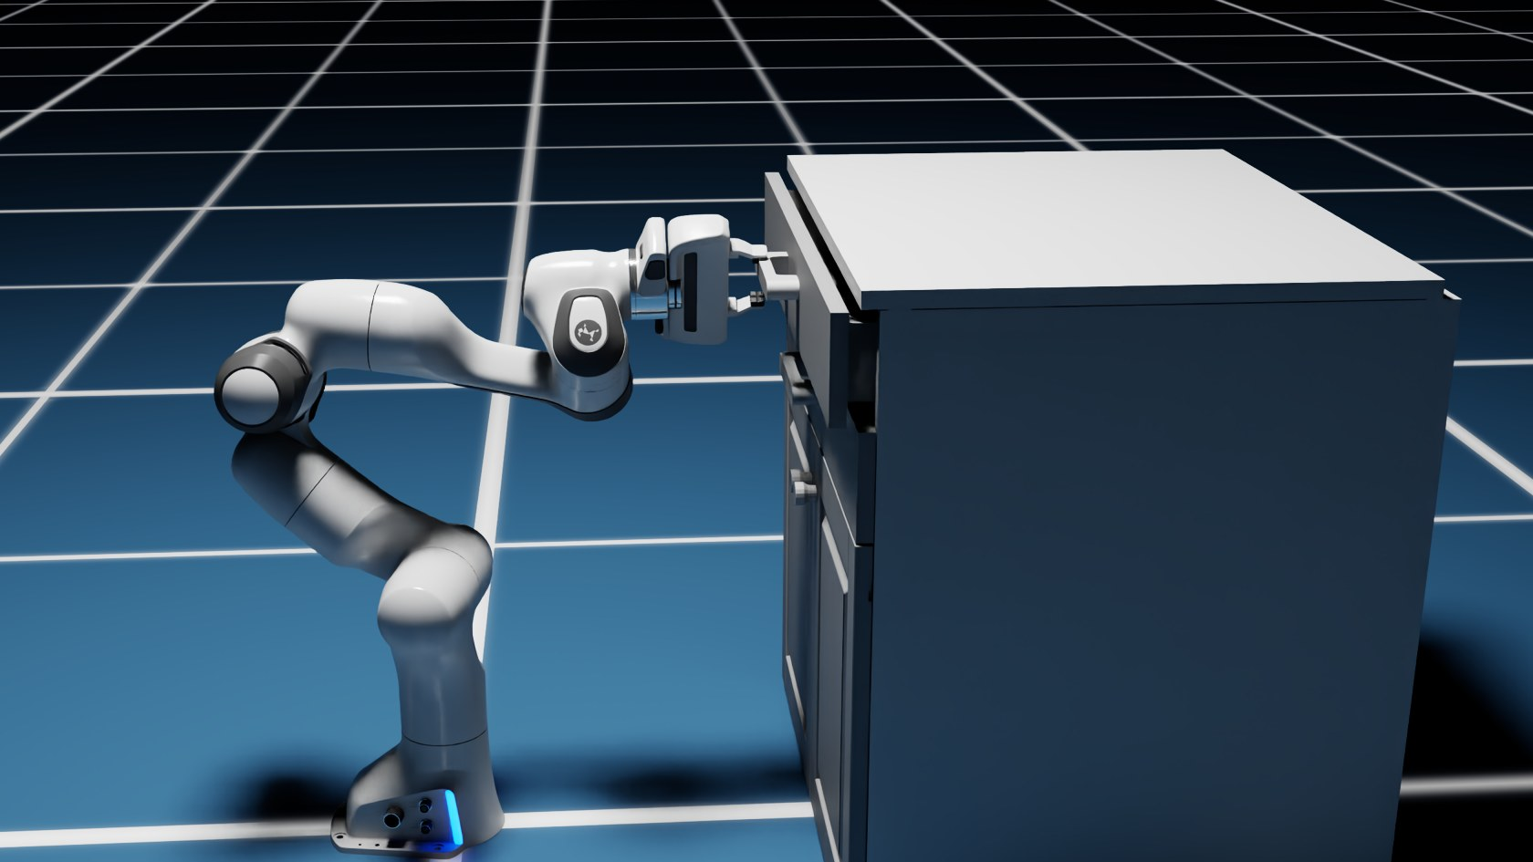
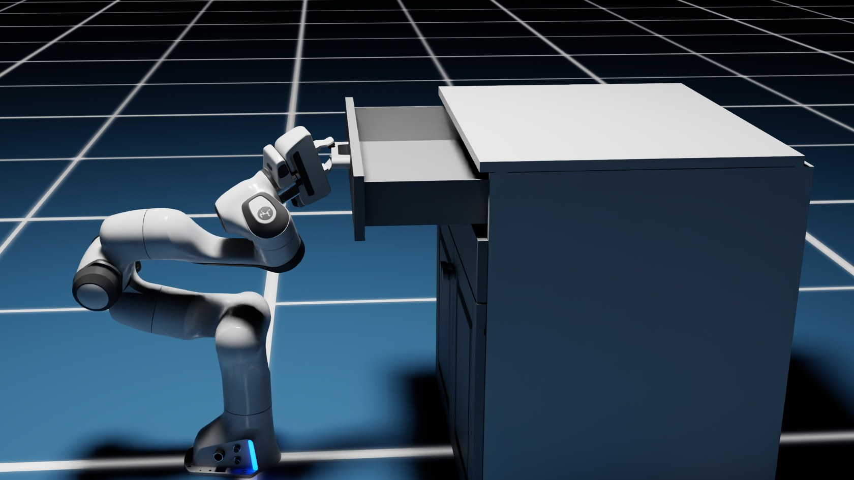
The policy: sense, decide, act
Sense
Joint angles, drawer position
Neural network
the “policy”
Act
New joint targets
repeats 60 times a second
Notes:
A policy is just a function from what the robot senses to what it does next. Here it is a small neural network: it reads the joint angles and speeds and where the drawer and handle are, and outputs new joint targets. It runs in a loop, 60 times a second. There are no hand-written steps like 'move to handle, close gripper, pull'.

Slide 4


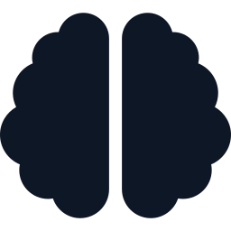
How it learned: reinforcement learning
Try
Random moves at first
Thousands
of robots practising at once, in simulation
Score
More drawer opened = higher reward
~0.5 s
Improve
Adjust the network toward what scored
for the trained policy to open the drawer
Notes:
Training happened beforehand in Isaac Lab, NVIDIA's robot-learning framework: many simulated robots practise in parallel, each attempt gets a reward, and the network is nudged toward actions that earned more. In our recording the finished policy opens the drawer about 40 cm in roughly half a second. Simulation makes this practical: no broken hardware, and far faster than real time.

Slide 5
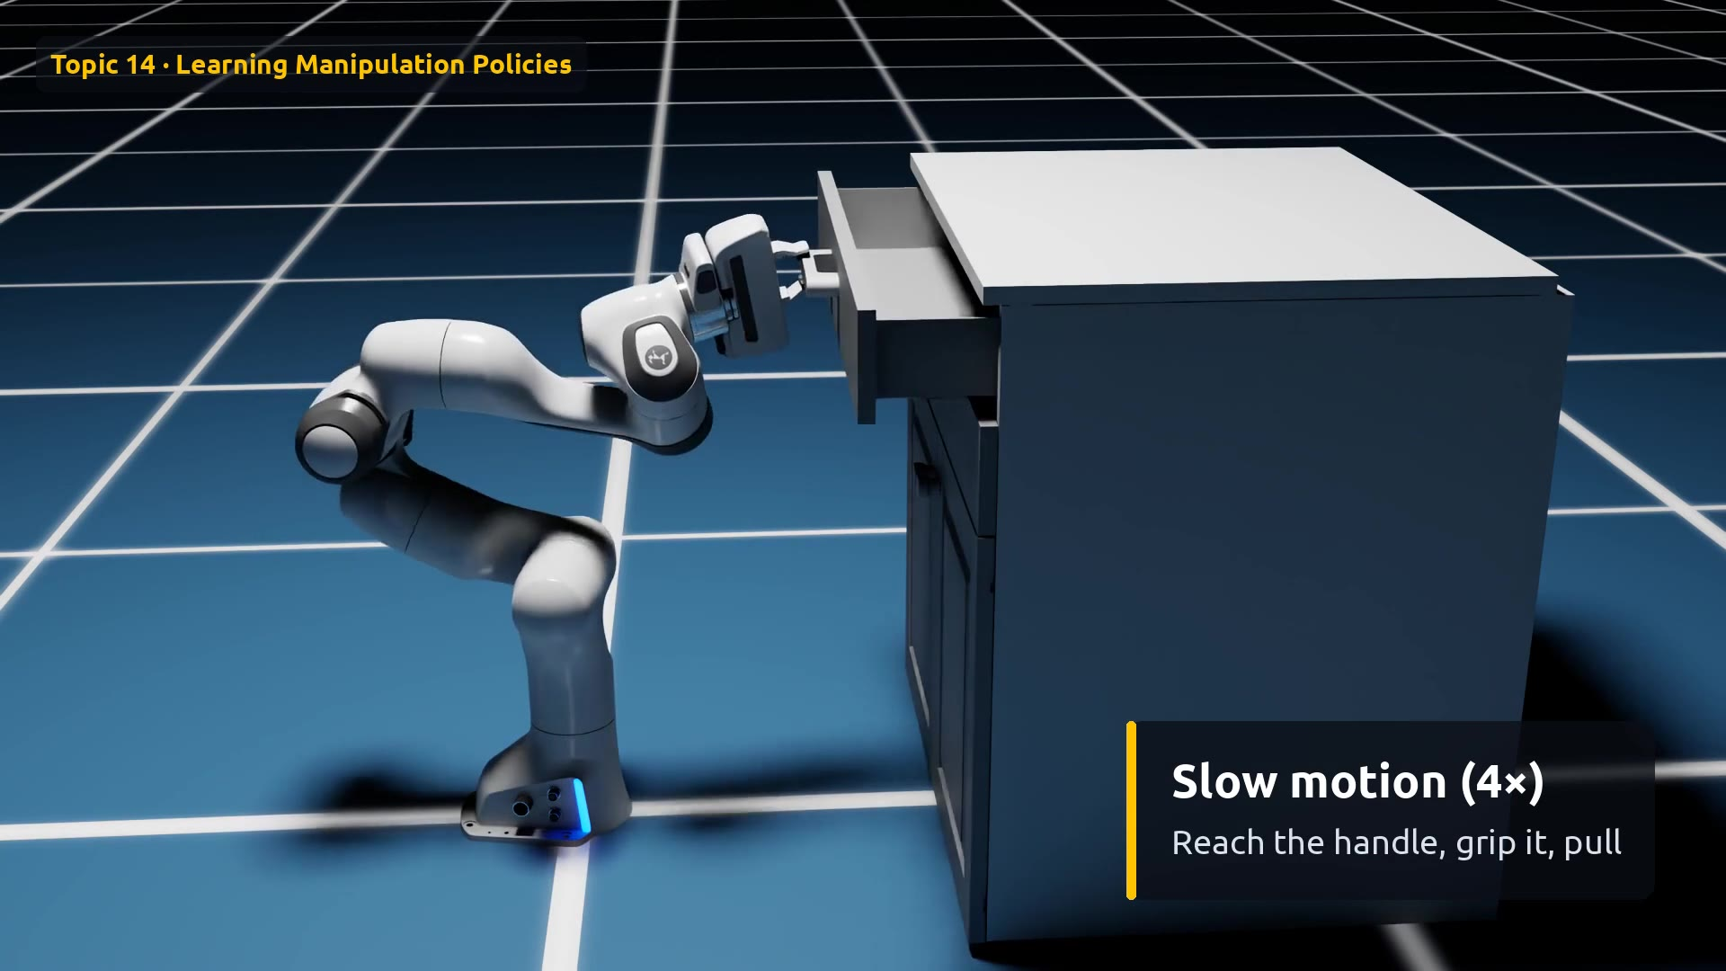
Demo: a trained policy opens a drawer
Watch for
0:00 Real time: very fast
0:02 4× slow motion
0:05 Trained by reward
0:08 What comes next
Click the video to play
Notes:
The real-time part is very fast, under half a second. The slow-motion replay shows the three phases: reach the handle, grip it, pull. Remind the audience that nobody programmed these phases; they emerged from training.

Slide 6
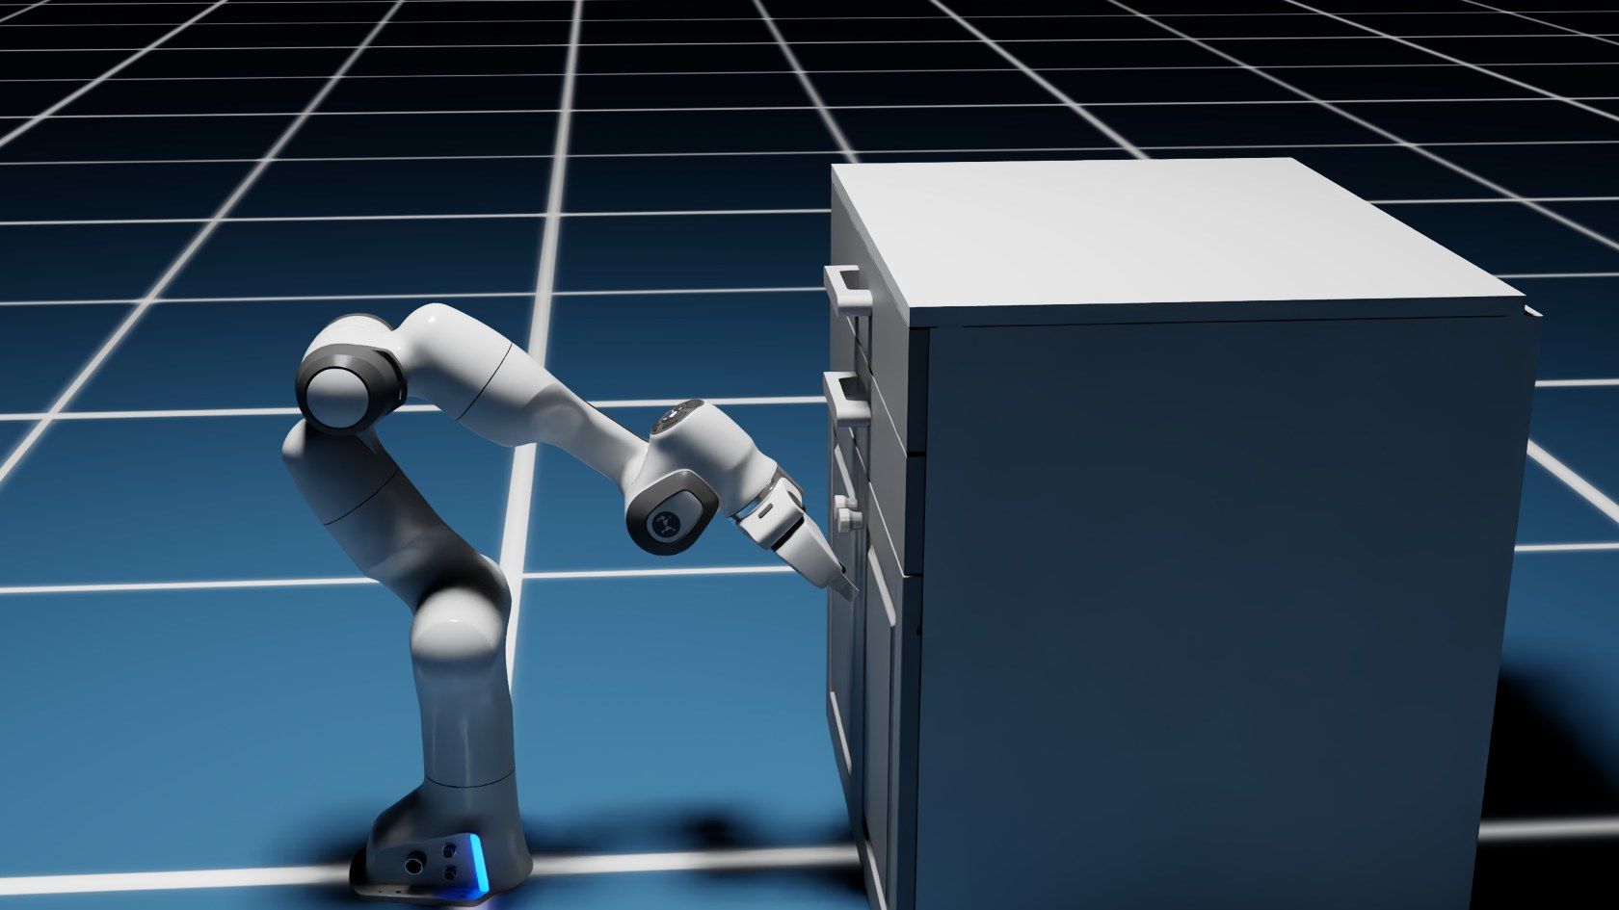
Half a second, three phases
1
0.00 s
2
0.27 s
3
0.47 s
4
0.67 s
Start
Reach the handle
Grip and pull
Drawer open
Notes:
Frames from the 60 fps recording. The policy discovered on its own that it should approach the handle, close the gripper, and pull straight back.

Slide 7
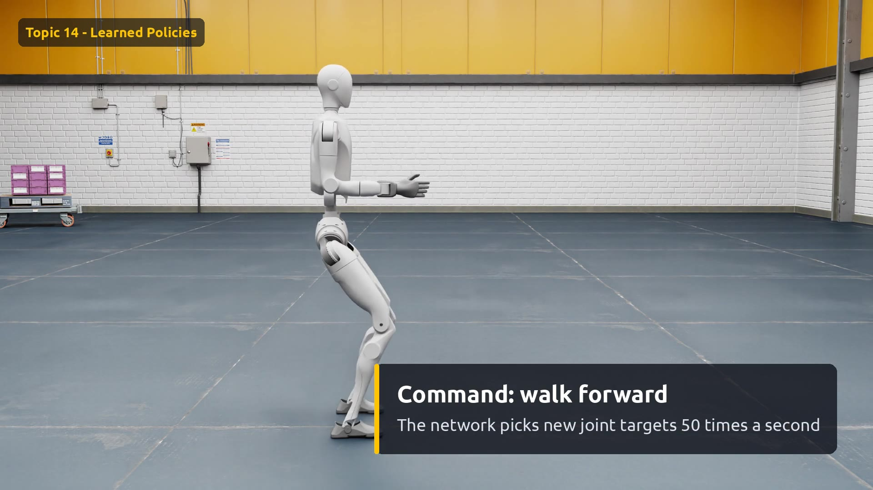
Demo: the same idea, a whole humanoid
Watch for
0:00 Unitree H2 humanoid
0:01 Walk forward
0:06 Turn around
0:09 Walk back
0:14 Step sideways
0:17 Stop and balance
Click the video to play
Notes:
Same recipe as the drawer, scaled up to a whole body. This is the Unitree H2 walking policy that ships with Isaac Sim, trained with reinforcement learning in Isaac Lab. We only send simple commands: walk forward at half a meter per second, turn, step sideways, stop. The neural network turns each command into joint targets 50 times a second and keeps the robot balanced. Every footstep is also a friction problem, which links back to topic 9.

Slide 8
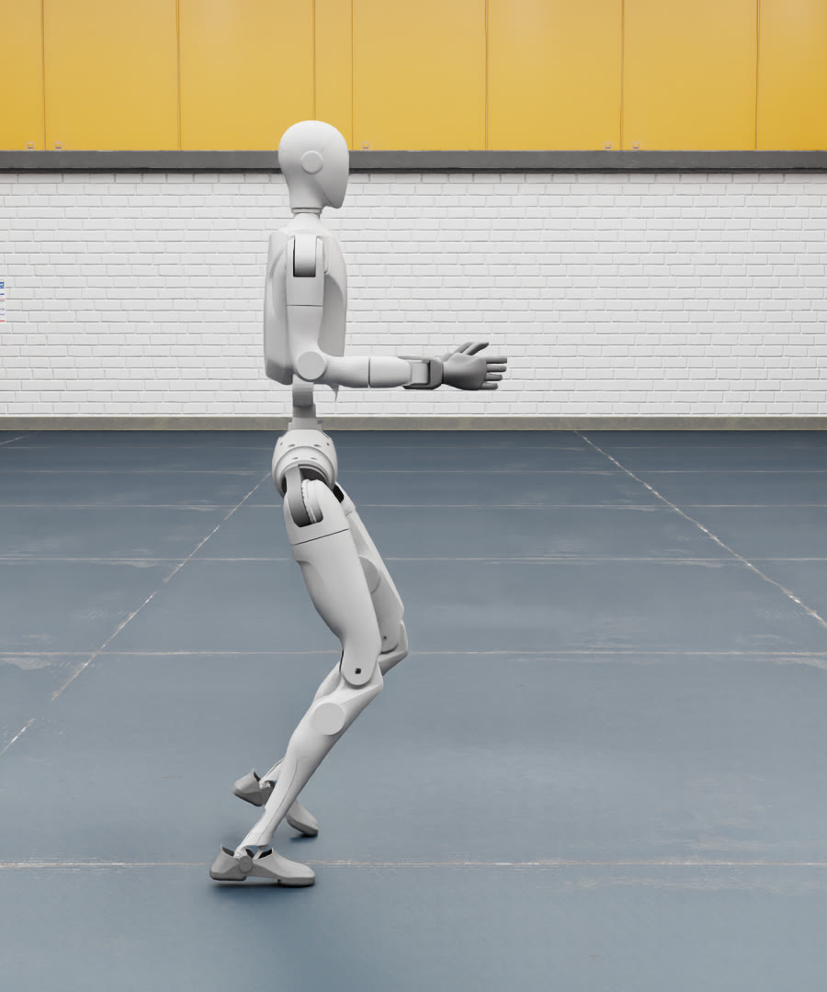
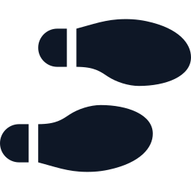

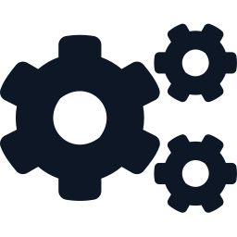

Why it doesn't fall: domain randomization
Floor friction
Slippery to grippy: μ 0.2 to 1.5
Body weight
Up to 5 kg extra on the torso
Motor strength
Every motor a bit stronger or weaker
Random pushes
Shoves of up to 10 N
Training changes the world every episode, so the policy can't rely on any one setting
Notes:
These numbers come from the training configuration that ships with this H2 policy. During training, every simulated robot gets a different world: floor friction anywhere from 0.2 to 1.5, its torso 1 kg lighter to 5 kg heavier, body part masses and centers of mass shifted, motor gains and joint friction varied, and random pushes of up to 10 newtons. A policy that walks in all of those worlds is much more likely to work on a real robot, whose exact values we never know. That is how domain randomization helps close the sim-to-real gap.

Slide 9
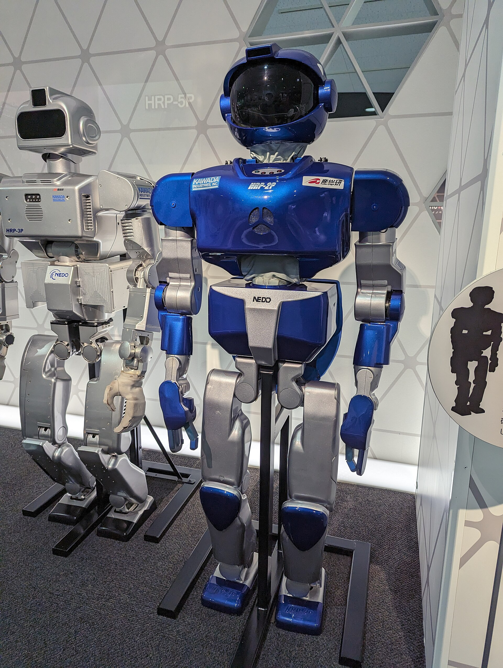
Beyond reinforcement learning
Learning from human demonstrations
Diffusion policies: smooth, multi-step skills
Vision-language-action models: “open the top drawer”
Photo: Syced · CC0 · Wikimedia Commons
Notes:
Behavior cloning learns by copying human demonstrations instead of trial and error. Diffusion policies generate whole motion sequences and handle tasks with several valid ways to do them. Vision-language-action models (VLAs) take camera images plus a spoken or typed instruction and output actions, the direction humanoid robots are heading. The open challenge for all of them is the sim-to-real gap: a skill learned in simulation must still work on a real robot.

Slide 10
Write the goal, not the steps
TAKEAWAY
The robot practises in simulation until the skill emerges.
Notes:
Recap: a policy maps senses to actions. Reinforcement learning shapes it through trial and reward, mostly in simulation. This complements the classical tools from earlier topics rather than replacing them.

