Slide 1
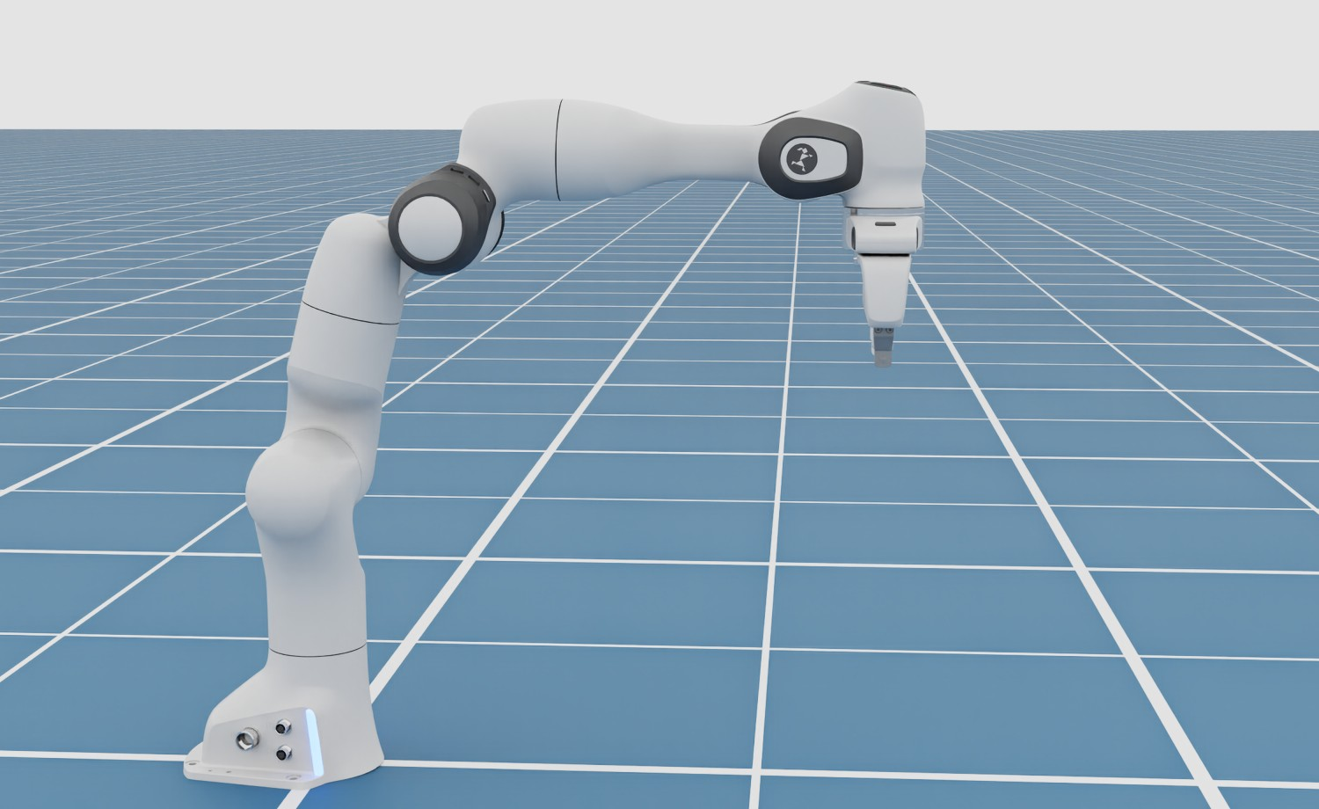
Robot Dynamics
TOPIC 4
Forward and inverse dynamics: from torques to motion, and back
Notes:
Kinematics told us WHERE the joints must be. Dynamics asks HOW HARD the motors must work to get there, and what happens when forces act on the robot. This arm is floating with no position control at all: its motors give exactly the torque that cancels gravity. By the end you will know how that torque is computed.

Slide 2
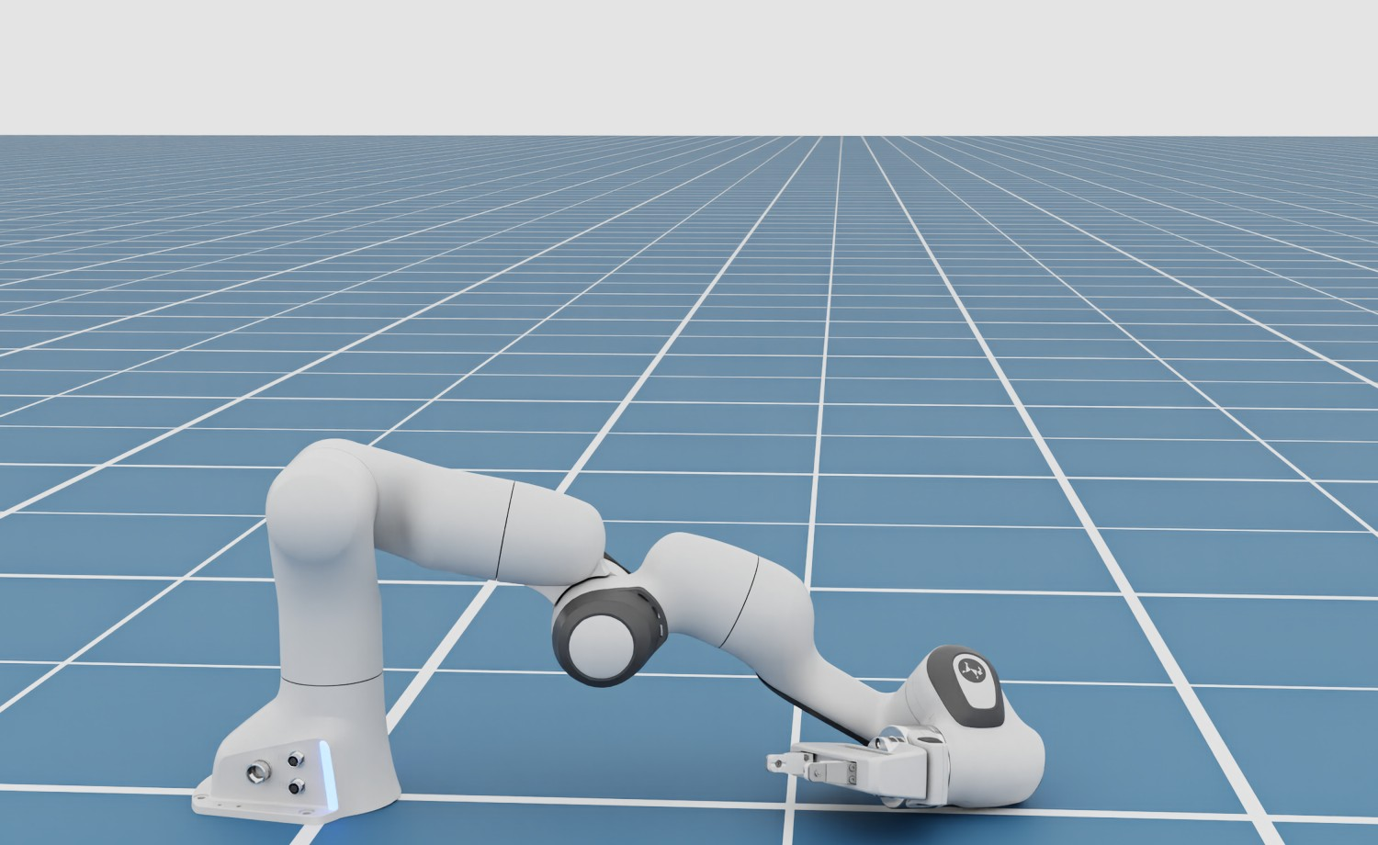
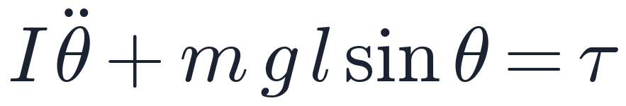
Kinematics said where. Dynamics says how hard
Kinematics (topic 3)
joint angles ↔ hand position. Pure geometry, no mass, no forces
Dynamics (today)
torques ↔ motion. Mass, inertia, gravity and the motors' effort
One joint: Newton's second law, for rotation
Motors off (τ = 0): gravity wins
inertia × angular acceleration + gravity torque = motor torque
Notes:
Kinematics only dealt with geometry: which joint angles put the hand where. It never asked whether the motors are strong enough, or what happens if they switch off. Dynamics adds mass and forces. For a single joint it is just Newton's F = m a for rotation: the inertia times the angular acceleration, plus the torque gravity creates, equals the torque the motor applies. Switch the motor off, tau becomes zero, and gravity alone decides the motion: the arm on the right collapsed to the floor.

Slide 3
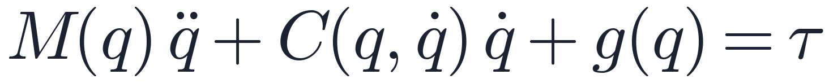
The equation of motion
M(q) q̈
C(q, q̇) q̇
g(q)
τ
Inertia
Coriolis & centrifugal
Gravity
Motor torques
Mass matrix × joint accelerations. M changes with the arm's pose
Appear when several joints move at once; grow with speed²
Torque needed just to hold the arm up. Depends on pose only
What the actuators apply: one number per joint
q = joint angles, q̇ = velocities, q̈ = accelerations. One row per joint: 2 for our 2-link arm, 7 for the Franka, 30+ for a humanoid
Notes:
This is the same F = m a, written for a whole robot. q is the list of joint angles, one per joint. Read it left to right. Inertia: the mass matrix times the joint accelerations; the matrix depends on the pose, because a stretched-out arm is harder to swing than a folded one. Coriolis and centrifugal terms: extra forces that appear when several joints move at the same time; they grow with speed squared, so they matter in fast moves. Gravity: the torque needed just to hold the arm still in a pose. On the right, tau: what the motors apply. Every robot simulator and every torque controller is built on this one line.

Slide 4


One equation, two questions
Forward dynamics Given these torques, how will the robot move?
Torques τ
what we apply
Motion
integrate q̈ → q̇ → q
Used by
simulators like Isaac Sim
Inverse dynamics To move like this, what torques do I need?
Motion
q, q̇, q̈ wanted
Torques τ
for the motors
Used by
controllers, motor sizing
Forward: solve and integrate, step after step. Inverse: one direct evaluation, fast enough for 1 kHz control loops
Notes:
Exactly like kinematics, dynamics comes in two directions, and it is the same equation read two ways. Forward dynamics: we know the torques and ask how the robot will move. Solve the equation for the accelerations, then integrate over time to get velocities and angles. That is what a physics simulator such as Isaac Sim's PhysX does thousands of times a second. Inverse dynamics: we know the motion we want, the angles, velocities and accelerations, and ask which torques produce it. Just plug in and multiply, no integration. That is what a torque controller does every millisecond, and what engineers use to size motors.

Slide 5
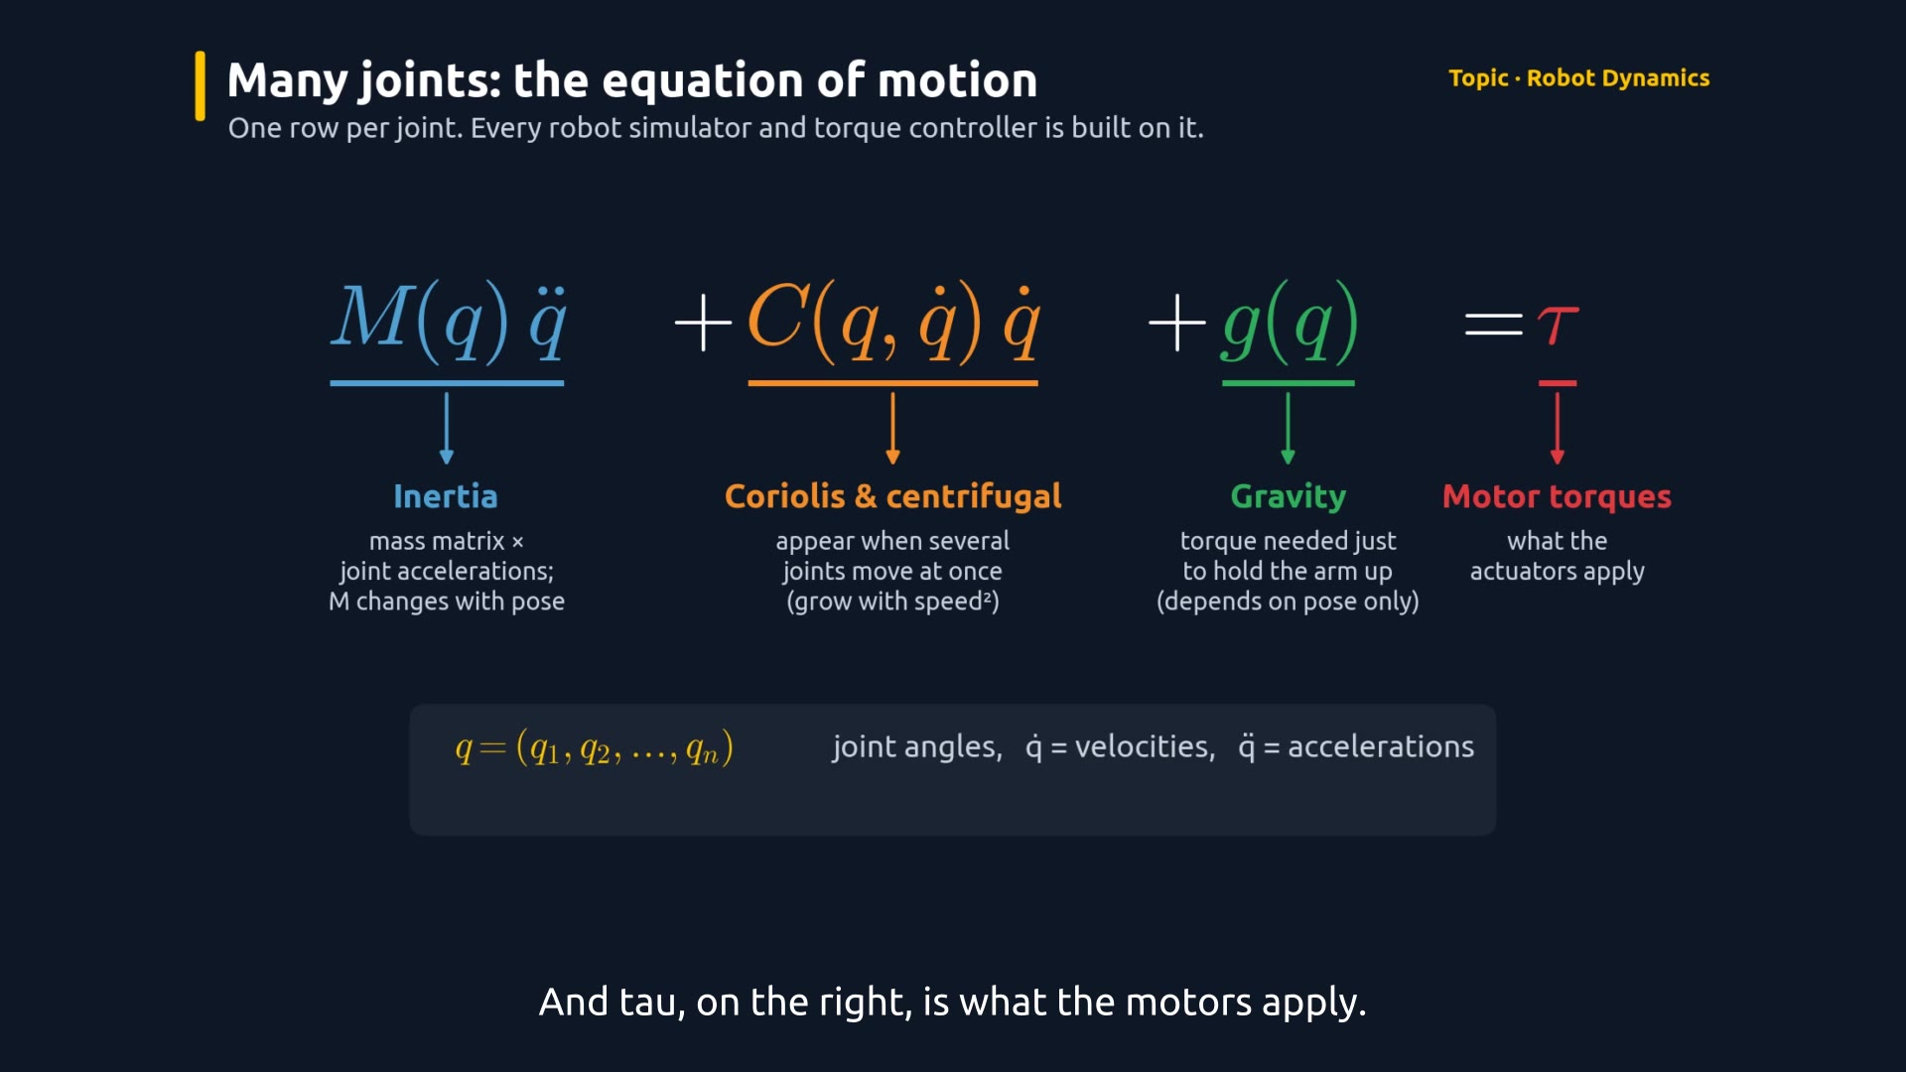
The maths, animated
Watch for
0:00 One joint: F = m a
0:26 Equation, term by term
0:58 Forward vs inverse
1:26 Forward: motors off, it falls
1:52 Inverse: torques for a circle
2:09 2× speed: inertia ×4
2:26 The control loop
Click the video to play
Notes:
This animation walks through the maths on a two-joint arm simulated with exactly the equation on the previous slides. First a pendulum, then the full equation term by term. In the forward-dynamics part the motors are off: the simulator only solves for the acceleration and integrates, and the arm falls and swings chaotically. In the inverse part we ask for a circle and compute the torques; the bar chart shows each term. Watch what happens when the circle speeds up: the inertia torque roughly quadruples, while the gravity torque stays the same because it depends only on the pose.

Slide 6
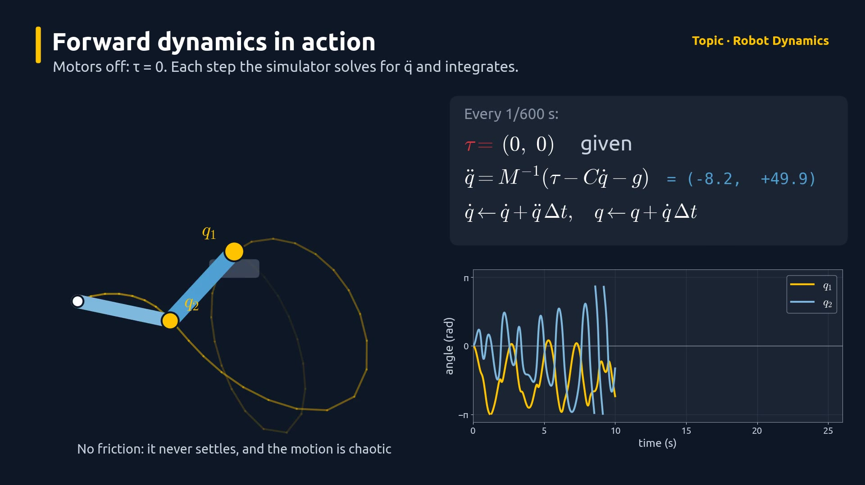
Faster moves cost more
2× speed
around the same circle
≈ 4×
the inertia torque (q̈ grows with speed²); gravity torque unchanged
Notes:
Acceleration around a circle grows with the square of the speed, so doubling the speed needs about four times the inertia torque. Gravity torque depends only on where the arm is, not how fast it moves, so it does not change. This is why fast robots need bigger motors and why motion planners limit acceleration.

Slide 7
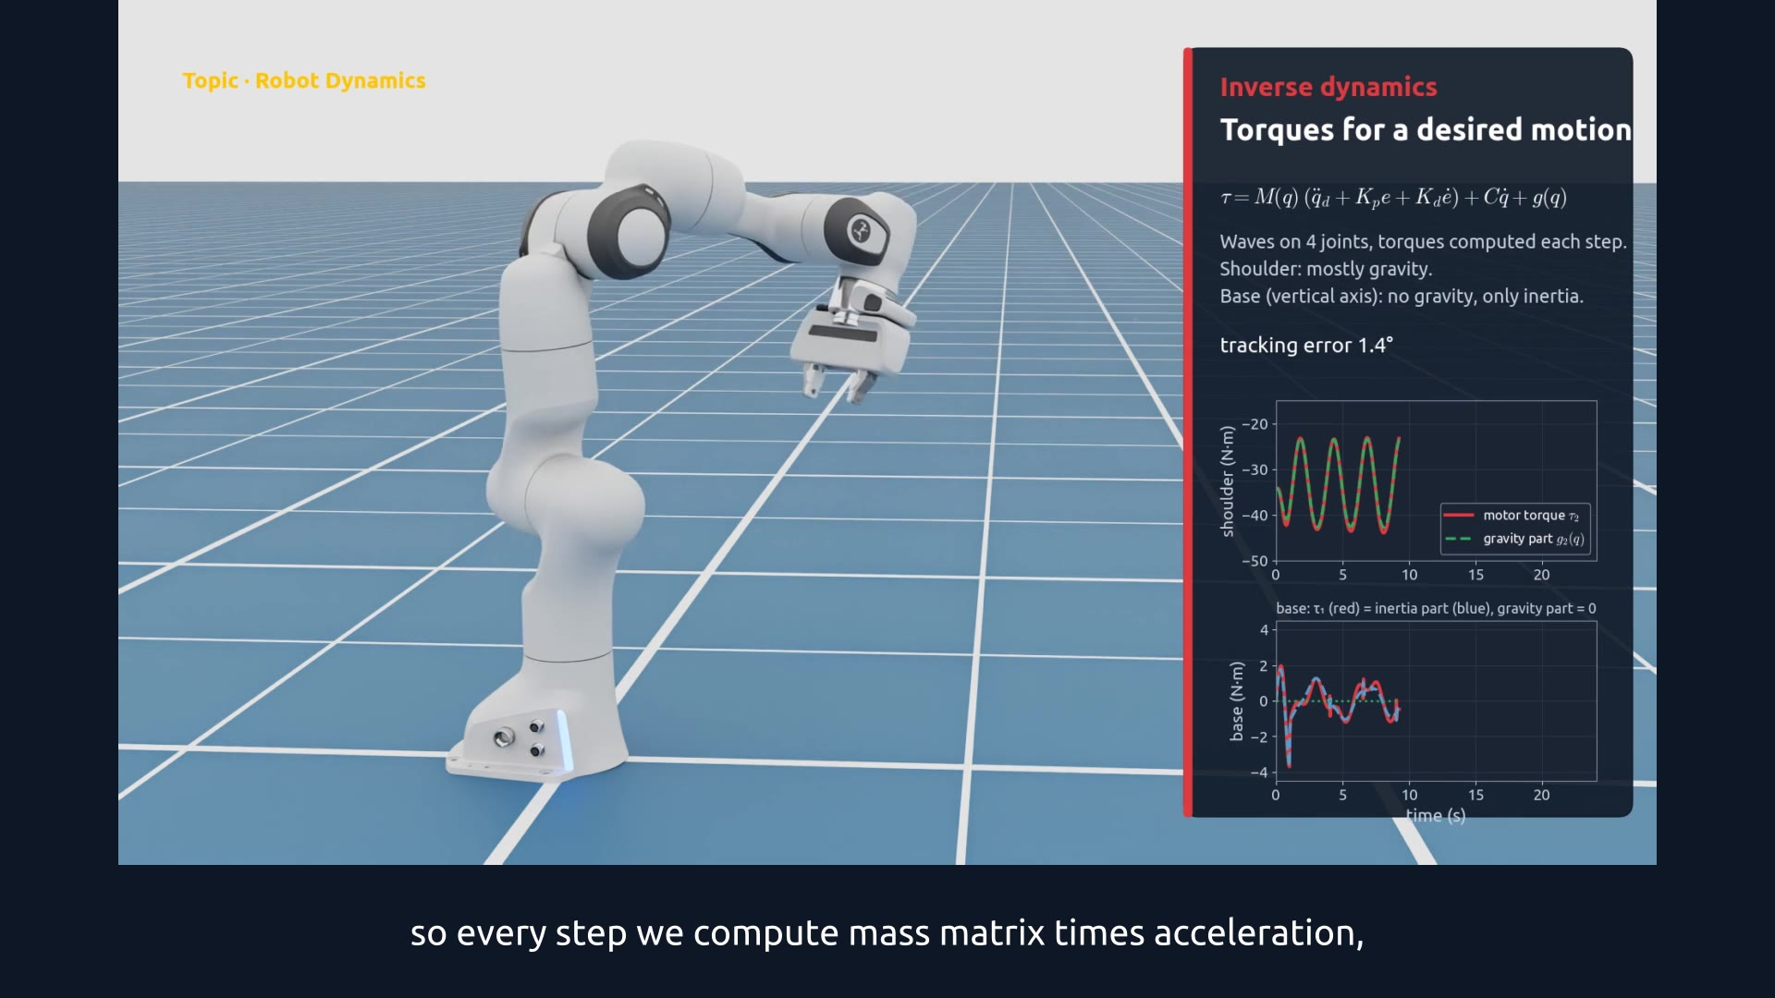
Demo: torque-controlled Franka in Isaac Sim
Watch for
0:09 τ = 0: forward dynamics, it falls
0:19 τ = g(q): it floats
0:36 Computed torque: tracks a wave
0:52 Base joint: inertia only
Click the video to play
Notes:
Now the real 7-joint Franka model in Isaac Sim. We switched off its position controllers and command raw motor torques every 1/120 s. Take one: zero torque. PhysX does forward dynamics and the arm collapses. Take two: we ask Isaac Sim for g(q), the gravity term of the equation, and apply exactly that. Nothing holds the angles in place, yet the arm floats: the shoulder needs about 34 newton-metres. Take three: the full inverse dynamics, computed-torque control, follows a wave on four joints. The plots show the shoulder torque is almost all gravity, while the base joint, which rotates about a vertical axis, has zero gravity torque: everything it needs is inertia.

Slide 8
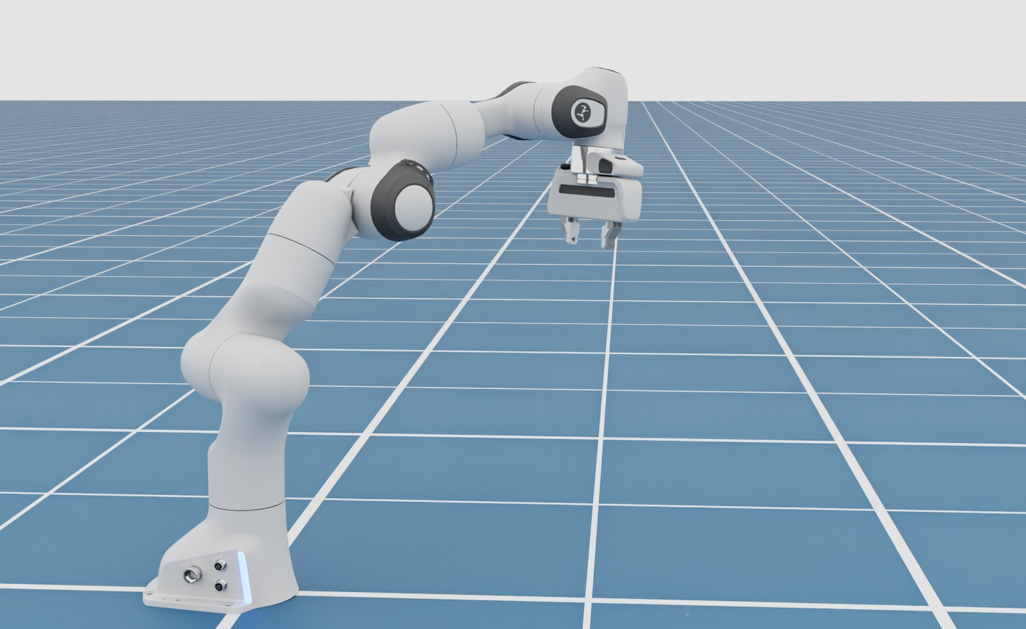
Three torque commands, three outcomes
1
τ = 0
2
τ = g(q)
3
τ = M q̈ + C q̇ + g
Forward dynamics: falls
Holds still: floats
Follows the wave
Notes:
Same robot, same simulator, only the torque formula changes. With zero torque the simulator's forward dynamics lets it fall. With the gravity term it holds any pose: the joint angles drifted less than 0.2 degrees in twelve seconds. With the full inverse dynamics plus a little feedback it follows the desired motion, within about 4 degrees at the fastest moments.

Slide 9


Both directions, in one loop
Desired motion
q, q̇, q̈ from the planner
Controller
inverse dynamics: motion → τ
Robot / simulator
forward dynamics: τ → motion
sensors measure q, q̇ and send them back to the controller
Gravity compensation
τ = g(q): cobots feel weightless to hand-guide
Fast moves cost more
Inertia torque grows with acceleration
Notes:
In a real robot both directions run together. The planner says what motion we want. The controller uses inverse dynamics to turn it into torques. The robot, or the simulator standing in for it, is forward dynamics: physics answering back with the actual motion. Sensors close the loop. Two practical consequences: gravity compensation lets collaborative robots feel weightless so people can push them around by hand, and fast moves need disproportionately more torque.

Slide 10
Forward: torques → motion. Inverse: motion → torques
TAKEAWAY
Simulators run forward dynamics; controllers run inverse dynamics.
Notes:
Recap: one equation of motion, read two ways. Forward dynamics predicts motion from torques, which is what Isaac Sim does. Inverse dynamics computes the torques a motion needs, which is what controllers do. Next, contact: what happens when the robot touches the world.

