Slide 1
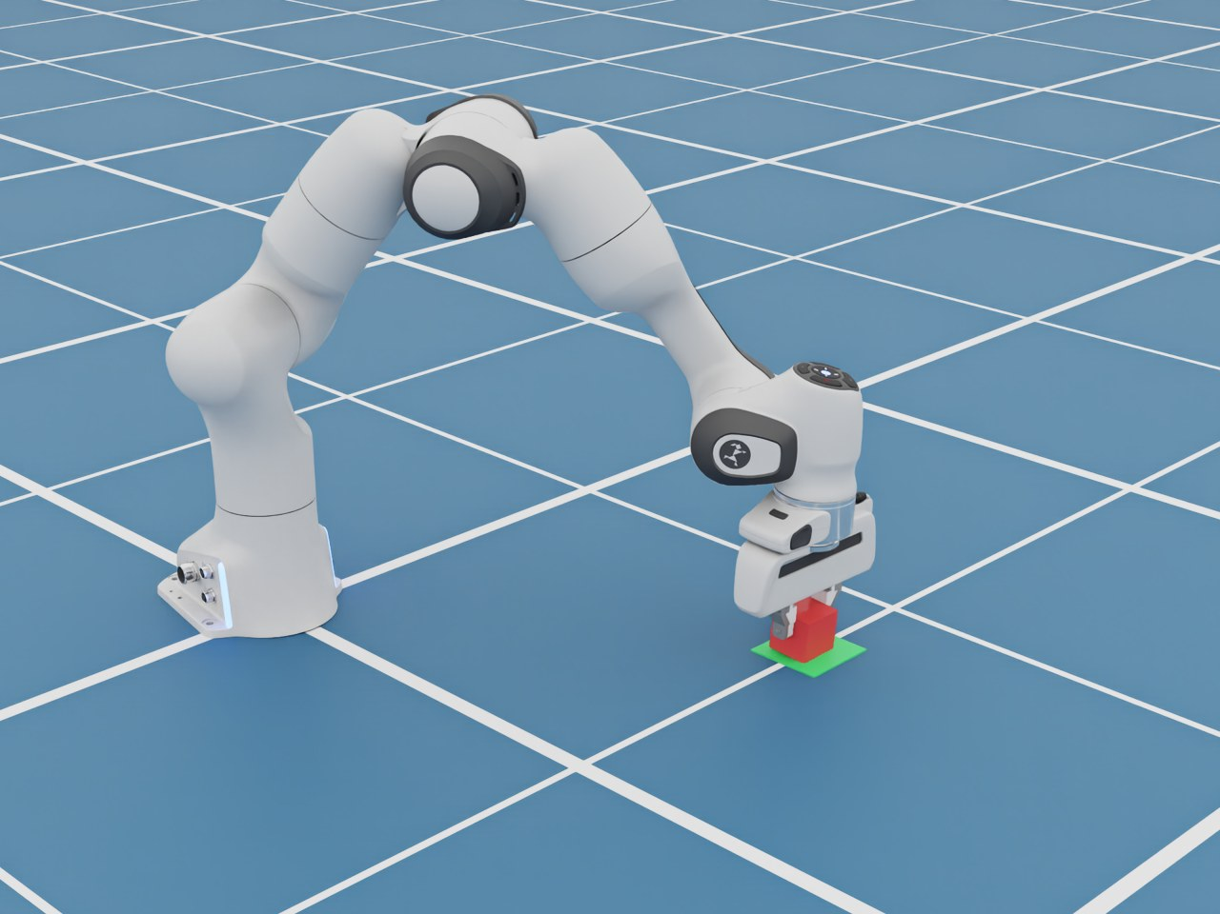
Contact Mechanics & Friction
TOPIC 9
Why a grasped object stays put, and when it slips
Notes:
Planning gets the gripper to the object. Now the hand touches it, and physics takes over: contact forces and friction decide whether the object comes along.

Slide 2
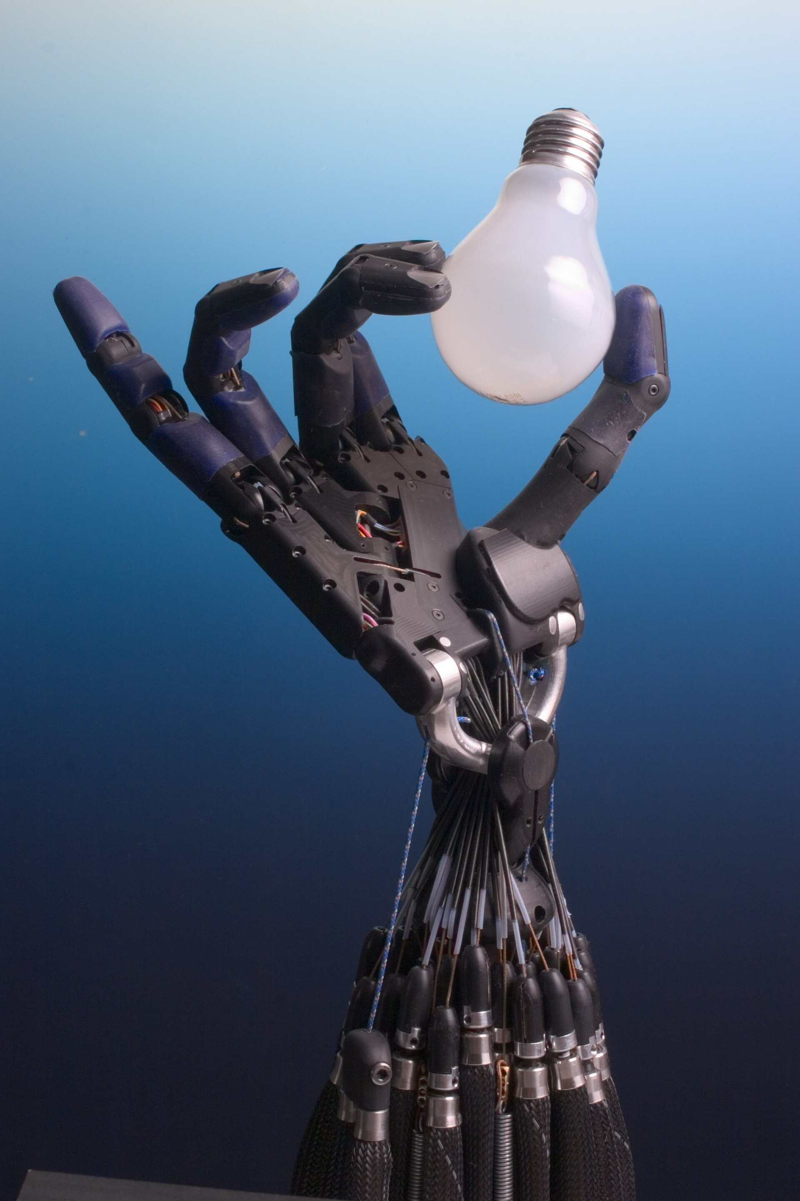
Holding = squeeze + friction
Too loose: it slips
Too tight: it breaks
Robots need the right balance
Photo: Richard Greenhill & Hugo Elias, Shadow Robot Co. · CC BY-SA 3.0 · Wikimedia Commons
Notes:
A robot hand holding a light bulb: squeeze too hard and it shatters, too gently and it slides out. People do this balance without thinking; robots need it modelled or sensed.

Slide 3
What holds the cube up?
Holds if
friction ≥ weight
squeeze
friction
squeeze
friction ≤ μ × squeeze
μ (“mu”) = how grippy the two surfaces are
weight
Notes:
The fingers squeeze the cube from both sides. That squeeze (the normal force) does not lift anything by itself, but it lets friction act along the surfaces, pointing up. Friction can grow only up to mu times the squeeze. If that maximum is less than the weight, plus extra force when the arm accelerates, the cube slides. Mu depends on both materials: rubber on dry wood is high, anything wet or oily is low.

Slide 4
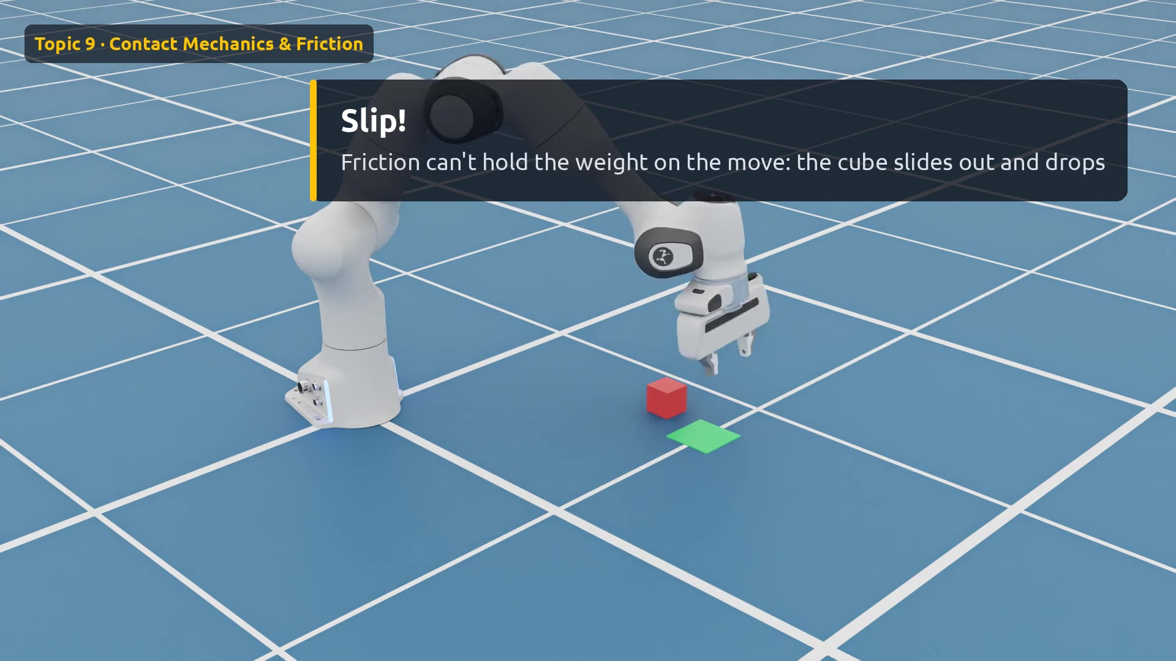
Demo: same grip, less friction
Watch for
0:00 Only the surface changes
0:03 μ = 1.0: carried
0:11 μ = 0.3: wet surface
0:15 Slip! The cube drops
0:21 Slow-motion replay
Click the video to play
Notes:
Two takes with identical robot code, identical squeeze and identical motion. The only change is the friction coefficient of the cube, from 1.0 to 0.3. In the second take the cube lifts, then slides out as the arm speeds up. Watch the slow-motion replay at the end.

Slide 5
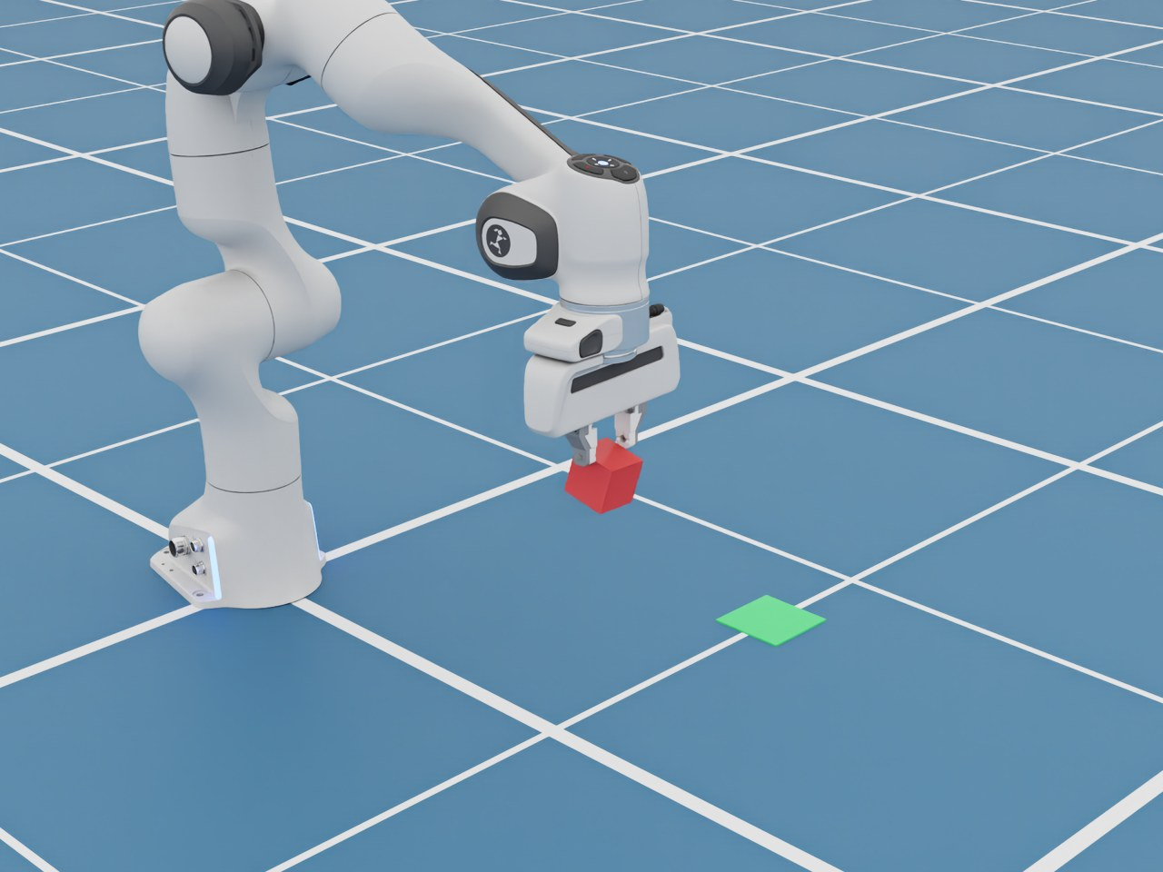
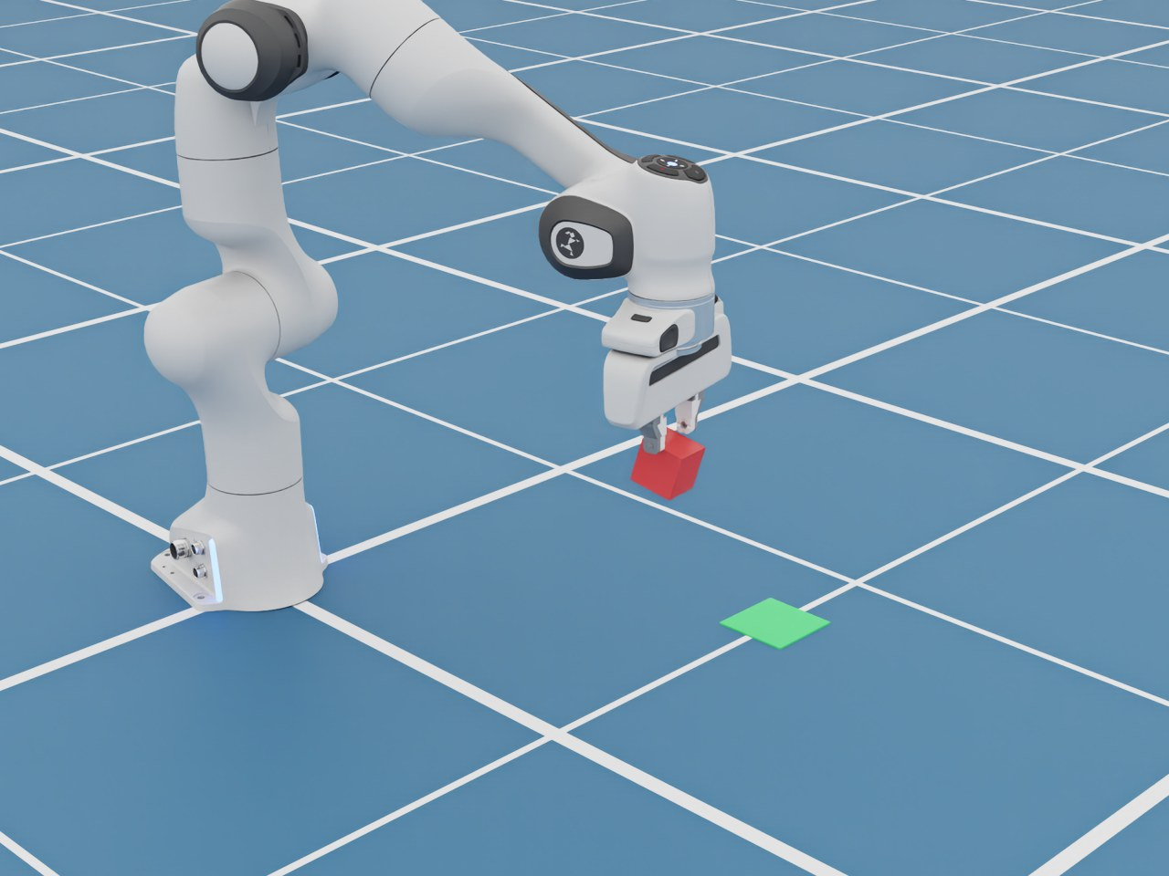
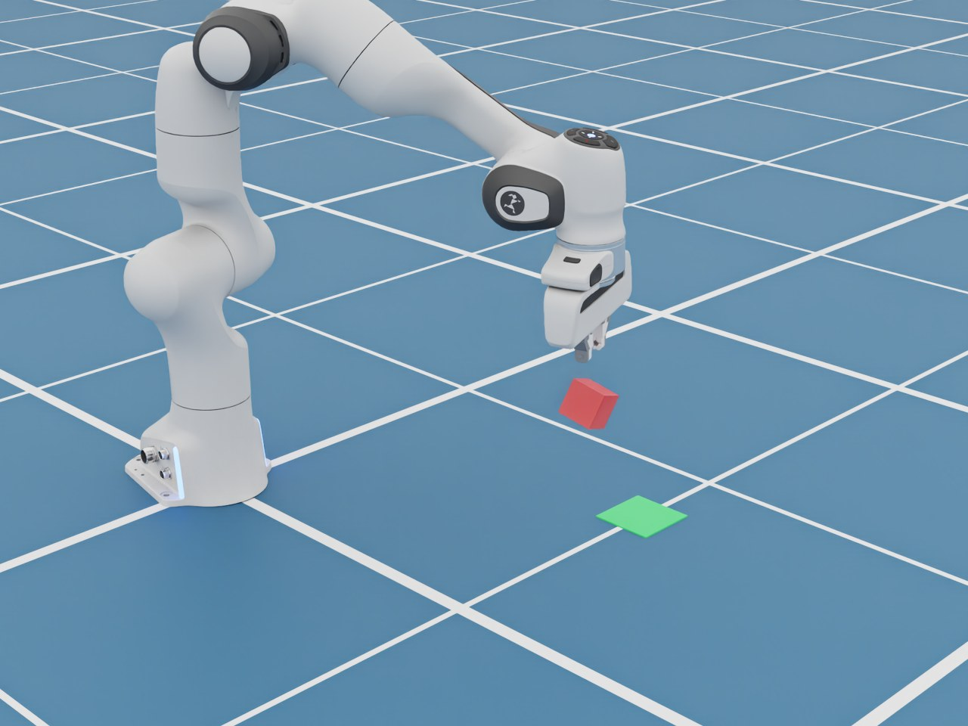
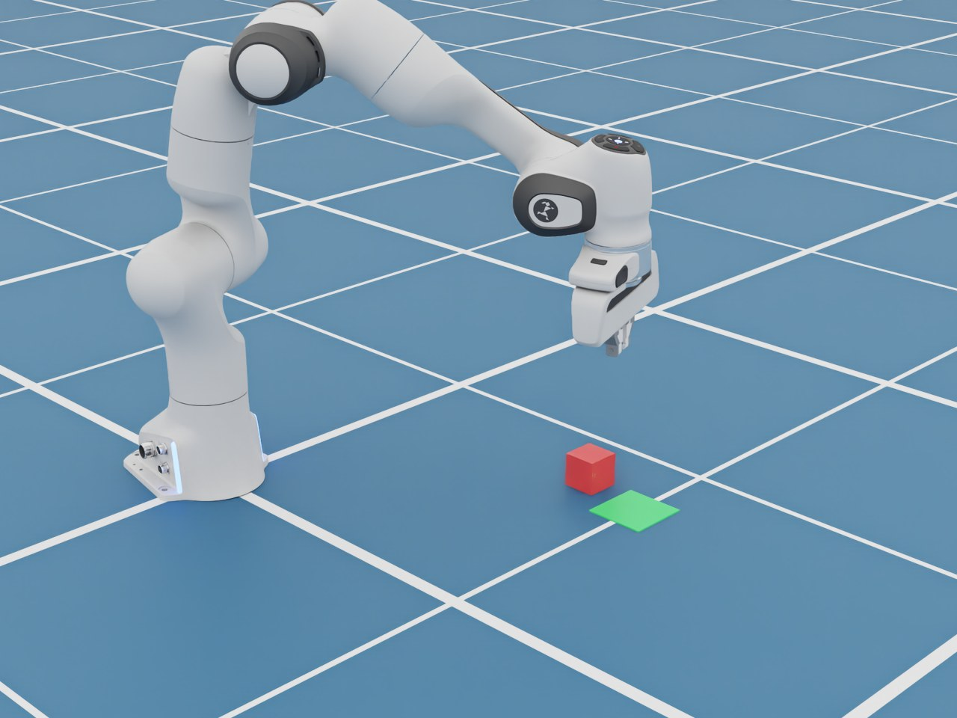
μ = 0.3: the slip, frame by frame
1
Held
2
Tilting
3
Sliding out
4
Dropped
Notes:
These frames are a fraction of a second apart. Lifting slowly works, but as the arm accelerates sideways the cube needs more friction than mu = 0.3 can provide. It rotates in the fingers, slides out, and falls short of the green pad.

Slide 6
How grippy is it?
Our slip take
Our grip take
0.0
0.5
1.0
Ice
Wet / oily
Wood on wood
Rubber
Values are rough, for intuition only
Notes:
Rough friction coefficients for intuition: ice is around 0.05, wet or oily surfaces around 0.3, dry wood about 0.5, rubber on a dry surface around 1. Our two demo takes sit at 0.3 and 1.0. Real values depend on both surfaces, so treat these as ballpark numbers.

Slide 7
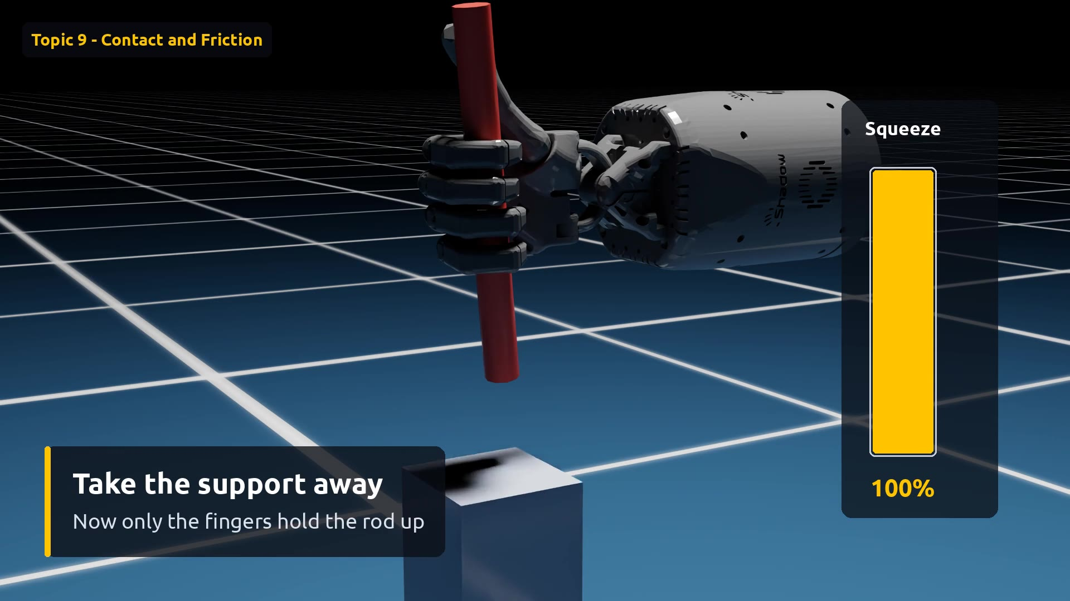
Demo: a human-like hand, squeezing less
Watch for
0:00 Five-finger Shadow Hand
0:01 Fingers close on the rod
0:04 Support removed
0:07 Squeeze fades
0:10 Starts to slide
0:14 Slow-motion replay
Click the video to play
Notes:
Same lesson, now with a human-like hand: the Shadow Hand, 24 joints. The finger motions are scripted, not AI. Once the stand drops away, only friction between fingers and rod holds the rod up. Then we slowly turn down how hard the finger motors may squeeze; the meter on the right shows it. The friction coefficient never changes. Friction grows with squeeze, so at about 1.4 percent of full squeeze, friction falls below the rod's weight and it slides down onto the stand. Behind the scenes: while the fingers close, the rod is made temporarily heavy so the fingers cannot knock it over; it gets its real weight, 250 grams, before the stand drops.

Slide 8
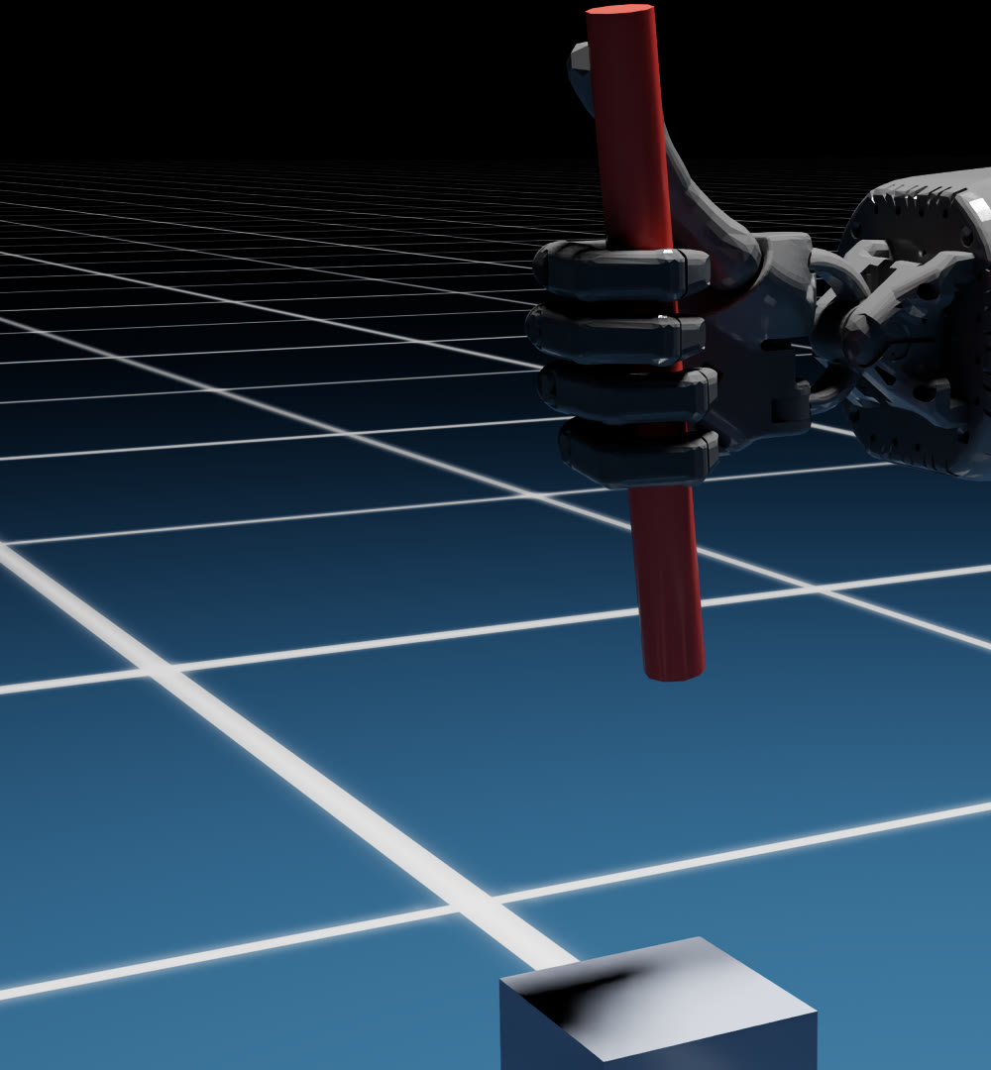

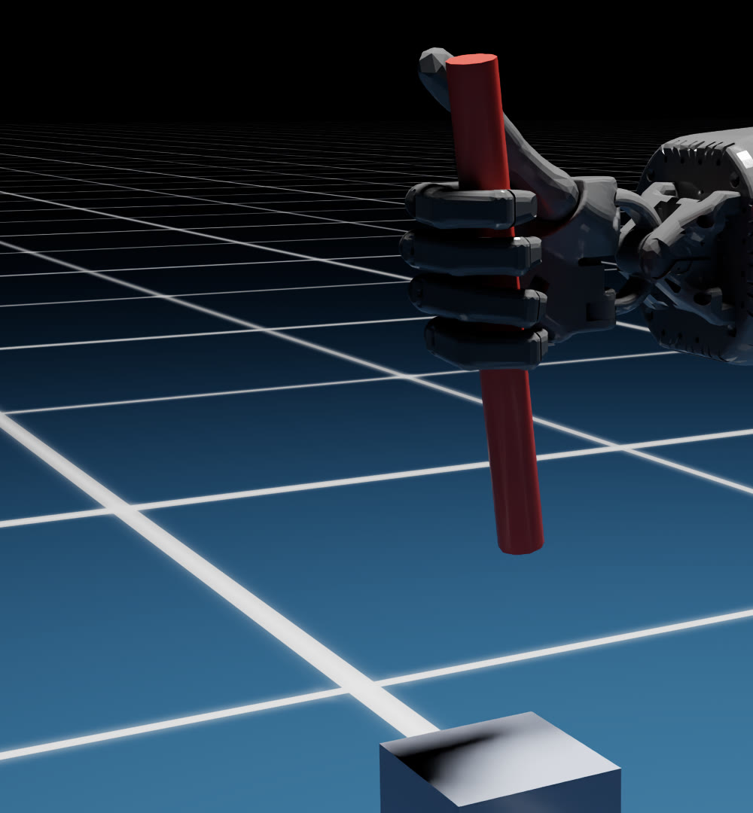
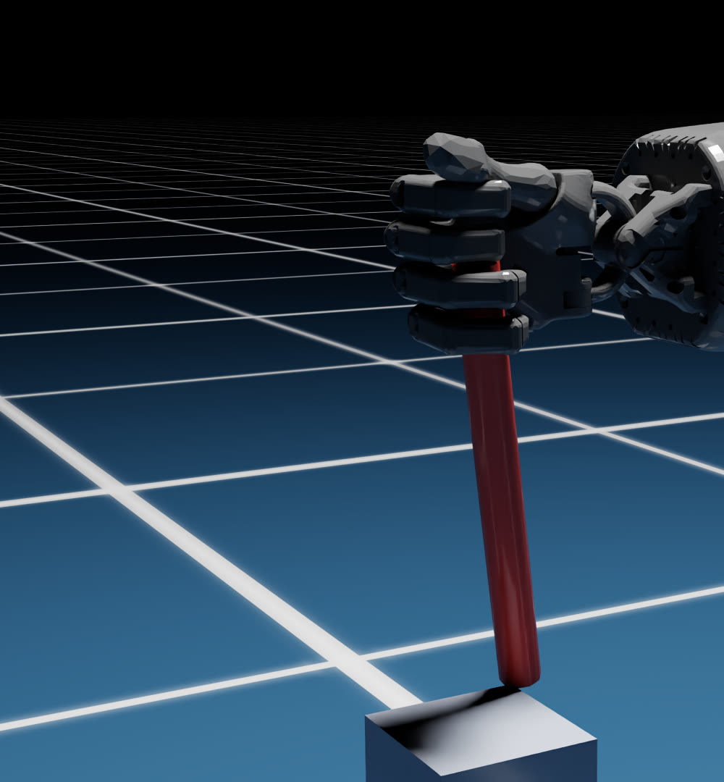
Same friction, less squeeze
1
100%
2
18%
3
1.4%
4
1%
Held
Still held
Sliding
Slipped
Notes:
Squeeze is shown as a percentage of the hand's full grip. The robot hand is far stronger than this light rod needs, so it holds until the squeeze is almost gone. Then friction (mu times squeeze) drops below the weight and the rod slides. The topic 3 Franka demo changed friction; this one changes squeeze. Both are terms of the same equation.

Slide 9
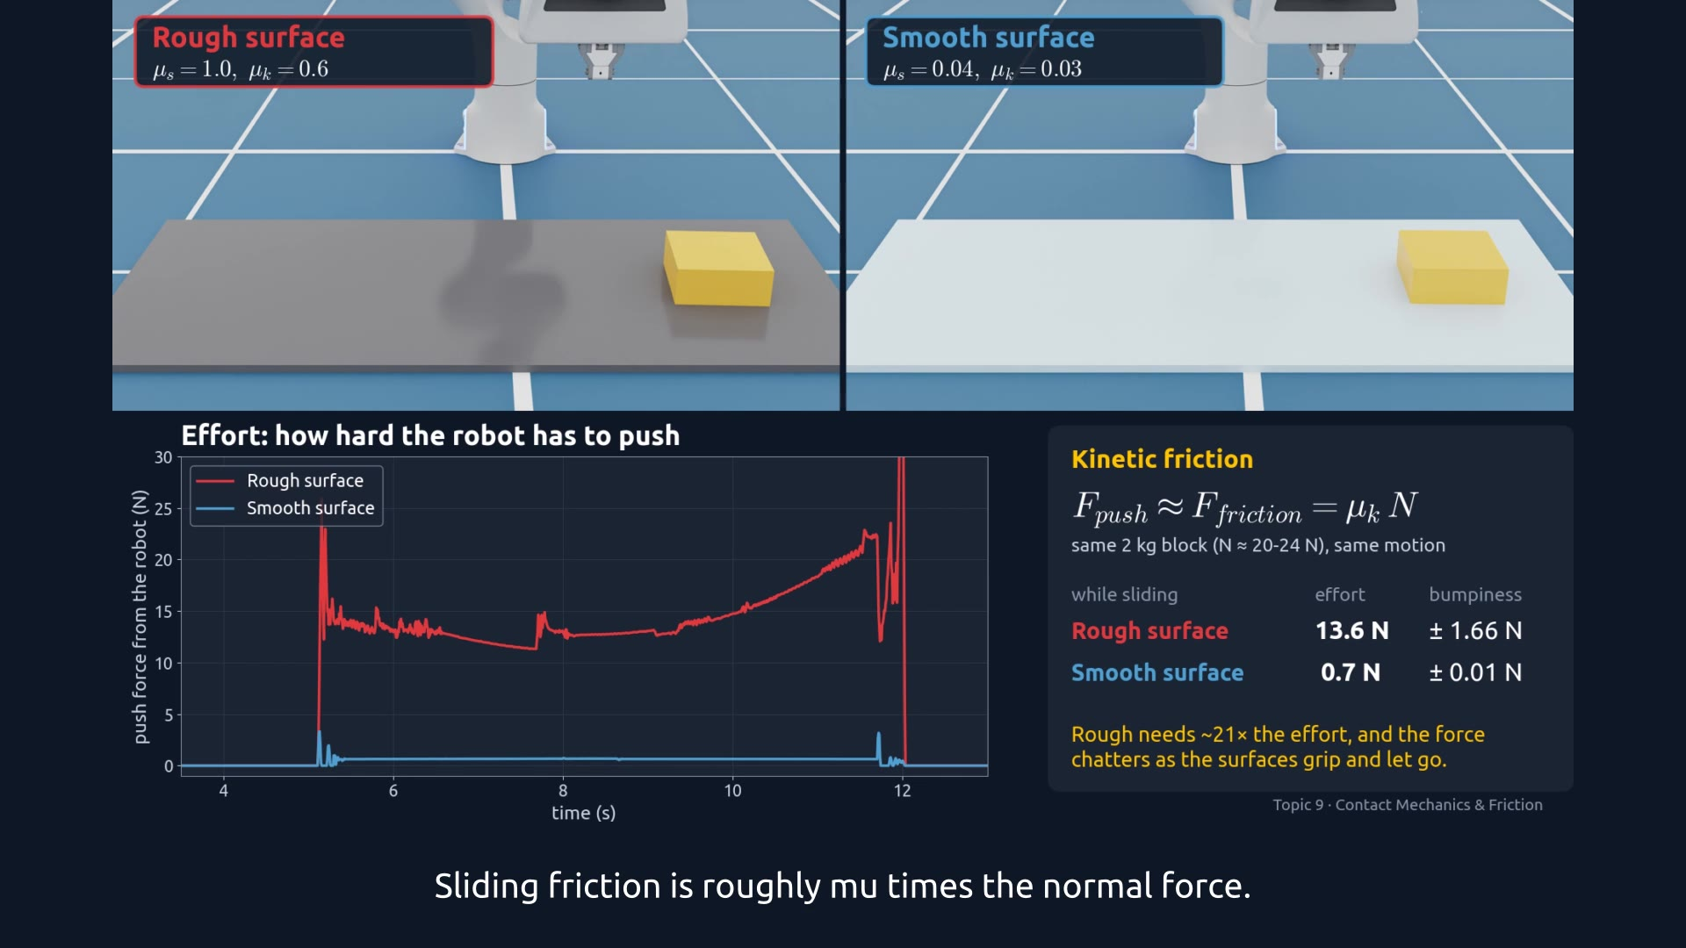
Demo: pushing on rough vs smooth
Watch for
0:00 Same block, same push
0:11 Rough: big, bumpy force
0:17 Smooth: tiny, steady force
0:27 Effort and bumpiness compared
0:38 Stick-slip
Click the video to play
Notes:
Now friction working against the robot. The Franka pushes the same 2 kg block along the same path at the same speed, on two mats: rough, like rubber (mu about 1.0 static, 0.6 sliding), and smooth, like ice or a polished, oily surface (mu about 0.04). The graph is the force the fingers measure on the block, straight from the physics engine. On the rough mat the robot needs about 14 newtons, and the force chatters by about plus or minus 1.7 newtons as the surfaces grip and let go. On the smooth mat it needs well under 1 newton, and the curve is flat.

Slide 10
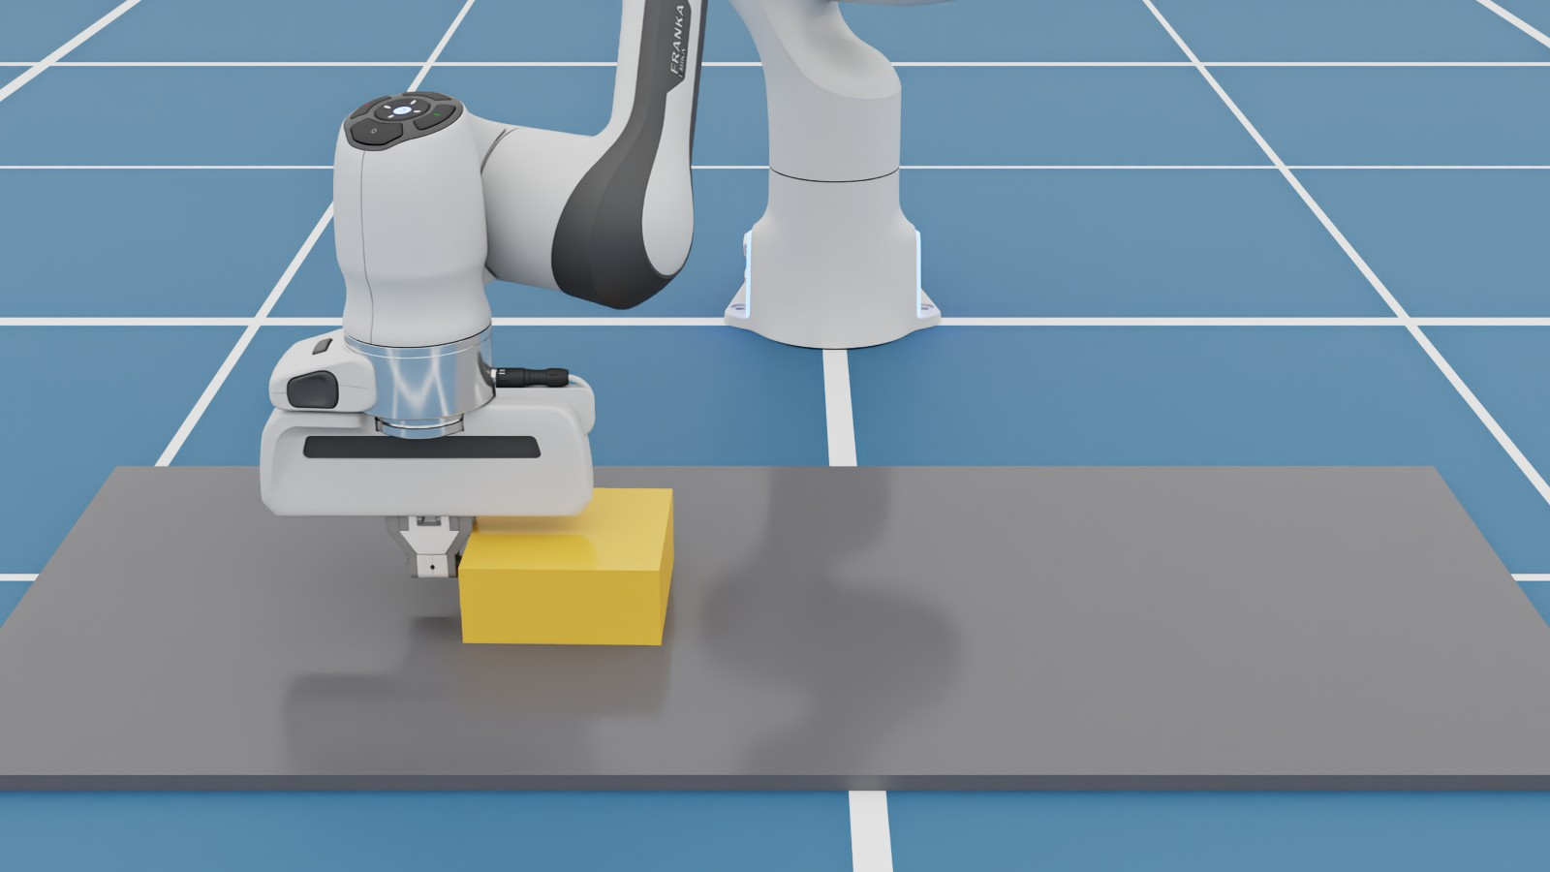
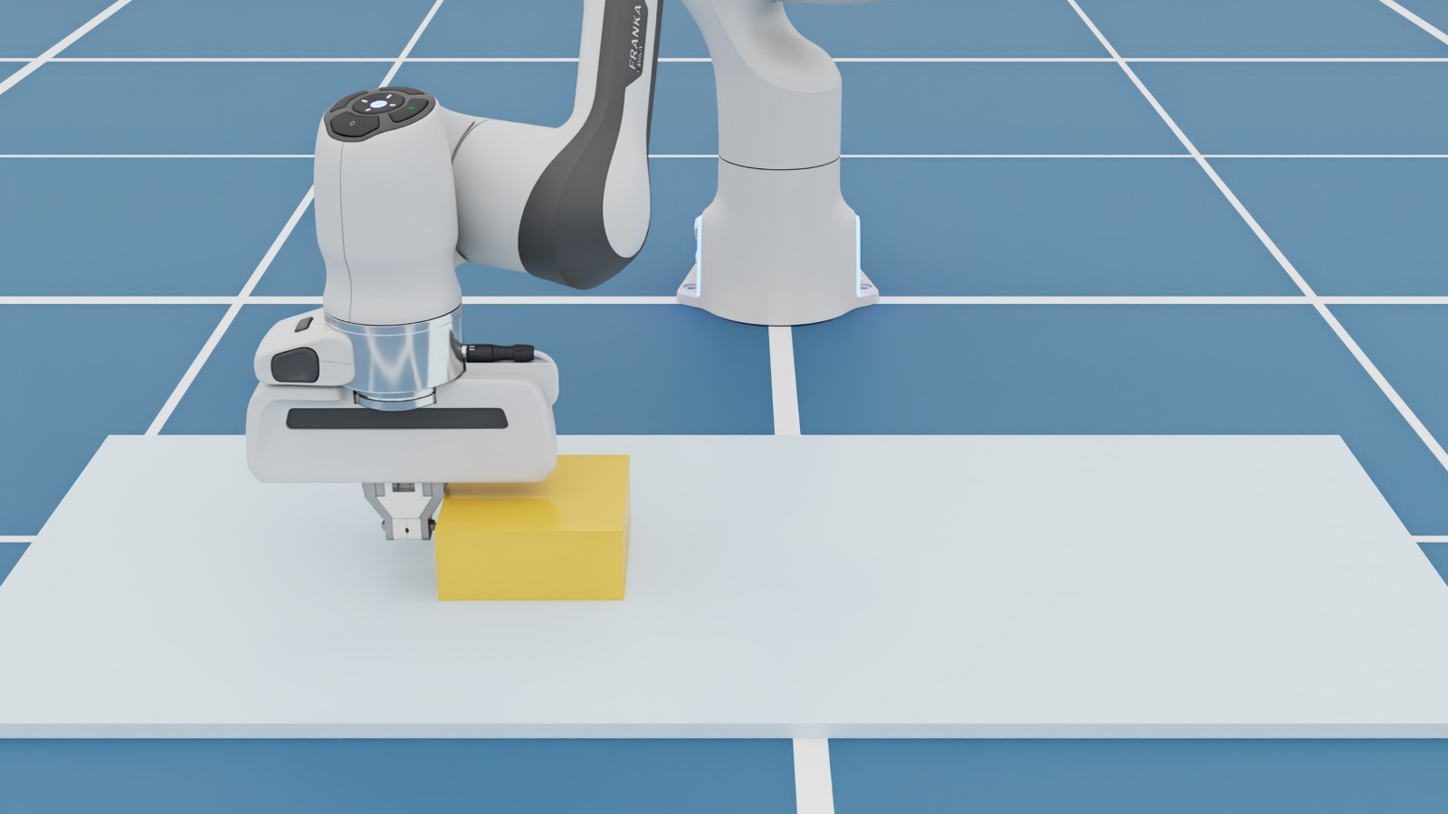
Rough costs effort, and it's bumpy
Rough
13.6 N
Sliding friction
push ≈ μ × N
push force, ripple ± 1.7 N
N ≈ the block's weight. Same block, so effort scales with μ: about 21× more on the rough mat
Smooth
0.65 N
Bumpiness: grip, let go, grip again (stick-slip)
push force, ripple ± 0.01 N
Notes:
Numbers measured in the simulation while the block was sliding. Sliding friction is roughly mu times the normal force, and the normal force is about the block's weight, 20 newtons, plus a little from the fingers pressing down. With mu 0.6 that is around 12 to 15 newtons; with mu 0.03 it is well under one. The rough surface also makes the force ripple: tiny moments of sticking and releasing, called stick-slip. That's the bumpiness you would feel pushing a box across rubber or carpet, versus gliding it on ice. For a robot: more motor effort, more vibration, and harder force control.

Slide 11




How real robots avoid slip
Soft, rubbery fingertips
Higher μ, more contact area
Squeeze harder
Up to what the object can take
Move gently
Less acceleration, less force needed
Feel the slip
Touch sensors trigger a correction
Notes:
Engineers attack every term of the equation: raise mu with soft rubber pads, raise the squeeze when the object is sturdy, lower the required force by moving gently, and add tactile sensors that detect the first micro-slip and tighten the grip. Simulators like Isaac Sim approximate contact; matching real friction is part of the 'sim-to-real' challenge.

Slide 12
Grip = squeeze × friction
TAKEAWAY
If that can't beat weight and motion, the object slips.
Notes:
Recap: the gripper's squeeze lets friction hold the object. Low friction or fast motion breaks that balance. Same robot, same code, different surface, different outcome.

