Slide 1
Capstone Project – Northwind Traders Sales Analytics

Slide 2
Overview of the Project
This project analyzes the operations of Northwind Traders, a global wholesale company, by building interactive Power BI dashboards. The analysis focuses on Sales, Customers, Employees, and Inventory, aiming to uncover business insights and support data-driven decision-making.
Objective
To create a comprehensive, user-friendly Power BI report that highlights key performance metrics such as sales trends, customer engagement, employee productivity, and inventory management — empowering stakeholders to make strategic business decisions.
Significance
Helps identify top-performing employees and products.
Improves understanding of customer behavior and segmentation.
Enhances inventory control through real-time visibility.
Supports management decisions with clear data visualization.

Slide 3
Data Dictionary –Key Analysis Areas
Analysis Type | Focus / Key Metrics | Purpose / Insights
Customer Analysis | Customer segmentation, order frequency, and revenue per customer | Identify loyal customers, understand buying behavior, and plan targeted marketing.
Order Analysis | Total orders, order volume, discounts, and shipping trends | Analyze order patterns, evaluate shipping efficiency, and track revenue contribution.
Employee Analysis | Revenue by employee, total and average orders handled | Assess performance, recognize top performers, and optimize workload distribution.
Product Analysis | Best-selling products, category trends, and stock status | Track product success, manage inventory, and ensure profitable category mix.
Supplier Analysis | Supplier contribution, stock availability, and regional supply data | Monitor supplier performance and improve procurement reliability.
Shippers Analysis | Delivery performance, and shipper utilization | Evaluate logistics partners and improve shipping cost-effectiveness.

Slide 4
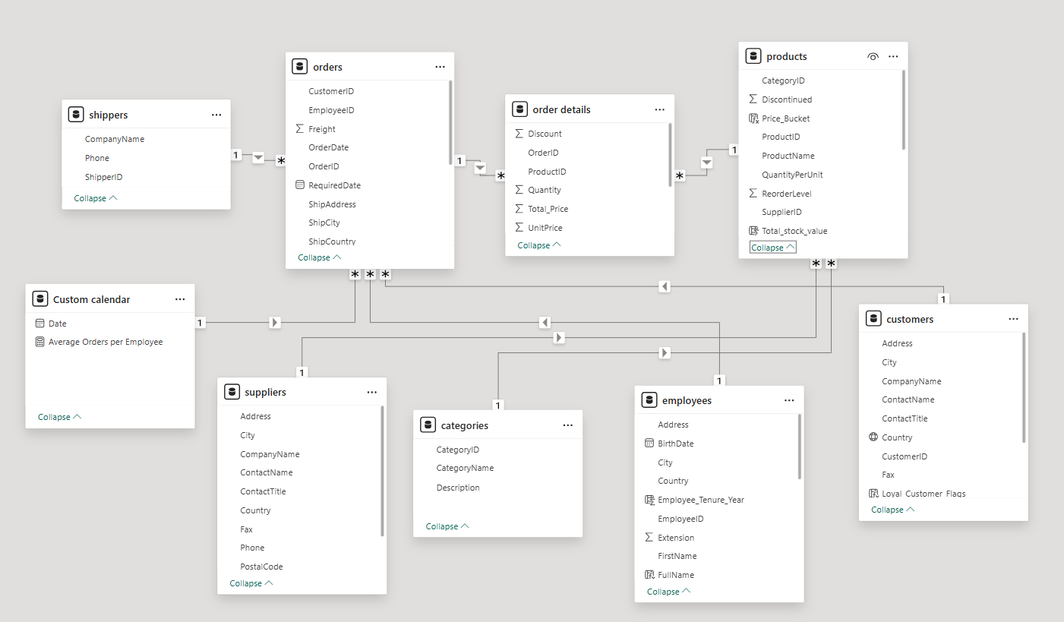
ER Diagram

Slide 5
🔗 Data Connection – Power BI
Connecting via CSV / Excel
Open Power BI Desktop → Click Get Data → Text/CSV (or Excel).
Browse and select your dataset file (e.g., Customers.csv, Orders.csv).
Preview the data and click Load.
Use Power Query to clean and transform data:
Create relationships between tables

Slide 6
🔗 Data Connection – MySQL
Connecting via Cleaned CSV Files
Open MySQL Workbench → Connect to local MySQL Server.
Create a new database → CREATE DATABASE Northwind;
Select the database → USE Northwind;
Import cleaned data files (CSV)
The data was cleaned and formatted in Excel using Power Query (removing nulls, correcting data types, standardizing formats).
Go to Server → Data Import → Table Data Import Wizard and select the cleaned CSV files (e.g., Customers.csv, Orders.csv, Products.csv).
Map columns properly and ensure correct data types (e.g., INT, VARCHAR, DATE, DECIMAL).

Slide 7

Power BI – Problem Statements with solutions and Insights

Slide 8
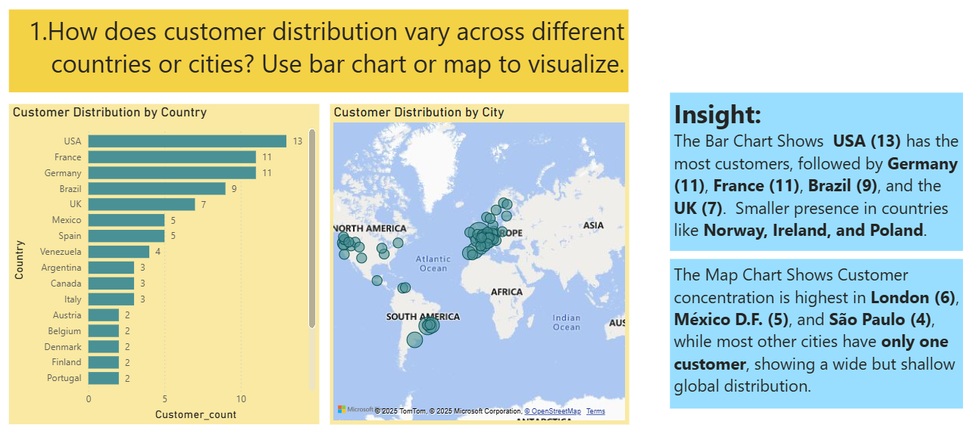

Slide 9
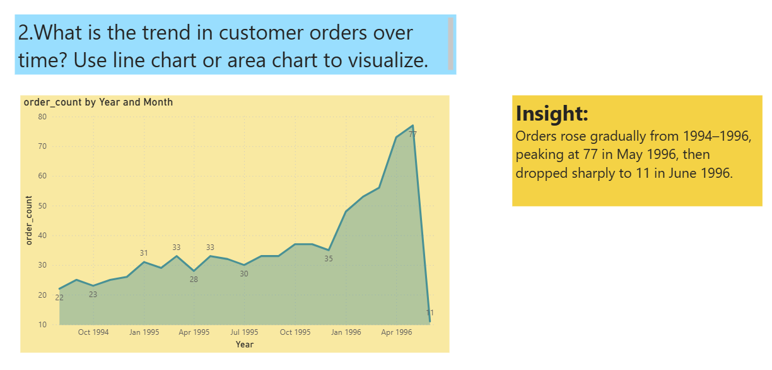

Slide 10
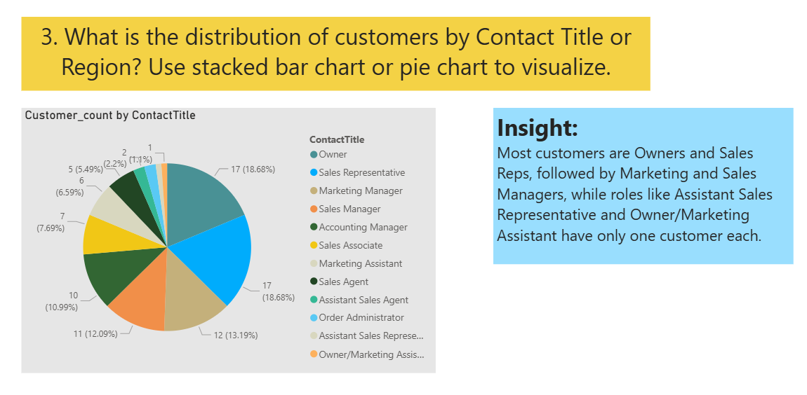

Slide 11
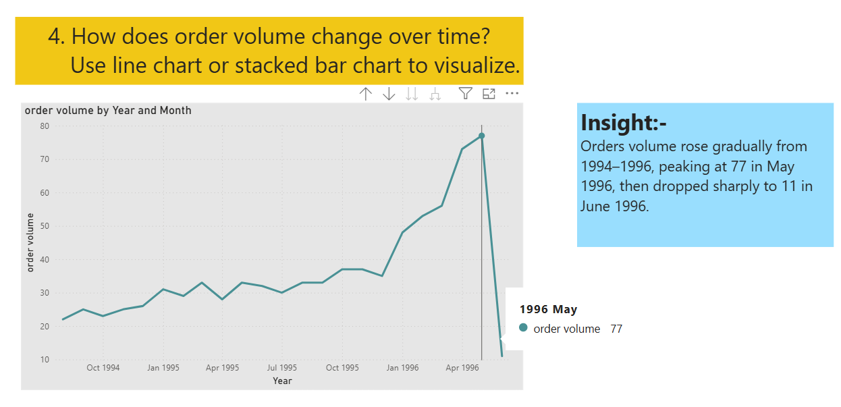

Slide 12
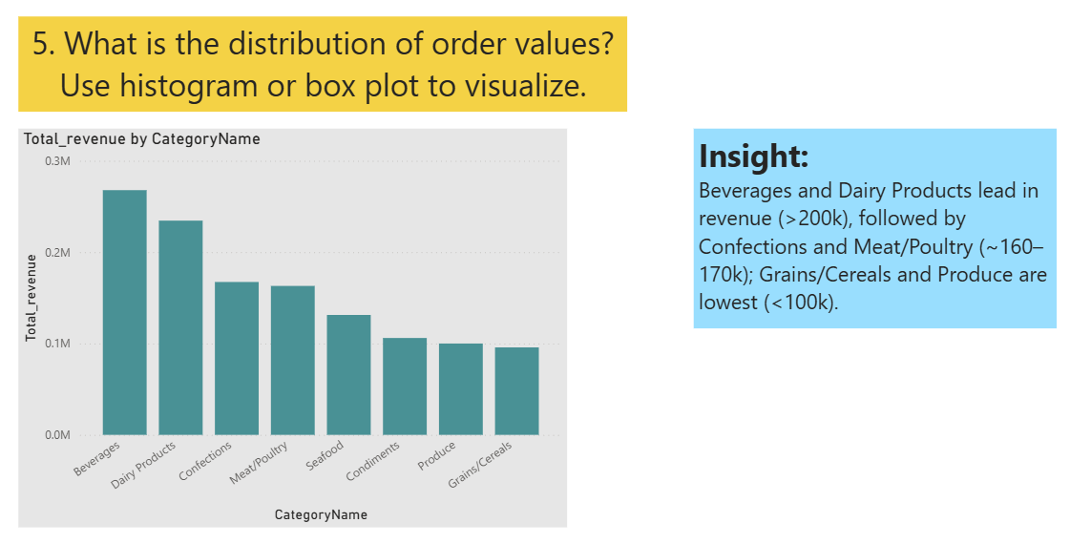

Slide 13
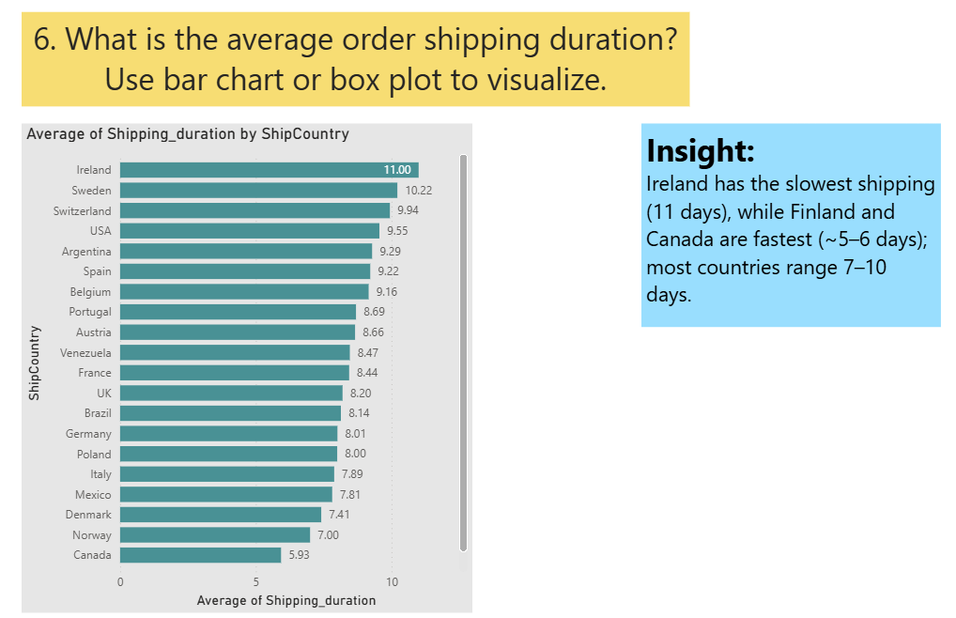

Slide 14
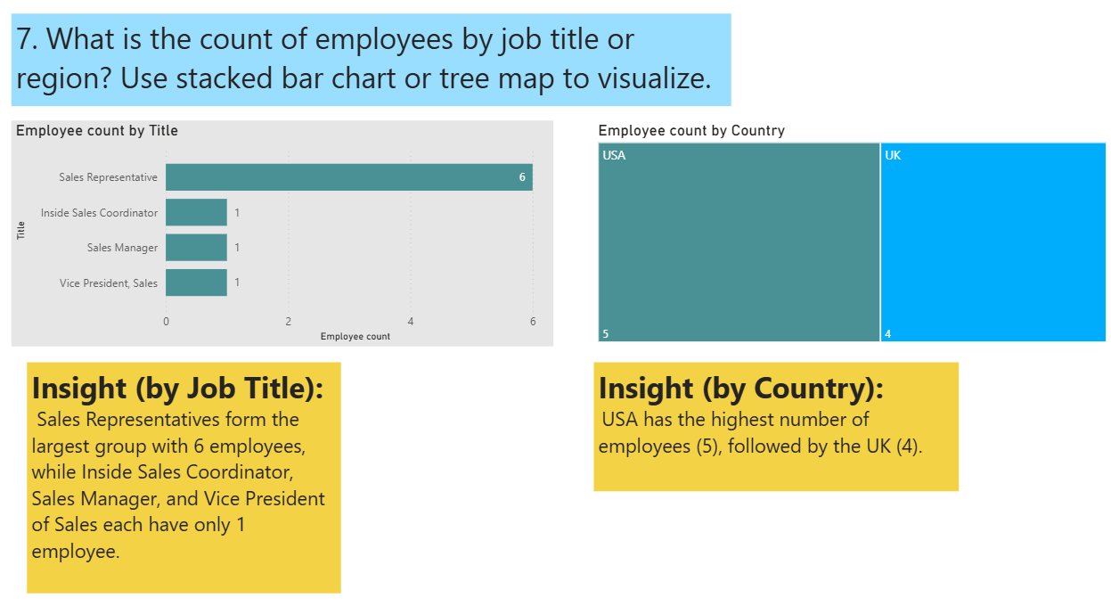

Slide 15
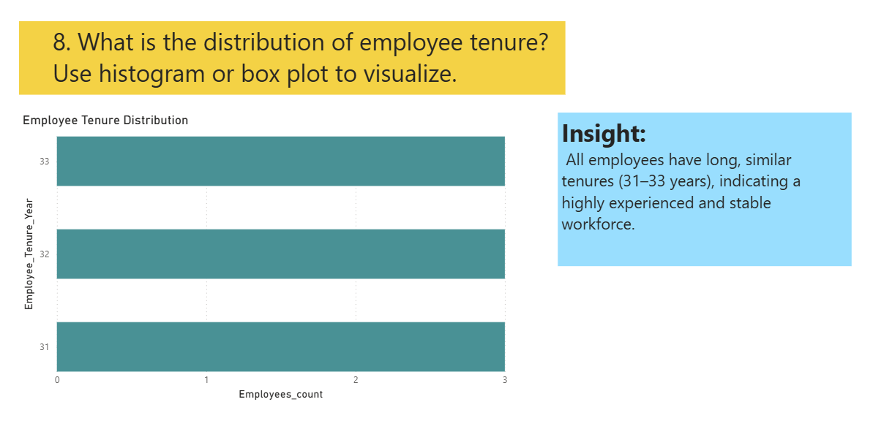

Slide 16
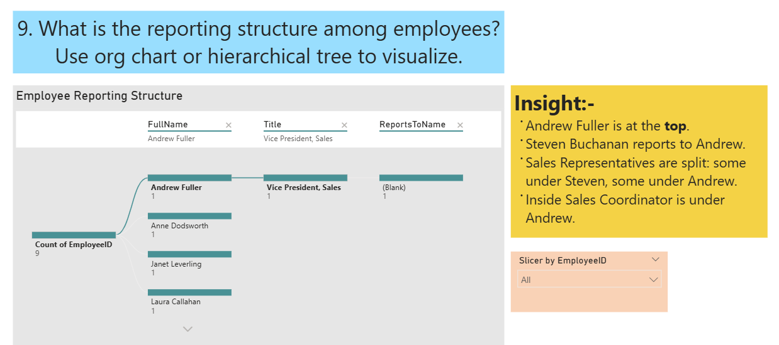

Slide 17
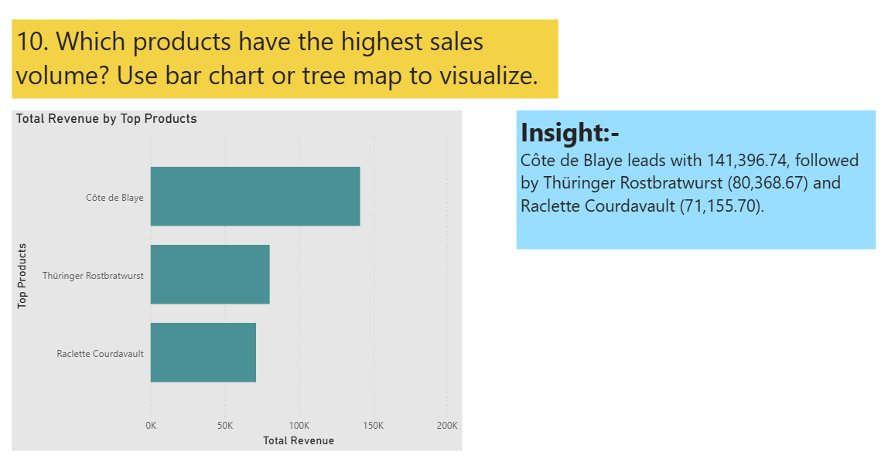

Slide 18
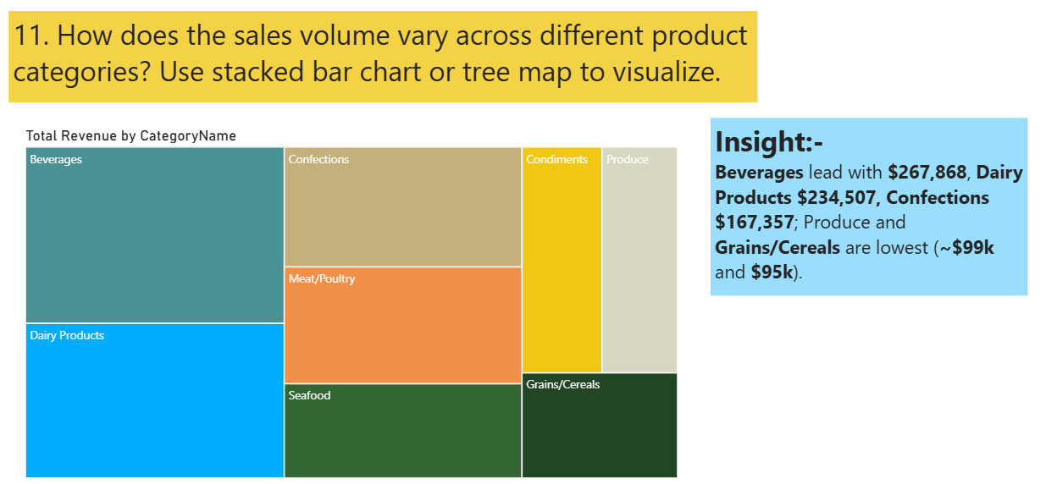

Slide 19
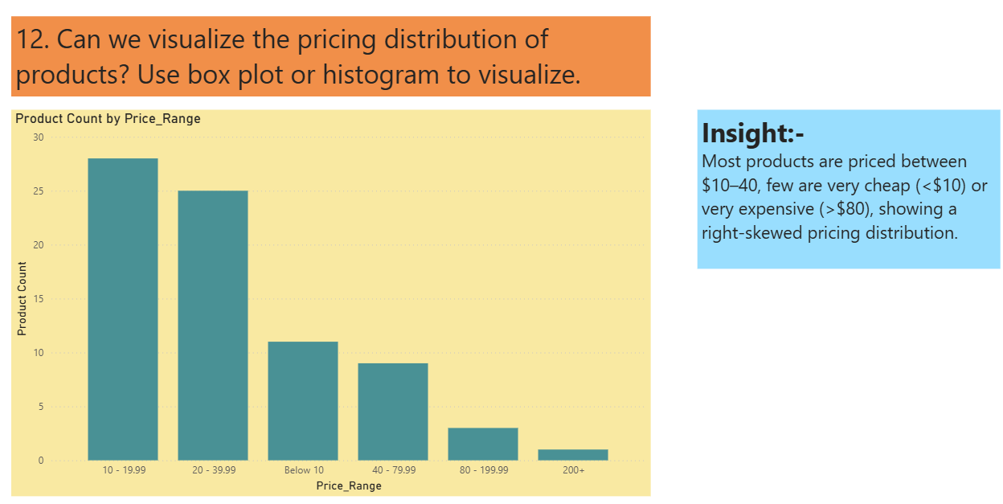

Slide 20
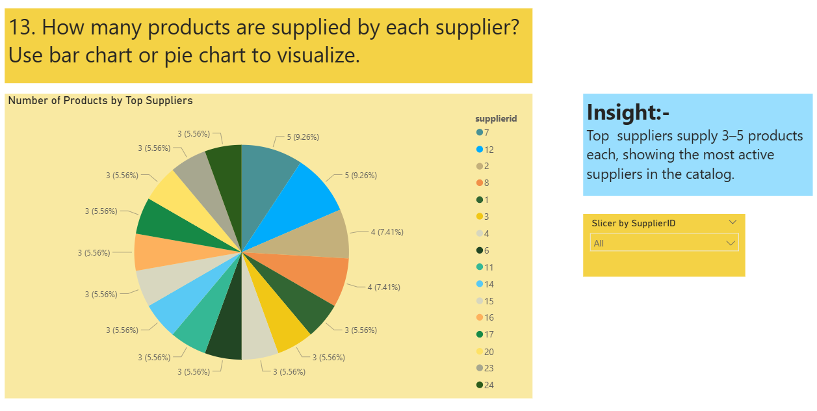

Slide 21
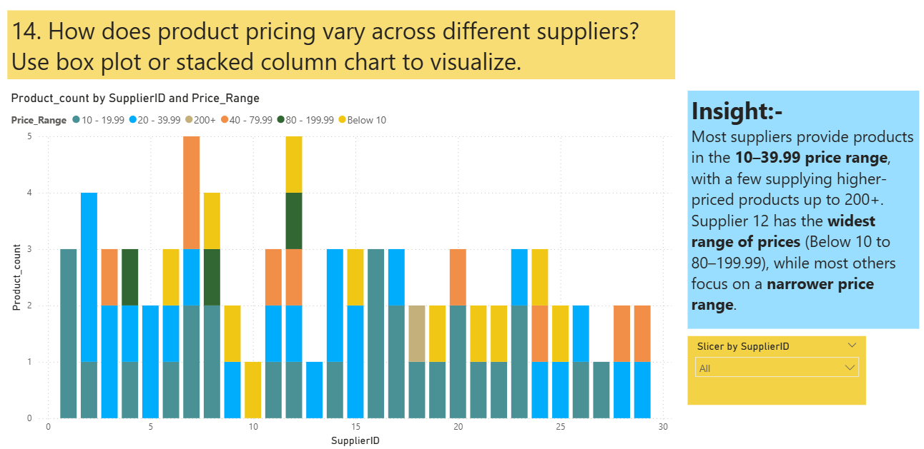

Slide 22
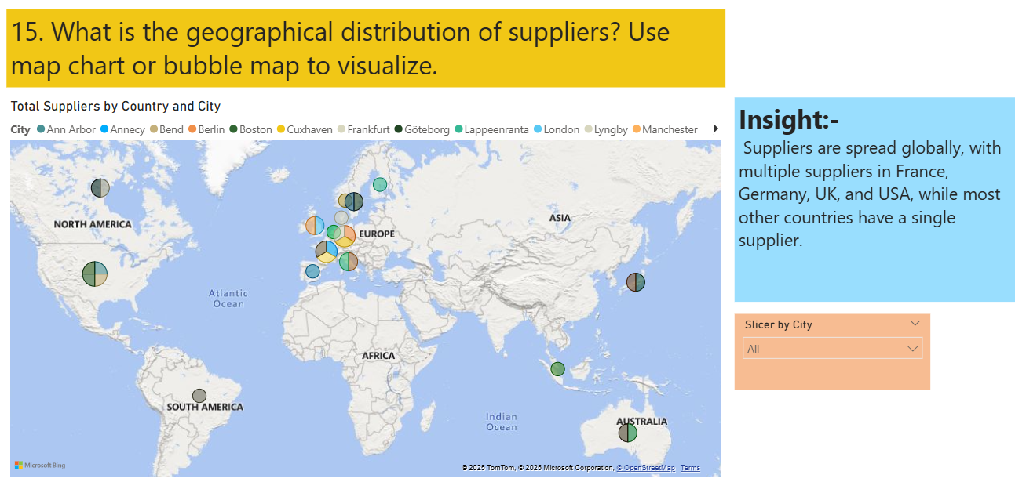

Slide 23

SQL & Excel – Problem Statements with Solutions & Insights

Slide 24

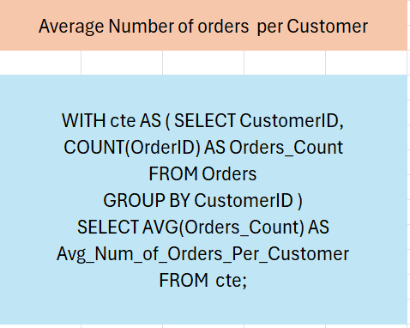
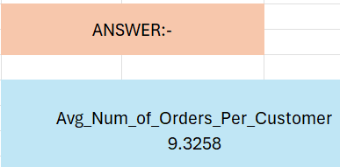
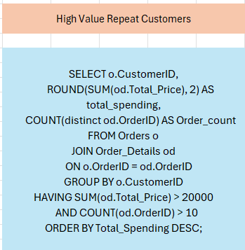
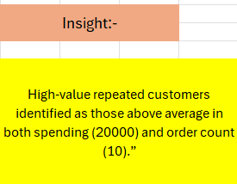
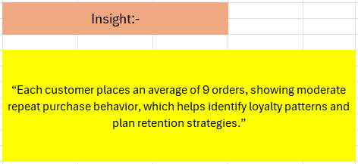

Slide 25

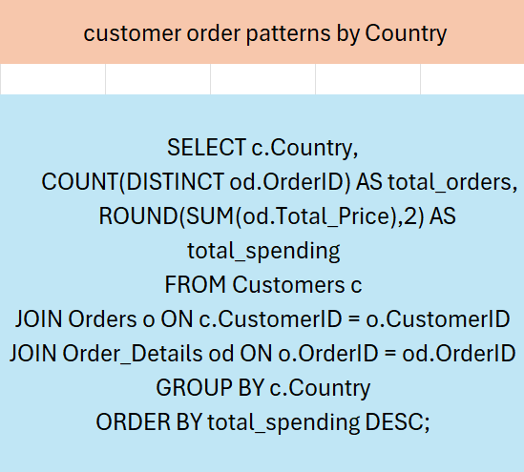
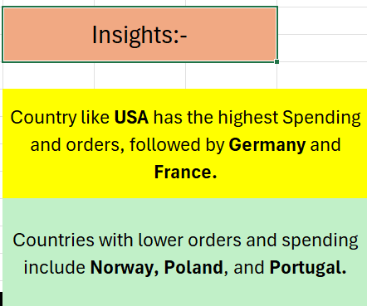

Slide 26

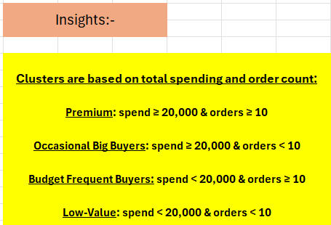
WITH cte AS ( SELECT o.CustomerID, ROUND(SUM(od.Total_Price),2) AS total_spending, COUNT(o.OrderID) AS order_count, cat.CategoryName AS preferred_category, RANK() OVER (PARTITION BY o.CustomerID ORDER BY SUM(od.Total_Price) DESC) AS ranking FROM orders o JOIN order_details od ON o.OrderID = od.OrderID JOIN products p ON od.ProductID = p.ProductID JOIN categories cat ON p.CategoryID = cat.CategoryID GROUP BY o.CustomerID, cat.CategoryName) SELECT CustomerID,total_spending, order_count,preferred_category, CASE WHEN total_spending >= 20000 AND order_count >= 10 THEN 'Premium' WHEN total_spending >= 20000 AND order_count < 10 THEN 'Occasional Big Buyers' WHEN total_spending < 20000 AND order_count >= 10 THEN 'Budget Frequent Buyers' ELSE 'Low-Value' END AS Cluster FROM cte WHERE ranking = 1 ORDER BY total_spending DESC;

Slide 27
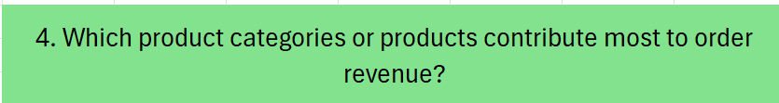
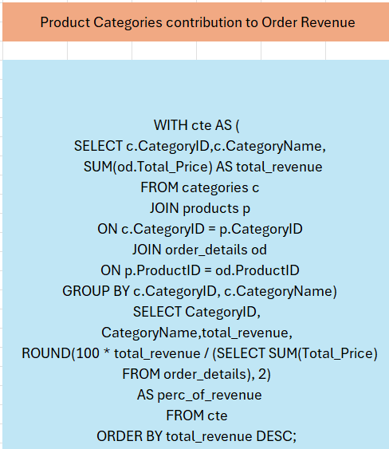
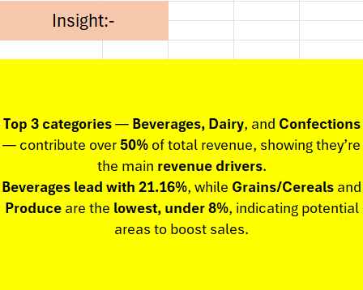

Slide 28
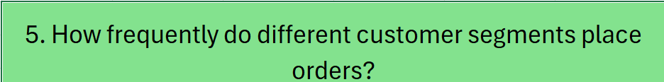
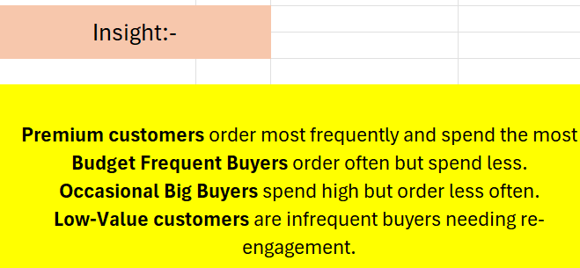
WITH customer_stats AS ( SELECT o.CustomerID, COUNT(DISTINCT o.OrderID) AS order_count, SUM(od.UnitPrice * od.Quantity) AS total_spending FROM orders o JOIN order_details od ON o.OrderID = od.OrderID GROUP BY o.CustomerID), customer_segments AS ( SELECT CustomerID, total_spending,order_count, CASE WHEN total_spending >= 20000 AND order_count >= 10 THEN 'Premium' WHEN total_spending BETWEEN 10000 AND 19999 AND order_count BETWEEN 5 AND 9 THEN 'Occasional Big Buyers' WHEN total_spending BETWEEN 5000 AND 9999 AND order_count >= 10 THEN 'Budget Frequent Buyers' ELSE 'Low-Value/Inactive' END AS Segment FROM customer_stats) SELECT cs.Segment, COUNT(DISTINCT o.OrderID) AS TotalOrders, COUNT(DISTINCT cs.CustomerID) AS TotalCustomers, ROUND(COUNT(DISTINCT o.OrderID) * 1.0 / COUNT(DISTINCT cs.CustomerID), 2) AS AvgOrdersPerCustomer, ROUND(AVG(cs.total_spending), 2) AS AvgSpendingPerCustomer FROM customer_segments cs JOIN orders o ON cs.CustomerID = o.CustomerID GROUP BY cs.Segment ORDER BY AvgOrdersPerCustomer DESC;

Slide 29
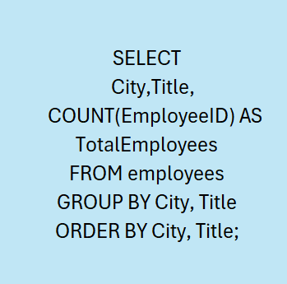
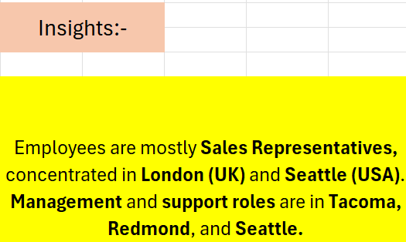
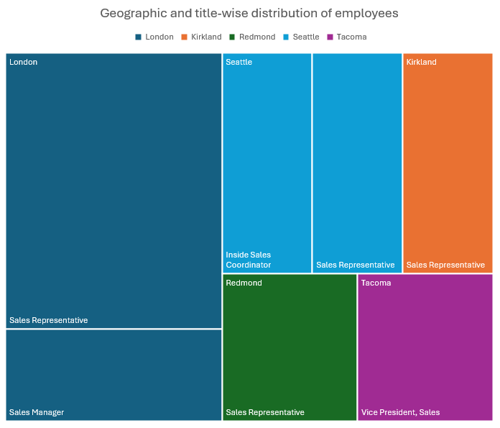

Slide 30
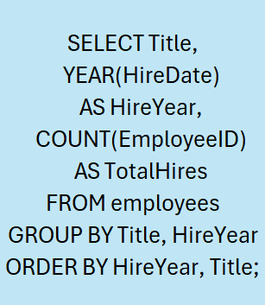
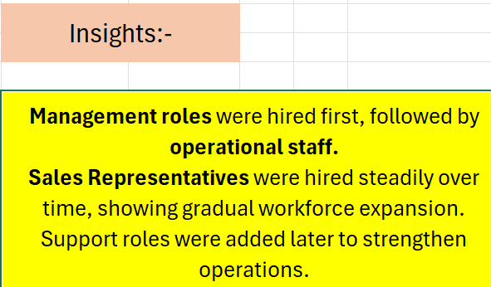

Slide 31
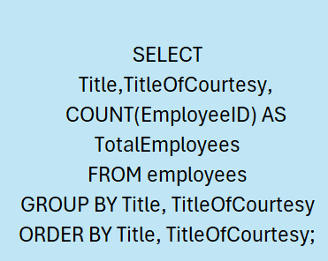
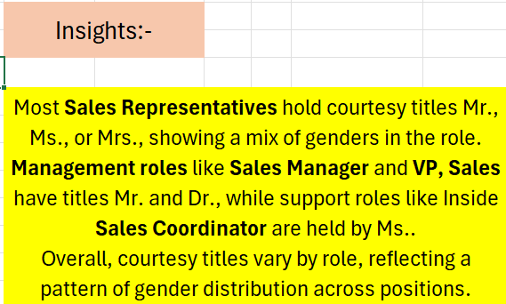

Slide 32
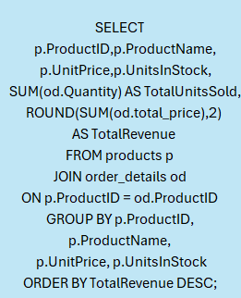
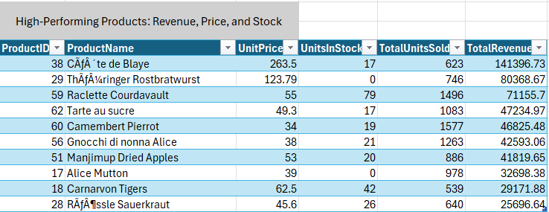
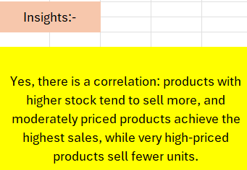

Slide 33

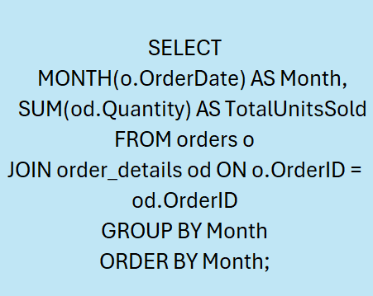
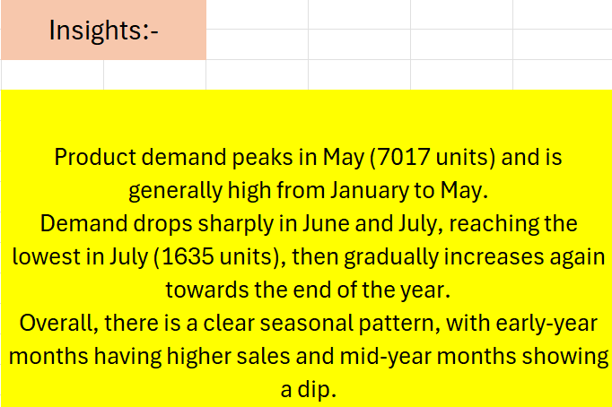

Slide 34

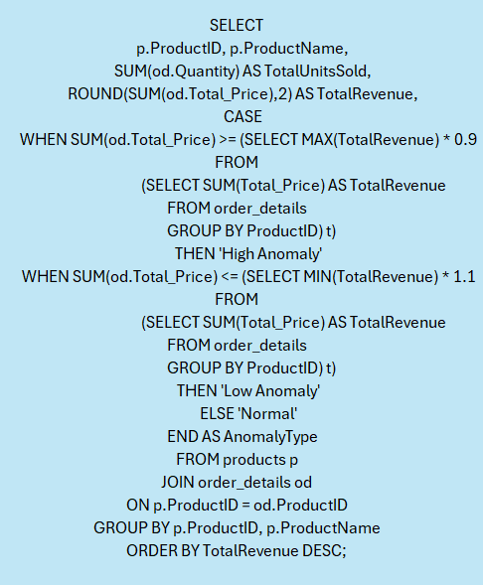
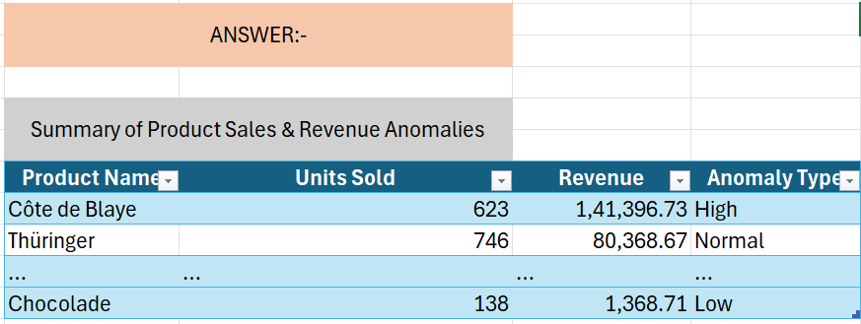
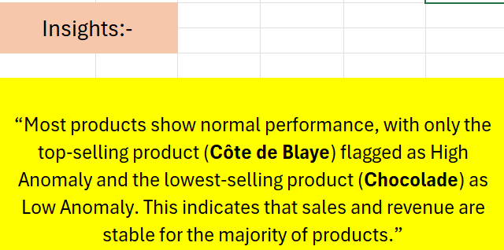

Slide 35

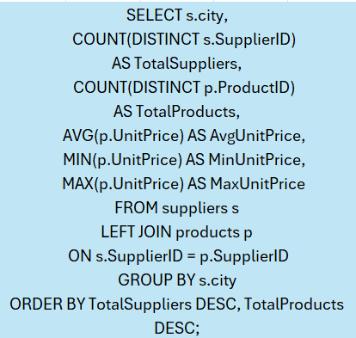
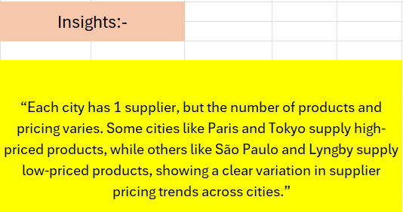

Slide 36

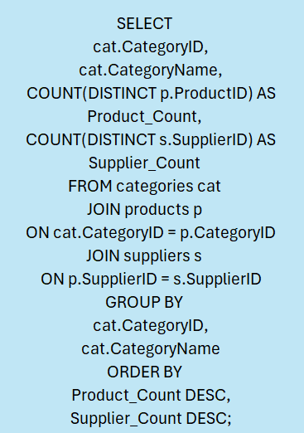
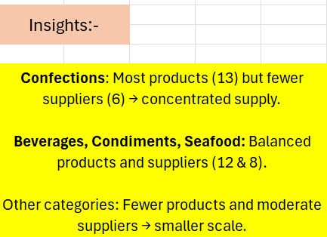

Slide 37
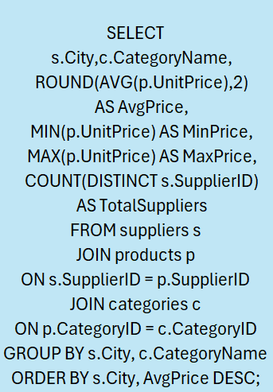
14. How do supplier pricing and categories relate across different regions?
Insight:-
Cities like Paris and Frankfurt show the highest average prices, especially in Beverages and Meat/Poultry, while cities such as São Paulo and Osaka have lower-priced categories like Beverages and Seafood, indicating regional variation in supplier pricing.

Slide 38
Power BI -Dashboards

Slide 39
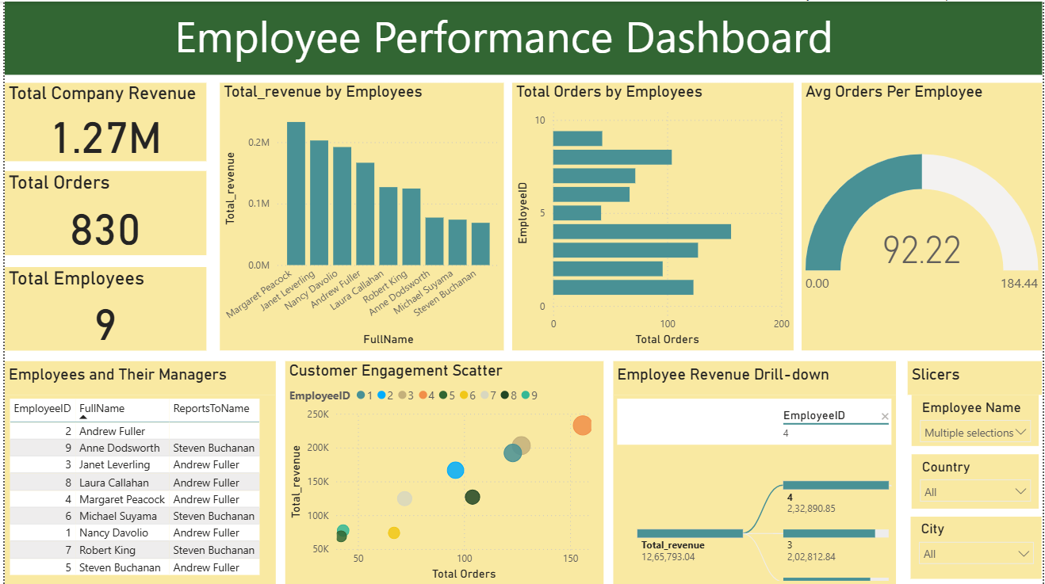

Slide 40


Slide 41


Slide 42


Slide 43

Conclusion
EDA in SQL and Excel revealed key trends in sales, customer behavior, employee performance, and inventory management.
Power BI dashboards provided interactive, easy-to-understand visual insights for stakeholders.
Analysis highlighted top-performing products, high-value customers, and areas for inventory and operational optimization.
The project demonstrates the value of data-driven decision-making in improving efficiency, strategy, and overall business performance.

Slide 44


