Slide 1
Goal 2 The Autonomous Compliance Sentinel Baseline model · Risk analysis · Fairness analysis

Slide 2
Four steps to making a decision
Baseline model
Analysis
Sentinel package
1
2
3
4
Read the text
Text to Numbers
Decide
Validate
Import the
application as
plain text
TF-IDF: weighting
important
words
Logistic Regr.
Red Flag? (0–1)
Metrics, Risk
& Fairness

Slide 3
Why use a ML model?
Generalises beyond keywords: Flags violations phrased in new ways, not only exact matches
Probability score (0-1): A risk score instead of plain yes/no, so we can set a threshold and prioritise by risk
Systematic evaluation: Consistent scores make metrics, fairness checks and XAI comparable and repeatable
Robust: Relies on many weighted signals and improves when retrained on new data

Slide 4
Three Frameworks
Standard
Risk
Fairness
What are our criteria?
What could go wrong?
Is it fair?
EU AI Act + ISO/IEC 27001
own RAI-01…09-Catalogue
EU AI Act, threshold_sweep,
Tests
Fairness per group
group_metrics, eo_gaps

Slide 5
Risk management (by Article 9 of the EU AI Act)
ID | Risk | Likelihood | Impact
R1 | False negative - violation missed | High | High
R2 | False positive - false alarm / alert fatigue | Med | Med
R3 | Class imbalance (1/3 violations) | High | Med
R4 | Synthetic data / shortcut learning | High | High
R5 | Data / concept drift (new methods, policies) | Med | High
R6 | Prompt injection / adversarial evasion | Med | High
R7 | Automation bias / over-reliance | Med | High
R8 | Group performance gap (fairness) | Med | Med
Red:
high likelihood AND high impact
R1, R4
Blue:
Drift, but at a high cost R5

Slide 6
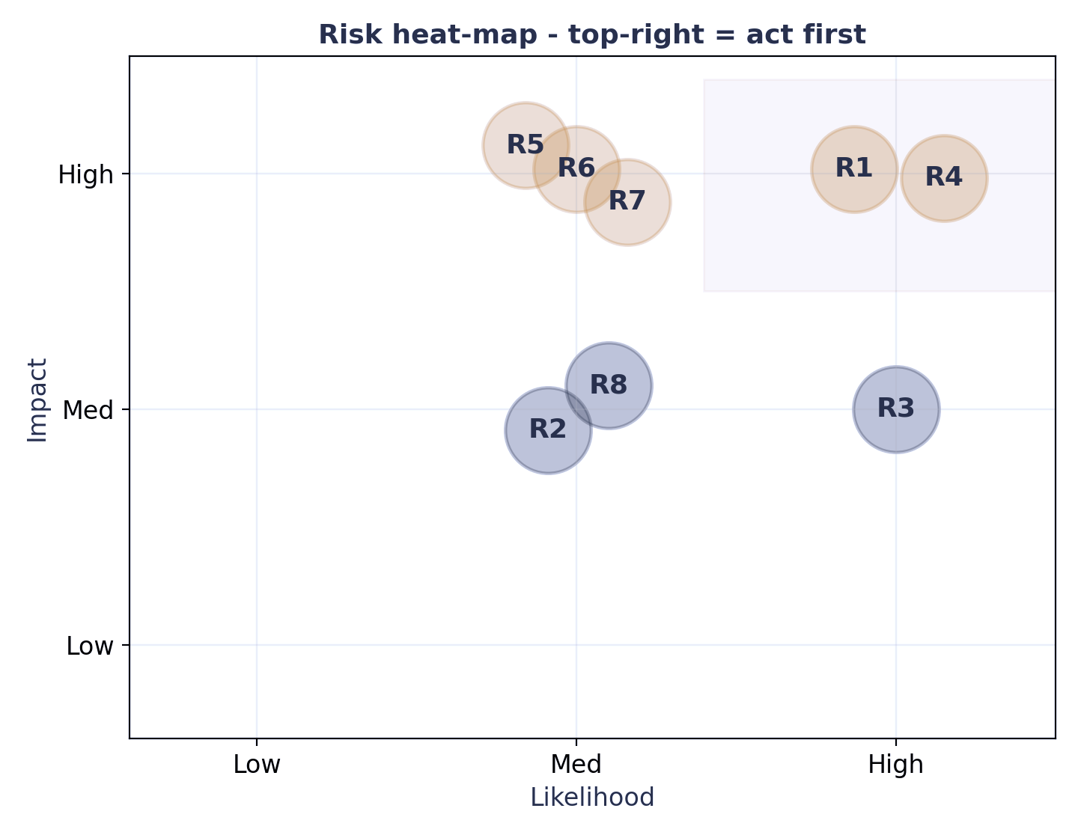
Risk management (by Article 9 of the EU AI Act)
Prioritisation We test the costliest,
most likely risks first.

Slide 7
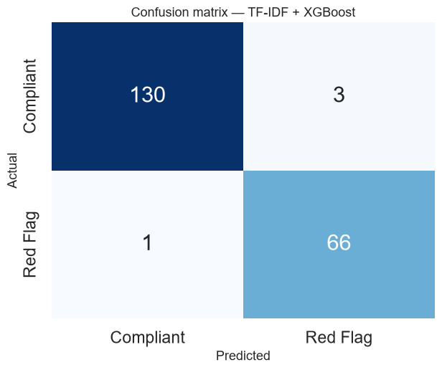
XG Boost Standard Framework:-
TF-IDF + XGBoost.
Precision : 0.957
Recall : 0.985
F1 : 0.971
ROC-AUC : 0.997
Only 1 red flag missed. (FN = 1)
3 over flagged. (FP = 3)

Slide 8
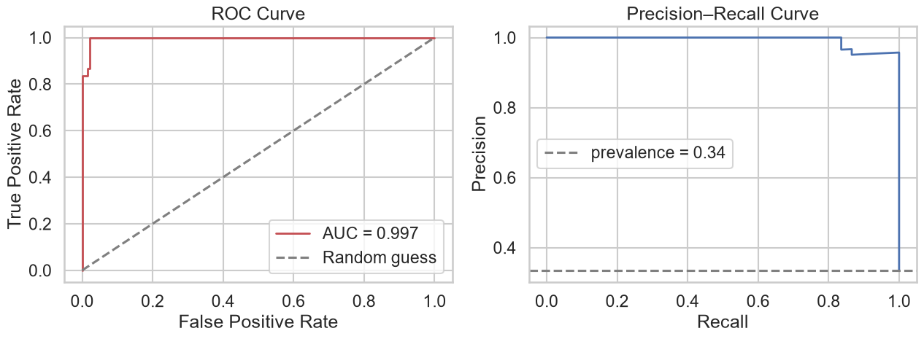
XG Boost ROC and Precision-Recall :-
AUC as discussed in the previous slide is 0.997 which answers whether if model consistently ranks red flags above compliant proposals regardless of what my threshold is.
If you randomly pick one real Red Flag proposal and one real Compliant proposal from your test set, there is a 99.7% probability that the model gave the Red Flag a higher probability score than the Compliant one.
As we push recall higher, (catching more violations by lowering the threshold), precision barely drops at all. (Second figure)

Slide 9
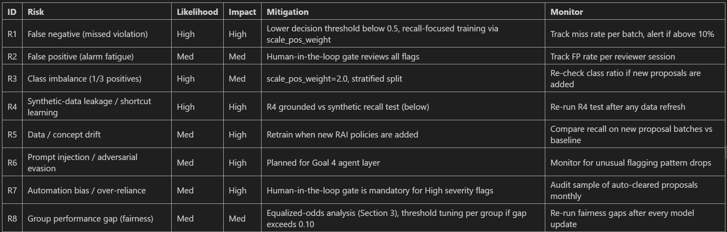
XG Boost Risk Framework:-
Risks identified in the Week 1 task:-

Slide 10
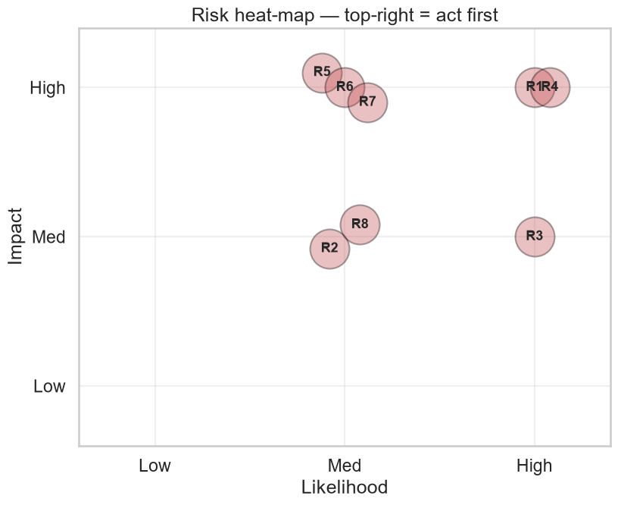
XG Boost Risk Framework:-
The approach follows a three-step cycle:-
1. Assess :- identify risks by likelihood and impact.
2. Mitigate :- define what we are doing about each risk.
3. Monitor :- define how we will know if a risk gets worse over time.
4. X axis = how likely is this risk to occur.
5. Y axis = how bad would it be if it did occur.
6. Top-right corner = highest priority, act first.
7. R1 and R4 sit in the top-right corner, both High likelihood and High impact.

Slide 11
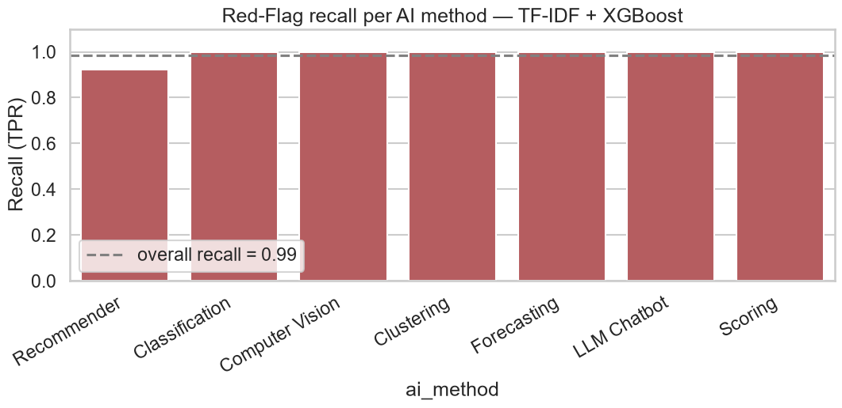
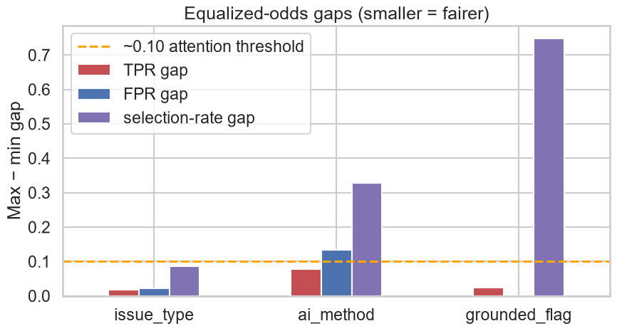
XG Boost Fairness Framework:-
issue_type gaps are small the model treats Bug and Suggestion proposals with similar fairness. No action needed
ai_method shows the largest TPR and FPR gaps this is the group where
fairness attention is most needed.
grounded_flag has a large selection-rate gap, which is expected by design:-
grounded proposals (real NFR violations) and synthetic proposals have structurally different flagging rates because they were generated differently.

Slide 12
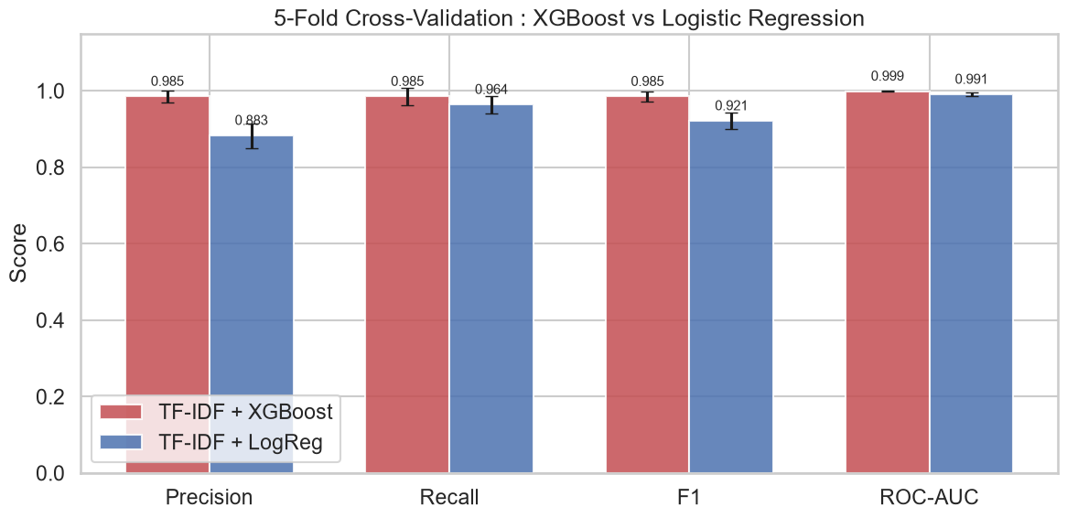
Logistic Regression Vs. XG Boost:-

Slide 13
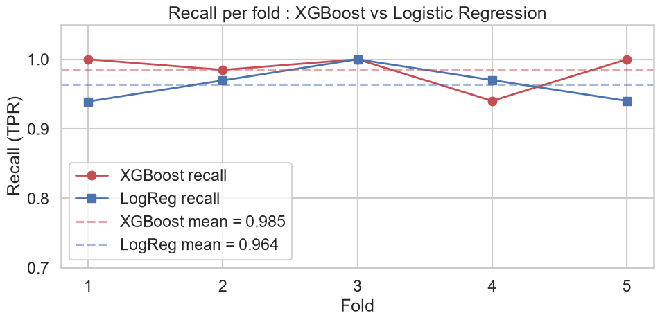
Logistic Regression Vs. XG Boost:-
RECALL COMPARISON:-
XGBoost : mean = 0.985 | std = 0.023
LogReg : mean = 0.964 | std = 0.023

