Slide 1
COEN 180
Flash Memory

Slide 2
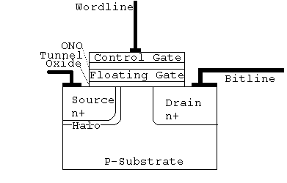
Floating Gate Fundamentals
Floating Gate is isolated.
Floating gate not charged: ➔ Functions like normal MOSFET
Floating gate charged: ➔ Charge shields channel region from control gate and prevents the formation of a channel between source and drain

Slide 3
Floating Gate Fundamentals
Charging / Discharging Floating Gate:
  Channel Hot Electron Injection
  Fowler-Nordheim Tunneling
Both approaches use high voltages for operations

Slide 4
Floating Gate Fundamentals
F-N Tunneling
  Usage
    Used for erasing (removing charge)
    Sometimes used for programming (placing charge)
  Quantum Mechanical Effect that allows electrons to pass from the conducting band of one silicon region to that of another region through an intervening barrier of SiO₂.
  Needs a high value of the injection field ~10MV/cm

Slide 5
Floating Gate Fundamentals
Channel Hot Electron Injection (CHEI)
  Usage
    Sometimes used for programming (placing charge)
  Hot Carrier injection occurs when the electrons are accelerated high enough to surmount the SiO₂ barrier
  Sometimes facilitated with a separate injection gate.

Slide 6
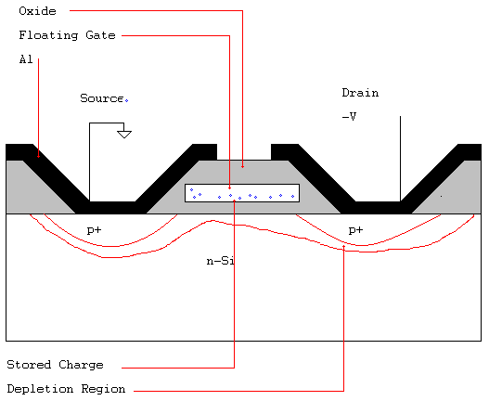
Floating Gate Metal Oxide Semiconductor FAMOS Structure

Slide 7
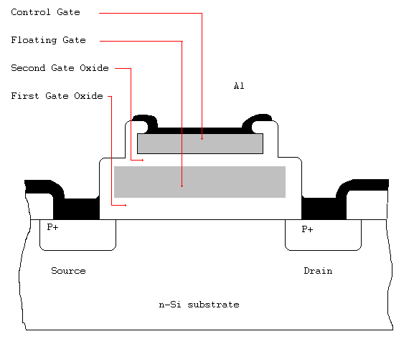
Stacked Gate Avalanche Injection Type MOS (SAMOS

Slide 8
Array Designs
Different Array Designs
  NOR (used)
  NAND (used)
  AND
  DINOR
  T-Poly

Slide 9
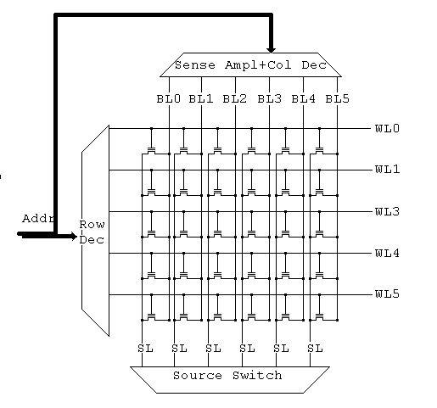
NOR Array
Reading:
Assert a single word line. The source lines are asserted and the read of the bitline gives the contents of the cell.

Slide 10
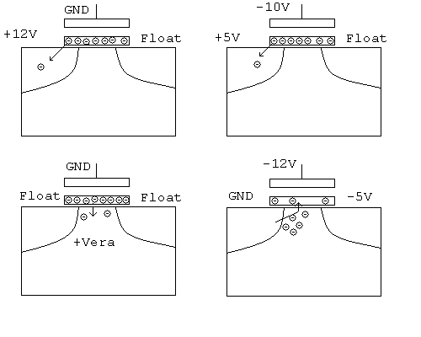
NOR Array
ul: High Voltage Source Erase
ur: Negative Gate Source Erase
ll: Channel Erase
lr: Programming

Slide 11
NOR Array
Erasure:
Set sources to 12V
Set word lines to Ground

Slide 12
NOR Array
Write:
Set sources to 12V
Set source line to -5V

Slide 13
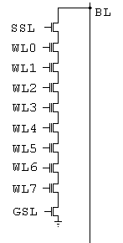
NAND Array
NAND array cell is much smaller than NOR cell.
Arranged in a line of typically 16 gates.
NAND cell has threshold voltage higher than 0V if programmed and a negative threshold voltage otherwise.

Slide 14
NAND Array
Read
  Cell to be read has grounded selected word line.
  Other cells have unselected level of 4.5 V
  If the selected cell is programmed, then the cell is not conductive.
  If the selected cell is erased, then the cell is conductive.

Slide 15
NAND Array
Programming
  Uses F-N tunneling.
  Substrate is grounded.
  High voltage on wordline.

Slide 16
NAND Array
Erasure
  Substrate is charged with 19-21V.
  Control gate is grounded.

Slide 17
NAND vs. NOR Layout
NAND arrays have densities at which there are more errors.
Programming NAND through F-N takes longer (200 μsec) per cell
However, NAND is programmed in parallel, whereas NOR is programmed one bit at a time.

Slide 18
NAND vs. NOR Layout
NAND is read per page (512B)
NOR is read individually.
Both erase blocks (8KB – 64KB)
Using NAND is closer to using disk
Using NOR is closer to using RAM

Slide 19
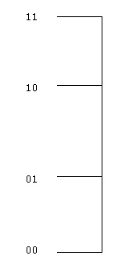
Multi-Levels
By charging the floating gates at different levels, a single cell can store multiple data, typically 2b.
These correspond to different threshold values at which the gate becomes conductive.

Slide 20
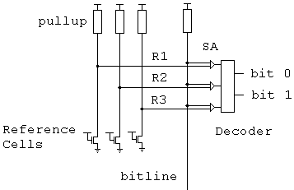
Multi-Levels
By using reference cells set at given levels and comparing them to the value from the bitline, we can determine the value stored.

