Slide 1
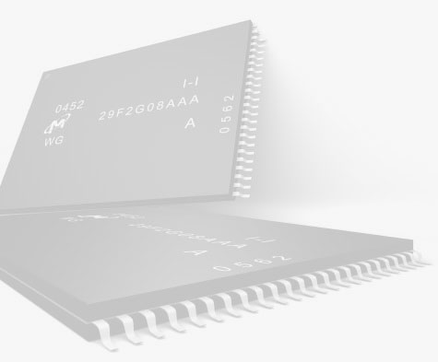
Flash Memory
EECS 277A Fall 2008
Jesse Liang #68686895

Slide 2
What is Flash Memory?
A type of Non-Volatile memory
A specific type of EEPROM (Electrically Erasable Read Only Programmable Memory)
Solid-State Memory
What is the big deal?
It can be read/written and it doesn’t need POWER for data retention.
It’s fast.
It’s durable

Slide 3
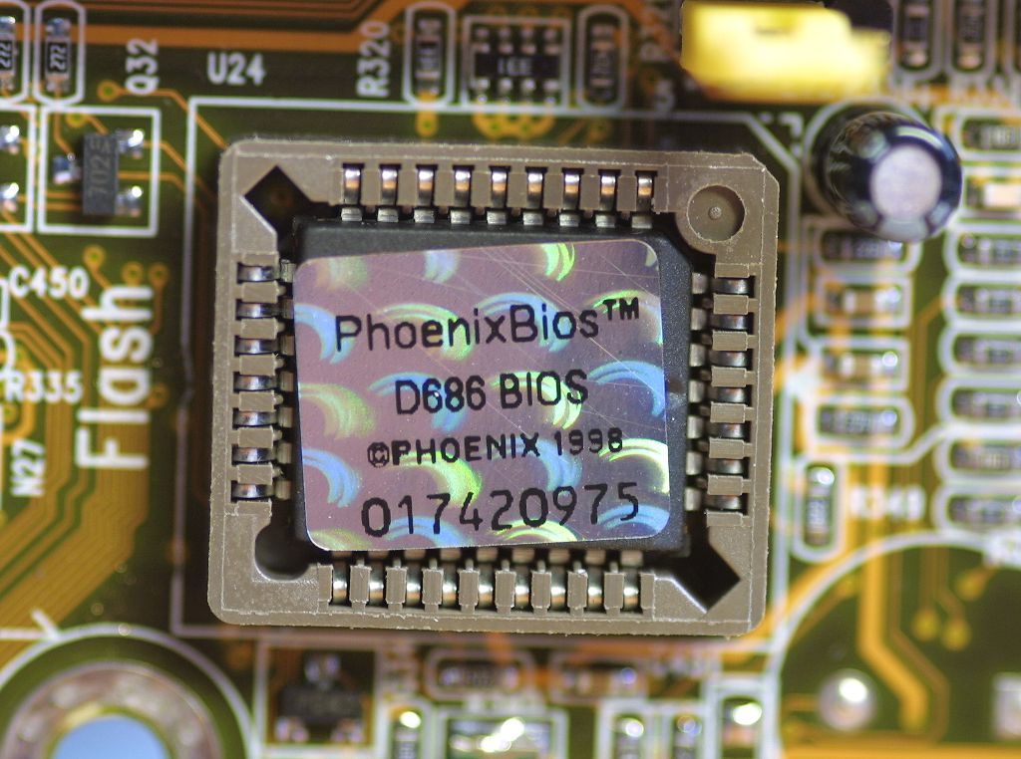
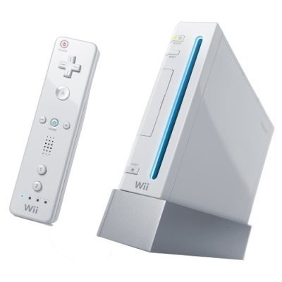
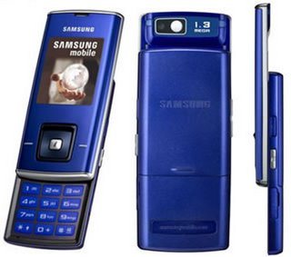


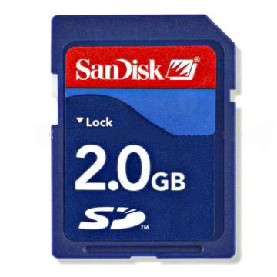
Applications
There’s many, many, more!

Slide 4
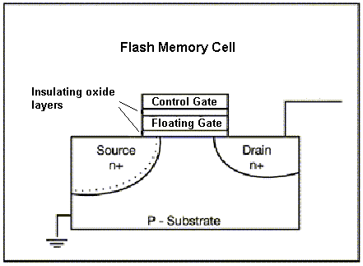
Device Structure
Similar to MOSFET Structure
Added Floating Gate (FG) between Control Gate (CG) and inversion layer
FG surrounded by insulators
FG traps electrons (~50 years)
CG is same as MOSFET gate
Charged FG disrupts / affects inversion layer
Current flows from the drain to source via inversion layer

Slide 5
Read Function
Logic state determined by current flow amount
  Let I_{D} be the current flow in a normal MOSFET
  Let I_{DF} be the current flow in a flash transistor
    If I_{DF} ≈ I_{D} → LOGIC 1
    If I_{DF} < I_{D} (significantly less than) → LOGIC 0
Flash Memory senses the amount of current flowing through its inversion layer as a means of logic state determination.

Slide 6
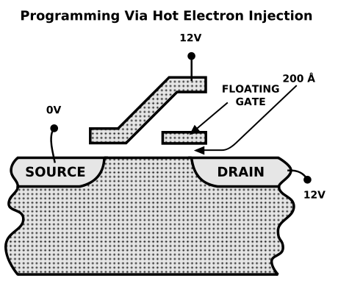
Write Function – Logic 0
Electrons are injected into the FG via hot-electron injection
Charged FG partially cancels the CG’s E-field
V_{t} is modified, changing current flow (less)
Reduced current flow in inversion layer - logic 0

Slide 7
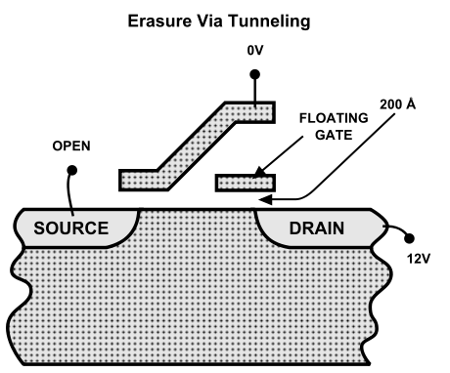
Write Function – Logic 1
Electrons are tunneled out of the FG
FG no longer partially cancels the CG’s E-field
V_{t} is back to default
Current flow in inversion layer returns to normal - logic 1

Slide 8
Lifespan
Hot electron injection or tunneling results in device deterioration
Electrons have a probability of becoming trapped in oxide layer, electron traps
Trapped electrons in oxide disrupt V_{t}
Flash Memory can “wear out”
Between 1,000 10,000 and up to 100,000 write cycles

Slide 9
Major Players in Flash Market
Samsung
Toshiba
AMD (Spansion)
Intel & Micron → IMI Flash Technologies
Hynix
SST
ST Microelectronics
Sharp

Slide 10
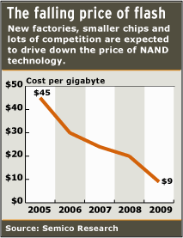
Motivations
Projected to be a $20 billion market by 2010
All handheld / mobile products rely on Flash memory
Optimists predict NAND Flash will replace CD/DVD
NAND Flash prices continue to fall
Storage densities are following Moore’s Law

Slide 11
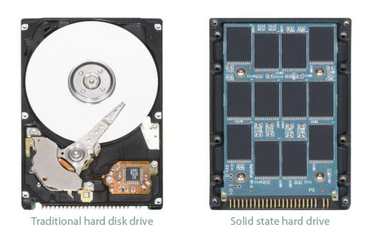
The End
(not really)

Slide 12
References
http://www.lascon.co.uk/ for Flash Memory Diagram on slide 4
http://bigtech.blogs.fortune.cnn.com/2008/06/09/intel-faces-volatile-flash-memory-market/
http://www.interfacebus.com/IC_Flash_Memory_Manufacturers.html
http://electronics.howstuffworks.com/flash-memory.htm
Fundamentals of Modern VLSI Devices. TUAR, Yuan. NING H., Tak pg. 96-97, pg. 85
http://news.cnet.com/Bye-bye-hard-drive,-hello-flash/2100-1006_3-6005849.html

