Slide 1
EEPROM and Flash Memory
Vikas Rokade
19-Dec-2018

Slide 2
Memory
Memory structures are crucial in digital design.
– ROM, PROM, EPROM, RAM, SRAM, DRAM
• All memory structures have an address bus and a data bus
– Possibly other control signals to control output etc.
• E.g. 4 Bit Address bus with 5 Bit Data Bus

Slide 3
Types of ROM

Slide 4
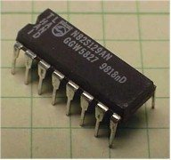
Types of ROM: PROM
Modified/Programmed only once by a user.
PROM is a way of allowing a user to tailor a microcode program using a special machine called a PROM programmer .
This machine supplies an electrical current to specific cells in the ROM that effectively blows a fuse in them.
The process is known as burning the PROM

Slide 5
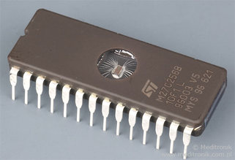
Types of ROM: EPROM
EPROM chips can be rewritten many times
EPROM is erased using Ultra violet rays.
EPROM chip has to be removed from the computer circuit to erase and reprogram the computer BIOS
An EPROM eraser is not selective, it will erase the entire EPROM
To rewrite an EPROM, you must erase it first

Slide 6
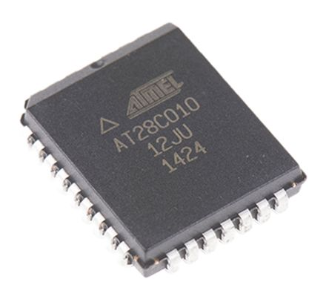
Types of ROM: EEPROM
EEPROM chip can be erased and reprogrammed in the computer circuit to erase and reprogram the content of computer BIOS.
EEPROM can be erased in the circuit by applying the special programming signals

Slide 7
Types of EEPROM: Parallel EEPROM
The serial access represents 90 percent of the overall EEPROM market, and parallel EEPROMs about 10 percent.
Parallel devices are available in higher densities (≥256Kbit), are generally faster, offer high endurance and reliability,
and are found mostly in the military market. They are pin compatible with EPROMs
and flash memory devices.

Slide 8
Types of EEPROM: Series EEPROM
Serial EEPROMs are less dense (typically from 256 bit to 256Kbit) and are slower than parallel devices.
They are much cheaper and used in more “commodity” applications.
serial ones are less expensive hardware-wise, as they require less pins, energy, and wires/circuits.
Programmability - serial EEPROMs are easier to program compared to parallel. Serial EEPROMs have the ability and ease of programming one byte at a time;

Slide 9
What is Flash Memory?
A type of Non-Volatile memory
A specific type of EEPROM (Electrically Erasable Read Only Programmable Memory)
Solid-State Memory
It can be read/written and it doesn’t need POWER for data retention.
It’s fast.
It’s durable

Slide 10
Types of Flash Memory : NAND Flash
Data storage memory
Does not allow to randomly access any location in the memory.
NAND type is primarily used in main memory, memory cards, USB flash drives, solid-state drives.
To Read the NAND memory, groups of bytes called pages to be requested.
In NAND Flash, several memory cells (typically eight cells) are connected in series similar to a NAND gate

Slide 11
Types of Flash Memory : NOR Flash
Execution in-place memory(XIP)
NOR offers faster read speed and random access capabilities.
write and erase functions are slow compared to NAND.
NAND or NOR flash memory is also often used to store configuration data in
numerous digital products, a task previously made possible by EEPROMs or battery-powered static RAM
NOR Flash, one end of each memory cell is connected to the source line and the other end directly to a bit line resembling a NOR Gate

Slide 12
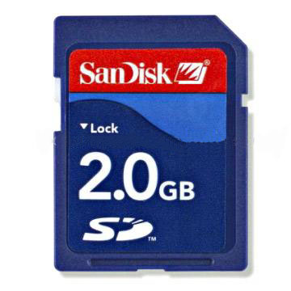
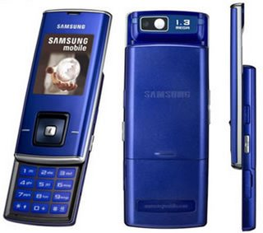
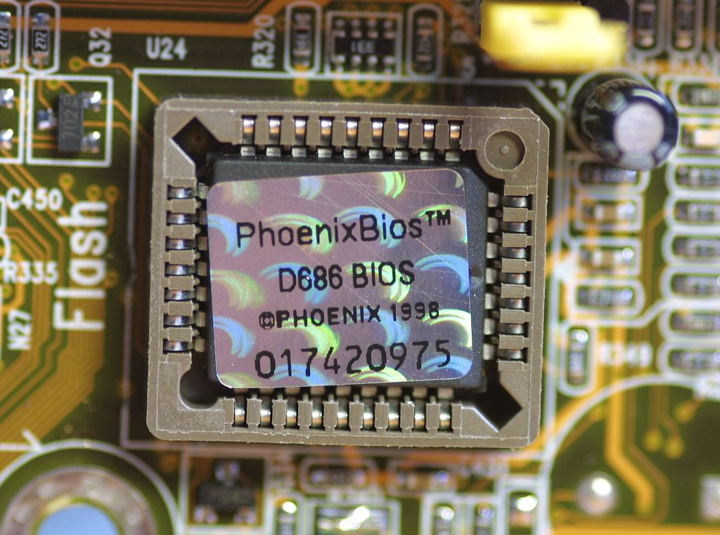
Applications of flash memory

Slide 13
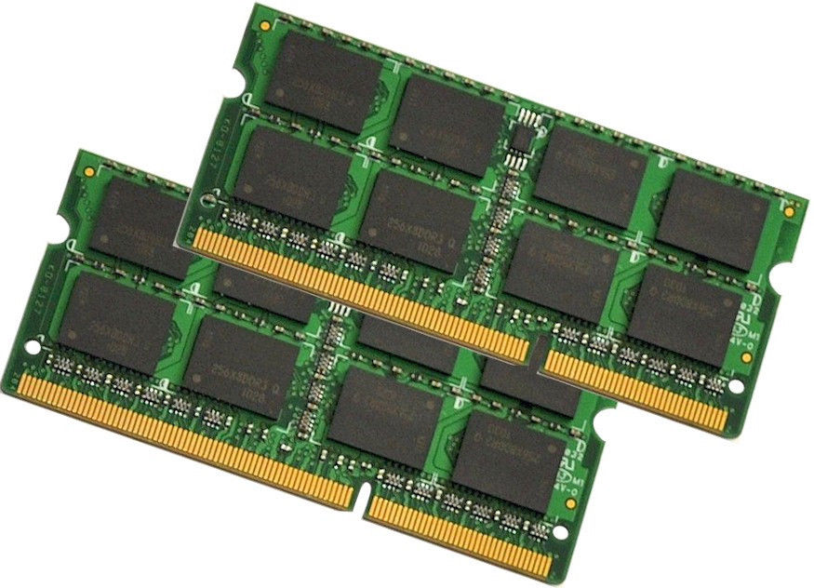
RAM

Slide 14
Types of RAM
Volatile
Basic types - SRAM, DRAM
Double Data Rate Synchronous Dynamic RAM (DDR SDRAM, DDR2, DDR3, DDR4)
SRAM used in CPU Cache, Hard drive buffer/cache
DRAM used in System memory, Video graphics memory

Slide 15
Thank You
www.kpit.com

