Slide 1
GMOCK

Slide 2
Outline
What is Mock?
What is different between gtest and gmock
What Is Google C++ Mocking Framework?
Writing the Mock Class

Slide 3
Why gmock??
While mock objects help you to remove unnecessary dependencies in tests and make them fast and reliable.

Slide 4
What IS Mock
We creates a mock object to test the behavior of some other object
An object that we want to mock has the following characteristics:
Supplies non-deterministic results (e.g. the current time).
Has states that are difficult to create or reproduce (e.g. a network error).
Is slow (e.g. a complete database, which would have to be initialized before the test).
Does not yet exist or may change behavior.
Would have to include information and methods exclusively for testing purposes (and not for its actual task).
A mock object implements the same interface as a real object
For example, crash test dummy is a mock object used to simulate the dynamic behavior of a human in vehicle impacts

Slide 5
What Is Google C++ Mocking Framework?
A mock allows you to check the interaction between itself and code that uses it
Instead of having your application talk to the API directly, wrap the API in an interface and code to that interface
Google C++ Mocking Framework is a library for creating mock classes and using them. Google Mock lives in testing namespace. For readability it is recommended to write using::testing::mock-class-name;
#include <gtest/gtest.h>
#include <gmock/gmock.h>

Slide 6
What Is Google C++ Mocking Framework?
Using Google Mock involves three basic steps:
Use some simple macros to describe the interface you want to mock, and they will expand to the implementation of your mock class
Create some mock objects and specify its expectations and behavior using an intuitive syntax
Exercise code that uses the mock objects. Google Mock will catch any violation of the expectations as soon as it arises

Slide 7
Difference Between gtest and gmock
"Google Mock is not a testing framework itself. Instead, it needs a testing framework for writing tests.
Google Mock works seamlessly with Google Test. It comes with a copy of Google Test bundled. Starting with version 1.1.0, you can also use it with any C++ testing framework of your choice. " - Google Mock, System Requirements
Mock are like objects, defined in such a way to mimick the real-deal by supplying controlled behavior.

Slide 8
Example:
This is the API we want to mock
Mock class
class NewTest {
public:
NewTest() {}
virtual ~NewTest() {}
virtual int Add(int x, int y)=0;
};
#include <gmock\gmock.h>
#include "NewTest.h"
class DerivedNew: public NewTest {
public:
MOCK_METHOD2(Add, int(int x, int y));
};
Mock-method
MOCK_METHODn(name-of-method, return-type(arguments)
Where n is no’s of arguments

Slide 9
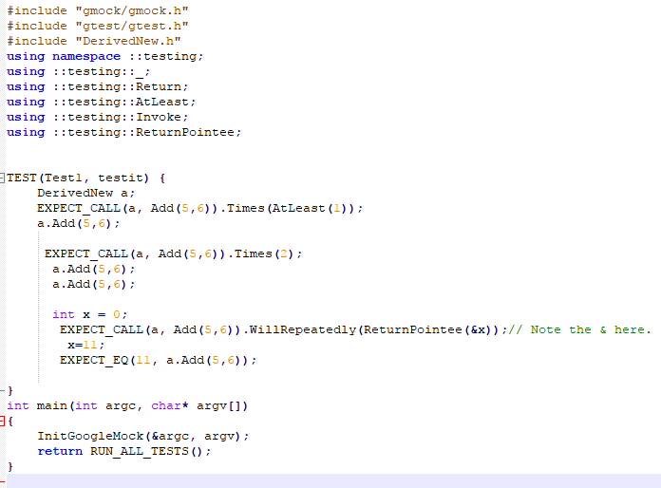
Creating mock-object

Slide 10
Setting Expectations - General Syntax
use the EXPECT_CALL() macro to set an expectation on a mock method
Two arguments: first the mock object, and then the method and its arguments
Note that the two are separated by a comma
e.g. EXPECT_CALL(mock-obj, method(matchers))
.Times(cardinality)
.WillOnce(action)
Optional clauses that provide more information about the expectation

Slide 11

Cardinalities - How Many Times Will It Be Called?
Times() is a clause can be specified follows an EXPECT_CALL()
We call its argument a cardinality as it tells how many times the call should occur
Times(cardinality) can:
Repeat an expectation many times.
A cardinality can be "fuzzy", just like a matcher can be.

Slide 12
Multi-Argument-Matcher
EXPECT_CALL(mock-Object, method(arg1Matcher, ..., argNMatcher)) .With(multi-Argument-Matcher)
.Times(cardinality)
.InSequence(sequences)
.After(expectations)
.WillOnce(action)
.WillRepeatedly(action)

Slide 13
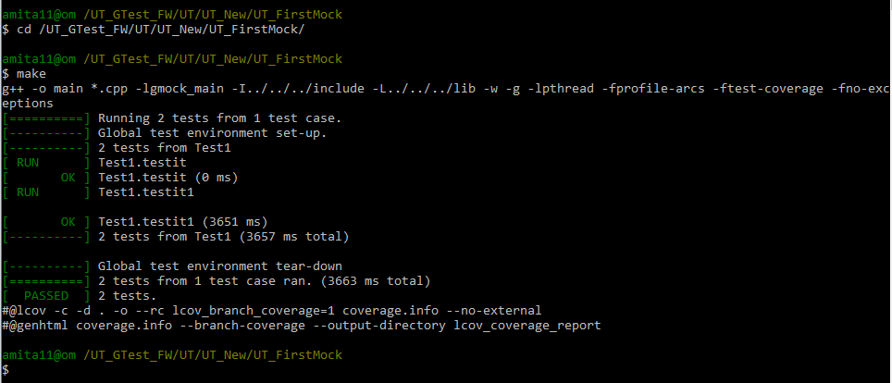

Slide 14
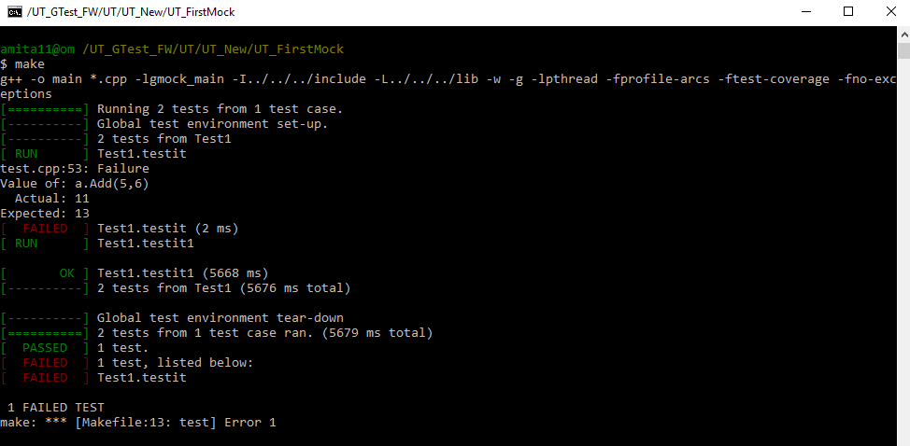

Slide 15


