Slide 1


MongoDB
Aggregation & Scaling
NOVEMBER 14, 2019

Slide 2
Aggregation
MongoDB
pipeline
& operators

Slide 3
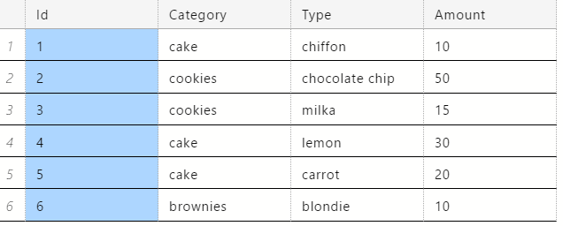
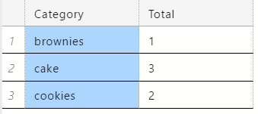
Aggregation
SELECT Category, COUNT(*) AS Total
FROM Orders
GROUP BY Category

Slide 4
Aggregation
{ "_id" : 1, "item" : { "category" : "cake", "type" : "chiffon" }, "amount" : 10 } { "_id" : 2, "item" : { "category" : "cookies", "type" : "chocolate chip" }, "amount" : 50 } { "_id" : 3, "item" : { "category" : "cookies", "type" : "milka" }, "amount" : 15 } { "_id" : 4, "item" : { "category" : "cake", "type" : "lemon" }, "amount" : 30 } { "_id" : 5, "item" : { "category" : "cake", "type" : "carrot" }, "amount" : 20 } { "_id" : 6, "item" : { "category" : "brownies", "type" : "blondie" }, "amount" : 10 }
db.orders.aggregate([{ $group: { _id: "$item.category", total: { $sum: 1 } } }])
{ "_id" : "brownies", "total" : 1 } { "_id" : "cookies", "total" : 2 } { "_id" : "cake", "total" : 3 }

Slide 5
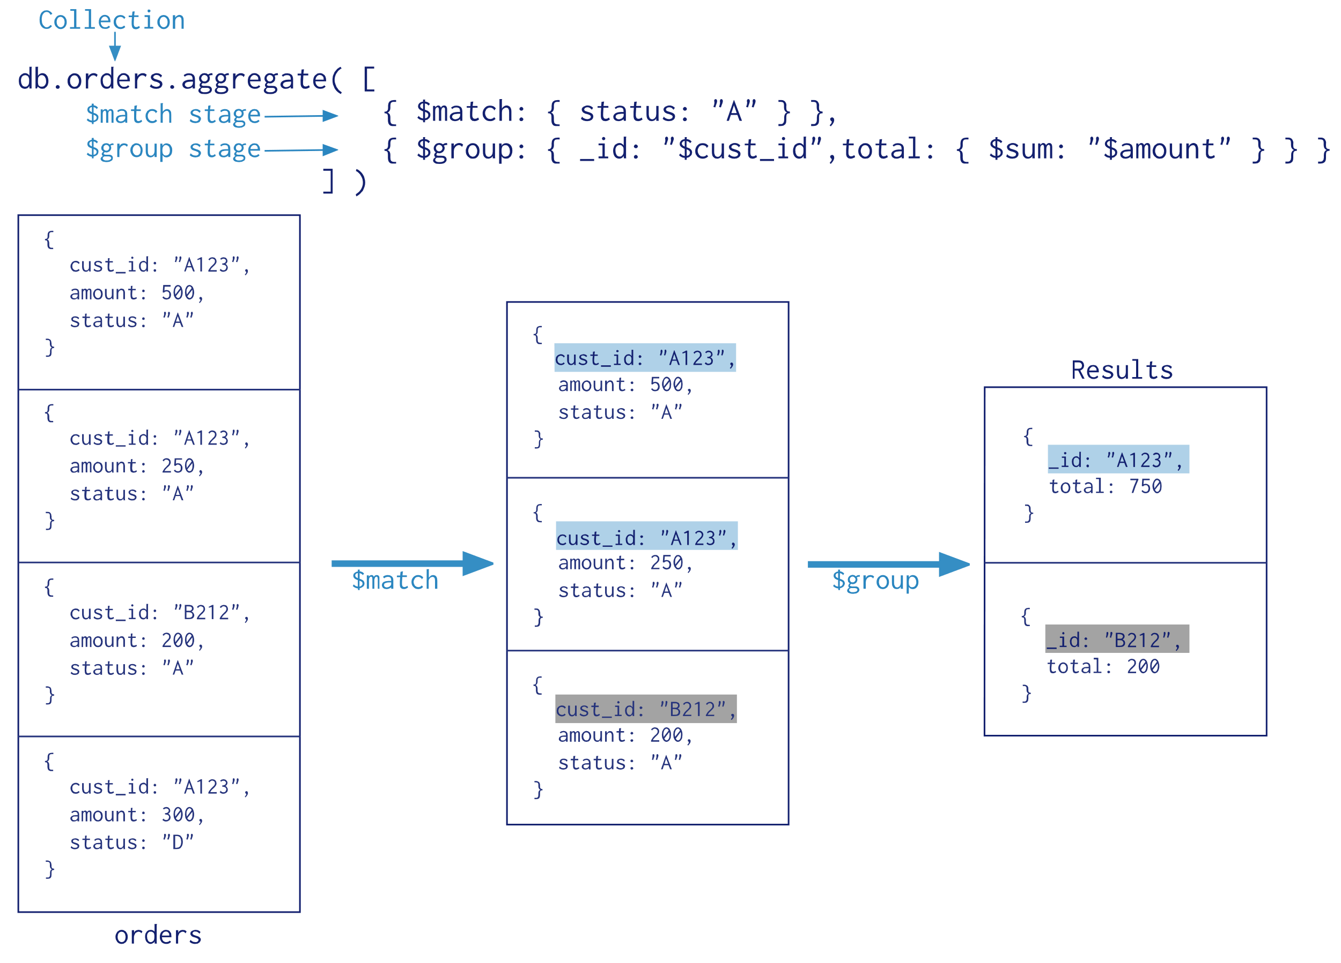
Aggregation

Slide 6
Aggregation
https://docs.mongodb.com/manual/reference/operator/aggregation-pipeline/#aggregation-pipeline-stages
Stage | Description
$match | Filter | N:1
$group | Group | N:1
$project | Reshape | 1:1
$sort | Reorder | 1:1
$unwind | Denormalize | 1:N
$limit | Limit | N:1
$skip | Skip | N:1

Slide 7
Aggregation
$match filters documents to pass to the next pipeline stage
{ $match: { <query> } }
{ "_id": 4, "item": { "category": "cake", "type": "lemon" }, "amount": 30 } { "_id": 2, "item": { "category": "cookies", "type": "chocolate chip" }, "amount": 50 }
db.orders.aggregate([ { $match: { amount: {$gt: 25} } } ])

Slide 8
Aggregation
$group groups documents by some specified expression; _id field is the distinct group key
{ $group: { _id: <expression>, <field1>: { <accumulator1> : <expression1> }, ... } }
{ "_id": "brownies", "total": 1, "averageAmount": 10 } { "_id": "cookies", "total": 2, "averageAmount": 32.5 } { "_id": "cake", "total": 3, "averageAmount": 20 }
db.orders.aggregate([{ $group: { _id: "$item.category", total: {$sum: 1}, averageAmount: {$avg: "$amount"} } }])

Slide 9
Aggregation
Group key can be compound
{ "_id" : ObjectId("5a5a650111e629fb0ad2a5ff"), "passangers" : 0, "carrier" : "Korean Air Lines Co. Ltd.", "originCity" : "Atlanta, GA", "originState" : "Georgia", "originCountry" : "United States", "destCity" : "Seoul, South Korea", "destState" : "", "destCountry" : "South Korea", "class" : "G" }

Slide 10
Aggregation
{ "_id": { "destCountry": "United States", "destCity": "Pensacola, FL", "carrier": "Delta Air Lines Inc." }, "avgPassangers": 28623.428571428572 } { "_id": { "destCountry": "United States", "destCity": "Hilo, HI", "carrier": "Hawaiian Airlines Inc." }, "avgPassangers": 26452.571428571428 } { "_id": { "destCountry": "United States", "destCity": "Richmond, VA", "carrier": "Delta Air Lines Inc." }, "avgPassangers": 23695.1 }
db.airlines.aggregate([ { $group: { _id: { destCountry: "$destCountry", destCity: "$destCity", carrier: "$carrier" }, avgPassangers: {$avg: "$passangers"} } }, { $sort: { avgPassangers: -1 } }, { $limit: 3 } ])

Slide 11
Aggregation
db.airlines.aggregate([ { $group: { _id: { destCountry: "$destCountry", destCity: "$destCity", carrier: "$carrier" }, avgPassangers: {$avg: "$passangers"} } }, { $group: { _id: { destCountry: "$_id.destCountry", destCity: "$_id.destCity" }, avgPassangers: {$avg: "$avgPassangers"} } }, { $sort: { avgPassangers: -1 } }, { $limit: 3 } ])
{ "_id": { "destCountry": "United Arab Emirates", "destCity": "Abu Dhabi, United Arab Emirates" }, "avgPassangers": 8052.380952380952 } { "_id": { "destCountry": "Egypt", "destCity": "Cairo, Egypt" }, "avgPassangers": 6186 } { "_id": { "destCountry": "Kuwait", "destCity": "Kuwait, Kuwait" }, "avgPassangers": 6089.142857142857 }

Slide 12
Aggregation
https://docs.mongodb.com/manual/meta/aggregation-quick-reference/#expressions
Operator | Description
$sum | Sum of values
$avg | Average of values
$first | Value from first document from each group
$last | Value from last document from each group
$max/$min | Max/min value for each group
$push | Array of values for each group
$addToSet | Array of unique values for each group

Slide 13
Aggregation
{ "_id": "brownies", "types": [ "blondie" ] } { "_id": "cookies", "types": [ "chocolate chip", "milka" ] } { "_id": "cake", "types": [ "chiffon", "lemon", "carrot" ] }
db.orders.aggregate([ { $group: { _id: "$item.category", types: { $push: "$item.type" } } } ])

Slide 14
Aggregation
{ "_id": "brownies", "types": "blondie" } { "_id": "cookies", "types": "chocolate chip" } { "_id": "cookies", "types": "milka" } { "_id": "cake", "types": "chiffon" } { "_id": "cake", "types": "lemon" } { "_id": "cake", "types": "carrot" }
$unwind deconstructs an array field to output document for each field
{ $unwind: <field path> }
db.orders.aggregate([ { $group: { _id: "$item.category", types: { $push: "$item.type" } } }, { $unwind: "$types" } ])

Slide 15
Aggregation
$project passes documents with the requested fields to the next stage
{ $project: { <specification(s)> } }
{ "item": { "category": "brownies", "type": "blondie" } } { "item": { "category": "cookies", "type": "chocolate chip" } } { "item": { "category": "cookies", "type": "milka" } } { "item": { "category": "cake", "type": "chiffon" } }
db.orders.aggregate([ { $group: { _id: "$item.category", types: {$push: "$item.type"} } }, {$unwind: "$types"}, { $project: { _id: 0, item: { category: "$_id", type: "$types" } } } ])

Slide 16
Aggregation
$min, $max, $avg, $sum can be used in $project
{ "_id": 3, "item": { "type": "milka" }, "amount": 15, "avgAmount": 25 } { "_id": 2, "item": { "type": "chocolate chip" }, "amount": 50, "avgAmount": 60 }
db.orders.aggregate([ { $match: { "item.category": "cookies" } }, { $project: { "item.type": 1, amount: 1, avgAmount: {$sum: ["$amount", 10]} } } ])

Slide 17
Aggregation
{ _id: 0, items: [ { item_id: 43, quantity: 2, price: 10 }, { item_id: 2, quantity: 1, price: 240 } ] } { _id: 1, items: [ { item_id: 23, quantity: 3, price: 110 }, { item_id: 103, quantity: 4, price: 5 }, { item_id: 38, quantity: 1, price: 300 } ] } { _id: 2, items: [ { item_id: 4, quantity: 1, price: 23 } ] }
$filter can be used to filter array elements.
{$filter: { input: <array>, as: <string>, cond: <expression> } }

Slide 18
Aggregation
https://docs.mongodb.com/manual/meta/aggregation-quick-reference/#expressions
db.sales.aggregate([ { $project: { items: { $filter: { input: "$items", as: "item", cond: { $gte: ["$$item.price", 100] } } } } } ])
{ "_id" : 0, "items" : [ { "item_id" : 2, "quantity" : 1, "price" : 240 } ] } { "_id" : 1, "items" : [ { "item_id" : 23, "quantity" : 3, "price" : 110 }, { "item_id" : 38, "quantity" : 1, "price" : 300 } ] } { "_id" : 2, "items" : [ ] }

Slide 19
Aggregation
db.airlines.aggregate([ { $sort: { passangers: -1 } }, { $group: { _id: { destCountry: "$destCountry", destCity: "$destCity" }, maxPassangers: {$first: "$passangers"}, carrier: {$first: "$carrier"} } }, { $sort: { maxPassangers: -1 } }, { $limit: 3 } ])
{ "_id": { "destCountry": "United States", "destCity": "Orlando, FL" }, "maxPassangers": 90309, "carrier": "Delta Air Lines Inc." } { "_id": { "destCountry": "United States", "destCity": "Atlanta, GA" }, "maxPassangers": 89183, "carrier": "Delta Air Lines Inc." } { "_id": { "destCountry": "United States", "destCity": "Seattle, WA" }, "maxPassangers": 88556, "carrier": "Alaska Airlines Inc." }

Slide 20
Aggregation
$sort and $match can use indexes if they are at the beginning of the pipeline.
Aggregation Pipeline Optimization
{ $sort: { age : -1 } }, { $match: { status: 'A' } }
{ $match: { status: 'A' } }, { $sort: { age : -1 } }

Slide 21
Aggregation
{ "stages" : [ { "$cursor" : { "queryPlanner" : { "parsedQuery" : { "destCity" : { "$eq" : "New York" } }, "winningPlan" : { "stage" : "COLLSCAN", "filter" : { "destCity" : { "$eq" : "New York" } }, "direction" : "forward" }, "rejectedPlans" : [ ] } } }, { "$sort" : { "sortKey" : { "passangers" : 1 }
db.airlines.explain().aggregate([ { $sort: { passangers: 1 } }, { $match: { destCity: "New York" } } ])

Slide 22
Aggregation
Memory restrictions:
Returned document size < 16 Mb
Pipeline stage RAM limit = 100 Mb; use allowDiskUse to enable using temporary files

Slide 23
Aggregation
Q&A

Slide 24
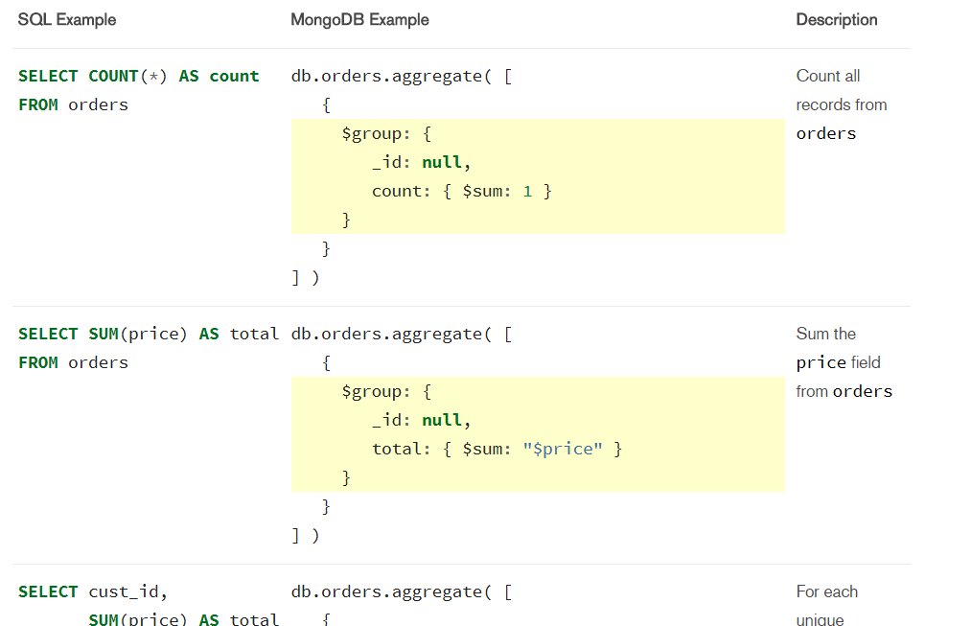
Aggregation
SQL to Aggregation Mapping Chart
Map-Reduce

Slide 25
Scaling
MongoDB
Replication
& sharding

Slide 26
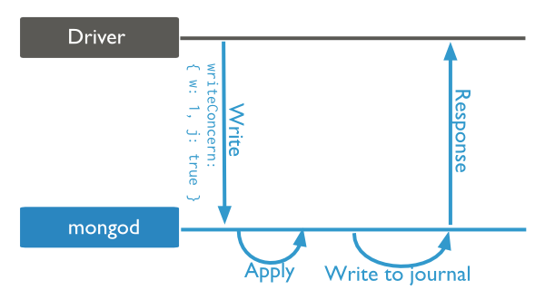
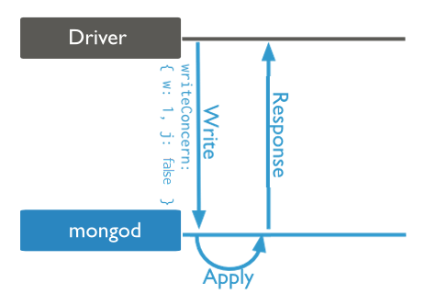
Write Concern
Write concern describes the guarantee that MongoDB provides when reporting success of a write operation.
{ w: <value>, j: <boolean>, wtimeout: <number> }
Journaled
Acknowledged

Slide 27
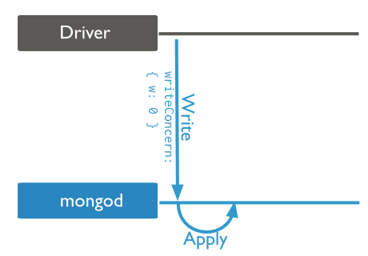
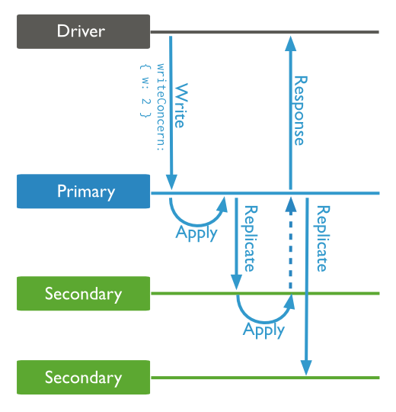
Write Concern
Unacknowledged
Replica Acknowledged

Slide 28
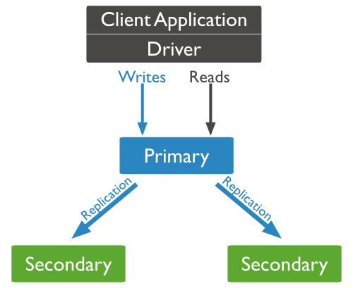
Replication
Primary instance accepts write operations from clients
Secondaries replicate data from primary
Clients can read from secondaries

Slide 29
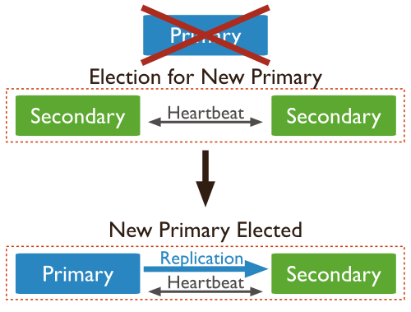
Replication
If the primary instance is unavailable, the replica set will elect a secondary to be primary

Slide 30
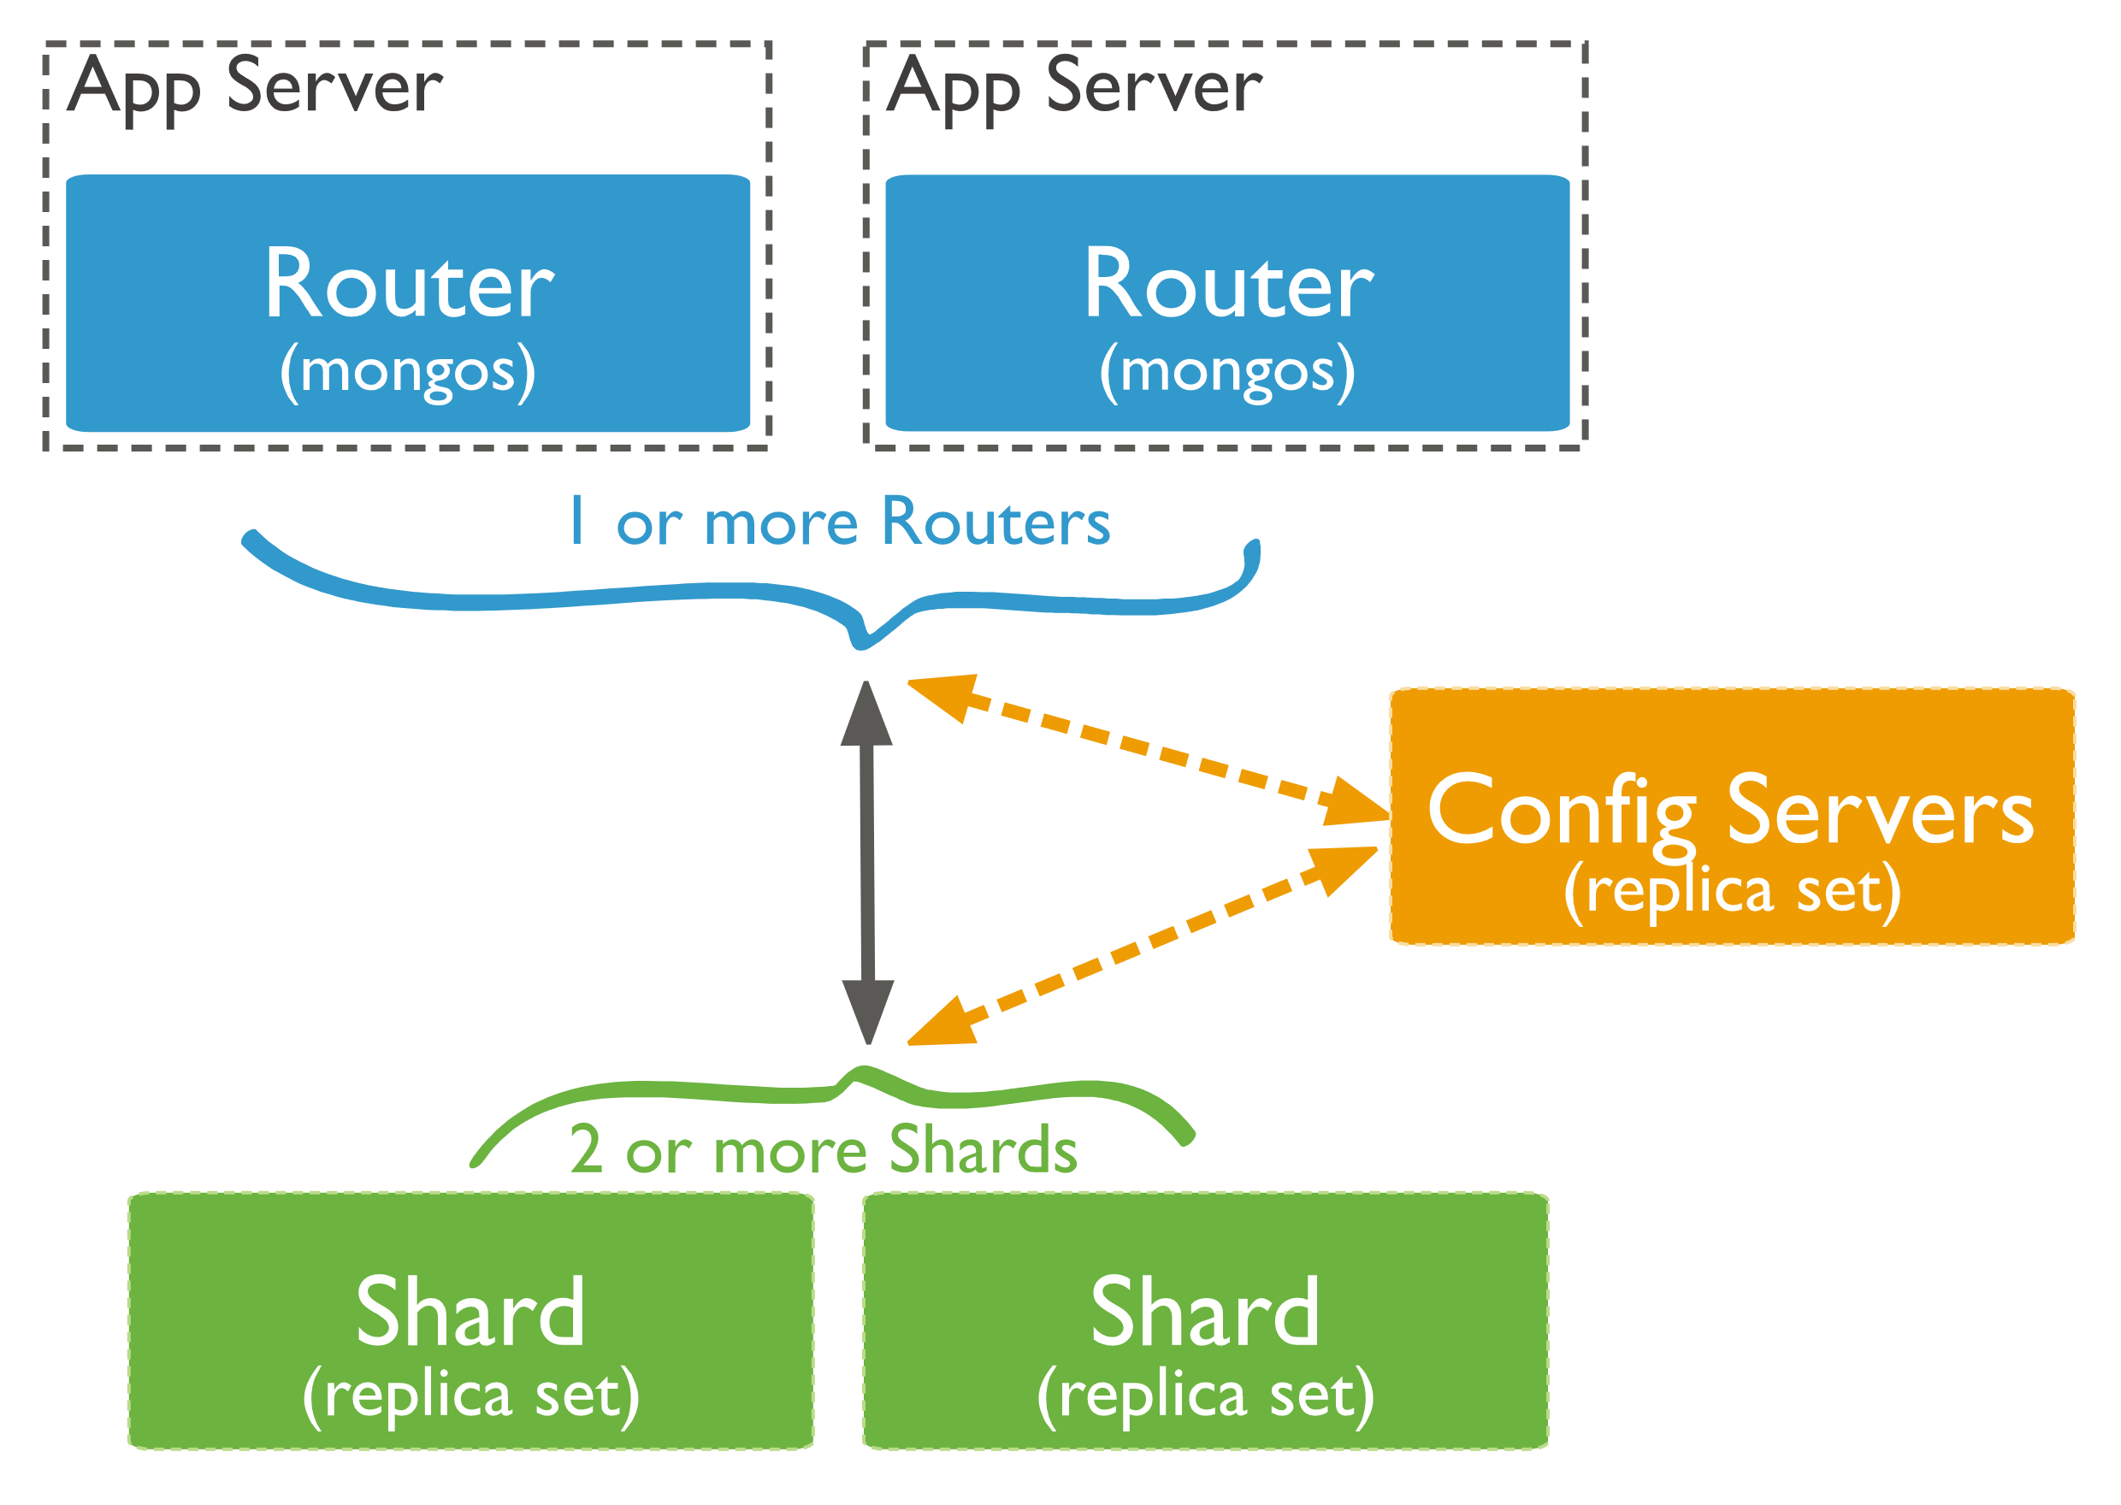
Sharding
Sharding is a method for distributing data across multiple machines.
Read and write operations can be distributed
Increased storage capacity
High availability

Slide 31
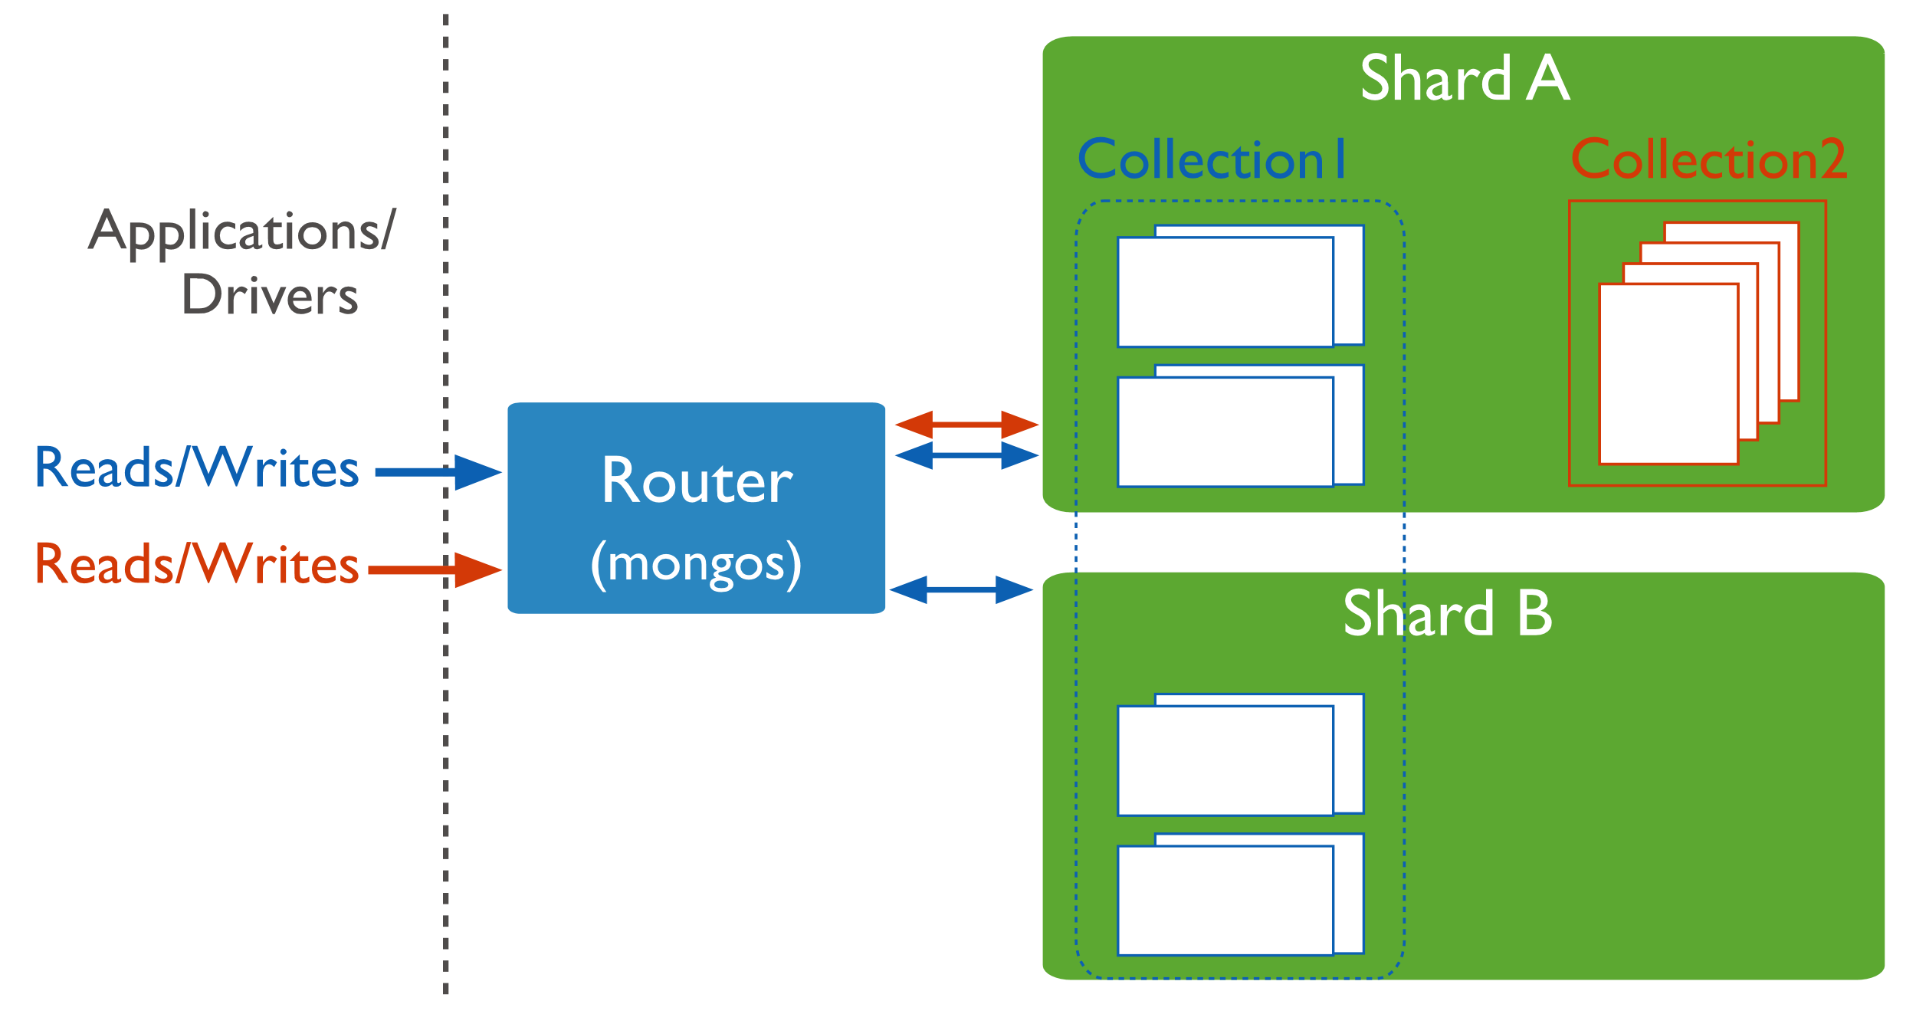
Sharding

Slide 32
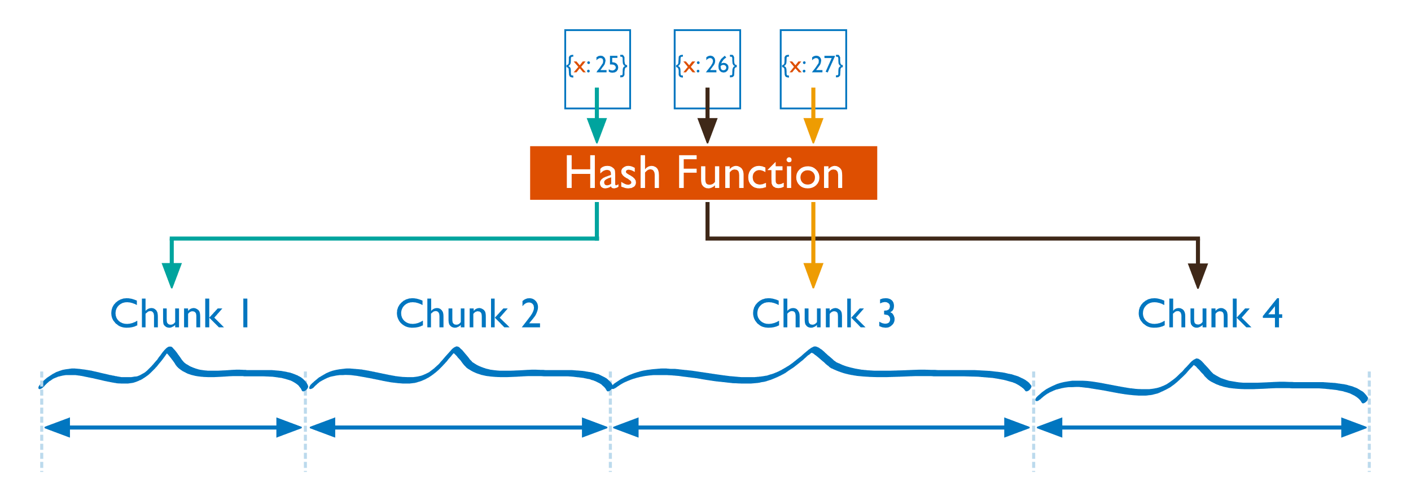
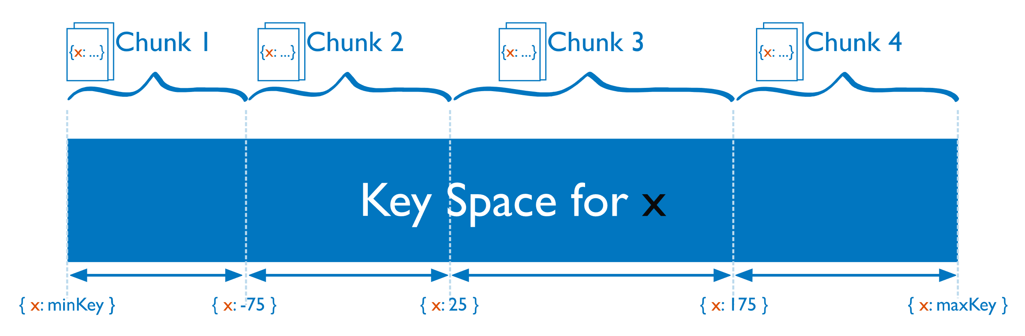
Sharding
Shard key is used to partition a collection. It is immutable and sharded collections can not be unsharded.
Hashed sharding
Ranged sharding

Slide 33
Sharding
Creating a Replica Set
Building a Sharded Environment
(lectures from MongoDB University)

Slide 34
Sharding
Q&A

