Slide 1

A Web Based Stock Forecaster
Priya Loke
Vikti Desai
Kiran Jatty
Lasya Nandamuri
Varun Vinnakota

Slide 2
Background
From many years, Stock investors are struggling to find a way out to find an optimum way of investing in stocks
Economists have been struggling to find an optimum prediction algorithm which would predict values of stocks optimally and reduce incurring losses
The main goal of our website is building an accurate and easy-to-use web interface which would help investors in their decision of buying, holding and selling shares.

Slide 3
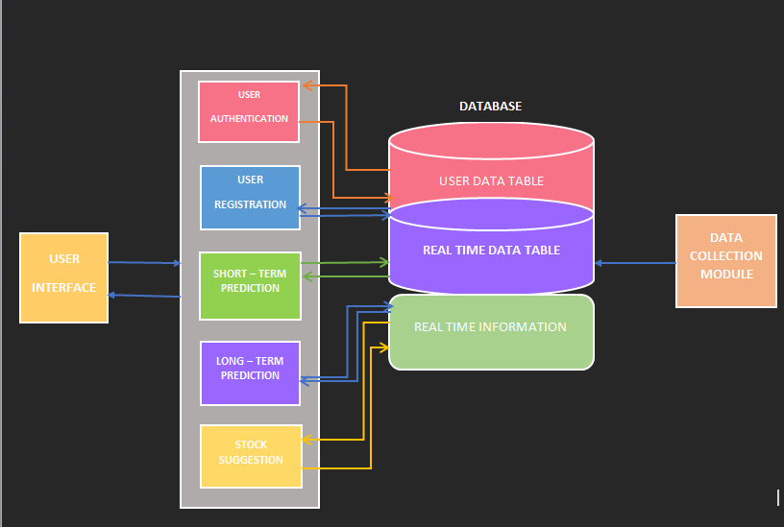
Architecture

Slide 4
Use Cases
UC1 – Register
UC 2 – Login
UC 3 – DropDown Search
UC 4 - Predict
UC 5- SuggestMe
UC 6- Logout
UC 7 – About
UC 8 – ContactUs
UC 9- ShowGraph
UC 10- Email Notification

Slide 5
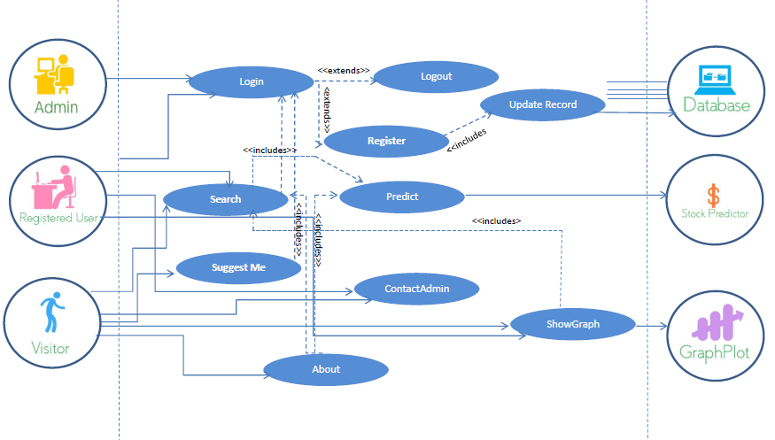
Use Case Diagram

Slide 6
Web Services
Login – Will Allow previous user to Log into the website
Register – Allows a new user to Register
Search – Helps to search a stock from the list of stocks
Predict – Predict Long Term and Short Term values of the selected stock and accordingly suggest the user to either buy, sell or hold stocks.
Current Best Deals- Allows the User to track the current best buys and sales in a glance
Graph – Helps user to view Graph of a given Stock
Contact Us- If the user has a query or problem, the user can contact the admin through email
Logout – Allows user to log out

Slide 7
Prediction Algorithms
LONG TERM PREDICTION:
We have implemented Artificial Neural Network (ANN) and SVM (Support Vector Machine) predictor for long term stock prediction to predict the stock price of the TICKER for the next five days.
Artificial Neural Networks:
We train the ANN with data collected from a url and validating it .
We then predict the stock closing price for next five days.
SVM:
SVM algorithm uses one year of historical stock high price per stock as the training dataset.
The predicted stock price using ANN is used as a test dataset.
SVM compares value from ANN with moving averages and determines the trend. This is used to suggest the user to either sell the stocks or buy more stocks.

Slide 8
Prediction Algorithms
SHORT TERM PREDICTION:
Bayesian Predictor:
It determines the mean and variance from given data set (taken from database).
These values are used to predict the ask price for the next minute.

Slide 9
Indicators:
Simple Moving Average(SMA):
A simple moving average (SMA) is a simple, or arithmetic moving average that is calculated by adding the closing price of the security for a number of time periods and then by dividing this total by the number of time periods.
Exponential moving Average(EMA):
Moving average that is similar to a simple moving average, except that more weight is given to the latest data.
They have less lag and are therefore more sensitive to recent prices and recent price changes.

Slide 10


Web Sources for Data Collection
Yahoo! Financ- - Used for Stock Data
Investopedia - Used for Stock Indicators

Slide 11
Technologies Used
We have coded our user interface from scratch using HTML , CSS and Jquery right from scratch
The server-side scripting was done in PHP
The algorithms were coded in Python
The web server used was Apache and the database technology used was MariaDB

Slide 12
Timeline
April 1st week: Implementation of long term and short term prediction algorithms to predict stock prices
April 2nd week: Developing the website(UI) using HTML, CSS, Javascript, AJAX
April 3rd week: Testing and further improvements
April 4th week: Final documentation

Slide 13
Roles
Although all team members have contributed equally to the project and giving equal inputs in all areas of the project, we have decided to give roles of supervision to subgroups
Database Management – Lasya Nandamuri, Priya Loke, Varun Vinnakota, Vikti Desai, Kiran Jatty
Web Design and UI – Vikti Desai, Kiran Jatty
Data Structures, Predictive Algorithms and Code- Priya Loke, Lasya Nandamuri
Technical and Non Technical Documentation – All Team Members

