Slide 1






Group Project 1

Slide 2
Agenda
Influencers on uber demand?
Influencers on uber price?
Uber Qasse

Slide 3




Influencers on uber demand?
Days or Dates
Weather Conditions
Location of Pickups

Slide 4
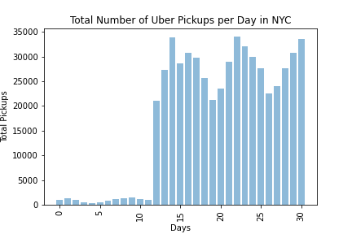

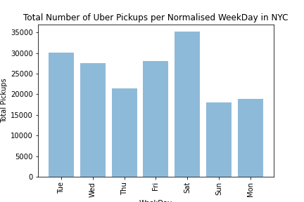
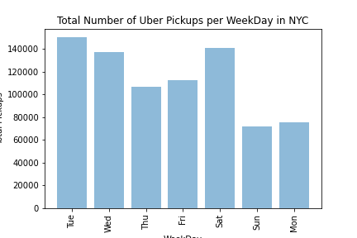
Days or Dates influence on uber demand?

Slide 5
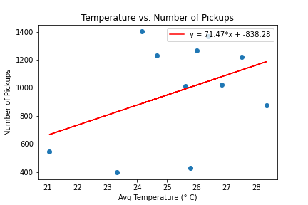
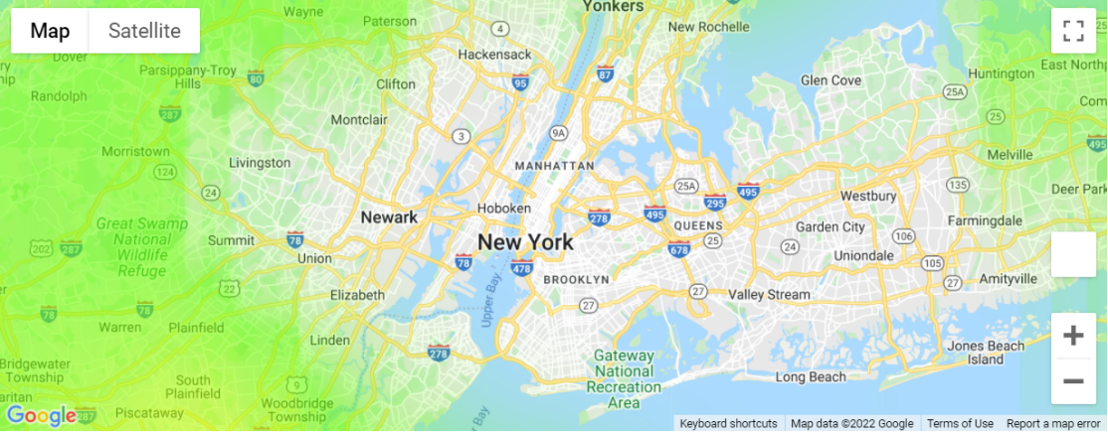
Weather influence on uber demand?

Slide 6
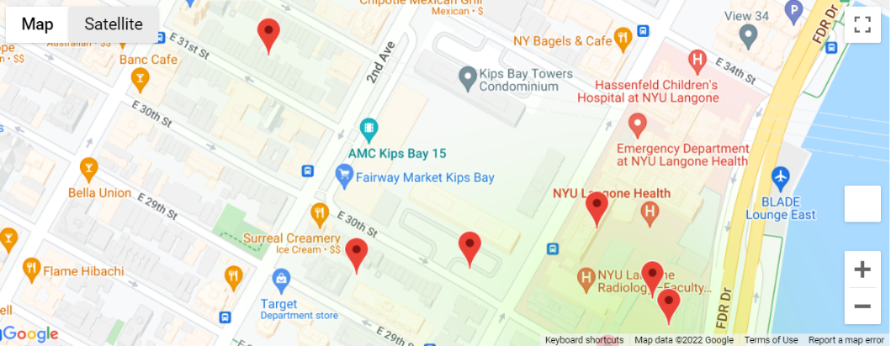
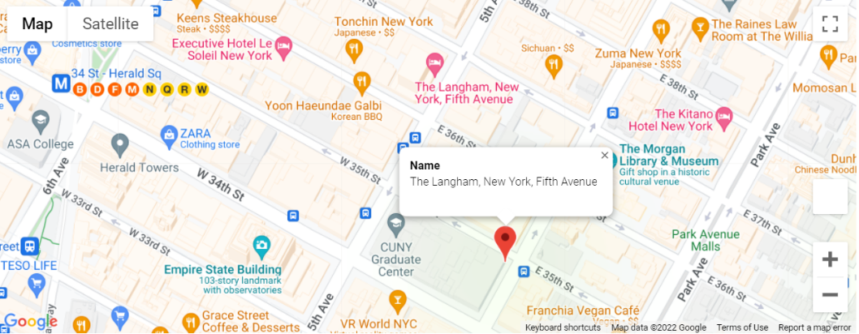
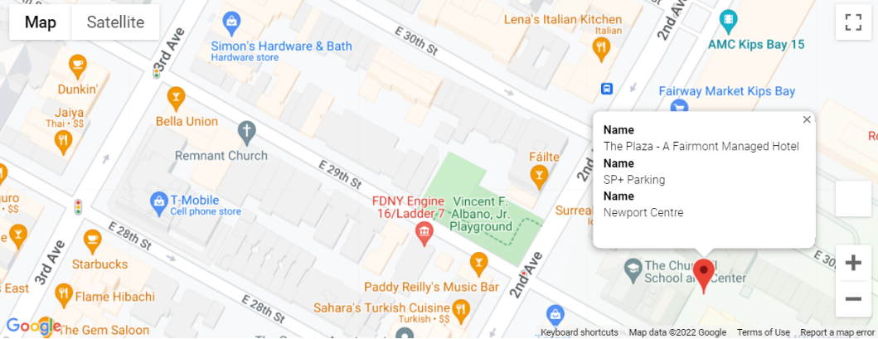
Location of Pickups influence on uber demand?

Slide 7

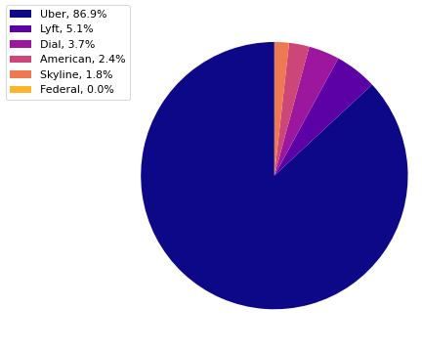
Uber vs Competition
Uber
Lyft
Dial
American
Skyline
Federal
(Federal data will not show as it does not contain individual ride data!)
For the purpose of demonstration
*The data that we received may not be able to judge as data from other providers were not as consistent.

Slide 8
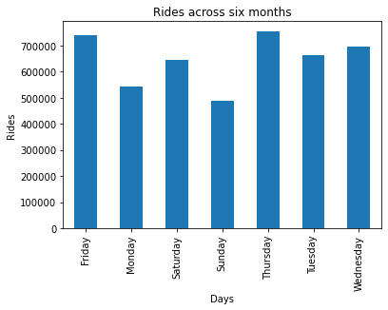
Uber data by themselves
Here, we look at Uber Data between April 2014 and September 2014
Spliting them up per weekdays
We see that the rides during weekdays are much more compared to the weekends (Saturday and Sunday)
The only day would be Monday vs Saturday
Varying reasons to results (Monday blues?)
This raises questions as to what do people mainly use uber for in New York City

Slide 9
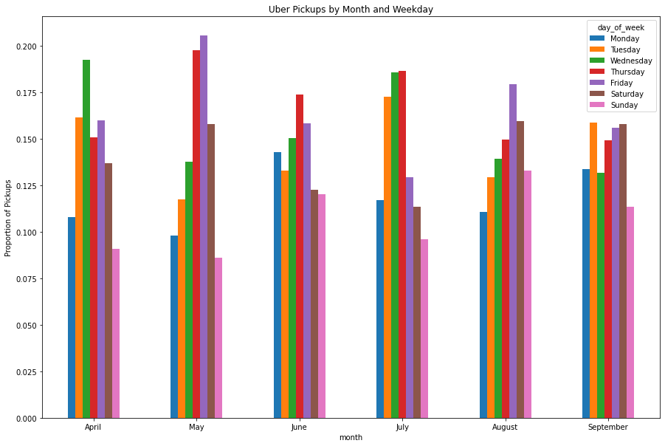
More: Uber Data Pickups during the week across the six months

Slide 11
Thank YOu

