Slide 1






Group Project 1

Slide 2
Agenda
Influencers on uber demand?
Influencers on uber price?
Uber Qasse

Slide 3




Influencers on uber demand?
Days or Dates
Weather Conditions
Location of Pickups

Slide 4
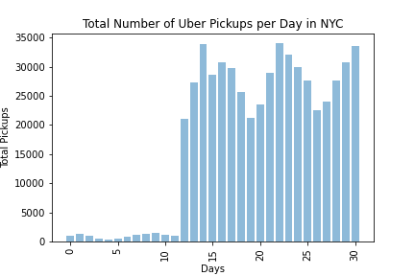

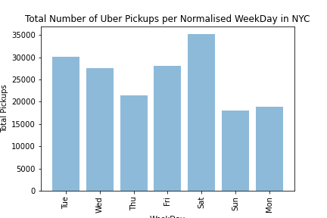
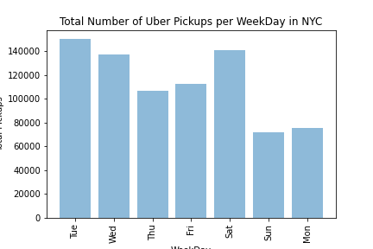
Days or Dates influence on uber demand?

Slide 5
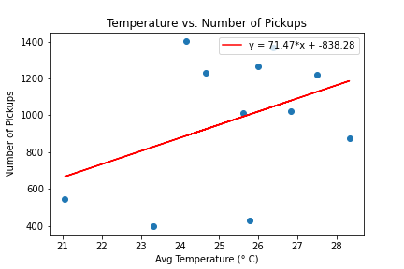
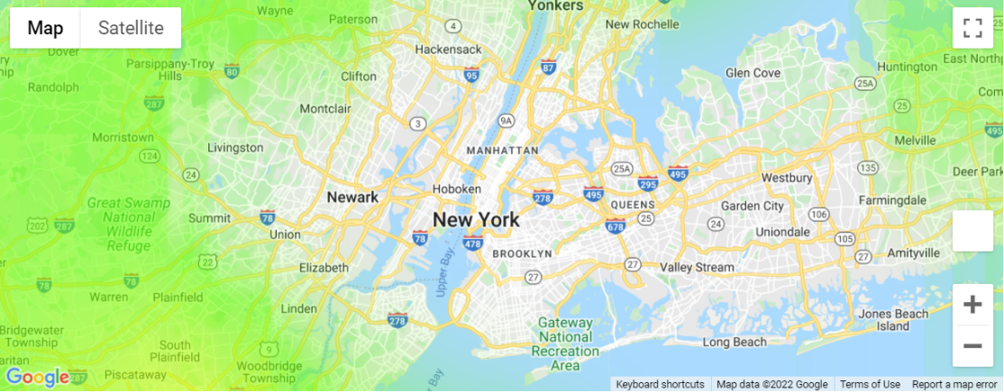
Weather influence on uber demand?

Slide 6
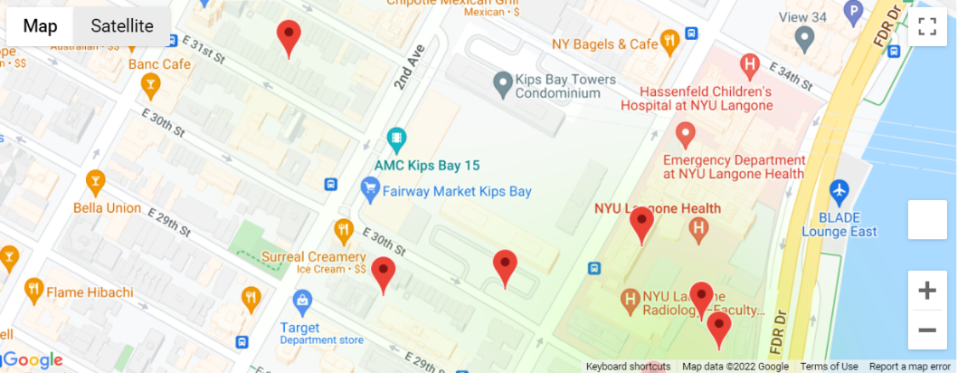
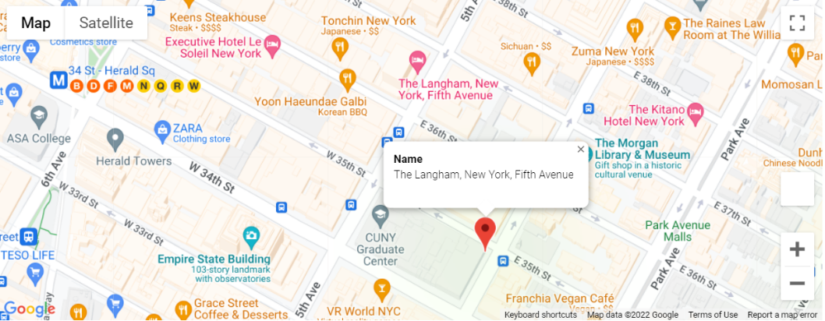
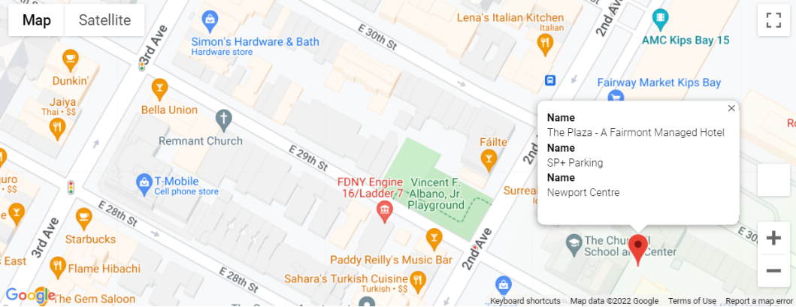
Location of Pickups influence on uber demand?

Slide 9
Thank YOu

