Slide 1
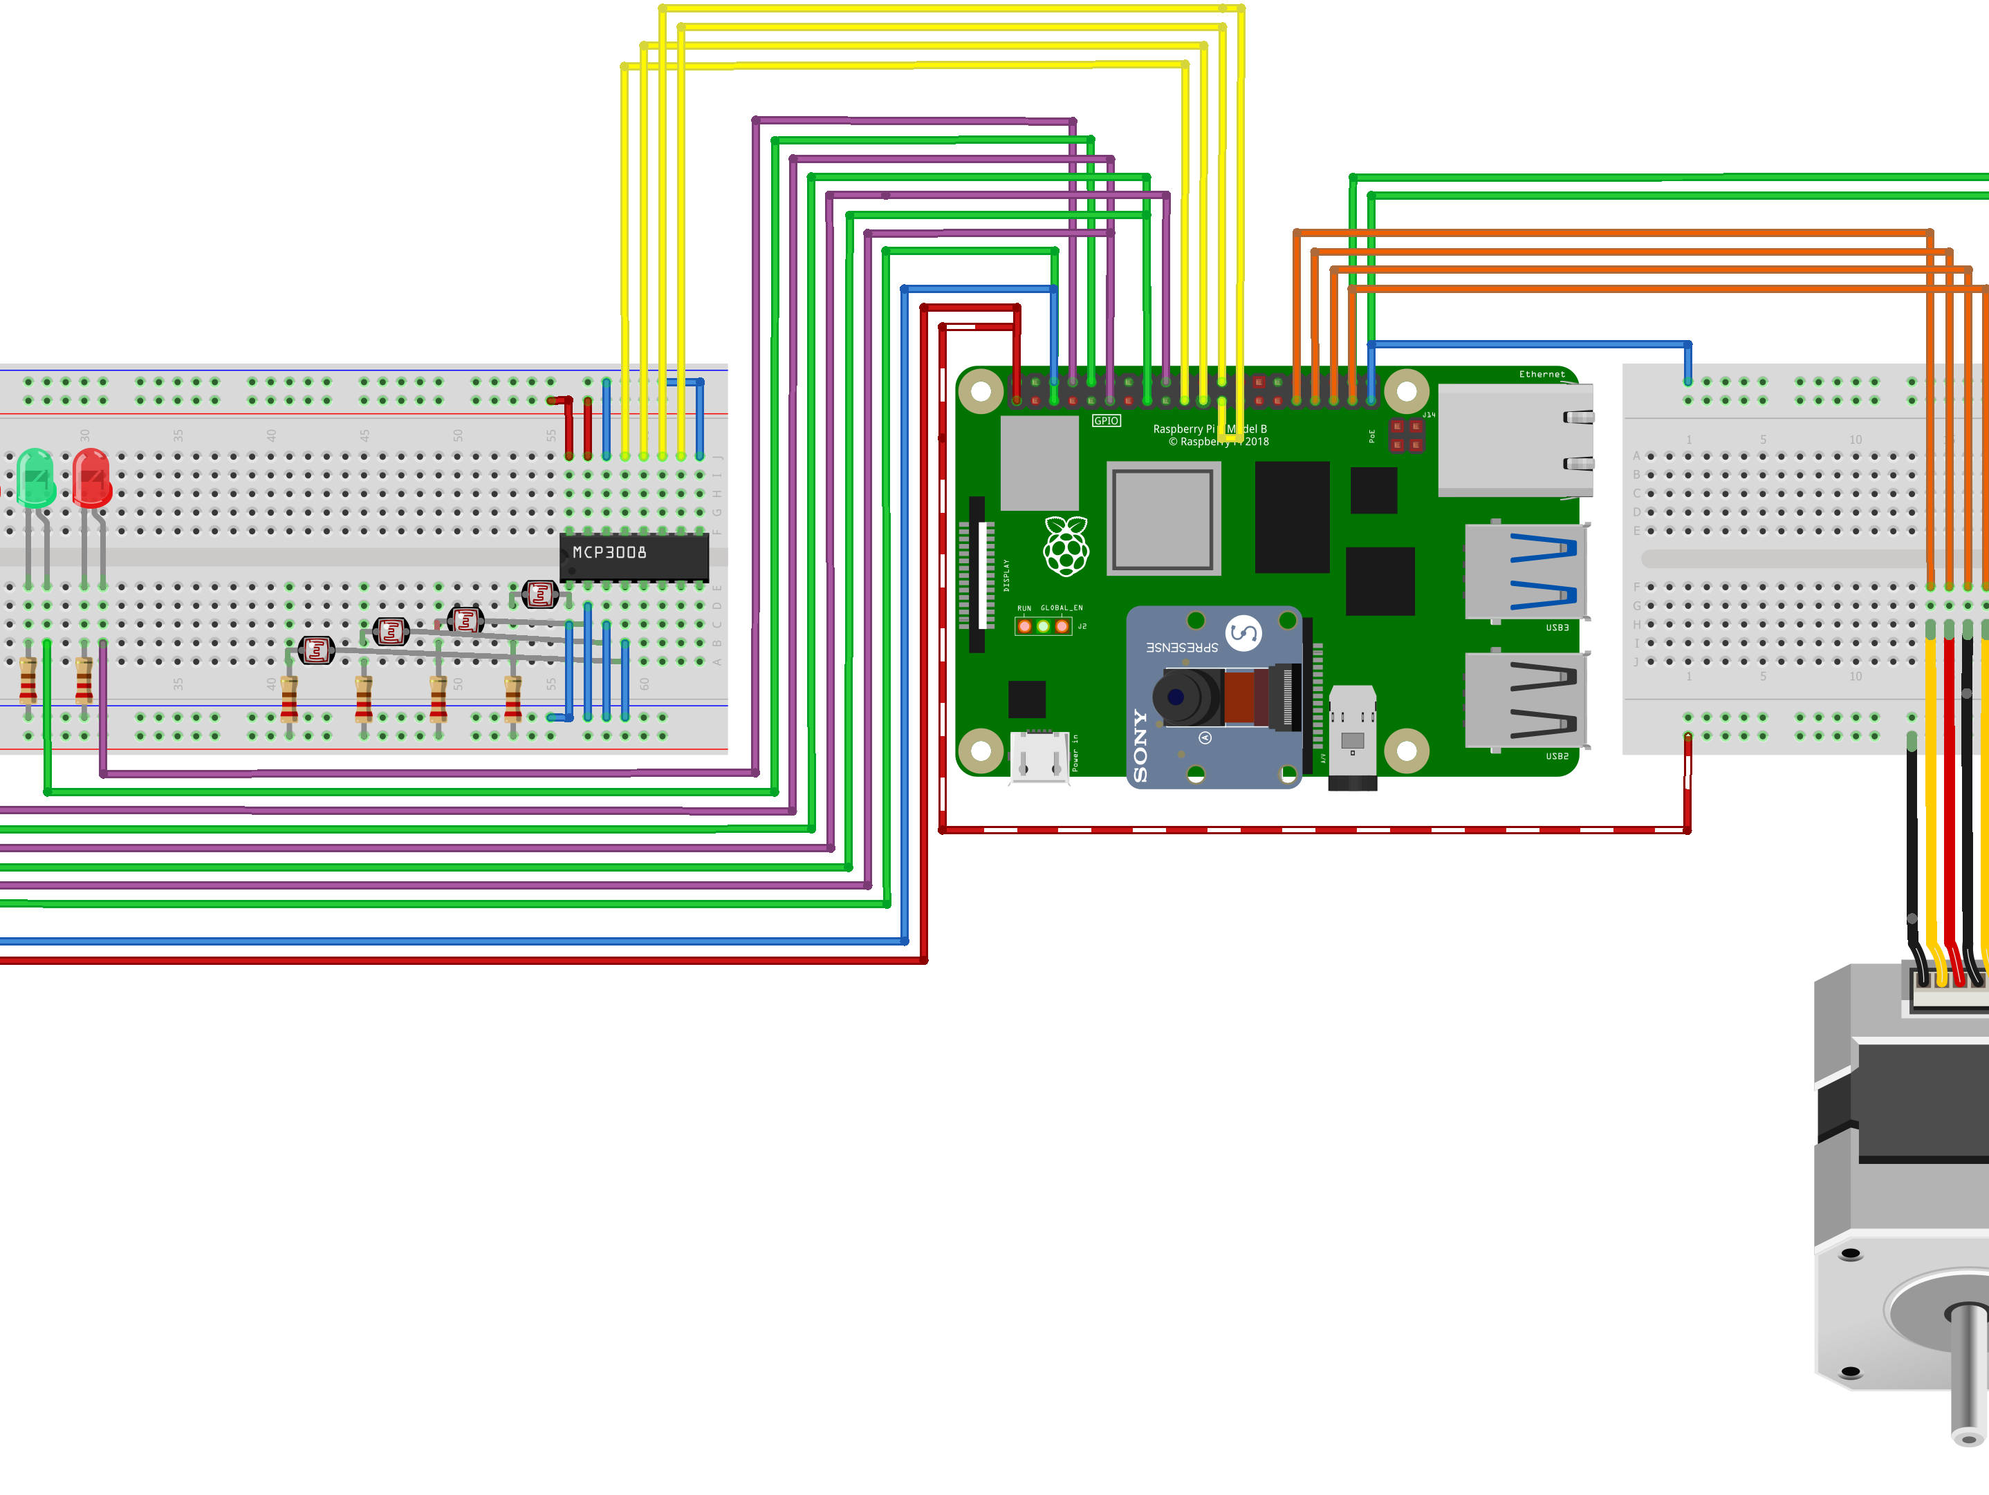
Parking place
Michiel Janssens, Emil Dudayev, Viktor Nagels, Bent Melis, Vincent Somers

Slide 2
efsfs
efsfse

