Slide 1

Replikacija analize podataka za Higsov bozon: Raspad u četiri leptona u ROOT Framework-u
Mentor:
dr Aleksandar Simović
Student:
Viktor Varkulja 469/23
Beograd, 2025

Slide 2
Deo istraživanja iz ovog rada predstavljen je na LINK IT & EdTech25 međunarodnoj konferenciji, gde je ocenjen kao visokokvalitetan doprinos sa ostvarenim zapaženim rezultatom. Ovo učešće potvrđuje značaj i kvalitet sprovedenog istraživanja.

Slide 3
Sažetak
Replikacija analize raspada Higsovog bozona (H → ZZ → 4l)
Ponavljanje analiza sa ograničenim resursima
CERN Open Data, CMSSW, ROOT, Google Cloud Platform
Stabilni histogrami i ponovljivost

Slide 4
Uvod
LHC u CERN-u
Otvorena nauka – CERN Open Data portal
Transparentnost, reproduktivnost i mogućnost novih analiza
Replikacija raspada H → ZZ → 4l pomoću javnih podataka i cloud infrastructure

Slide 5
Analitički pristup
Kvantna teorija polja i Standardni Model
Higsov bozon daje masu česticama
Otkriven 2012. godine sa masom od 125 GeV
Značajnost Big Data tehnologija fizike

Slide 6
ROOT Framework
ROOT Framework je softverski okvir razvijen u CERN-u za obradu i analizu velikih količina podataka
Open-source okvir od 1997 i standard u CMS/ATLAS eksperimentima
Objektno orijentisana arhitektura sa klasama u C++ jeziku
.root fajlovi: kompresovani, hijerarhijski (TTree/branches/leaves)

Slide 7
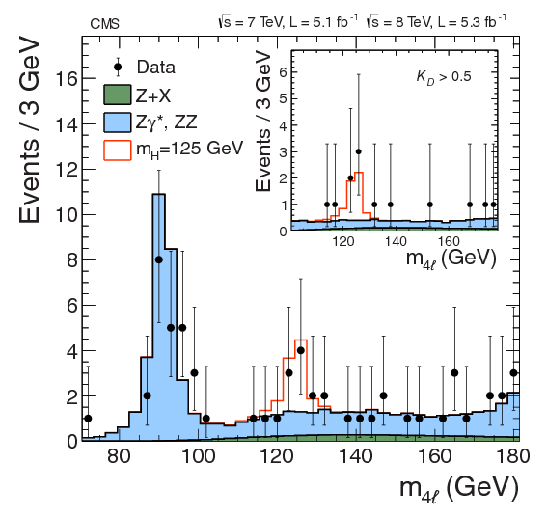
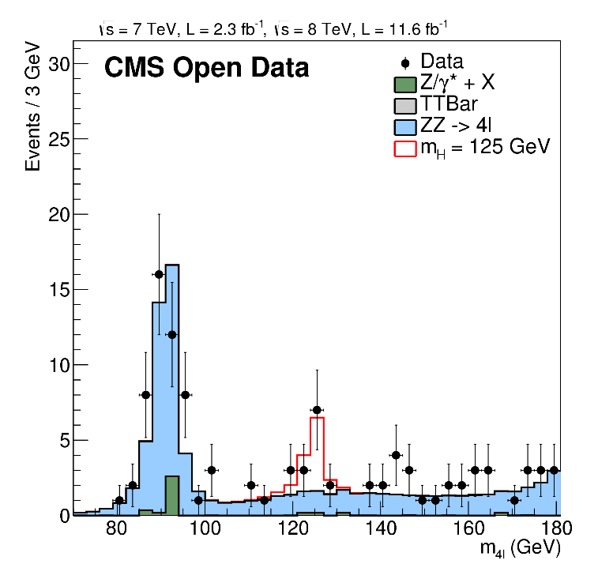
Replikacija analize podataka
Četiri nivoa replikacije
Prvi nivo replikacije, upoređenje:

Slide 8
Replikacija analize podataka
Drugi nivo replikacije, reprodukcija pomoću virtualne mašine:
#postavljenje okruženja
cmsrel CMSSW_5_3_32
cd CMSSW_5_3_32/src
cmsenv
#nova datoteka
mkdir rootfiles
cd rootfiles
#dohvatanje ROOT fajlova
wget https://opendata.web.cern.ch/record/5501/files/rootfilelist.txt
wget -i rootfilelist.txt
#preuzimanje i pokretanje C++ makroa
wget https://opendata.web.cern.ch/record/5500/files/M4Lnormdatall.cc
root -l M4Lnormdatall.cc

Slide 9
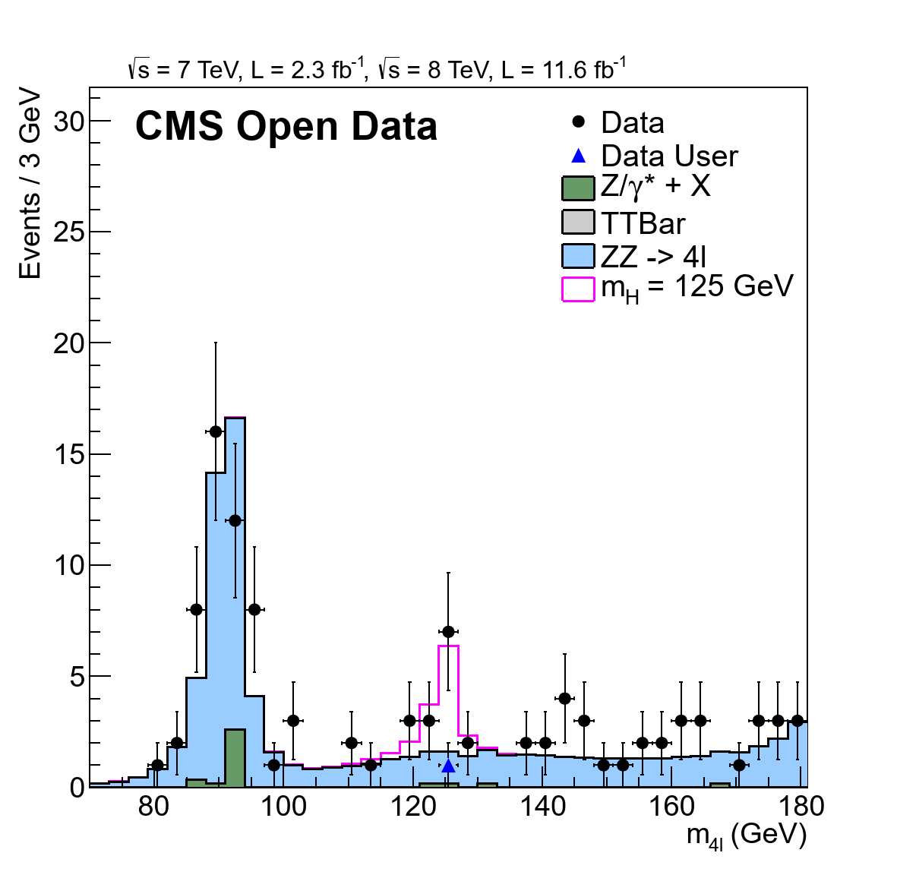
Replikacija analize podataka
Treći nivo replikacije, produkcija Higsovog kandidata:
#preuzimanje i kompajliranje HiggsDemoAnalyzer.cc
mkdir src
cd src
wget https://opendata.web.cern.ch/record/5500/files/HiggsDemoAnalyzer.cc
cd ..
scram b
. . .
#pokretanje analize podataka
cd ..
cmsRun demoanalyzer_cfg_level3data.py
cmsRun demoanalyzer_cfg_level3MC.py
. . .
#preuzimanje i pokretanje c++ makroa
wget https://opendata.web.cern.ch/record/5500/files/M4Lnormdatall_lvl3.cc
root -l M4Lnormdatall_lvl3.cc

Slide 10
Replikacija analize podataka
Python fajl demoanalyzer_cfg_level3data.py:
. . .
# define JSON file for 2012 data
goodJSON = '/home/cms-opendata/CMSSW_5_3_32/src/Demo/DemoAnalyzer/datasets/Cert_190456-208686_8TeV_22Jan2013ReReco_Collisions12_JSON.txt' myLumis = LumiList.LumiList(filename = goodJSON).getCMSSWString().split(',')
. . .
# to speed up, pick single example file with 1 nice 2mu2e Higgs candidate
# (9058 events)
process.source = cms.Source("PoolSource",
fileNames = cms.untracked.vstring(
'root://eospublic.cern.ch//eos/opendata/cms/Run2012C/DoubleMuParked/AOD/22Jan2013-v1/10000/F2878994-766C-E211-8693-E0CB4EA0A939.root'
)
)
. . .
process.demo = cms.EDAnalyzer('HiggsDemoAnalyzer')

Slide 11
Replikacija analize podataka
C++ fajl HiggsDemoAnalyzer.cc:
class HiggsDemoAnalyzer: public edm::EDAnalyzer {
public:
explicit HiggsDemoAnalyzer(const edm::ParameterSet&);
~HiggsDemoAnalyzer();
private:
virtual void beginJob();
virtual void analyze(const edm::Event&, const edm::EventSetup&);
virtual void endJob();
bool providesGoodLumisection(const edm::Event& iEvent);
TH1D *h_globalmu_size;
TH1D *h_recomu_size;
TH1D *h_e_size;
. . .
}

Slide 12
Replikacija analize podataka
// Loop over muons size and select good muons
for (unsigned u = 0; u < muons->size(); u++)
{
const reco::Muon &itMuon = (*muons)[u];
// math::XYZPoint point(beamSpot.position());
math::XYZPoint point(primvtx[0].position());
// select global particle flow muons
// some muons might not have valid track references
if (itMuon.isPFMuon() && itMuon.isPFIsolationValid() && (itMuon.globalTrack()).isNonnull())
{
h_p_reco->Fill(itMuon.p());
h_pt_reco_b4->Fill(itMuon.pt());
h_eta_reco_b4->Fill(itMuon.eta());
h_phi_reco->Fill(itMuon.phi());
. . .
if (std::abs(SIP3d_mu) < 4. && std::abs((itMuon.globalTrack())->dxy(point)) < 0.5 && std::abs((itMuon.globalTrack())->dz(point)) < 1. && relPFIso_mu < 0.4)
{
if (itMuon.pt() > 5. && std::abs(itMuon.eta()) < 2.4)
{
vIdPtmu.push_back( std::make_pair(u, itMuon.pt()) );
}
}
} // end of if (itMuon.isPFMuon().........
} // end muons loop

Slide 13
Replikacija analize podataka
//============================ ZTo2Electron start ============================//
if (nGoodElectron >= 2)
{
const reco::GsfElectron &elec1 = (*electrons)[vIdPte.at(0).first];
const reco::GsfElectron &elec2 = (*electrons)[vIdPte.at(1).first];
if (elec1.charge() + elec2.charge() == 0)
{
for (unsigned i = 0; i < vIdPte.size(); i++)
{
// These pT and eta are filled after all the cuts
// access directly .second as the second pair is already pT
h_pt_e_after_Zto2e->Fill(vIdPte.at(i).second);
h_eta_e_after_Zto2e->Fill((((*electrons)[vIdPte.at(i).first]).superCluster())->eta());
}
s1 = sqrt(((elec1.p()) * (elec1.p()) + sqme) * ((elec2.p()) * (elec2.p()) + sqme));
s2 = elec1.px() * elec2.px() + elec1.py() * elec2.py() + elec1.pz() * elec2.pz();
s = sqrt(2.0 * (sqme + (s1 - s2)));
h_mZ_2e->Fill(s);
}
}
//========================== ZTo2Electron end ================================//

Slide 14
Replikacija analize podataka
C++ fajl M4Lnormdatall_lvl3.cc:
// Replace the input file for Higgs MC 2012
// with user's generated Higgs input file level 3
string inFileHZZ12 = "Higgs4L1file.root"; // Add the input file for data
// with user's generated data input file level 3
string inFileUser = "DoubleMuParked2012C_10000_Higgs.root";
. . .
//////////////////////// HISTOGRAM 1 DATA FILE FROM USER ///////////////////////
f3 = TFile::Open((inDir + inFileUser).c_str());
TH1D *DouMuser = (TH1D*) f3->Get("demo/mass2mu2e_8TeV_low")->Clone();
DouMuser->SetMarkerColor(kBlue);
DouMuser->SetMarkerStyle(22);
DouMuser->SetMarkerSize(2.0);
DouMuser->SetLineColor(kBlack);
DouMuser->SetLineWidth(1);

Slide 15
Četvrti nivo replikacije
Pararelizacija, Amdahlov zakon i Gustafsonov zakon
Google Cloud Platforma
Indeks fajlovi, ukupno ~200.000.000 događaja
Prikupljanje indeks fajlova pomoću cernopendata-client paketa

Slide 16
Četvrti nivo replikacije
Bash skripta za prikuljanje indeks fajlova
#!/bin/bash
INPUT_FILE="List_indexfile.txt"
OUTPUT_DIR="indexfiles" # Create output directory if it doesn't exist
mkdir -p "$OUTPUT_DIR" # Read each line from List_indexfile.txt
while IFS= read -r DATASET_PATH; do
# Skip empty lines and comments
[[ -z "$DATASET_PATH" ]] && continue
[[ ! "$DATASET_PATH" =~ ^/ ]] && continue # Make a safe filename from dataset path
SAFE_NAME=$(echo "$DATASET_PATH" | tr '/' '_' | tr ' ' '_') echo "Fetching file locations for: $DATASET_PATH"
# Run cernopendata-client and save output
cernopendata-client get-file-locations \
--title "$DATASET_PATH" \
--protocol xrootd &> "$OUTPUT_DIR/${SAFE_NAME}.txt" echo "Saved to: $OUTPUT_DIR/${SAFE_NAME}.txt"
done < "$INPUT_FILE"

Slide 17
Četvrti nivo replikacije
Priprema za obradu:
Očekivano prosečno vreme obrade po događaju: 0,008732 s
Mogući broj događaja obrađeno za 24 h: 9.894.640
Broj indeks fajlova: 21
Broj virtualnih mašina: 38 (23 data + 15 MC)
CernVM image i podešavanje okruženja pomoću kontekst fajlova
Podešavanje NAT gateway-a

Slide 18
Četvrti nivo replikacije
Bash skript fajl za kreiranje virtualnih mašina:
#!/bin/bash
VM_NAMES_FILE="vm-names-first-5"
#PROJECT="beaming-octagon-462413-s6" #project for data sets
PROJECT="mcsets-analisys-higgs-boson"
#ZONE="europe-west1-b" #First zone, limit 20 instances
ZONE="europe-central2-a"
SERVICE_ACCOUNT="484133232890-compute@developer.gserviceaccount.com"
DISK_IMAGE="projects/beaming-octagon-462413-s6/global/images/cern-vm-08-10"
STARTUP_FILE="./cms-opendata-startup.context"
while read -r VM_NAME; do
if [ -z "$VM_NAME" ]; then
continue
fi
echo "Dry run: Creating VM $VM_NAME ..."
gcloud compute instances create "$VM_NAME" \
--project="$PROJECT" \
--zone="$ZONE" \
--machine-type=e2-medium \
--network-interface=network-tier=PREMIUM,stack-type=IPV4_ONLY,subnet=default,no-address \
--service-account="$SERVICE_ACCOUNT" \
. . .
--enable-display-device \
--tags=http-server,https-server \
--create-disk=auto-delete=yes,boot=yes,device-name=persistent-disk-0,image=$DISK_IMAGE,mode=rw,size=20,type=pd-standard \
--labels=project=cernvm-opendata,vm-name="$VM_NAME" \
--reservation-affinity=any \
--metadata-from-file user-data="$STARTUP_FILE"
done < "$VM_NAMES_FILE"

Slide 19
Četvrti nivo replikacije
Konfiguracija demoanalyzer.py fajlova:
# **********************************************************************
# set the maximum number of events to be processed *
# this number (argument of int32) is to be modified by the user *
# according to need and wish *
# default is preset to -1 (all events) *
# 9894640 events per 24 hour *
# **********************************************************************
process.maxEvents = cms.untracked.PSet( input = cms.untracked.int32(9894640) )
. . .
# use the following if you want to run over a full index file
# *** DoubleMuParked2012C_10000 data set (many million events) ***
files2012data = FileUtils.loadListFromFile ('/home/cms-opendata/CMSSW_5_3_32/src/Demo/DemoAnalyzer/datasets/_DoubleElectron_Run2011A-12Oct2013-v1_AOD.txt')
process.source = cms.Source("PoolSource",
fileNames = cms.untracked.vstring(*files2012data
)
)
. . .
# *************************************************
# number of events to be skipped (0 by default) *
# *************************************************
process.source.skipEvents = cms.untracked.uint32(3*9894640)

Slide 20
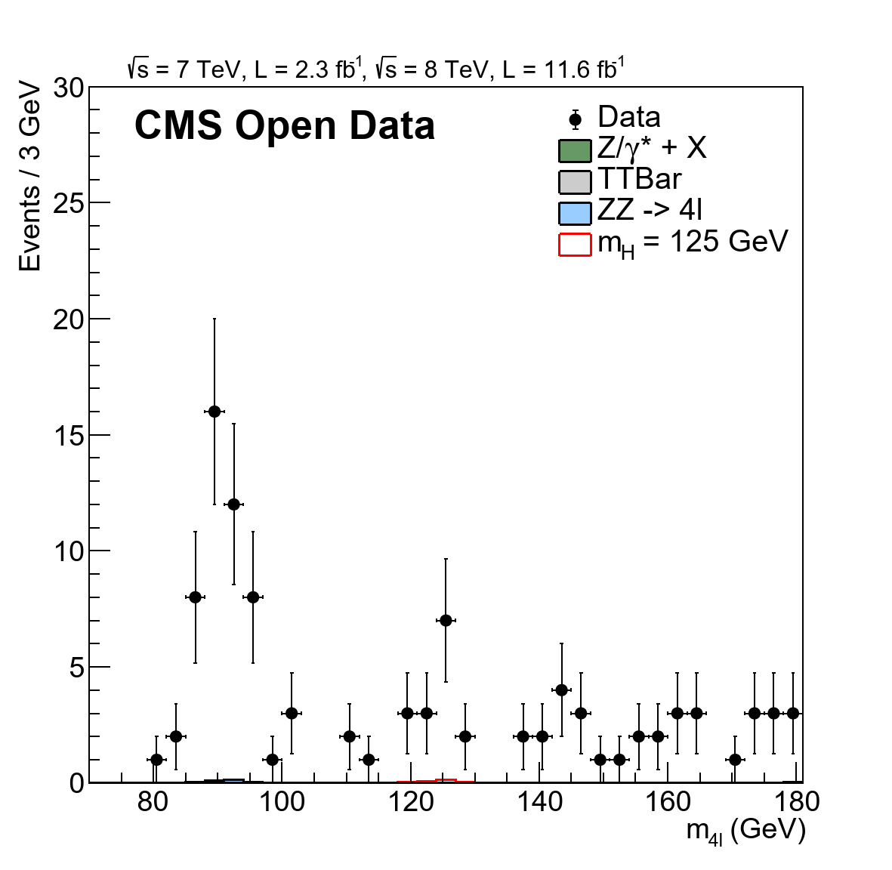
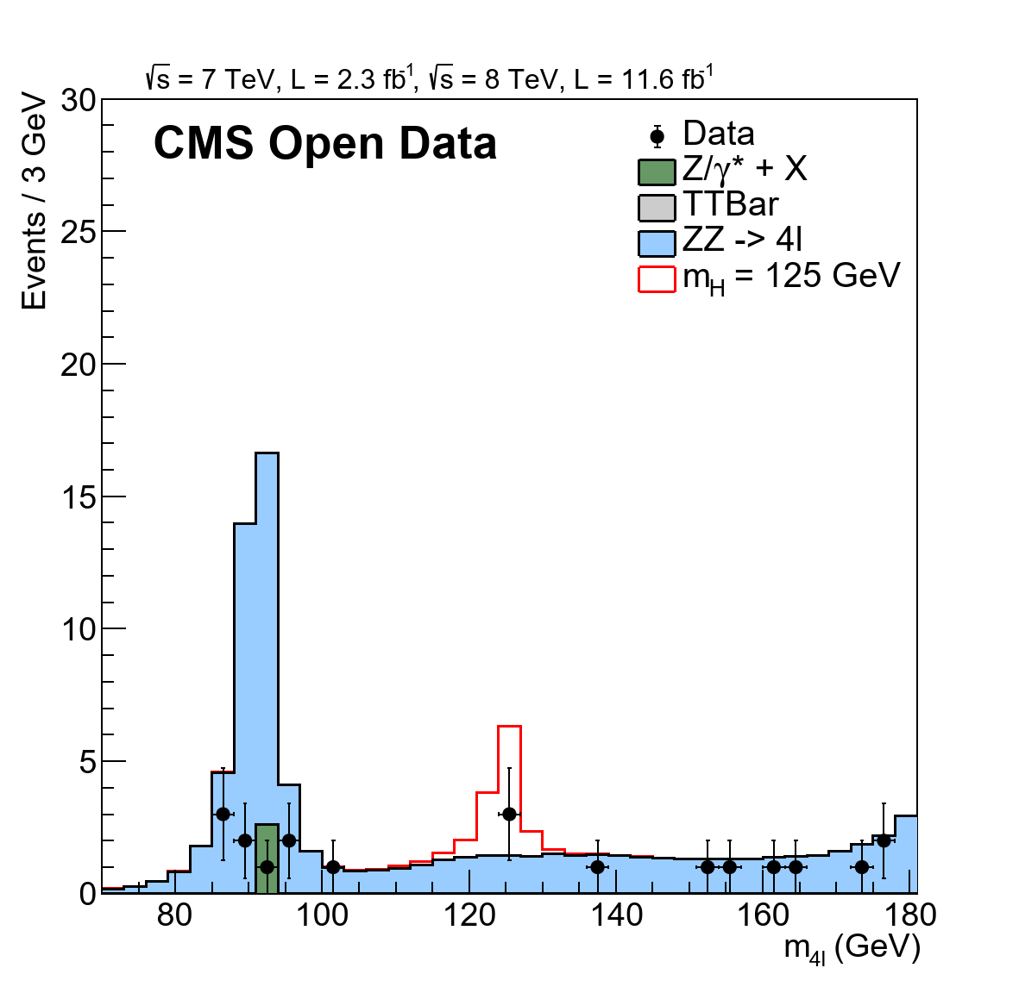
Rezultati replikacije
Rezultat sa generisanim MC podacima
Rezultat sa delimično uključenim stvarnim podacima

Slide 21
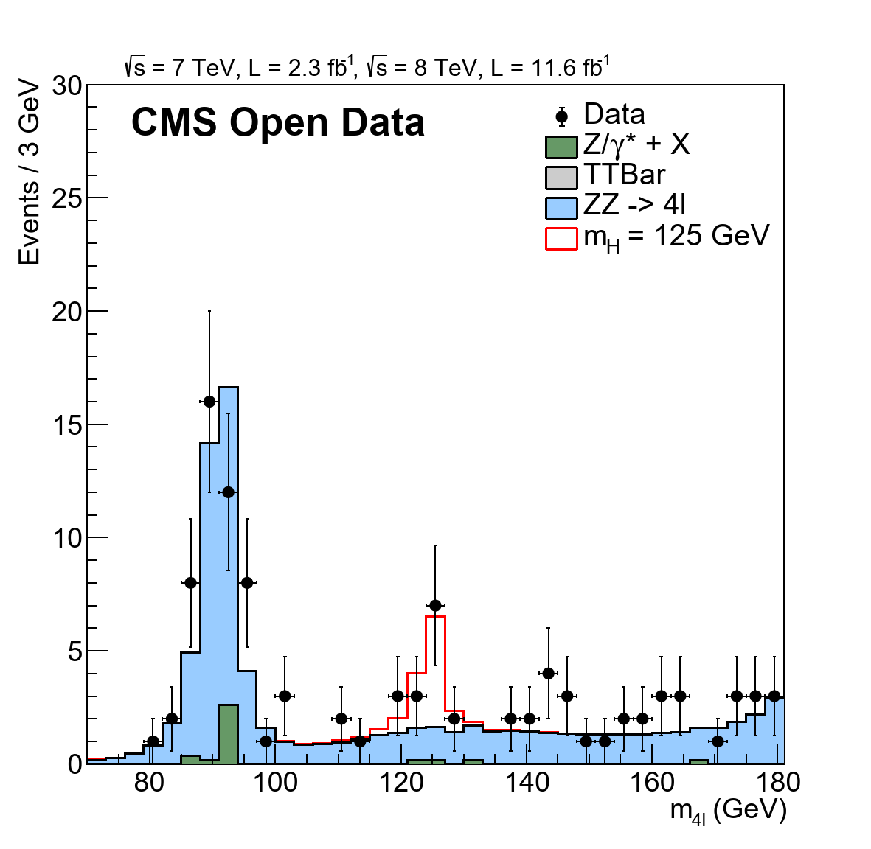
Rezultati replikacije
Rezultat sa svim generisanim podacima
// Name of the input file for MC
string inFileZZ4mu12 = "ZZ4mu12.root"; //"ZZTo4mu_8TeV_12.root";
string inFileZZ4e12 = "ZZ4e12.root"; //"ZZTo4e_8TeV_12.root";
string inFileZZ2mu2e12 = "ZZ2mu2e12.root"; //"ZZTo2e2mu_8TeV_12.root";
string inFileZZ4mu11 = "ZZ4mu11.root"; //"ZZTo4mu_mll4_7TeV_11.root";
string inFileZZ4e11 = "ZZ4e11.root"; //"ZZTo4e_mll4_7TeV_11.root";
string inFileZZ2mu2e11 = "ZZ2mu2e11.root"; //"ZZTo2e2mu_mll4_7TeV_11.root";
string inFileHZZ12 = "HZZ12.root"; // "SMHiggsToZZTo4L_M-125_8TeV_12.root";
string inFileHZZ11 = "HZZ11.root"; // "SMHiggsToZZTo4L_M-125_7TeV_11.root";
string inFileTTBar12 = "TTBar12.root"; // "TTbar_8TeV_12.root";
string inFileTTBar11 = "TTBar11.root"; // "TTTo2L2Nu2B_7TeV_11.root";
string inFileDY5012 = "DY50TuneZ12.root"; // "DYJetsToLL_M-50_TuneZ2_12.root";
string inFileDY5011 = "DY50TuneZ11.root"; //"DYJetsToLL_TuneZ2_M-50_11.root";
string inFileDY1012 = "DY1012.root"; //"DYJetsToLL_M-10to50_12.root";
string inFileDY1011 = "DY1011.root"; //"DYJetsToLL_M-10To50_11.root";
// Name of input file for data
string inFileDouMu12 = "DoubleMuParked_Run2012.root"; //"DoubleMu12.root
string inFileDouMu11 = "DoubleMu_Run2011.root"; //"DoubleMu11.root";
string inFileDouE12 = "DoubleElectron_Run2012.root"; //"DoubleE12.root";
string inFileDouE11 = "DoubleElectron_Run2011.root"; //"DoubleE11.root";

Slide 22
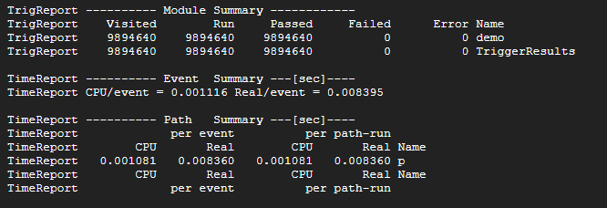
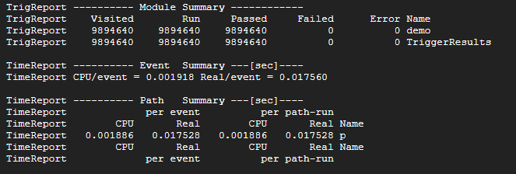
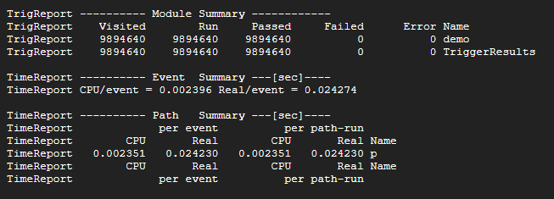
Rezultati replikacije
Rezultati sa očekivanom brzinom obrade (~0,0087 s po događaju)
Rezultati sa prosečnim vremenom obrade približno duplo u odnosu na očekivano vreme
Rezultati sa prosečnim vremenom obrade oko tri puta veće od planirane vrednosti

Slide 23
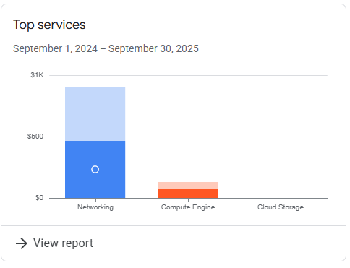
Rezultati replikacije
Prikaz troškova obrade na Google Cloud Platformi

Slide 24
Zaključak
Uspešna replikacija analize podataka
Otvorena nauka pruži transparentnost i reproduktivnost
Nepotpuni MC datasetovi daju praznine i fluktuacije, dopunjeni podacima sa ranijih nivoa
Realni podaci daju očekivani oblik histograma što validuje korištene metode
Preporuke:
proveravati dostupnost datasetova,
povećati automatizaciju,
širiti metod na druge kanale/datasetove

