Slide 1

Artificial Intelligence

Slide 2
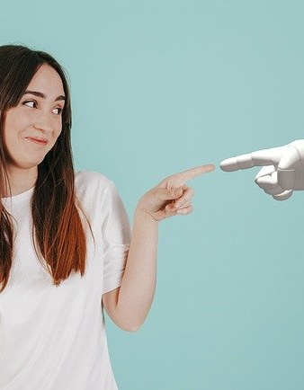
Artificial intelligence
Artificial intelligence (AI) is intelligence demonstrated by machines, as opposed to natural intelligence displayed by animals including humans.
Mind
Learning
Problem solving

Slide 3
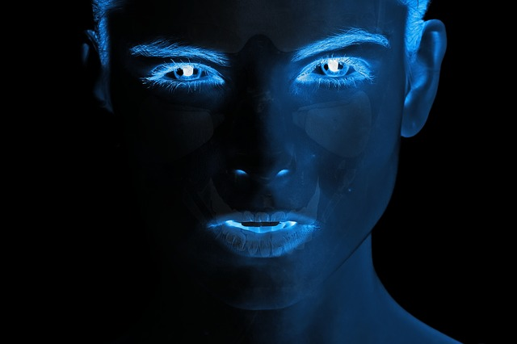
Can machines think?
Alan Turing wrote in 1950 "I propose to consider the question 'can machines think'?" He advised changing the question from whether a machine "thinks", to "whether or not it is possible for machinery to show intelligent behaviour"
Thinking vs. acting: the Turing test

Slide 4
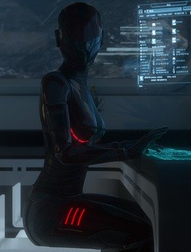
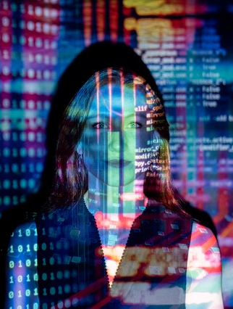
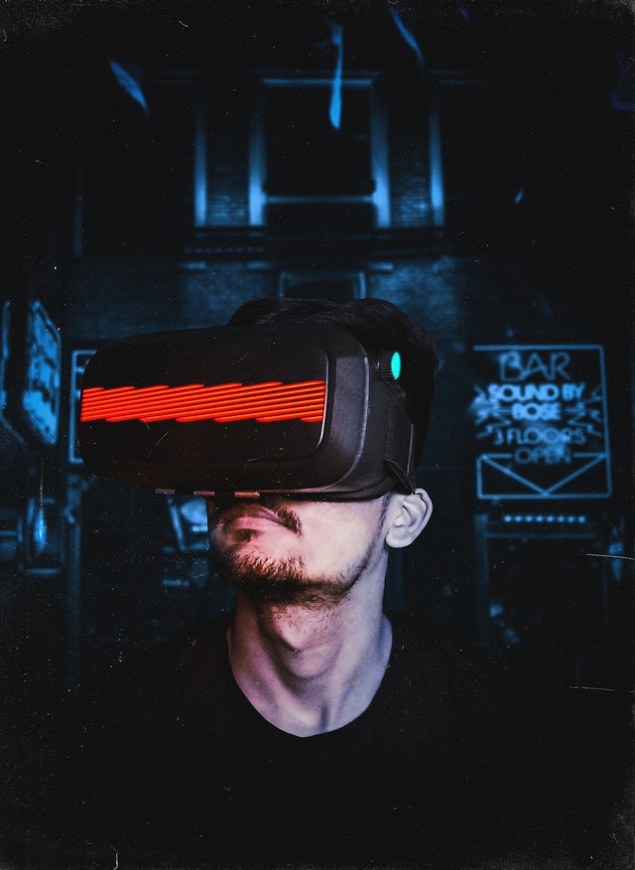
AI everyday
AI applications include advanced web search engines (e.g., Google), recommendation systems (used by YouTube, Amazon and Netflix), understanding human speech (such as Siri and Alexa), self-driving cars (e.g., Tesla), automated decision-making and competing at the highest level in strategic game systems

Slide 5
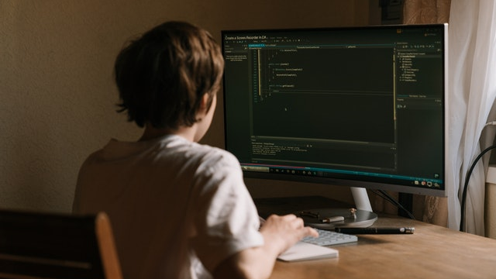
AI in games
Poker
Game playing has been a test of AI's strength since the 1950s. Deep Blue became the first computer chess-playing system to beat a reigning world chess champion, Garry Kasparov, on 11 May 1997.
Chess
Computer Go

Slide 6

CAN AI BE DANGEROUS
Most researchers agree that a superintelligent AI is unlikely to exhibit human emotions like love or hate, and that there is no reason to expect AI to become intentionally benevolent or malevolent.

Slide 7
THANKS
Viktor Cvetanovic 4421

