Slide 1




Course name: Electrical & Electronics System (EE1002)
B.TECH FIRST YEAR
ACADemic YEAR: 2023-2024
Course code : EE 1002
lecture series no : 01 (one)
Credits : 04
Mode of delivery : oFF line (Power point presentation)
Faculty : Himanshu PRIYADARSHI
Email-id : Himanshu.priyadarshil@jaipur.manipal.edu
PROPOSED DATE OF DELIVERY: 16 Sept 2023

Slide 2
Session outcome
“Describe the phasor operations and calculation of different quantities pertaining to different combinations of series ac circuits”

Slide 3
Assessment criteria’S
Assignment,
Quiz, Mid terms and End term.

Slide 4

CO2 mapped with PROGRAM OUTCOMES MAPPING WITH [po1],[po2], & [po12]

Slide 5

Dept. of Electrical & Electronics Engineering School of Electrical, Electronics & Communication SEEC Faculty of Engineering
Single Phase Circuits
Phasors, Analysis of pure R, L, C, Series RL, RC & RLC circuits, Impedance, Power, Power factor

Slide 6

Contents
Single phase circuits:
1. Phasors
2. ‘j’ operator

Slide 7
1. Introduction to Phasors
V_{m}
v(wt) = V_{m} sin wt
v(α) = V_{m} sin α
Rotation
ω
V_{m}
N
S
v
π
2π
α
0
0
ωt
a
α
V_{m}
b
-V_{m}
Coil
A phasor is a graphical representation of the magnitude and angular position of a time varying quantity such as a voltage or current in which variation is sinusoidal.
A phasor diagram can be used to show the relative relationship of two or more sine waves of the same frequency.

Slide 8
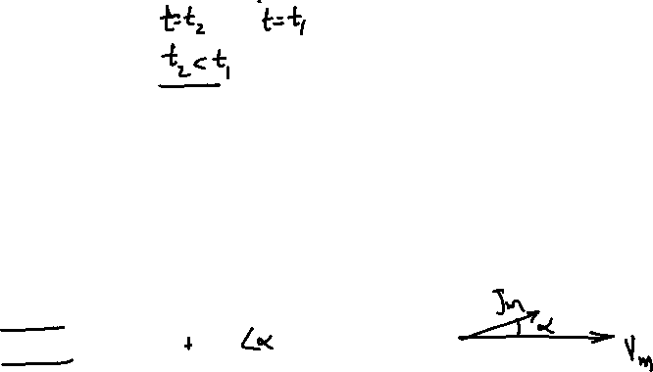
Leading Sine Wave
I_{m}
v(ωt)
α
ωt
V_{m}
α
i(ωt)
Phase angle is the angular difference between the two quantities under consideration.
One quantity is the reference
I_{m} leads V_{m} (or i leads v) by an angle α where V_{m} is the reference.
Time domain: v(t) = V_{m} sin(ωt); i(t) = I_{m} sin (ωt + α)
Polar form: V = V_{m} / 0º; I = I_{m} /α

Slide 9

Lagging Sine Wave
i(ωt)
α
0
ωt
V_{m}
α
I_{m}
v(ωt)
I_{m} lags V_{m} (or i lags v) by an angle α
Time domain: v(t) = V_{m} sin(ωt); i(t) = I_{m} sin (ωt - α)
Polar form: V = V_{m} / 0º; I = I_{m} /-α

Slide 10
The ‘j’ operator
jA
O
A
Any phasor when operated by ‘j’ is rotated in anticlockwise direction by 90 degrees.
jOA = OA /90 ;
j*jOA = - OA = OA /180 ;

Slide 11
The ‘j’ operator …
y
C
A
α
O
x
B
A phasor can be resolved into two components at right angles to each other.
OA is a phasor.
Horizontal component = OB
Vertical component OC = AB
OA=OB + jOC

Slide 12
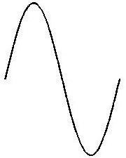
Phasor Representation
Two forms of representation:
Polar form: represented by magnitude and the angle
Rectangular form: represented by its X and Y coordinates
i
I_{m}
A
I_{A}
0
θ
θ₁
π
I_{B}
2π
θ₂
B
y
A
θ₂
θ₁
X - Ref.
B

Slide 13
Exercise
Convert the following into polar form using calculators
Convert the following into rectangular form using calculators

Slide 14
Pure resistive circuits
Pure inductive circuits
Pure capacitive circuits

Slide 15
1. Pure resistive circuits
Let
v(t) = V_{m} sin ωt --------------- (1)
i(t)
v(t)
R
= I_{m} sin ωt -------------(2)
Where I = I_{rms}
Phasor diagram
v(t)
i(t)
Phase angle between V & I = 0
current through the resistor is in phase with the voltage across it.
V & I are RMS values
π/2
π
2π
ωt
0

Slide 16
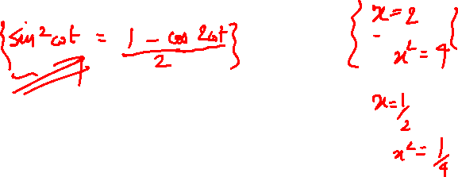
Pure Resistive Circuits - Power Consumed
Instantaneous power,
p(t) = v(t).i(t)
= V_{m} I_{m} sin²ωt
p(t)
v(t)
i(t)
π/2
π
ωt
0
2π

Slide 17
2. Pure Inductive Circuits
i(t)
+
L
e(t)
v(t)
-
v(t)
i(t)
π/2
π
3π/2
2π
ωt

Slide 18

Pure Inductive Circuits - Phasor diagram
Current through pure inductor lags the voltage across it by ${90}^{0}$.
V_{m} = ωL I_{m.}
= X_{L} I_{m.}
X_{L} = ωL = 2πf L ----- inductive reactance, in ohm
Phasor Diagram
90º
Phase difference = 90º

Slide 19
Pure Inductive Circuits …
The inductive reactance is directly proportional to frequency.
X_{L} = ωL = 2πf L
The current through pure inductor is inversely proportional to frequency.
I = V/(ωL)
Inductive
reactance
Current
0
Frequency

Slide 20
Pure Inductive Circuits -Power Consumed
Instantaneous power,
p(t) = v(t).i(t)
= V_{m} I_{m} sinωt. sin(ωt-90)
= - V_{m} I_{m} cosωt. sinωt
= -(V_{m} I_{m}/2) sin2ωt
Average Power Consumed in a Pure Inductor
The net (average/active) power absorbed in a pure Inductor is zero
v
i
p
ωt
0
π/2
π
3π/2
2π

Slide 21
3. Pure Capacitive Circuits
i(t)
v(t)
C
v(t)
i(t)
π/2
π
3π/2
2π
ωt

Slide 22
Pure Capacitive circuits - Phasor diagram
Current through pure Capacitor leads the voltage across it by 90º.
V_{m} = I_{m}/(ωC)
= X_{C} I_{m.}
X_{C} = 1/(ωC) = 1/(2πf C) -----
Capacitive reactance, in ohm
Phasor Diagram
90º
Phasor diagram
Phase difference = 90º

Slide 23
Pure Capacitive Circuits…
The capacitive reactance is inversely proportional to frequency.
X_{C} = 1/ (ω C)
The current through a pure capacitor is directly proportional to frequency.
I = ω C V
Capacitor current
Capacitive Reactance
0
Frequency,ω

Slide 24
Pure Capacitive Circuits - Power Consumed
Instantaneous power,
p(t) = v(t).i(t)
= V_{m} I_{m} sinωt. sin(ωt+90)
= V_{m} I_{m} cosωt. sinωt
= (V_{m} I_{m}/2) sin2ωt
Average Power Consumed in a Pure Capacitor
v
i
p
0
ωt
π/2
π
3π/2
2π
The average/active power consumed by a pure Capacitor is zero.

Slide 25
Series RL Circuits
Series RC Circuits
Illustrations

Slide 26
1. Series RL Circuit
Phasor Diagram -
R
L
v(t)
i(t)
φ
90º
Reference
(phasor)

Slide 27
Series RL Circuit - Complex Impedance
Complex Impedance
φ
90º
Reference
(phasor)
φ
90º
Reference
(phasor)
The phase difference between V & I is termed as phase angle , φ.
Also φ is termed as Impedance angle

Slide 28
Series RL Circuit - Waveforms
v
i
π/2
π
3π/2
2π
ωt
φ
The current lags behind the voltage by a phase angle φ

Slide 29
2. Series RC Circuit – Phasor diagram
Phasor Diagram -
R
C
v(t)
i(t)
Reference
(phasor)
φ
-90º

Slide 30
Series RC Circuit - Complex Impedance
Complex Impedance
Reference
(phasor)
φ
-90º
Reference
(phasor)
φ
-90º
The phase difference between V & I is termed as phase angle , φ.
φ is the Impedance angle

Slide 31
Series RC Circuit - Wave forms
v
i
π/2
π
3π/2
2π
ωt
φ
The current Leads behind the voltage by a phase angle φ

Slide 32
Solved Examples
A resistance of 50Ω is connected in series with an inductance of 100 mH across a 230V, 50 Hz, single phase AC supply. Calculate
a) impedance
b) current drawn
c) power factor
d) power consumed
e) Draw the phasor diagram.

Slide 33
Ans.
a) Z =
e)
V
V_{L}
b) I =
32.12º
c) Pf =
0.847 lag
V_{R}
I
d) P = 759.15W

Slide 34
2. A resistance of 50Ω is connected in series with a capacitance
of 100 μF across a 230V, 50 Hz, single phase AC supply.
Calculate
a) impedance
b) current drawn
c) power factor
d) power consumed
e) Draw the phasor diagram.

Slide 35
Ans.
a) Z =
e)
V_{R}
b) I =
I
32.48º
0.847 lag
V_{C}
c) Pf =
0.843 lead
V
d) P = 752.81W

Slide 36
Series RLC Circuits
Complex power
Illustrations

Slide 37
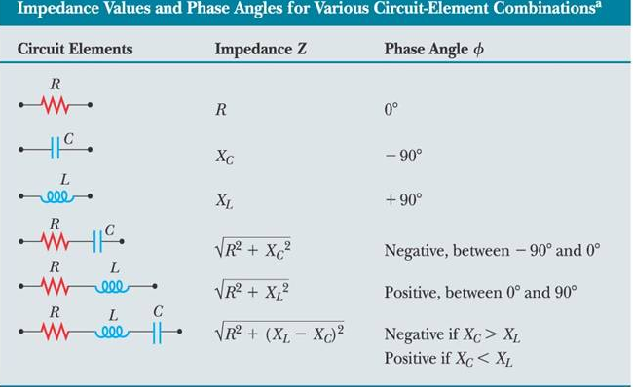
Series RLC Circuit
R
L
C
Let i(t) = I_{m} sinωt
Impedance, Z=R+j(X_{L}-X_{C})
(i) If X_{L}=X_{C} , resistive circuit
(ii) If X_{L}>X_{C}, RL series circuit
(iii) If X_{L}<X_{C}, RC series circuit
v(t)
i(t)
Note: - i(t) is the reference

Slide 38
Series RLC Circuit
R
L
C
v(t)
i(t)

Slide 39
Series RLC Circuit – Power consumed
Instantaneous power
Average power
= Active Power
Cos φ is called the power factor

Slide 40
Power Triangle
φ
90º
φ
90º
P = Average power = Active power =
measured in Watt
Q = Reactive power =
measured in VAr
(Volt-Amp reactive)
S = Absolute power = Apparent power =
measured in VA (Volt-Amp)

Slide 41
Complex Power
For inductive loads, current is lagging, the angle φ is negative.
Q = Reactive power =
But in SI units, lagging reactive power is +ve.
Hence, conjugate of the angle φ is used in power calculations.
S = VI* = = =
S = P + j Q
Similarly For capacitive loads, reactive power is –ve in SI units.
S = VI* = = =
S = P - j Q

Slide 42
Power Factor
- Ratio of active power to absolute power
- Also, cosine of the impedance angle is numerically same as power factor.

Slide 43
Solved Examples
1. The value of the capacitor in the circuit given below is 20 μF and the current flowing through the circuit is 0.345 A. If the voltages are as indicated, find the applied voltage, the frequency and loss in the coil.
coil
C
I
R
L
R_{L}
25 V
55 V
V
40 V
50 V

Slide 44
Power Loss = 1.8967 W

Slide 45
2. A resistance of 50Ω is connected in series with an inductance of 100 mH across a 230V, 50 Hz, single phase AC supply. Calculate
a) impedance
b) current drawn
c) power factor
d) power consumed
e) Draw the phasor diagram.

Slide 46
Ans:
a) Z =
e)
V
V_{L}
b) I=
32.12º
V_{R}
I
c) Pf =
0.847 lag
d) P = 759.15W

Slide 47
3. A resistance of 50Ω is connected in series with a capacitance of 100 μF across a 230V, 50 Hz, single phase AC supply. Calculate
a) impedance
b) current drawn
c) power factor
d) power consumed
e) Draw the phasor diagram.

Slide 48
Ans:
a) Z =
e)
V_{R}
b) I =
I
32.48º
V_{C}
c) Pf =
0.843 lag
V
d) P = 752.81W

Slide 49
4. Write the nodal equations for the network shown in Figure and express them in matrix form.

