Slide 1
Line
Counter
“Only if I could measure how many lines it took me to finish that project...”

Slide 2
TABLE OF CONTENTS
01
02
03
04
What is LineCounter?
Project Overview
How to use it?
Technical Part

Slide 3
What is LineCounter
01

Slide 4
What is LineCounter?
I’m sure that there are a lot of people out there, that work on big projects either personal or at their job and sometimes they ask themselves:
“Phew. The project is finally complete. I wonder how many lines I wrote for that project…”
This is where LineCounter comes in hand!

Slide 5
Suitable everywhere!
Personal Projects
Projects at work
Want to measure how many lines it took you to write that project?
Want to measure how big the new project at work is?

Slide 6
02
Project Overview

Slide 7
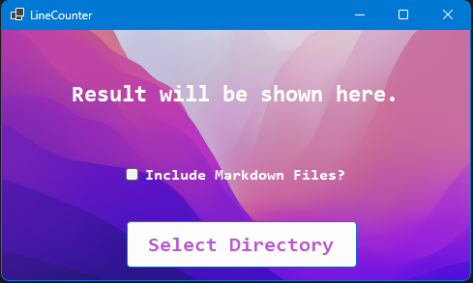
Project Overview
UI
When you open the application, you will be greeted by a very calm design.
The application is made easy to use and everything is pretty straight forward.
This is the only page in the application, so let’s see how to use it!

Slide 8
03
How to use it?

Slide 9
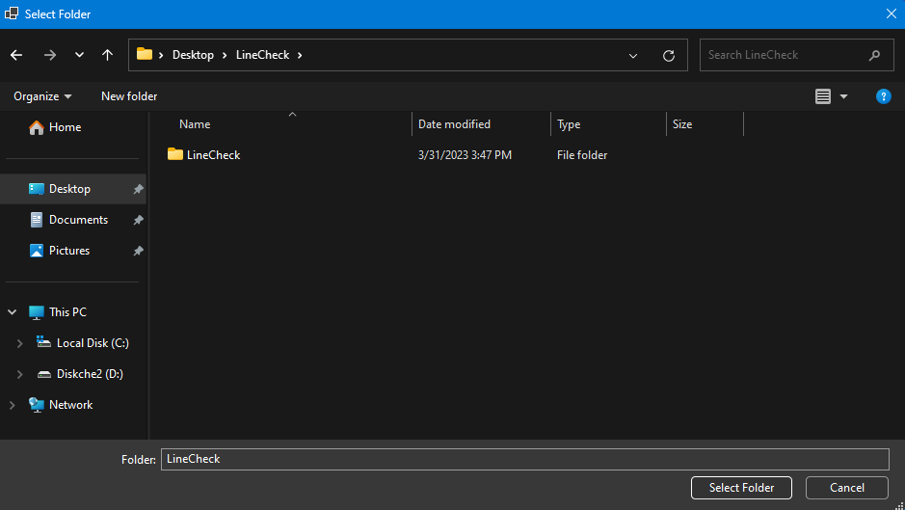
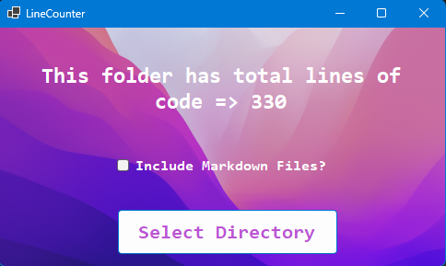
How to use it?
All you need to do is click on Select Directory and choose the folder of the project you want to measure.
On the right you see the result after clicking Select Folder.

Slide 10

How to use it?
If you have written or read a README in your life, then let’s see what that checkbox is.
By checking the box you tell the program that you want to count the lines from the markdown file in the project.
Most of the projects on Github have what’s called README file.
A README file contains brief information about the project and maybe how to set it up.

Slide 11
04
Technical Part

Slide 12

Technical Part
The project uses something called Recursion in order to go through each folder without using repetitive code.
The project was built with Windows Forms on .NET 7
You can check out the repository on Github through the QR code!

Slide 13
Live Demo?

Slide 14

THANK YOU!
Any questions?

