Slide 1
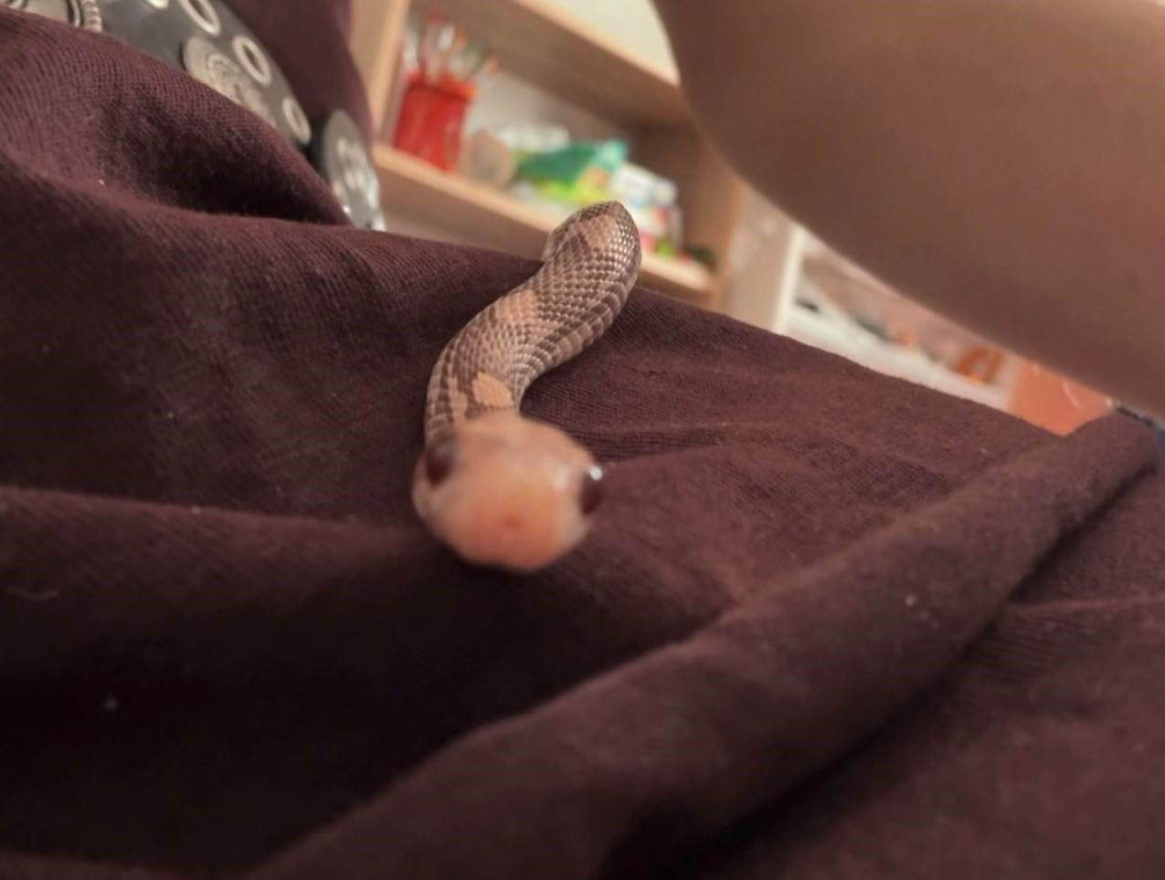
My Home Pet
Meet Dana — my racer snake 🐍

Slide 2
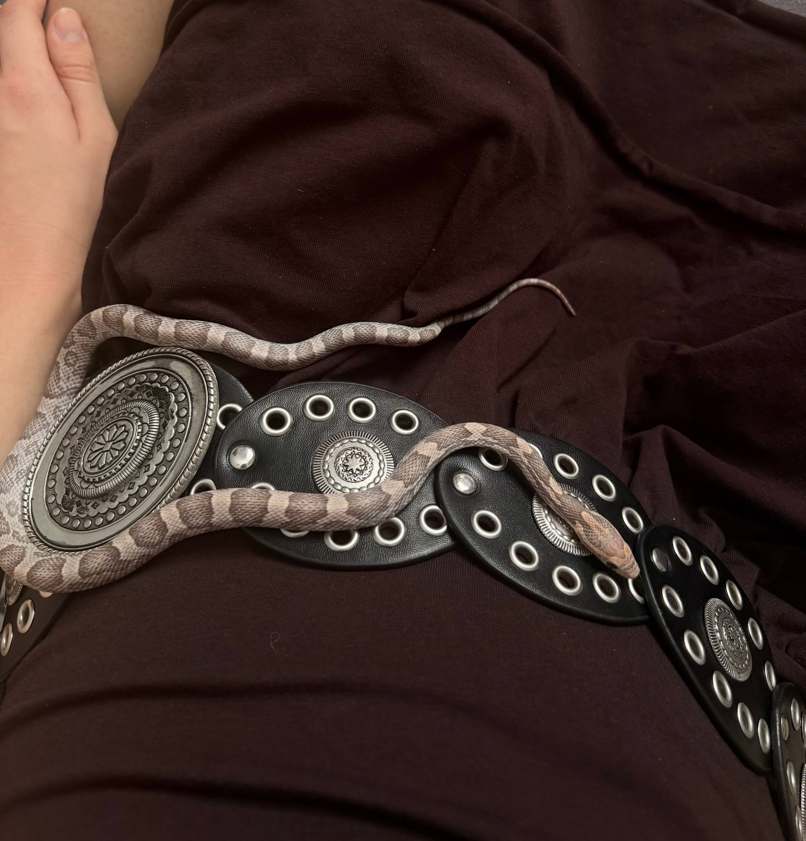
Meet My Pet
Name
Dana
Kind of animal
Snake
Family
Racer
Native to
South America

Slide 3
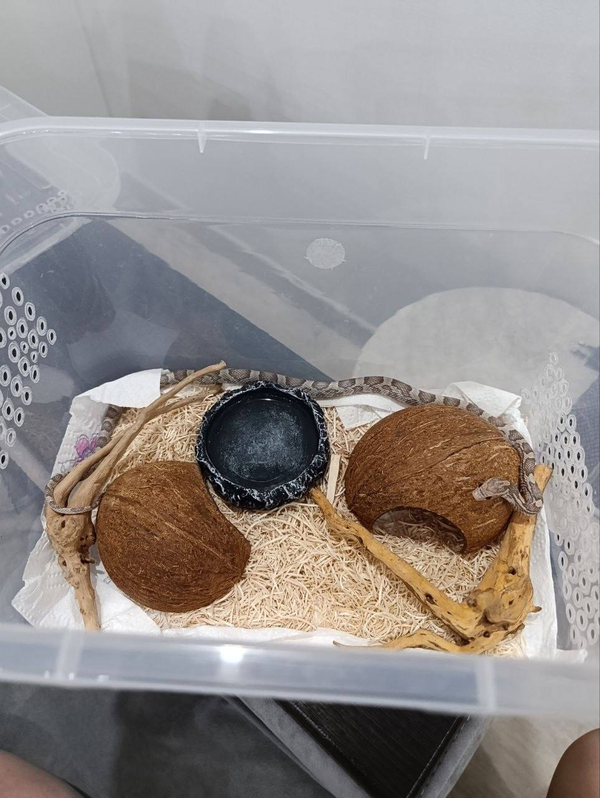
Dana's Home 🏠
A homemade terrarium
• Equipped with everything necessary:
small houses, a water bottle and other elements
• A special heating panel is installed under the terrarium
to maintain the right temperature
• Dana slowly crawls around her terrarium —
and it is mesmerizing to watch!

Slide 4
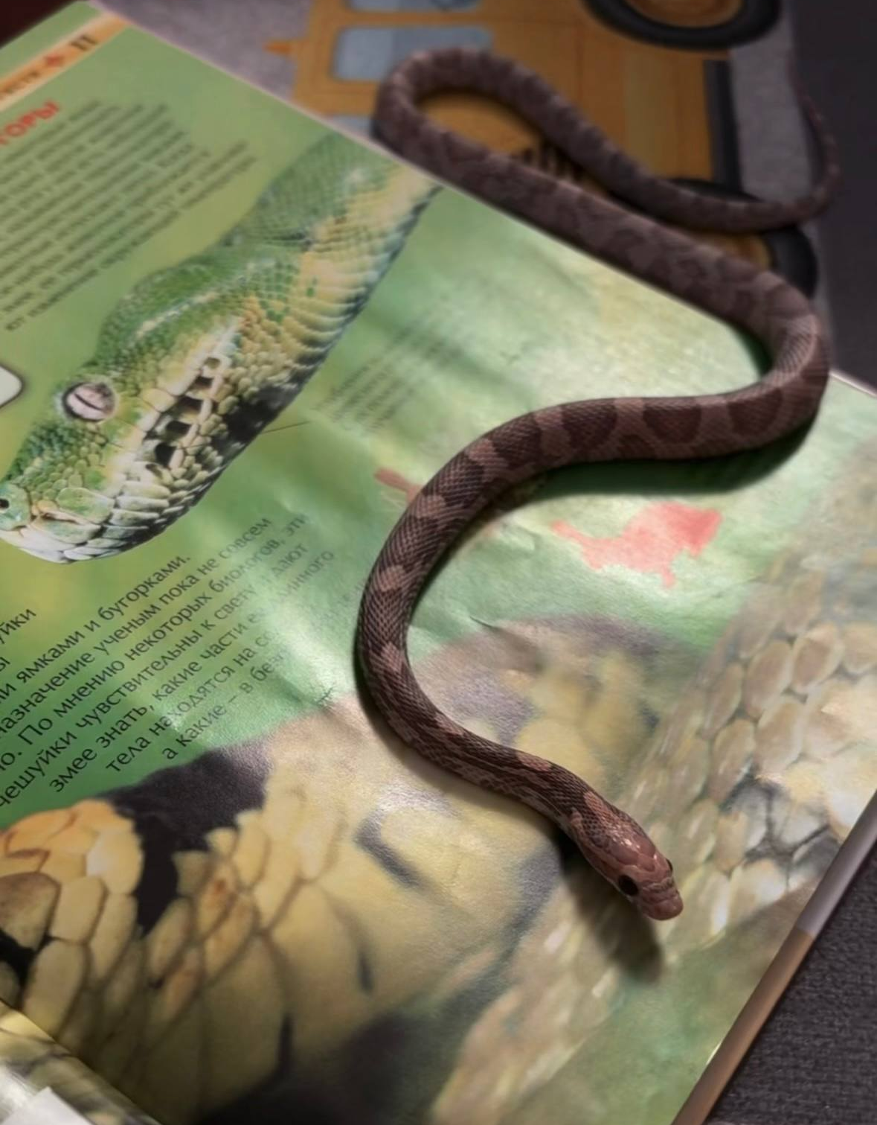
Dana's Character
Calm
Independent
Mesmerizing
Quiet
Unusual
Graceful
There is a belief that watching fish in an aquarium helps you relax. Personally, I find it calming to watch Dana slowly crawl around her terrarium. There is something mesmerizing about it.

Slide 5

Feeding Time 🍽
What Dana eats
• Frozen mice
• Fed about once a week
An unusual experience
You literally witness your pet displaying her natural predatory instincts with your own eyes. Honestly, I am still a little scared watching her feed!

Slide 6
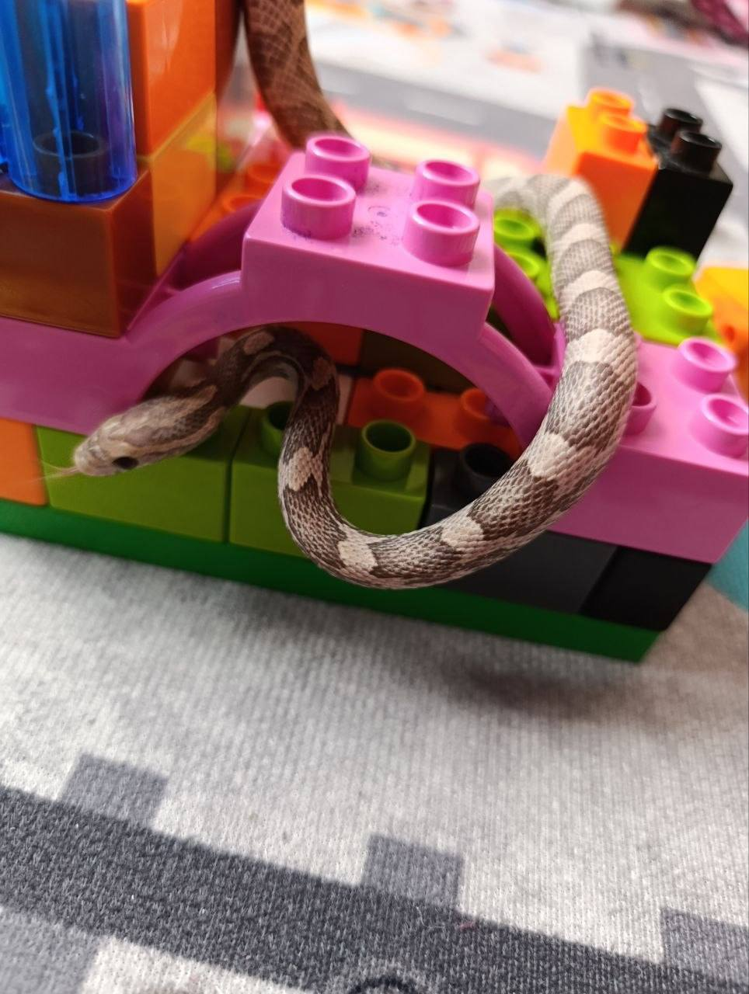
Fun Facts About Dana
1. Dana has shed her skin several times during her life.
2. I keep her shed skin as a souvenir — a rather unusual but interesting keepsake from my pet!
3. Snakes don't require constant attention — Dana is calm and undemanding.
My favourite moment: watching Dana glide gracefully around her terrarium.

Slide 7
Why a snake is a wonderful pet
It doesn't require constant attention and, with proper care, is quite easy to maintain. I am very glad I chose a snake — and I would happily recommend others get to know these unusual animals better.
Thank you for your attention! 🐍

