Slide 1
Security Pillar Recommendations
Viktoriia Bielhrad

Slide 2
Table of Contents
Introduction
Key Security Considerations in my POC
Three Design Principles to Improve Security
Conclusion
References

Slide 3
Introduction
The security pillar shows how Bean & Bytes can use the cloud to protect their data, systems, and assets and improve overall security.

Slide 4
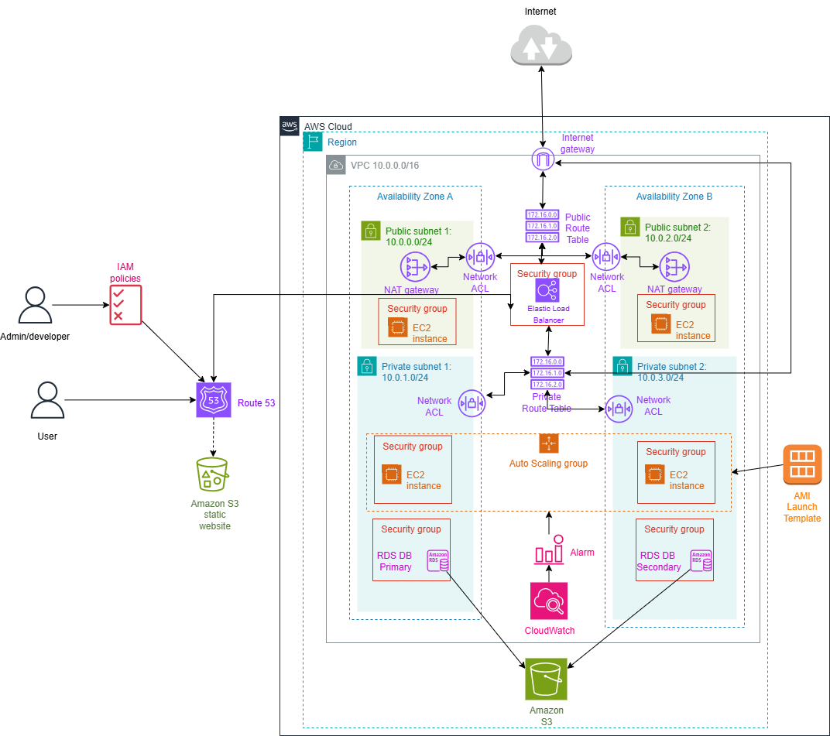
Key Security Considerations in my POC
Multi‑layered protection
  Network ACLs
  Security Groups
IAM Policies
Private and Public Subnets

Slide 5
Three Design Principles to Improve Security
Implement a strong identity foundation
  IAM roles
  MFA
  Least privilege access
Maintain traceability
  AWS CloudTrail
  CloudWatch
Prepare for security events
  Incident management and investigation policy
  Run incident response simulations

Slide 6
Conclusion
Bean & Bytes’ cloud solution already uses strong security measures like multi-layered protection, IAM policies, and private subnets. By improving identity controls, adding better monitoring, and preparing for security events, the company can keep its systems secure, resilient, and compliant as it grows.

Slide 7
References
Security Pillar - AWS Well-Architected Framework - Security Pillar. (n.d.). https://docs.aws.amazon.com/wellarchitected/latest/security-pillar/welcome.html

