Slide 1
D7016B · PROJECT DEMONSTRATION 2
Track change over time as 3D curves
…one LiDAR scan, a curve of both rails, and how it would be used over time
Viktor Lindberg
Supervisor: Amit Patwardhan
Luleå University of Technology · D7016B – Industrial AI and eMaintenance: Part II
Notes:
Demonstration 2. Since demonstration 1 the project has changed direction. I will show why, the idea, the method, how it is tested with one scan, how it would be used over time, and where the report stands. No results today; they come in the report.

Slide 2
CHANGE OF IDEA
From fault types to change over time
BEFORE
NOW
Link vibration events to geometry
Follow the track geometry over time
Group abnormal vibration events by track geometry, then predict the fault type.
Turn each LiDAR run into a 3D curve and compare runs of the same track.
Why the change. The vibration data that would link events to positions on the track was not available, so the first idea could not be tested. The point cloud was, so the project follows the geometry instead.
One LiDAR scan
No second scan
Height from the sensor
a 3D point cloud of a stretch of double track
so two runs of the track cannot be compared yet
so gauge and alignment can be followed; height only for short dips
One scan, so no real comparison yet: the project builds the method and tests it.
Notes:
The first idea was to link the vibration events from part one to the track geometry and predict fault types. The vibration data that links events to positions was not available, so that could not be tested. What I have is one LiDAR scan of a stretch of double track. There is no second scan, so two runs cannot be compared yet. And the height in the file is measured from the sensor, which rides on the rails, so slow height changes cancel out: gauge and sideways alignment can be followed in full, height only for short dips and humps. So the project became: build a method that turns a scan into a comparable 3D curve, and test it.

Slide 3
THE IDEA
An index says how rough, a curve says where
TODAY: AN INDEX
THIS PROJECT: A CURVE
One number per section
Both rails as a curve in a fixed frame
The Track Quality Index says how rough a section is. Where a change sits, and how big it is, is averaged away.
Runs can be compared point by point, in millimetres. The index can still be computed from the curve afterwards.
The idea. Keep the index, but read it from a curve that still knows where and how the track changed.
Gauge
Alignment
Height
the distance between the rails: measured in full
the sideways position of the track: measured in full
only short dips and humps, because the sensor rides on the rails
Catmull-Rom: a change in one place moves the curve only there, which is what an index cannot show.
Notes:
Track geometry is usually followed with an index, one number per section, that says how rough the section is. That is useful, but where the change is and how big it is get averaged away, and a single bad spot can hide in a good average. The idea here is to represent both rails as a curve in a fixed frame. Then two runs can be compared point by point, in millimetres, and the index can still be computed from the curve afterwards. With this data, gauge and sideways alignment are measured in full; height only for short dips and humps, because the scanner rides on the rails.

Slide 4
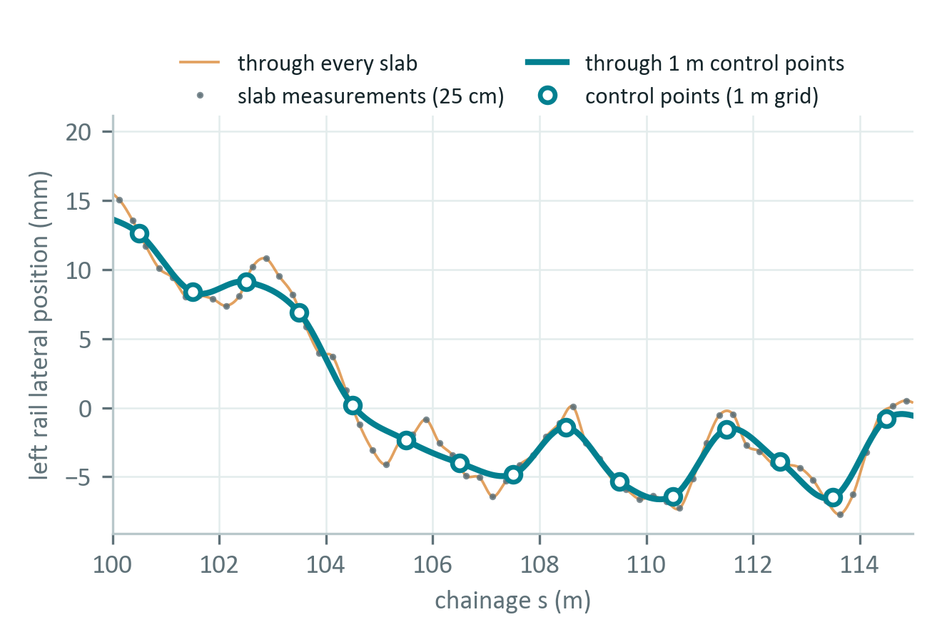
METHOD
One scan becomes one repeatable 3D curve
1
Reference line
one fixed line along the track; every run is projected onto it
2
Rail heads
in every short slab, find the top of each rail and its inner face
3
Control points
average the slabs at regular steps along the track
4
Catmull-Rom
a smooth curve through every control point; a change stays local
5
Read off
gauge, alignment and the index per section, from the same curve
A curve through every raw measurement copies the noise; one through the control points does not.
Notes:
The method in five steps. A reference line is built once along the track, and every run is projected onto it, so that a position means the same thing in every run. In every short slab along the line the top of each rail and its inner face are found in the points. The slabs are averaged into control points at regular steps. A Catmull-Rom curve goes through every control point, and each piece of it depends only on its nearest points, so a change in one place moves the curve only there. From that curve the gauge, the alignment and the index per section are read off. Nothing is random: the same scan always gives the same curve.

Slide 5
TEST PLAN
How the method is tested with one scan
The problem. The method compares two scans, and there is only one. So two are made from it.
Repeat
the same points, twice
the same scan must give exactly the same curve
Scan 1
Noise
Scan 1 against Scan 2
One scan
every other handful of points
Compare
nothing changed, so the difference is the method's own noise
all its points
Scan 2
the handfuls in between
Faults
known faults planted in Scan 2
a widening, a dipped joint, a twist, a cross-level step: found, at their size?
Also tried: control points closer together or further apart, to see what the curve keeps and what it smooths away.
Notes:
The method compares two scans of the same track, and I have one. So I make two out of it: the points are dealt out in turns, a handful to scan 1, the next to scan 2. Each set covers the whole track, and no point is in both, like two scans taken at the same moment. Then three checks. Repeat: the same points through the method twice must give exactly the same curve. Noise: scan 1 against scan 2, where nothing has changed, so whatever differs is the method's own noise. Faults: known faults are planted in scan 2, a widening, a dipped joint, a twist and a cross-level step, and the method must find them at their size. Cant cannot be tested, because it needs an absolute height. The same test is also run with the control points closer together or further apart. The results come in the report.

Slide 6
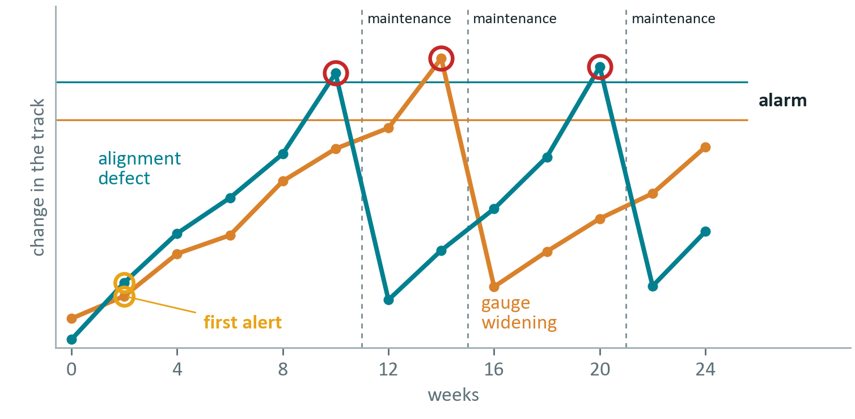
SIMULATION
How the curve would be used over time
WHAT HAPPENS
Runs every few weeks, all made from the one scan
Assumed defects grow a little each run
An alert when a place steps out of its normal scatter
At the limit: an alarm, maintenance, and the defect resets
Simulated from the one real scan: the defects and the limits are assumed, not measured.
The method warns early and shows where, so maintenance can be planned instead of forced.
Notes:
To show how the curve would be used, I simulated a monitoring period: a run every few weeks, each made from the real scan with assumed defects that grow a little each time. Every run goes through the same method and is compared with the first. A control chart watches every place along the curve: an alert when a place steps out of its normal scatter, which happens early, while the change is small. When the change reaches an assumed limit, an alarm orders maintenance there, the defect is reset, and it starts growing again. Nothing is scripted to happen in a certain week. This shows the behaviour of the method, not of the real track.

Slide 7
RESEARCH QUESTIONS
What the report answers
1
Split the scan in two: how much do the two curves differ?
for gauge, alignment and height
2
Which faults can it detect?
and how does the distance between the control points affect what can be detected?
3
How is it used over time?
how would the curve raise alerts and alarms, shown by the simulation?
Exploratory: one scan, so the answers describe the method, not the track.
Notes:
Three research questions. One: when the scan is split into two halves and a curve is built from each, how much do the two curves differ, for gauge, alignment and height. Two: which track faults can be detected using the curve, and how the distance between the control points affects what can be detected. Three: how would the curve be used over time to raise alerts and alarms, shown by the simulation. The study is exploratory: with one scan the answers describe the method, not the track.

Slide 8
WHERE WE ARE
Introduction done, method written
✓
Introduction
done: the background, the idea and the research questions
✓
Method
written: the pipeline, the test plan and the simulation
3
Results
next: the test on the real scan and the simulation
4
Discussion and conclusion
later: what the method can and cannot show
Next: write up the results, then the discussion.
Notes:
Where the report stands: the introduction is written, with the background, the idea and the research questions. The method section is written: the pipeline, the test plan and the simulation. Next come the results, the test on the real scan and the simulation, and then the discussion of what the method can and cannot show.

