Slide 1
D7016B · PROJECT DEMONSTRATION 1
Railway track geometry from point cloud data
…and how it relates to abnormal vibration events
Viktor Lindberg
Supervisor: Amit Patwardhan
Luleå University of Technology · D7016B – Industrial AI and eMaintenance: Part II
Notes:
One sentence: I want to measure the shape of the track from a 3D laser scan, and check it against the abnormal vibration events I already found in the previous course. Mention that Amit has agreed to have data collected for it.

Slide 2
WHERE THIS STARTS
From the previous course
150
vibration events
three measurement trials at switches
16
features per event
time and frequency statistics of the signal
6
features after selection
kurtosis, crest factor, zero crossings, and three more
93 %
classified correctly
SVM on a held-out test set
Feature selection showed most of the 16 were redundant: 9 matched the best accuracy, 6 came close.
Notes:
Keep this short. Sensors measured how hard the wheels hit the track. Each event was summarised into 16 numbers describing the shape of the vibration signal, and an SVM learned to separate normal from abnormal. Four selection methods were compared - Pearson correlation, mutual information, recursive feature elimination and Lasso. RFE was best: 9 of the 16 features matched the full 96.7 per cent cross-validated accuracy, and 6 features reached 95.3 per cent. The six it kept are physically sensible - two measures of how sharp the impact is, one of how big it is, and three of its frequency character. The point of the slide: the model is good at saying THAT something is wrong.

Slide 3
THE PROBLEM
Detection is not diagnosis
What the vibration data shows
What it leaves unanswered
“Something is wrong
here.”
“…but what is wrong
with the track?”
Where it happened
How hard the impact was
A widened gauge?
A worn crossing?
A settled sleeper?
The vibration looks the same — but each one needs a different repair.
Notes:
This is the motivation. For a maintenance planner, knowing something is wrong at km 42.3 is much less useful than knowing the gauge there is 8 mm too wide.

Slide 4
THE IDEA
Measure the track itself, at the same places
VIBRATION DATA
3D DATA
the reaction
the track itself
How hard the wheel was hit.
Measured indirectly.
The actual shape of the rails.
Measured directly, in metres.
Today: “Something is wrong here.”
With 3D data: “Something is wrong here — and the rails are 8 mm too far apart.”
Or one rail sits higher than the other, or the rail top is uneven — whatever the scan shows at that spot.
Notes:
Same table I already built, with geometry columns added. The vibration is a symptom; the 3D data measures the thing causing it.

Slide 5
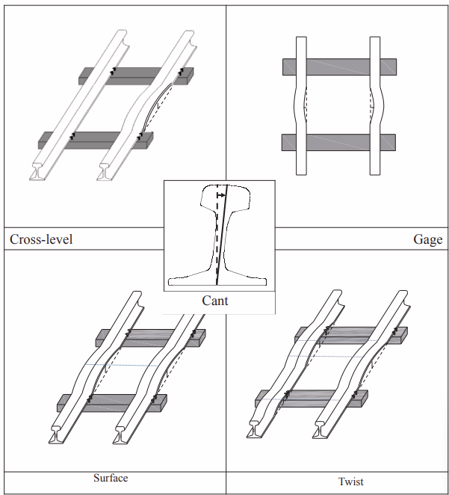
MEASUREMENTS
Five geometry parameters per section of track
1
Gauge
how far apart the rails are
2
Cross-level
how much one rail sits above the other
3
Cant
the cross-level a curve is designed to have
4
Twist
how much that tilt changes over a short distance
5
Surface
how even the top of the rail is
Figure 1: Track geometry measurements.
From Sharma et al. (2018)
These are the parameters railways already use to judge track condition — Sharma et al. (2018).
Notes:
These five come from the paper Amit sent (Sharma et al. 2018), and all five can be measured from a point cloud. Cant is the odd one out: it is the cross-level a curve is meant to have, because the outer rail is deliberately raised so trains can take the curve. So on a curve the quantity that matters is measured cross-level minus design cant. Twist then follows from cross-level measured at two points a fixed distance apart.

Slide 6
TRACK QUALITY INDEX
One number per section, so sections can be ranked
TQI = ( L_{s} / L₀ − 1 ) × 10⁶
Perfect track → the trace is straight, and TQI = 0.
Every wobble makes it longer, and TQI is that extra length.
L₀ the length of the section L_{s} the length of the trace
Applied to each parameter separately, then normalised and averaged — Sharma et al. (2018).
section | gauge | cross-level | cant | twist | surface | TQI
42.000 – 42.025 | 1.2 | 0.9 | 1.0 | 1.1 | 1.3 | 1.1
42.025 – 42.050 | 4.8 | 3.6 | 3.9 | 5.2 | 5.0 | 4.5
42.050 – 42.075 | 1.0 | 1.1 | 0.9 | 0.8 | 1.2 | 1.0
The middle row is the one to look at: far more variation in every parameter, so a much higher TQI. Illustrative values — no data yet.
Every section of track becomes one row — and that table is what gets joined to the vibration events.
Notes:
Explain it in three sentences: each section gives a series of measurements, not one number. If the track were perfect, plotting them would give a straight line exactly as long as the section. Every wobble makes that line longer, and TQI is the extra length. The x10^6 is only cosmetic - it turns 0.000002 into 2. The formula is applied to each parameter separately, because gauge is in millimetres and cant is an angle and they cannot be added; each column is normalised by its own 95th percentile and averaged into the TQI column. Keep the individual columns as well as the TQI - if one fault type drives the abnormal events, averaging them together would hide it. Say clearly that these numbers are illustrative.

Slide 7
METHOD
Six steps
1
Extract the two rails from the point cloud
2
Split the track into sections
3
Measure the geometry and compute TQI per section
4
Match the vibration events to the same sections
5
Cluster the abnormal events into named fault types
6
Predict the fault type from the vibration features alone
Steps 1-3 need point cloud. Steps 4-6 relies on vibration data carrying position information
Notes:
Steps 1 to 3 are the point cloud processing - the bulk of the project and what the course brief asks for. Step 3 is where the condition table and the TQI come from. Step 4 is the join, and it is the step that depends on there being position information in the vibration data. Steps 5 and 6 are the analysis, and the next slide expands them. Flag that the centreline inside step 1 is what makes everything else possible: gauge has to be measured perpendicular to the track, and on a curve that direction changes constantly.

Slide 8
THE ANALYSIS
Where the geometry is meant to lead
1
2
3
Cluster the events
Analyse each group
Predict the type
PCA to reduce the geometry, k-means to group
the parameter furthest from design gives it a name
using the vibration features only
TODAY
normal
abnormal
GOAL
normal
gauge fault
twist fault
surface fault
Geometry defines what the fault types are. Vibration then tells them apart.
Notes:
This is the one-slide version of where the project is heading; the three backup slides at the end expand each step. Step 1: standardise the five geometry parameters, reduce them with PCA and group the abnormal events with k-means, choosing the number of clusters by silhouette score. Strictly the clustering can be done in the full five-dimensional space with PCA used only to plot it - say that if asked, it is the more careful version. Step 2: for each cluster, look at which parameter sits furthest from design, and name the cluster after it. Step 3: train the classifier on the vibration features only. The headline is the two rows at the bottom: today two classes, the aim is one normal class plus three or four named fault types. If asked whether that is circular - it is not. Geometry defines the types once; the classifier never sees geometry, so after one survey the onboard sensor can diagnose on its own.

Slide 9
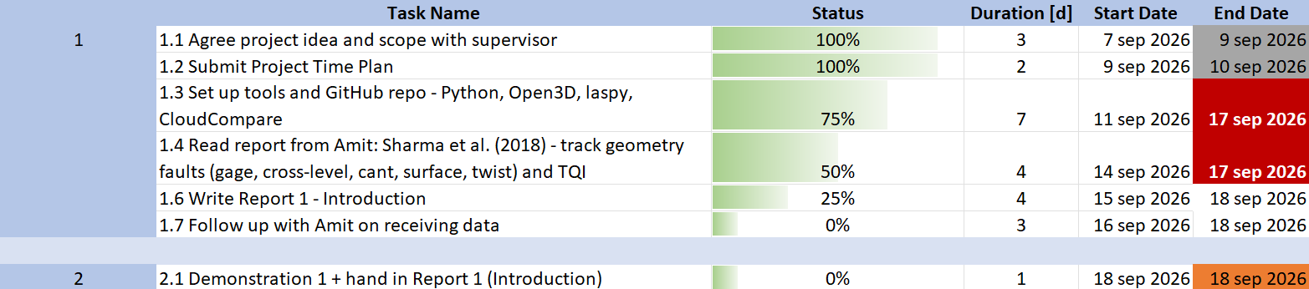
PROGRESS
Where the project stands
PHASE 1 GOAL
Understand what the common track geometry faults are, agree the scope with Amit, and have the tools and a test point cloud ready so the work can start as soon as the LTU data arrives.
Notes:
Walk through the time plan quickly rather than reading it out. Phase 1 is essentially done: the scope is agreed, the plan is submitted, the paper is read and the introduction is drafted. The red cells are the tasks still open today. Point out that the pipeline is being built on a public railway dataset so the work is not blocked while LTU collects the data, and that if the two datasets cannot be matched in the end, steps 1 to 3 still make a complete project.

Slide 10
DISCUSSION
Questions?
Viktor Lindberg · viklio-3@student.ltu.se
Thank you
Notes:
Ask the position-log question out loud here: do the vibration runs have a speed or position log? Whether that exists decides whether the two datasets can be matched at all, and someone in the room may simply know. Two other things worth raising if there is time: whether 25 m is a sensible section length, and which TQI formulation they would use.

Slide 11
THE GOAL
From one abnormal class to named fault types
TODAY
normal
abnormal
GOAL
normal
gauge fault
twist fault
surface fault
The vibration model already separates normal from abnormal. Clustering those abnormal events on their geometry is what splits them further.
PC2
gauge
surface
twist
PC1 and PC2 — the five geometry parameters projected to two dimensions · illustrative
PC1
Instead of “something is wrong here”, the answer becomes “the gauge is wrong here”.
Notes:
State the goal plainly: today the model has two classes, and the aim is to end with one normal class plus three or four named fault types. The geometry is what defines those types - take only the events already flagged abnormal, describe each by the geometry measured at that location, and cluster them with k-means. No hand labelling is needed. Choose the number of clusters with a silhouette score rather than by eye, and if the clusters turn out weak, say so - it would mean the vibration signature is driven by something the scanner cannot see, which is itself a finding. If asked about the axes: they are the first two principal components, so each axis is a mixture of all five geometry parameters and has no physical unit. The projection only shows that groups exist; the next slide is what says what each group is made of, in real units. This figure is illustrative; there is no data yet.

Slide 12
ANALYSIS
Each fault type has a geometric signature
For every group, the average deviation of each geometry parameter. One parameter dominates each group — that is what names it.
A group is no longer just a cluster number — it is “the gauge is out here”, which is something a maintenance planner can act on.
Notes:
This slide is what makes the clusters mean something. Each group is described by which parameter is furthest from design, so cluster 1 becomes a gauge fault, cluster 2 a twist fault, and so on. That is the diagnosis: not just that the track is bad here, but what is wrong with it. Normalise each parameter before comparing, since they are in different units.

Slide 13
ANALYSIS
Can the fault type be predicted from vibration alone?
Geometry defines the fault types once. The classifier is then trained on the vibration features only — so no scan is needed to diagnose the next event.
true ↓ predicted → | normal | gauge | twist | surface
normal | 88 | 3 | 2 | 1
gauge | 2 | 14 | 1 | 1
twist | 1 | 1 | 19 | 2
surface | 1 | 1 | 2 | 11
88 %
correct across four classes
against 93 % for the two-class model
4
classes instead of 2
normal, plus three fault types
0
extra scans needed
one survey defines the types, then vibration alone
Counts over 150 events. Diagonal = correct. Illustrative.
One laser scan defines what the fault types are. After that the vibration sensor alone can tell them apart — which is what makes the result useful in practice.
Notes:
Be ready for the obvious challenge: is this circular? No - and this is the important point. The fault types are defined from the geometry, but the classifier is trained on the vibration features only. So geometry supplies the ground truth once, and after that the cheap onboard sensor can diagnose on its own. That is what would make the method deployable: you do not need to laser scan the network every time you want a diagnosis. Compare against the two-class baseline from Assignment 3 and use the same cross-validation, and read the off-diagonal cells as well as the accuracy - confusing twist with surface matters less than missing a fault entirely. With only 150 events and four classes the per-class counts are small, so report cross-validated figures rather than a single split.

Slide 14
REFERENCE
Worked example — TQI for gauge
Gauge is plotted against distance along the track. The length of that graph, compared with the straight length of the section, is the TQI. The line is the graph — not the rail.
position | gauge (m) | Δy (m) | segment √(Δx² + Δy²)
0.00 m | 1.4350 | — | —
0.25 m | 1.4352 | +0.0002 | 0.25000008
0.50 m | 1.4349 | −0.0003 | 0.25000018
0.75 m | 1.4358 | +0.0009 | 0.25000162
1.00 m | 1.4351 | −0.0007 | 0.25000098
gauge
biggest wobble →
longest segment
distance along the section
Each step moves 0.25 m sideways and a fraction of a millimetre up or down, so every segment is barely longer than 0.25 m. Those tiny excesses are the whole signal.
L_{s} = 1.00000286 m L₀ = 1.00 m → TQI = ( 1.00000286 / 1.00 − 1 ) × 10⁶ = 2.9
Same procedure for cross-level, cant, twist and surface — only the quantity on the vertical axis changes.
Notes:
Keep this slide for reference rather than presenting it. Two traps worth remembering. First, gauge and the spacing must be in the same unit - gauge in millimetres against a spacing in metres gives nonsense. Second, only the differences between neighbouring measurements enter the formula, so a section that is uniformly 10 mm too wide but perfectly smooth scores TQI = 0. TQI measures roughness, not offset, which is why the fault-signature analysis uses mean deviation from design instead.

Slide 15
D7016B · PROJECT DEMONSTRATION 2
Track change over time as 3D curves
…comparing runs of the same track
Viktor Lindberg
Supervisor: Amit Patwardhan
Luleå University of Technology · D7016B – Industrial AI and eMaintenance: Part II

Slide 16
The following dashed list is old and what created based on assumption that certain data would be available. The project have changed and these do not apply anymore:
Connect vibration/acceleration data to maintenance decisions
Connect 3d point cloud / geometric data to maintenance decisions
Explain the idea of the project - to cluster and classify abnormal events based on geometric faults and train a SVM that can predict these without geometric data.

Slide 17
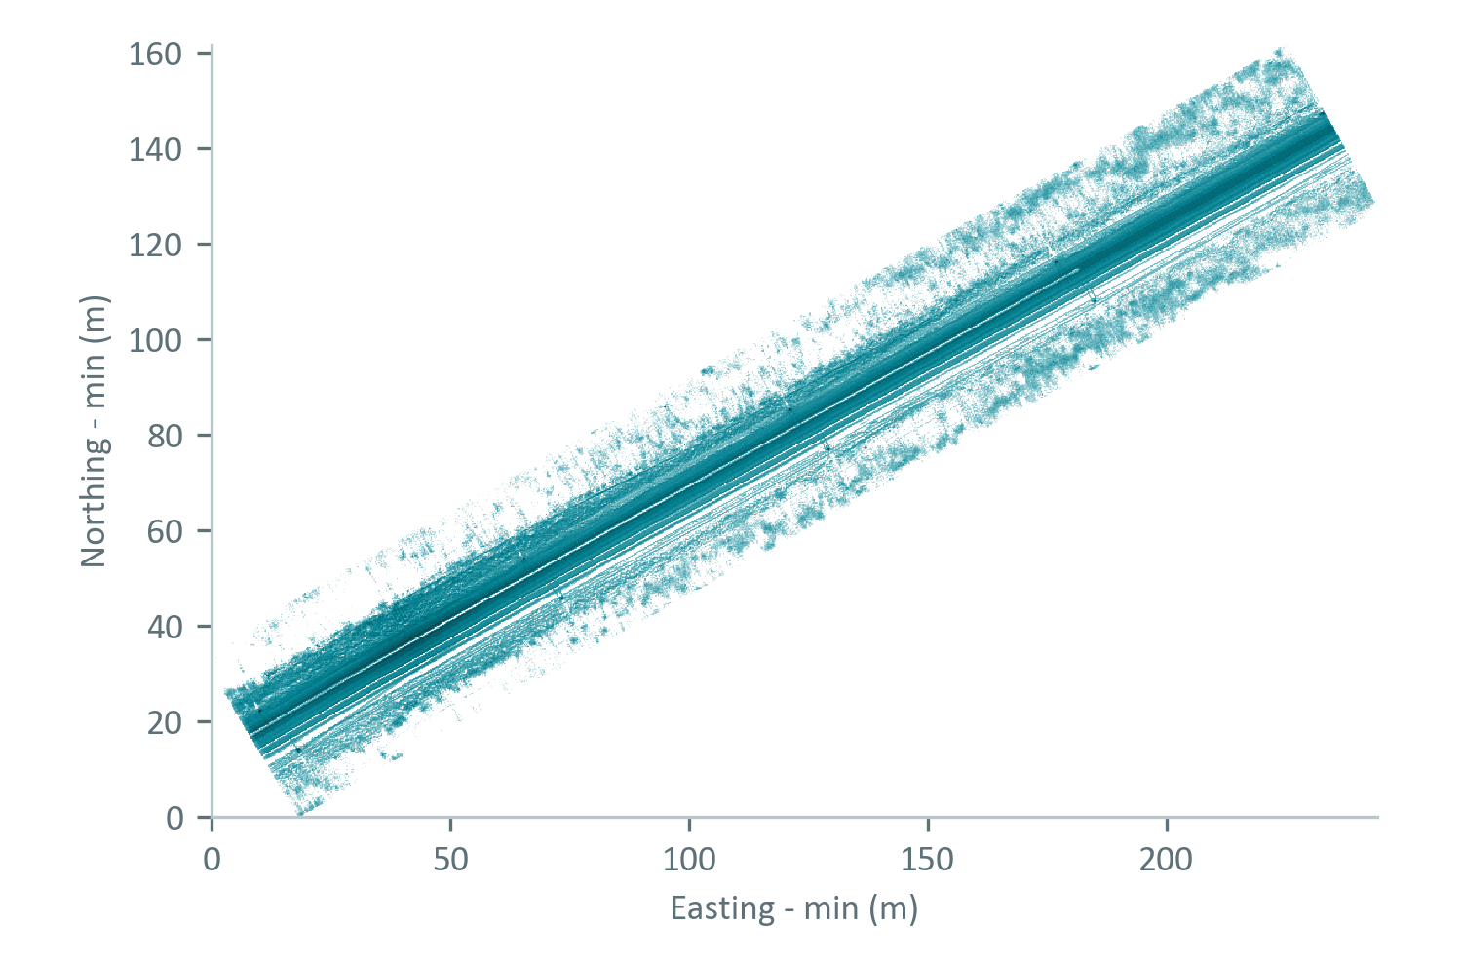
THE DATA
One scan of double track, no vibration data
15.9 M
points in one LAZ file
47 MB, LAS 1.2, point format 0
≈ 260 m
of track, with one gentle curve
straight for most of the scan, curving at the start
2
tracks in the scan
the LiDAR rode the left one, so we work on that track
0
timestamps or coordinate system
only intensity is stored besides X, Y and Z
Top-down point density (log scale). Two parallel tracks run through the scan.

Slide 18
DIRECTION
From fault types to change over time
BEFORE
NOW
Link vibration events to geometry
Follow the track over time
Cluster the abnormal vibration events by their geometry, then predict the fault type from vibration alone.
Represent every run as a 3D curve and compare runs of the same track, to see where faults appear and how they grow.
Why the change. The vibration data that would link events to the geometry is not available, so the first idea cannot be tested. A point cloud gives every point an exact location, so runs of the same track can be compared directly.
One run is a snapshot. Several runs show a trend.

Slide 19
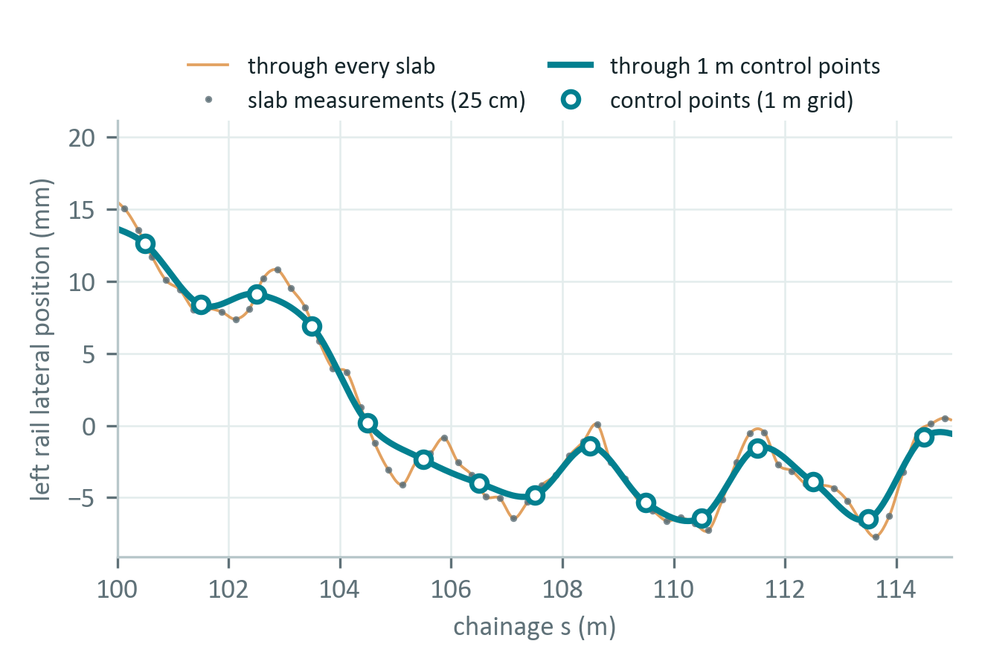
REPRESENTATION
One run becomes one 3D curve
1
Reference
one track centreline from run 1, used for every run
2
Position
chainage s, sideways offset d and the LiDAR height Z
3
Control points
1 m averages on a fixed grid, so runs line up
4
Catmull-Rom
a smooth curve through every control point
5
Repeatable
settings and file hashes stored; rebuilds are byte-identical
Left rail, 15 m of the run. A curve through every slab copies the noise; one through 1 m control points does not.

Slide 20
FIRST TEST
Catmull-Rom on the real run
261
control points per rail
1 m spacing keeps the curve within 1.4 mm of the measurements
0.9 mm
noise floor, gauge
lateral 1.4–1.5 mm, height 0.3 mm; two halves of the scan compared (RMS)
3.9 mm
change recovered
a known 4 mm gauge change added to one half of the scan; found across the stretch
Control points are averages over 1, 2, 5 and 10 m. Wider spacing smooths away real lateral structure of a few millimetres.

Slide 21
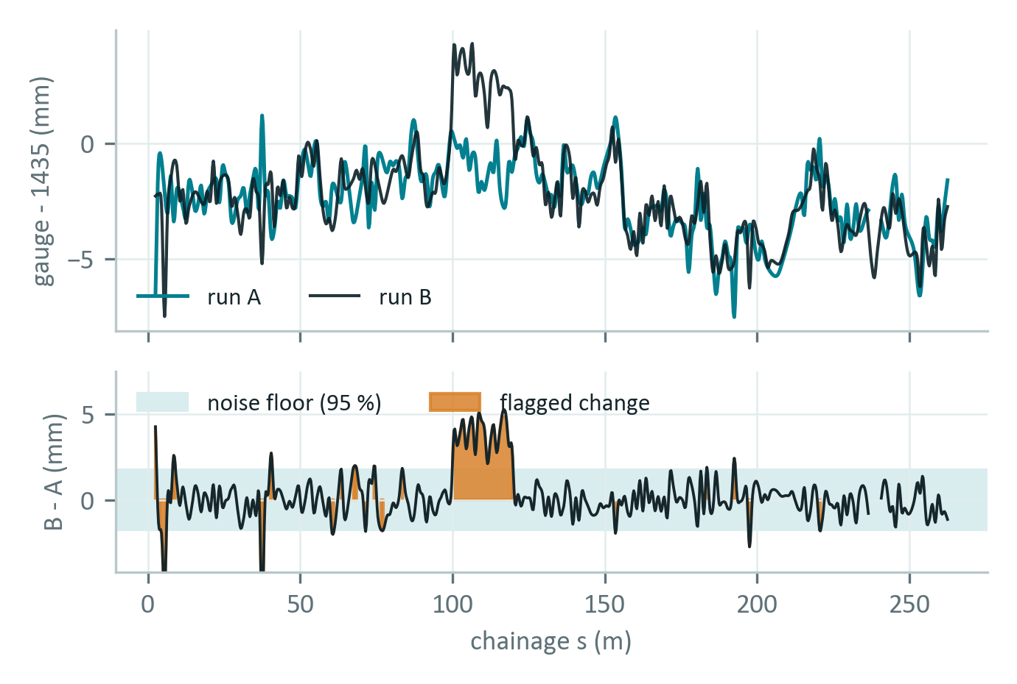
COMPARING RUNS
Comparing two runs of the same track
1
Same frame
both runs projected onto the same reference frame
2
Curve per run
rail curves through 1 m control points
3
Resample
evaluate every curve at the same chainage
4
Subtract
difference per parameter and per section
5
Flag change
mark where the difference exceeds the noise floor
Run A: one half of the scan. Run B: the other half with a known 4 mm gauge widening added at 100–120 m.

Slide 22
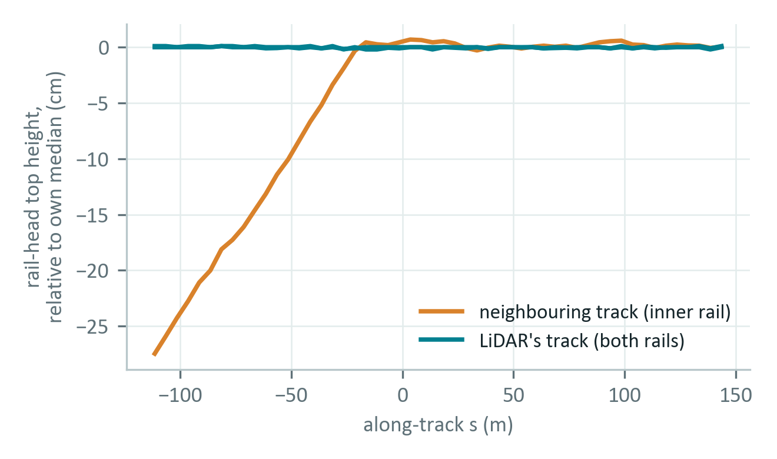
DATA LIMITS
What can be tracked over time
Parameter | Over time? | Why
Gauge | Yes | Measured inside one cross-section, so it does not depend on positioning between runs
Alignment | Yes, relative | Sideways offset from the shared reference frame; needs consistent positioning between runs
Height (Z) | Yes, relative | The LiDAR height Z as it is, relative to the sensor: shows change against the neighbouring track
Cross-level, twist, surface | No | The rails keep the same height and roll relative to the sensor; roll and elevation are needed
Cant | No | Needs cross-level and the designed values
Rail-head height along the scan. The neighbouring track moves about 28 cm relative to the LiDAR; the LiDAR’s own rails move 3 mm.
Gauge, relative alignment and relative height can be followed over time. Cross-level, twist, surface and cant cannot.

Slide 23
TIME SERIES
From one table to a time series
Section | s range (m) | Run 1 gauge | Run 1 TQI | Run 2 | Run 3 | Run n
1 | 0 to 25 | −2.6 | 0.85 | – | – | –
2 | 25 to 50 | −2.8 | 1.07 | – | – | –
3 | 50 to 75 | −1.9 | 0.65 | – | – | –
4 | 75 to 100 | −1.4 | 0.52 | – | – | –
5 | 100 to 125 | −1.2 | 0.35 | – | – | –
6 | 125 to 150 | −1.9 | 0.58 | – | – | –
7 | 150 to 175 | −3.0 | 0.43 | – | – | –
8 | 175 to 200 | −4.5 | 0.60 | – | – | –
9 | 200 to 225 | −3.6 | 0.39 | – | – | –
10 | 225 to 250 | −3.5 | 0.32 | – | – | –
WHAT IT GIVES
TQI per section over time shows how fast each stretch deteriorates
Differences between runs flag where a fault is growing
Sharma et al. (2018) model TQI over 13 inspection runs in the same way
Run 1 is this scan on the fixed 25 m grid: gauge is the mean deviation from 1435 mm (mm), TQI combines gauge and alignment and is normalised with run 1. Runs 2 to n are not available yet.
Each new run adds a column. The trend per section is the result.

Slide 24
NEXT
Questions for Amit, and what comes next
QUESTIONS FOR AMIT
NEXT STEPS
Are there more runs of this track, in the same coordinate system?
How repeatable are the positions between runs?
Is the height relative to the sensor, as it looks, and do all runs use the same reference?
Build a second run with the same reference and compare it with run 1
Check how well the coordinates of real runs line up, and set change thresholds from that
Follow TQI per section over the runs, normalised with run 1
The number of runs, and how well they line up, decide how much change we can detect.

Slide 25
