Slide 1


BookBazaar Software Architectrure Document

Slide 2

Document Overview
In summary, the SAD follows the C4 model framework to provide multiple levels of architectural abstraction, enabling different stakeholders to understand the system from their respective perspectives.
The goal is to:
Provide clear architectural guidance for development
Document key architectural decisions and their justifications
Support architecture reviews and seek feedback for improvement
The architecture is founded on the SOLID Principles:
Single Responsibility Principle: Each class and module have a single, well-defined responsibility
Open-Closed Principle: Software entities are open for extension but closed for modification
Liskov Substitution Principle: Derived classes must be substitutable for their base classes
Interface Segregation Principle: Clients should not be forced to depend on interfaces they don't use
Dependency Inversion Principle: High-level modules should not depend on low- level modules; both should depend on abstractions

Slide 3
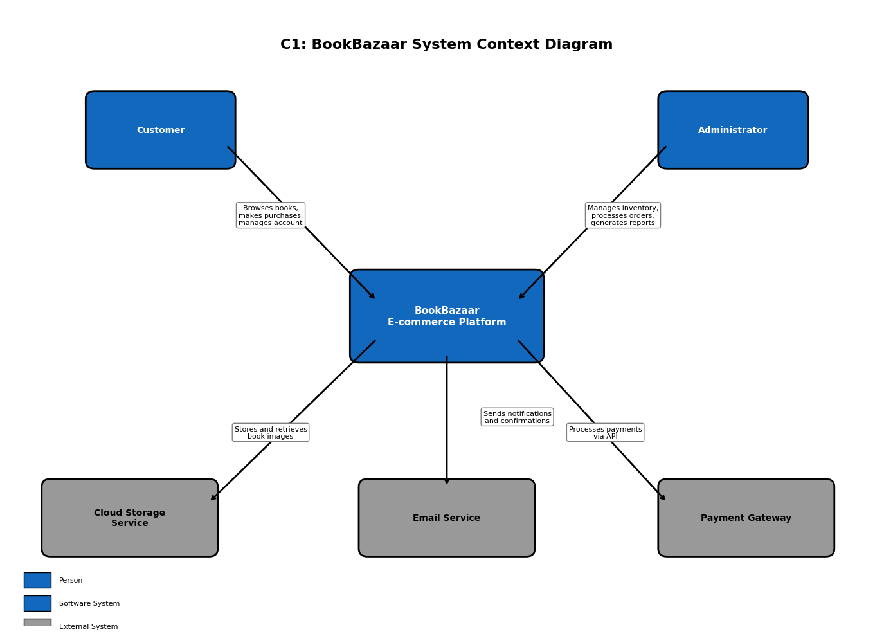
System Context (C1)

Slide 4
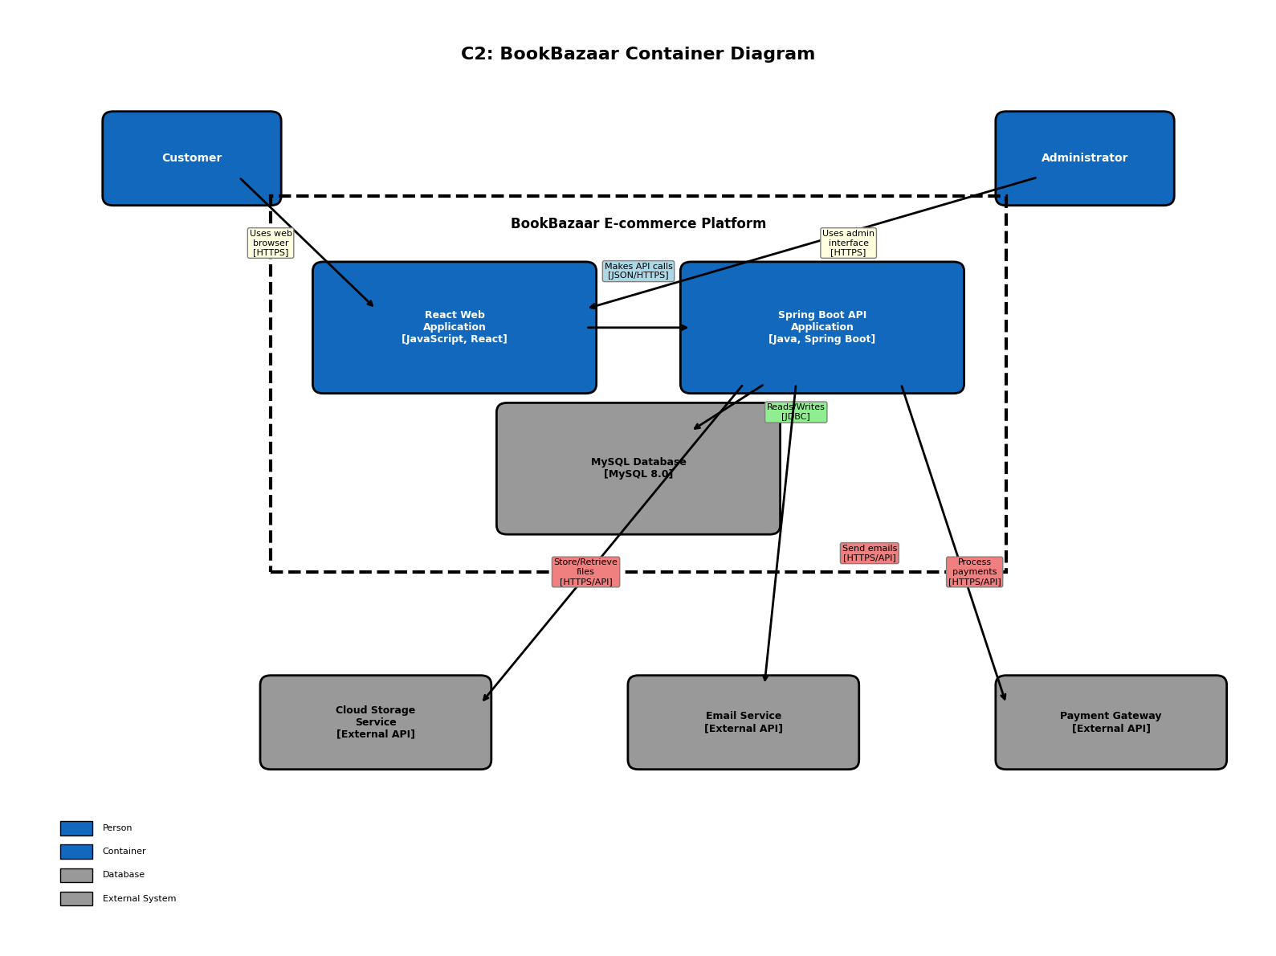
Container Diagram (C2)

Slide 5
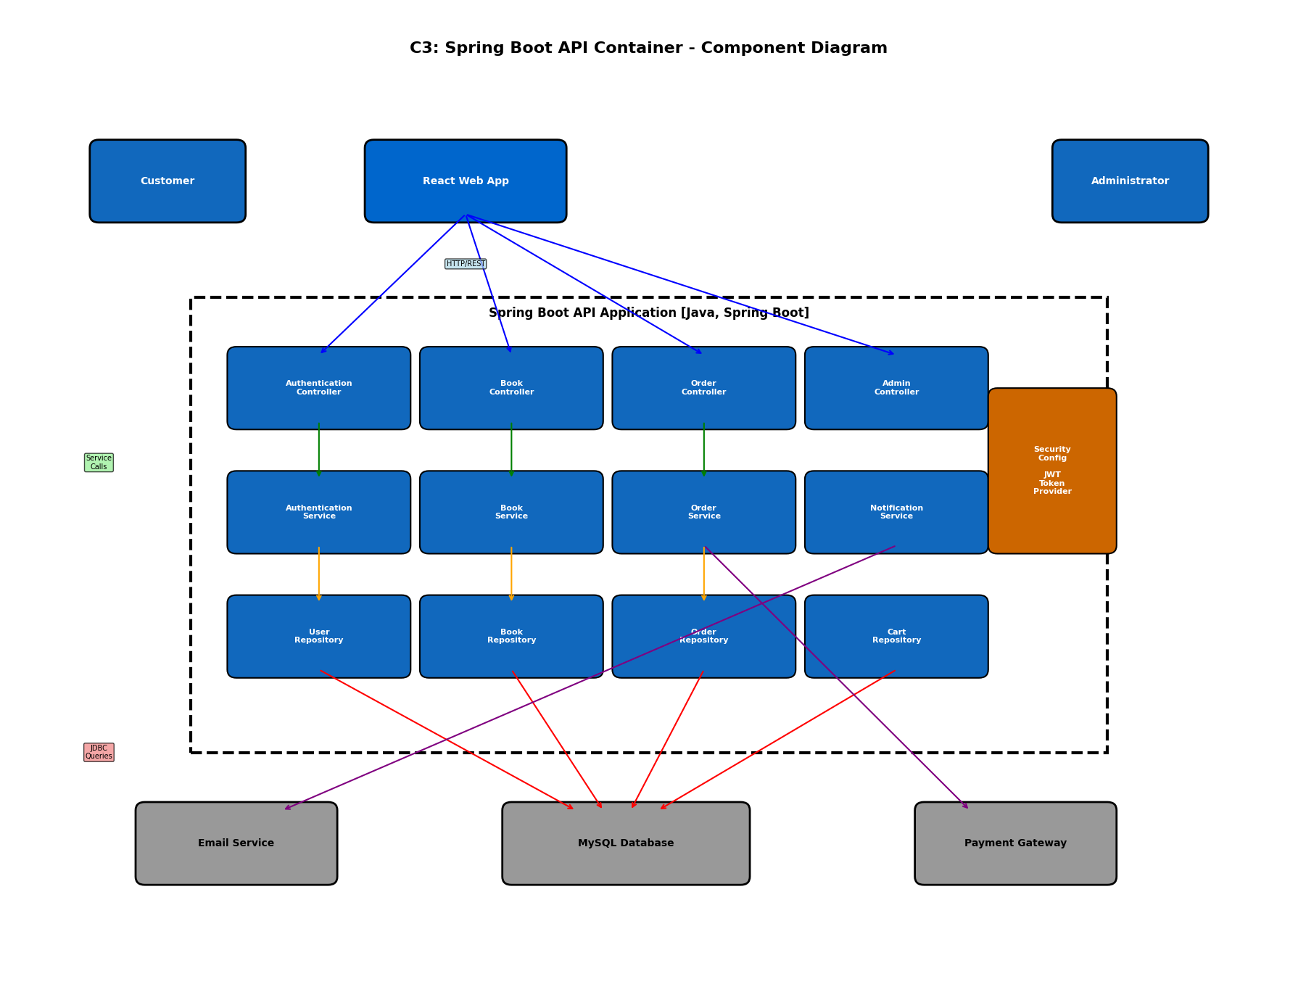
Component Diagram (C3)

Slide 6
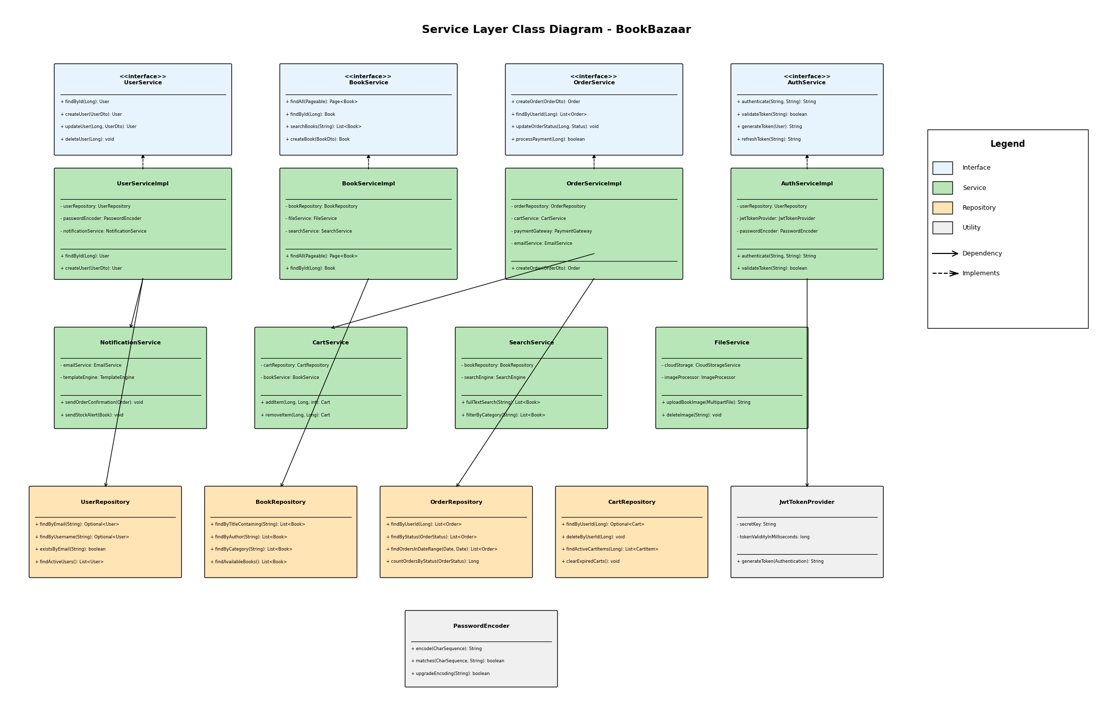
Service Layer Architecture

Slide 7
Viktor Pavlov
v.pavlov@ student.fontys.nl
Fontys University
July 2025

