Slide 1
Synthetic Data Generation for Skin Cancer
v.pavlov@student.fontys.nl
https://www.linkedin.com/in/viktorpavlov/

Slide 2

Background – Image classification
Data Collection
(Data Generation*)
Model Training & Evaluation
Model Use in Real world scenarios (e.g. during diagnosis)

Slide 3
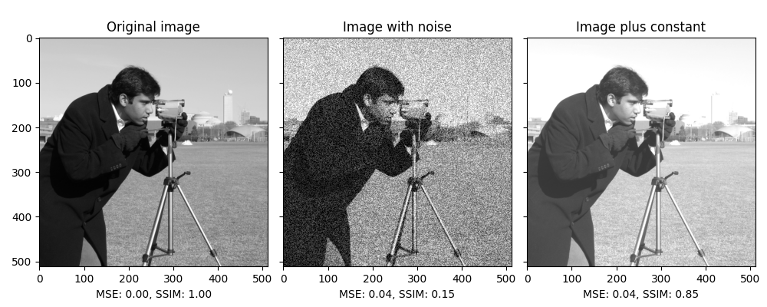

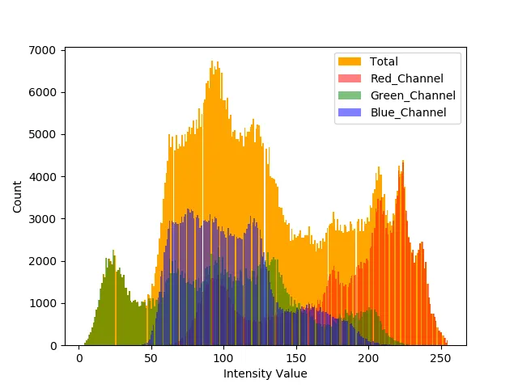
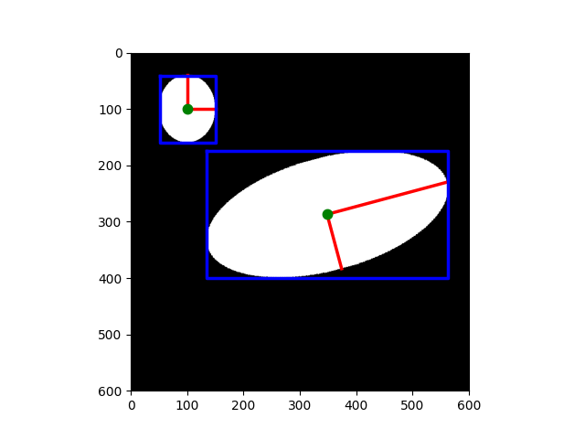
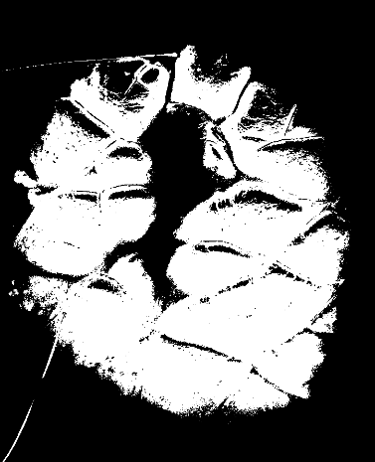
Evaluation
Generated Images evaluation
Does it look structurally similar? (Structural Similarity – MSE/SSIM)
Does it have similar pigmentation? (Color similarity)
Is the lesion roughly the same shape and size? (Simple shape & size comparison)
Notes:
Using SSIM functions- e.g. skimage.metrics.structural_similarity
Color histogram similarity – e.g. cv2

Slide 4
Evaluation
Model Performance Benchmarks
Compute cost per image [and per dataset of N size]
Energy cost per image (power usage)
Batch scaling efficiency (how well the model uses a GPU)
Timing stability (how predictable the cost is across prompts)
seconds_per_image_1 = total_time_seconds_batch1 / num_images_batch1
seconds_per_image_B = total_time_seconds_batchB / num_images_batchB
batch_speedup_factor = seconds_per_image_1 / seconds_per_image_B
mean_time = sum(times_per_prompt) / len(times_per_prompt)
std_time = (sum((t - mean_time) ** 2 for t in times_per_prompt) / len(times_per_prompt)) ** 0.5
cv_time = std_time / mean_time
seconds_per_image = total_time_seconds / num_images
avg_power_watts = sum(power_readings_watts) / len(power_readings_watts)
energy_per_image_Wh = (avg_power_watts * total_time_seconds / 3600.0) / num_images
Notes:
cv_time — coefficient of variation
std_time — standard deviation of time
**2 = to the Power of 2

Slide 5
Test Scenarios
Manual prompting | Manual, based on prompt guides | AI generated prompts | AI gen. (Guides Ref.)
For 1 image
For 100 images (1% of original dataset)
For 1000 images (10 % of original dataset)
For 10000 images (100% of original dataset)*
Time is a constraint!
Notes:
https://services.google.com/fh/files/misc/gemini-for-google-workspace-prompting-guide-101.pdf

