Slide 1

WHO DID
By “VEJN” Team Development AKA “Group 5”
Viktor, Ejmen, Nathan, Johnathan, Joey

Slide 2


GAMBLING
PROBLEM-SOLVING

Slide 3
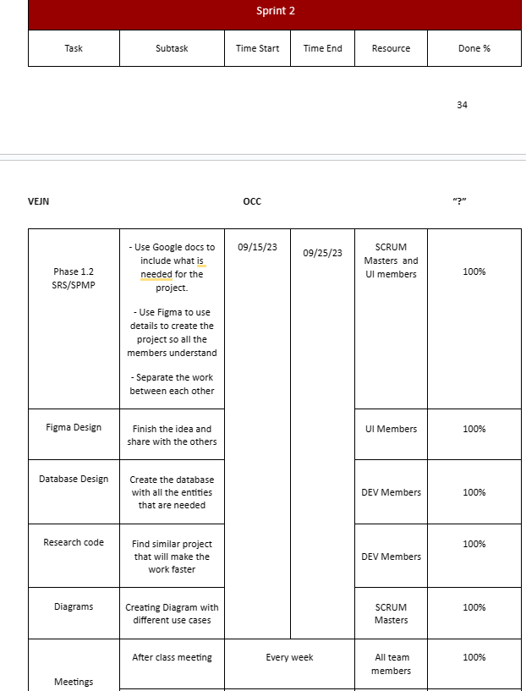
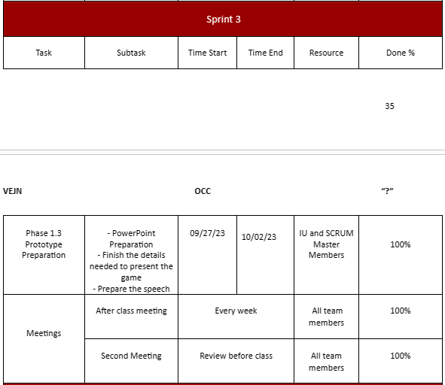
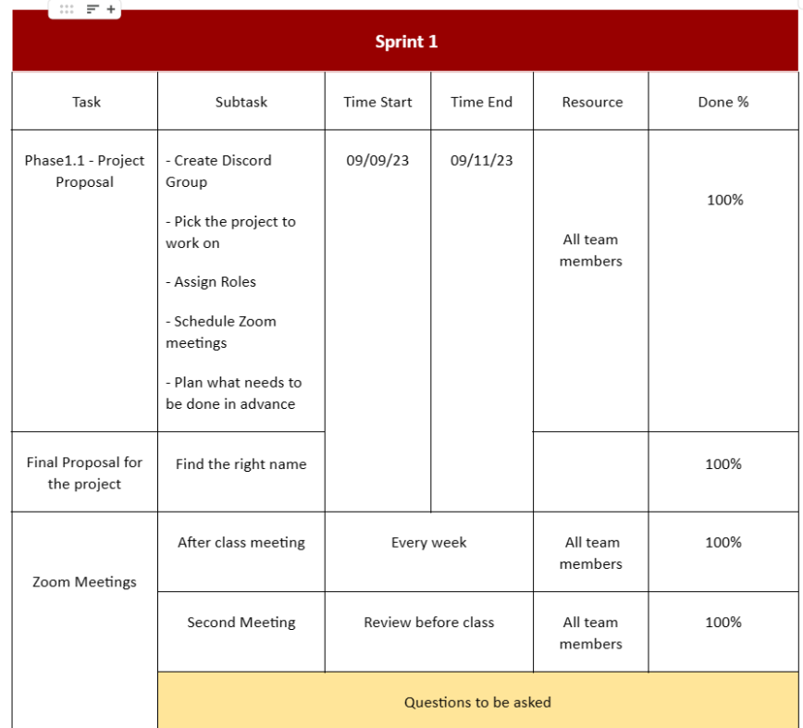
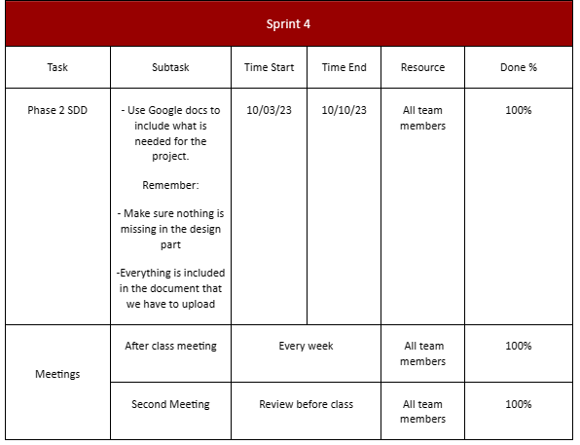
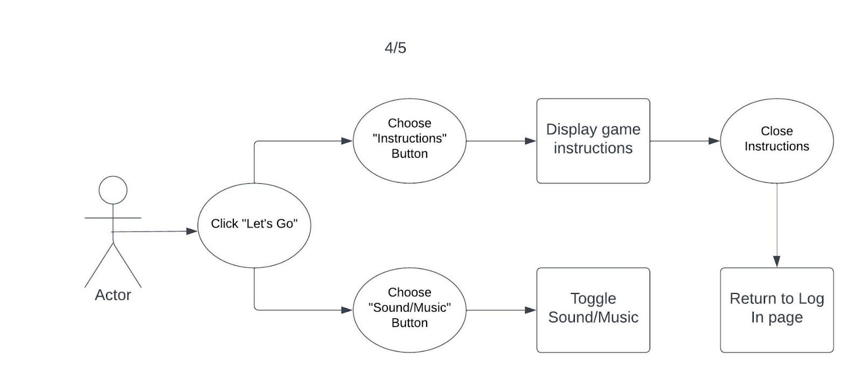
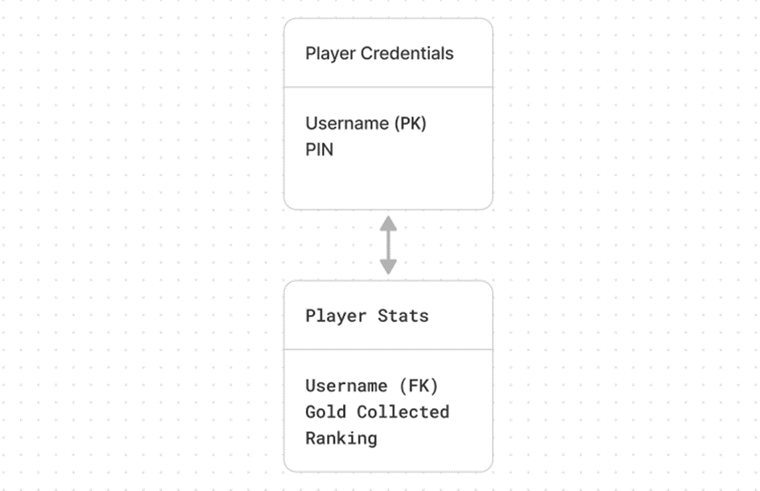
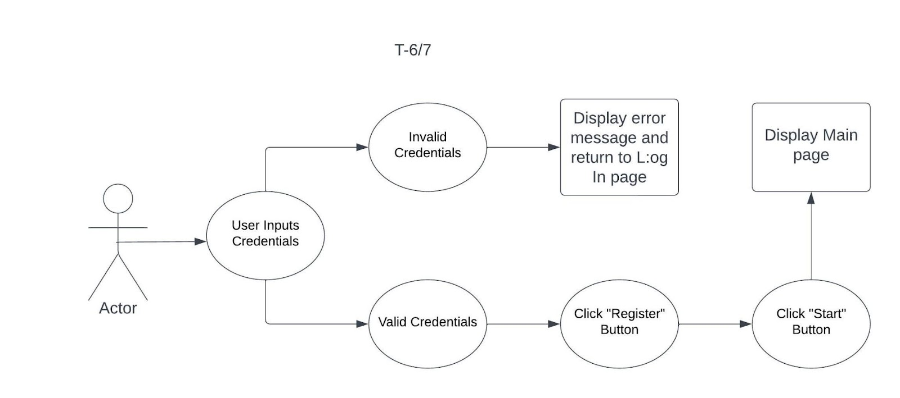
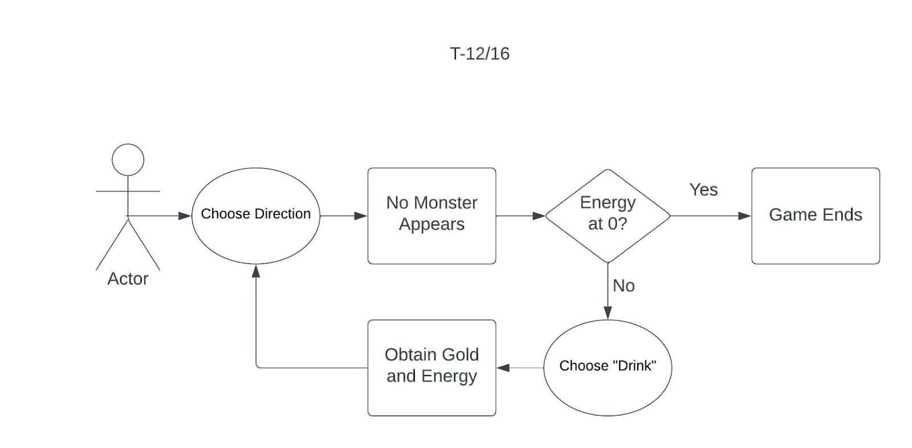
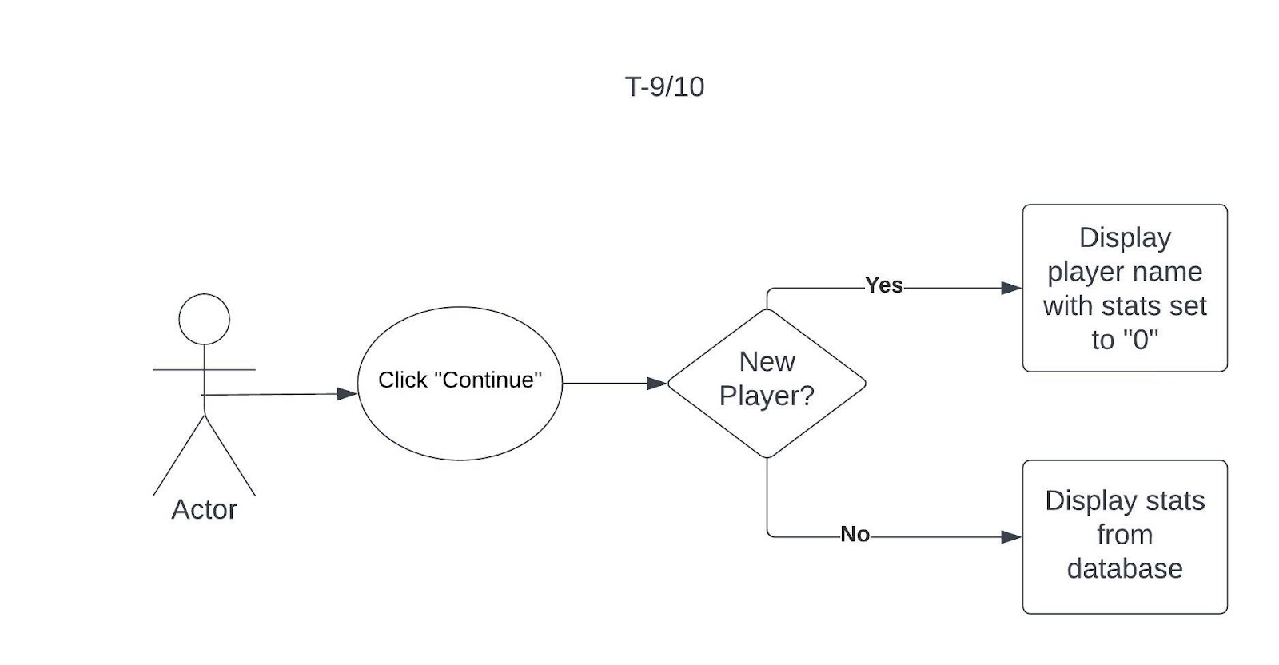
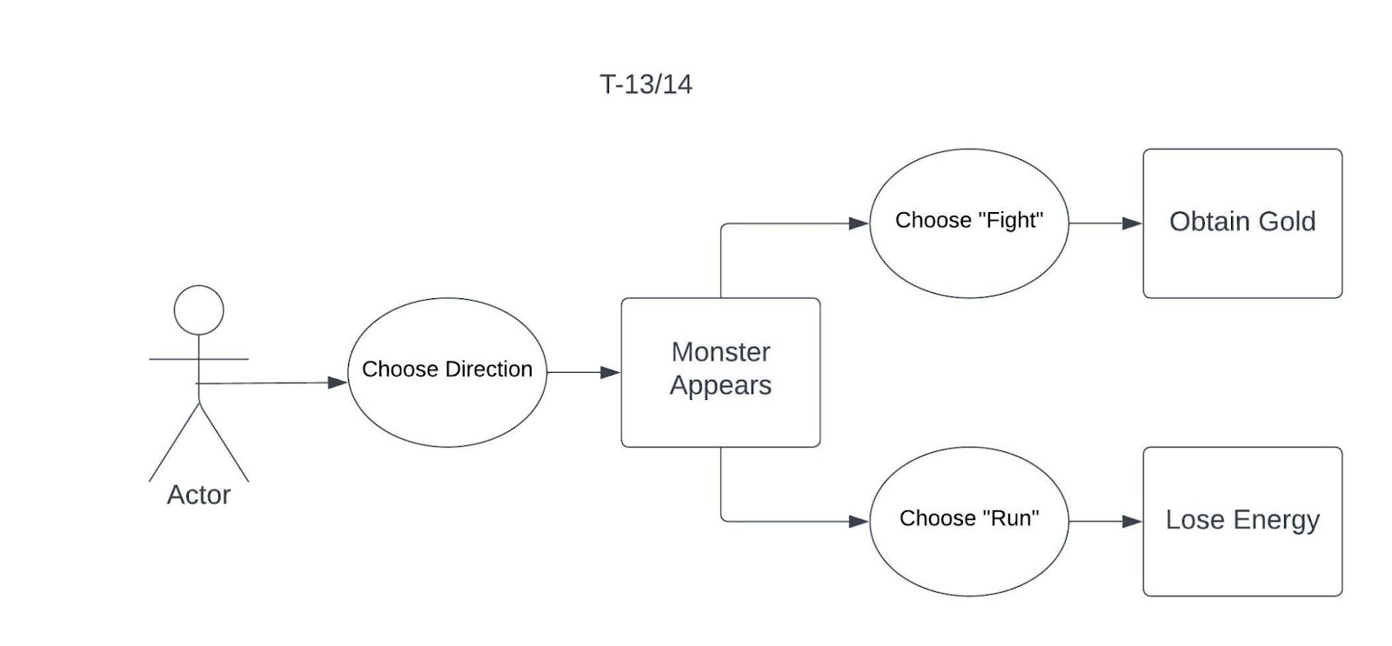



SRS/SPMP
DESIGN
Including Goals and Objectives
- Functional Requirements
- Non-functional requirements Non-functional
IMPLEMENTATION
V&V TESTING
Major Software
Functionality
MAINTENANCE

Slide 4
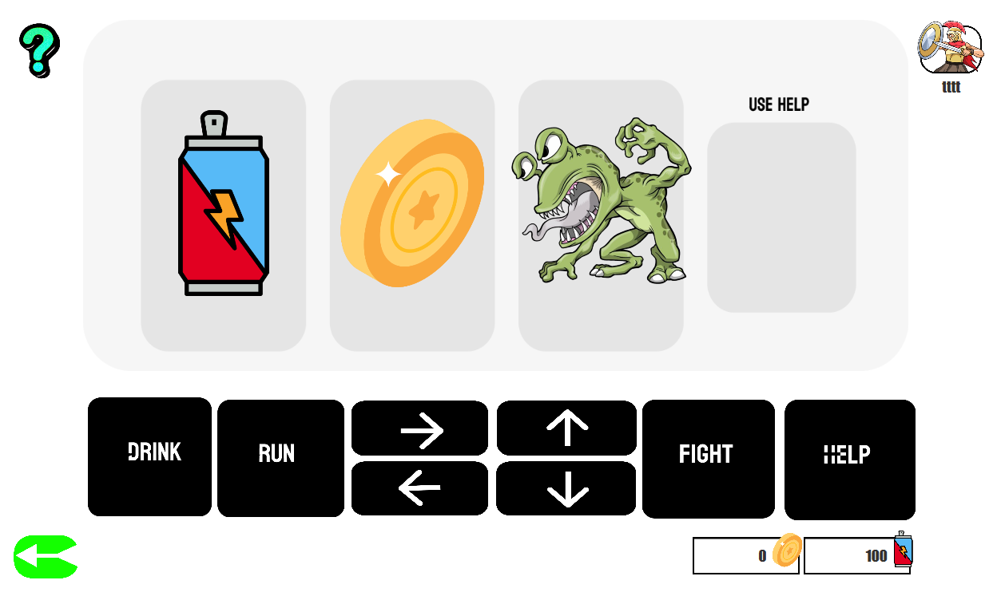
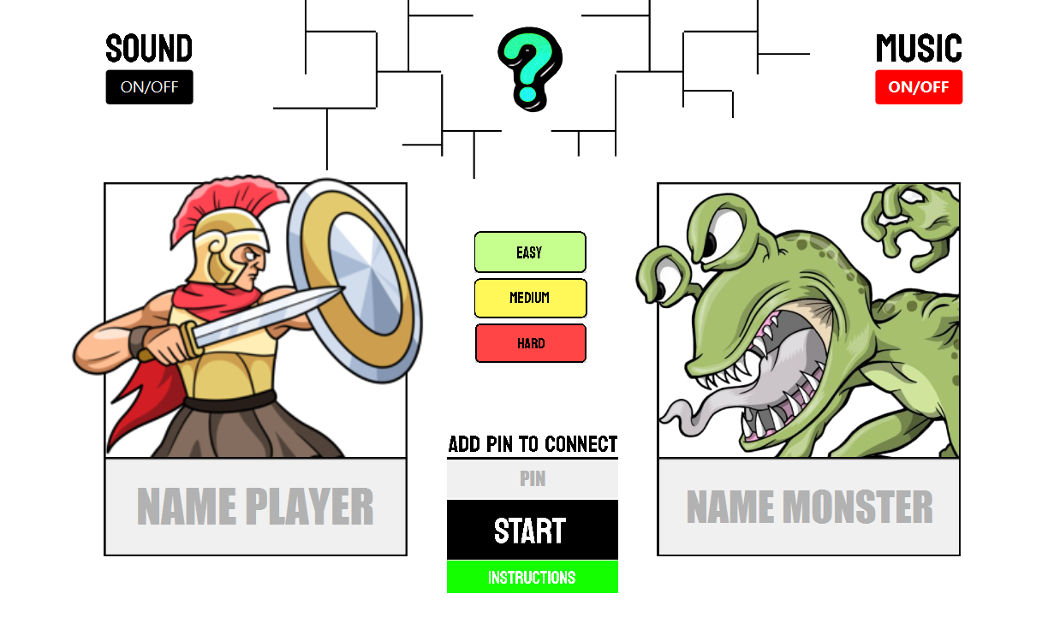

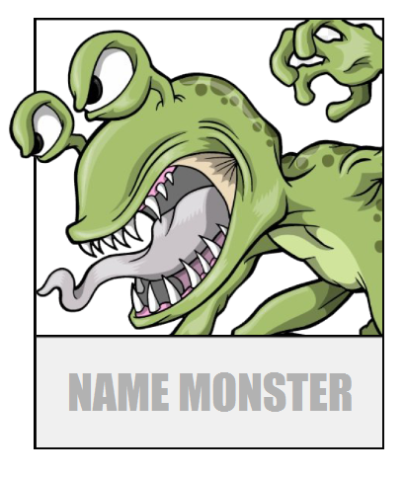

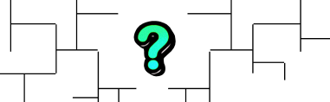







DESIGN

Slide 5
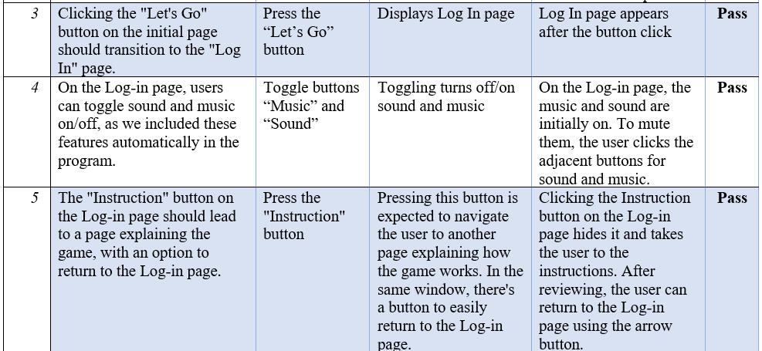
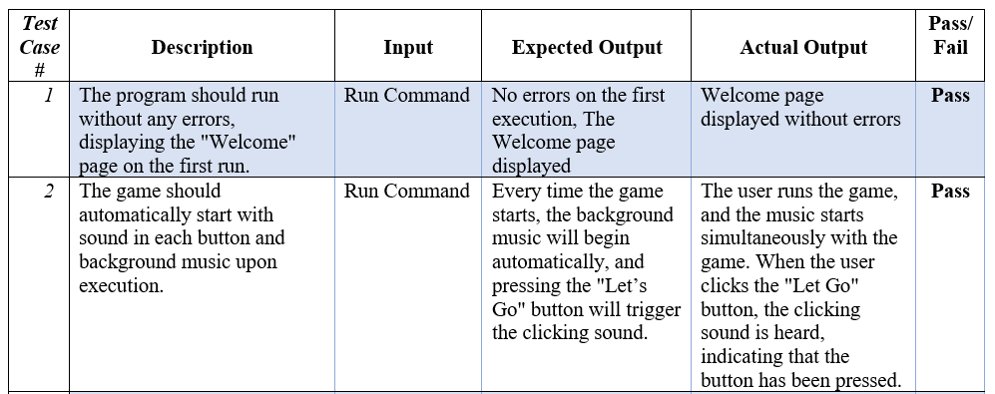
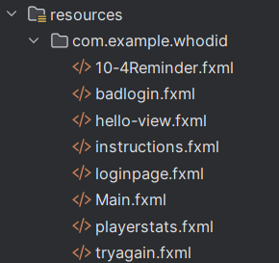
IMPLEMENTATION / V&V TESTING
BLACK-BOX TESTING

Slide 6
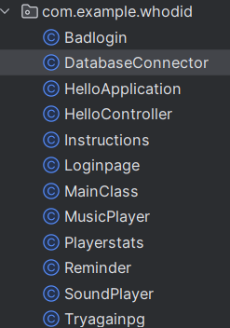
MAINTENANCE
lesson we learned
Performance Optimization
&
Code simplification
code review
and documentation

Slide 7
Group 5
DEMO NEXT

