Slide 1
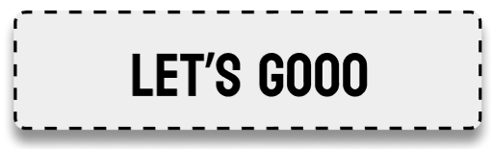
Oakland Community College
Prof Hadi Nasser
prototype
WHO DID
GROUP 5
Viktor, Ejmen, Nathan, Johnathan, Joey

Slide 2
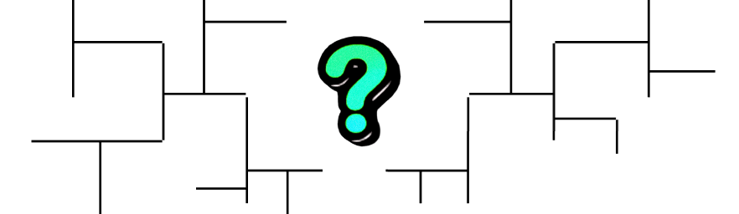


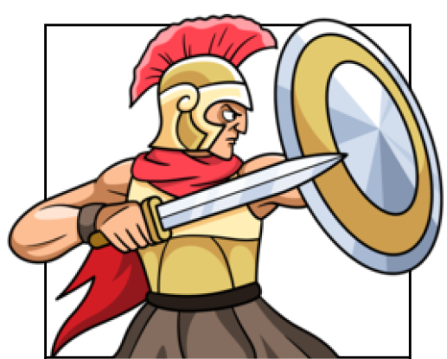

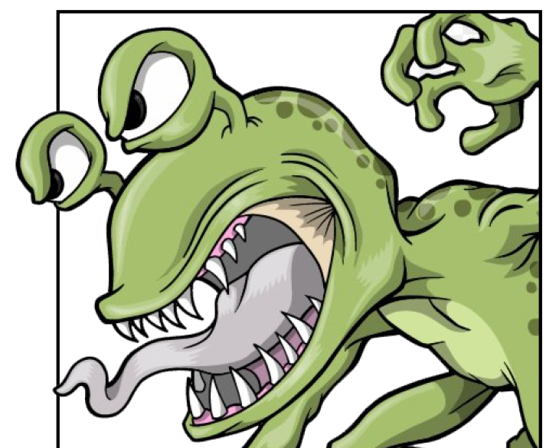
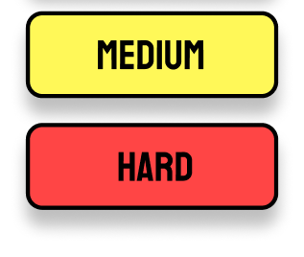






Slide 3


Slide 4

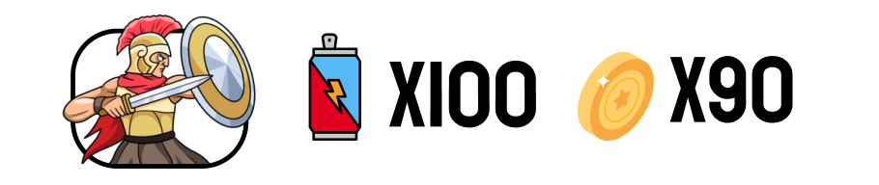

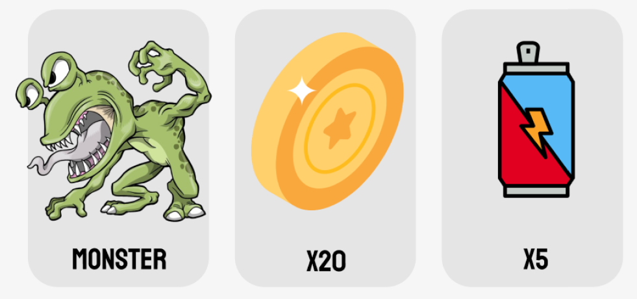




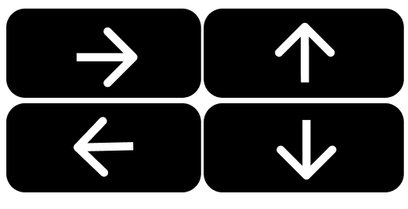






Slide 5
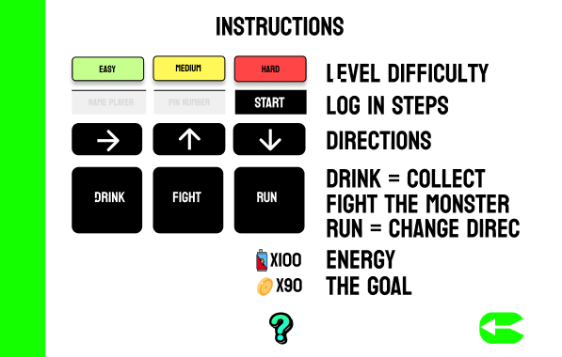

Slide 7


Slide 8
THANK YOU
GROUP 5
Viktor, Ejmen, Nathan, Johnathan, Joey

