Slide 1



2024
BAD TWiTter CLONE
Viktor Shkrivani - Documentation

Slide 2
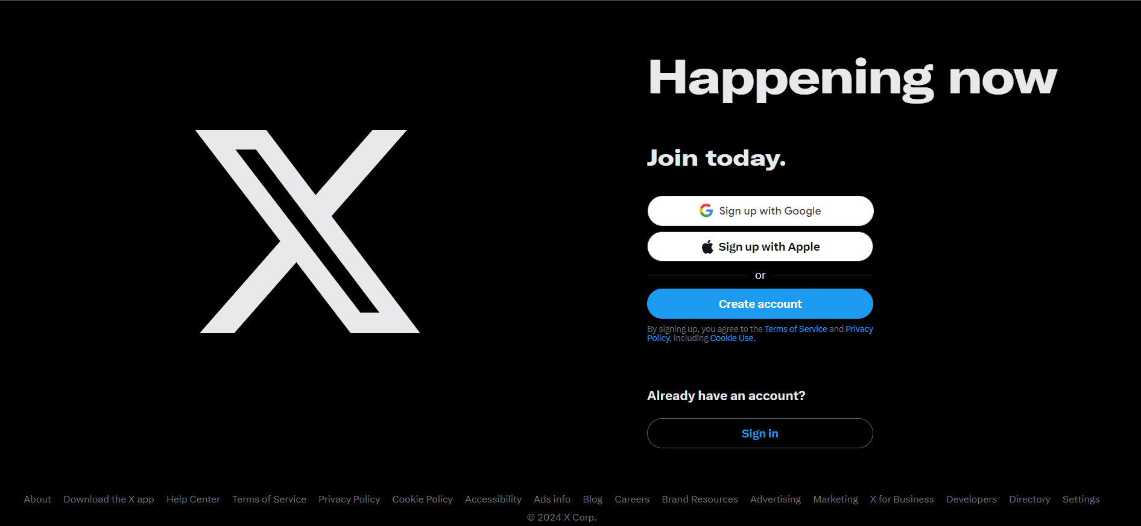

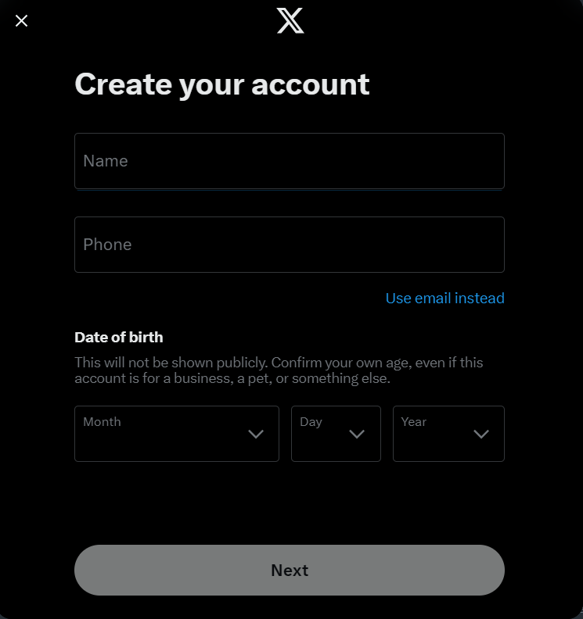

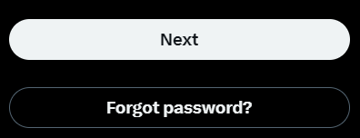
Index.php
1. background img
2. Create account or Sigh in
3. If Creates a new account
3. If Sign in
3. Bottom
zoom out for content
Note: build two flows that show two different tables
Notes:
- Allow users to create accounts and login (no delete account or email verification)

Slide 3
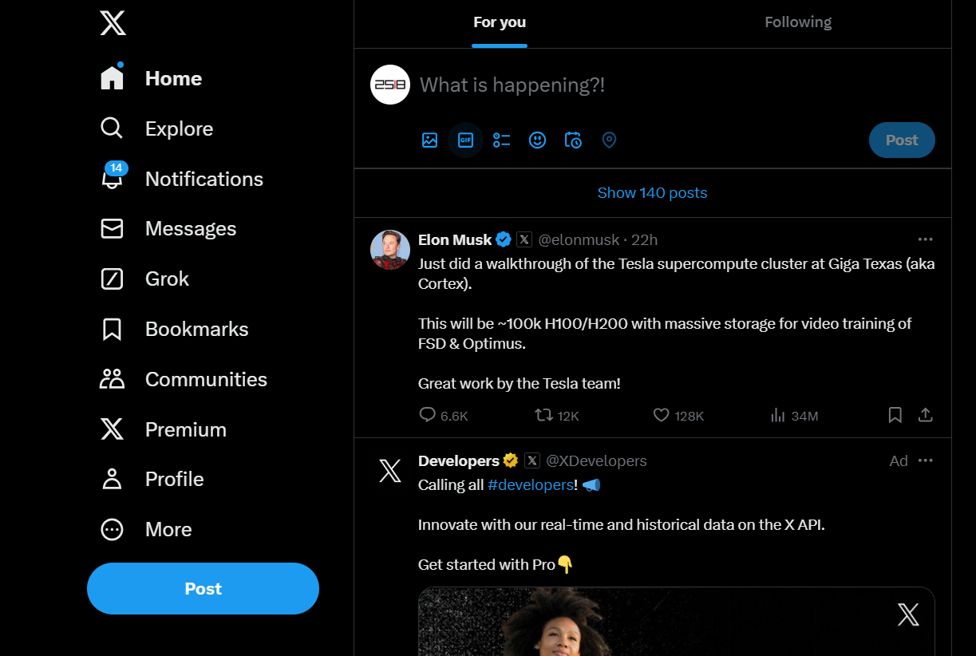
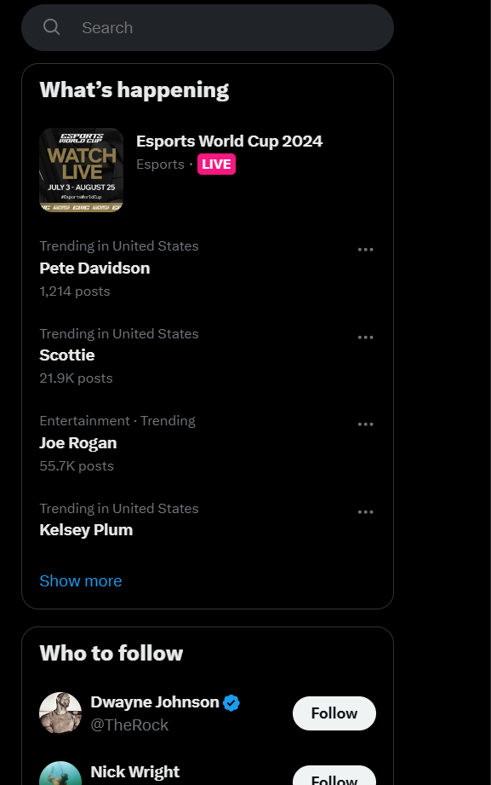




1. Follow/unfollow people
1. List of newest tweets
1. Tweets of those they follow on their page
1. Like a tweet, count likes
1. Able to tweet including images
Notes:
- Allow follow/unfollow people
See the list of newest tweets
See the list of the newest tweets of those they follow on their home page
Include an option to 'like' a tweet, include a count of likes when displaying tweets
create new tweets including uploading images.

Slide 4
Notes:
Database backend Clone
-/username will show the list of tweets of that user
-allow the logged in user to follow - if the username doesn't exist, give a generic error page

Slide 5
Step 1.
Building the index.php
Background image

