Slide 1
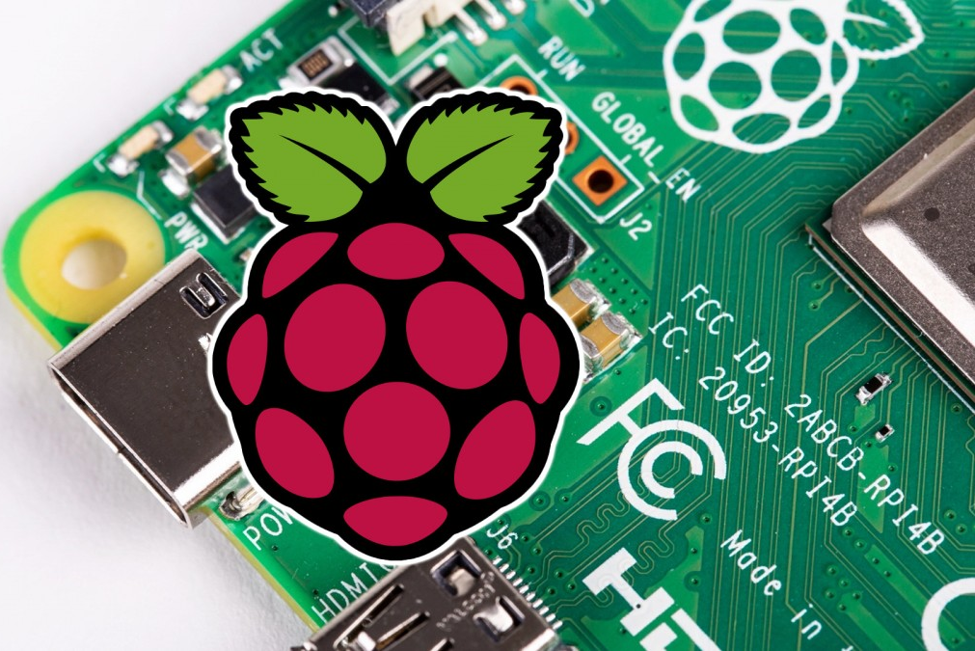
PiSec
Group 35

Slide 2
Members of the group:
David Roelofsen
Dimitar Popov
Mauricio Merchan
Viktor Tonchev
Vladimirs Popovs
Yordan Tsintsov

Slide 3
Description
Project Requirements
It is a security system, which monitors the state of doors and windows through sensors.
When the system detects any change of this state it will send a notification to the user.
Functional Requirements:
The system should detect the change of the state of the sensor and notify the user if the system is armed
The system should be armed or disarmed using the web interface.
Nonfunctional requirements:
The system should contain a friendly user interface
The system should contain a security process (authentication)
The system should be able to install newly added sensor by itself or without much work by the user

Slide 4
Planning
Week 4
-Improve the requirements
-Start working on the design
Week 5
-Design phase (UML Diagrams, illustrations, etc)
-Create a mock-up.
Week 6
-Start with the development phase

Slide 5
Planning
Week 7
-Development and MVP
Week 8
-Specifying MVP improvements
-Development
Week 9-10
-Improvements and polishing

Slide 6
Task division
Development
Testing
Documentation
Progress check
Reports

Slide 7
Team Communication
Meetings:
Discord, Zulip, Whatsapp
Documentation:
Google Drive, Javadoc
Version control, Project management:
Gitlab, Atlassian Jira

Slide 8
Any Questions?

