Slide 1
Rest of Java
Objective: Learn about some of the more advanced language features in Java:
Functional interfaces & Lambda expressions.
Varargs parameters.
Ternary operator.
Anonymous classes.
Switch statement.
Notes:
Home many kind of files? Text, music, video. Word documents, Power point documents. Zip files.
What can you do with a file: reading, playing, uncompressing, deleting, copying, moving.
What errors can you encounter: can't find file (when opening). Can't delete file (protected?). Can't read file (wrong format – can't play a song from a txt document).

Slide 2
Functional Interfaces
Simplified way to create instances from an interface.
Functional interfaces have only one method.
Instantiating a functional interface into a variable:
IntfName instance = (pName1, pName2, …) -> { code };
pName1, pName2, … have to be in the same number as the number of parameters in the only method of the interface.
The code in the instance body has to return a value of the same type as the return type of the method.
This variable is called a lambda instance and can be used like a regular object.
public interface MyInterface {
String myMethod (String myParam1, float myParam2);
}
...
MyInterface f = (p1, p2) -> { return p1 + p2; };
...
String s = f.myMethod("myString", 4.2);
...
Anonymous classes
Another simplified yet more flexible way to create instances from an interface.
No restriction to the number of methods the interface can have.
Instantiating an interface with Anonymous classes is a mix of class instantiation (using the new keyword) and declaration (providing code to methods):
IntfName instance = new IntfName() {
Type method1 (Type pName1, Type pName2, …) { code };
Type method2 (Type pName3, Type pName4, …) { code };
};
Using the instance is identical to using any other object instance.
public interface MyOtherInterface {
String myMethod1 (String myParam1, float myParam2);
void myMethod2 (int myParam3);
}
...
MyOtherInterface f = new MyOtherInterface() {
String myMethod1 (String p1, float p2) { ... }
void myMethod2 (int p3) { ... }
};
...
System.out.println(f.myMethod1("abc", 4.2));
f.myMethod2(37);
...

Slide 3
Varargs parameters
A more flexible way to pass a collection of elements (array) as individual parameters to a method.
Formal declaration:
public TypeName methodName (TypeName... paramName) { ... }
Actual invocation can be either of the following:
Passing in one value of type TypeName[].
Passing in zero or more values of type TypeName.
When used in a method with multiple parameters, it can only be one varargs parameter and it has to be the last in the list.
public void myMethod1 (SomeType [] arr) { ... }
public void myMethod2 (SomeType... arr) { ... }
SomeType [] a = {someVal1, someVal2, someVal3 };
myMethod1(a);
myMethod1(someVal1, someVal2, someVal3);
myMethod2(a);
myMethod2(someVal1, someVal2, someVal3);
myMethod2(someVal1, someVal2);
myMethod2();
Ternary operator
A flexible way to evaluate an expression to different values based on the result of a Boolean condition.
Similar to the if..else statement, but for expressions not for as alternate blocks:
Type value = condition ? exprOnTrue : exprOnFalse;
Both the values on the True and False branches have to evaluate to a value of the left-hand-side type.
Can be chained and embedded in more complex expressions.
Has low priority: only assignment operators are evaluated after ternary operator. All other operators are evaluated before. Nesting is evaluated left to right.
int v = 10; v == 20 ? 20 : 30
v + 10 == 20 ? 20 : 30
(v == 10) ? v – 10 : v + 10
int w = 2; w < 2 ? (w == 0 ? "t" : "r")
: (w < 3) ? "l" : "b"
int n = 13, d = 0;
int r = d != 0 ? n / d : "div by 0"
System.out.println(
d != 0 ? n / d : "div by 0");
30
20
0
"1"
Comp. Error
"div by 0"

Slide 4
switch..case statement
Allows forking the execution flow based on multiple possible values of a given expression. Similar to if..else if..else if.. else chains.
Use the break statement carefully otherwise execution falls through the next case.
Can be nested.
When nested, the break statement exits only the inner-most switch..case.
Default case is optional,
...
int year = ...; /* 9, 10, 11, 12 */
String school = ...; /* "LWHS", "RHS" */
String label;
switch (school) {
case "LWHS":
switch(year) {
case 9:
label = "freshmen in 98033";
break;
case 10:
label = "sophomore in 98033";
break;
}
break;
case "RHS":
switch(year) {
case 10:
label = "sophomore in 98052";
break;
case 12:
label = "senior in 98052";
}
break;
default:
label = "out of the area";
break;
}
Start
Switch(expr)
expr == val1?
Y
statement;
statement;
...
break?
Y
N
N
expr == val2?
Y
statement;
statement;
...
break?
Y
N
N
...
...
...
default?
Y
statement;
statement;
...
break?
Y
N
N
End

Slide 5
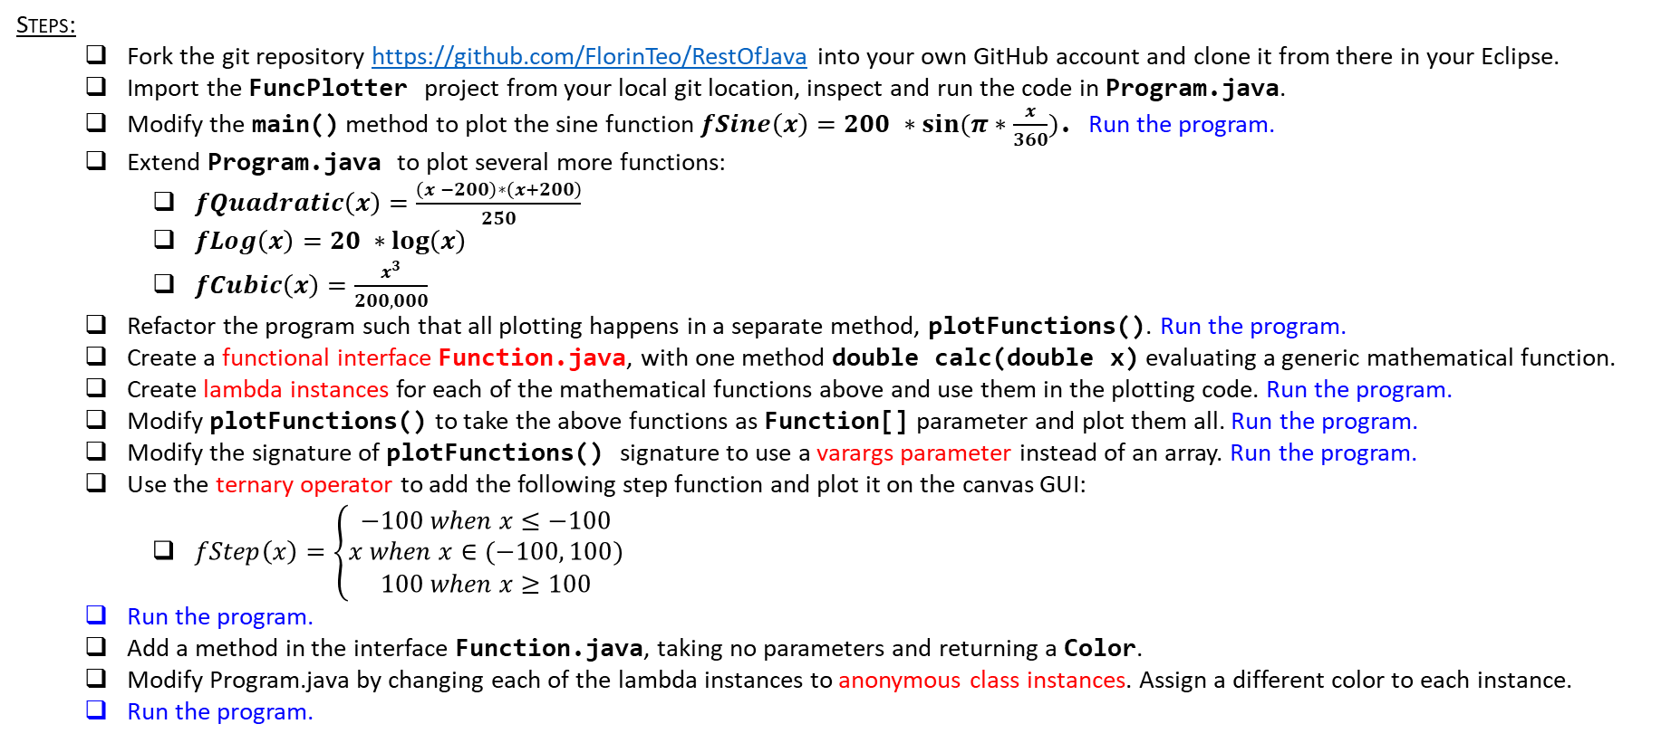
Plotting math functions
Goal:
Write a program that is plotting on a canvas GUI several mathematical functions, in different colors.
Steps:
Fork the git repository https://github.com/FlorinTeo/RestOfJava into your own GitHub account and clone it from there in your Eclipse.
Import the FuncPlotter project from your local git location, inspect and run the code in Program.java.
Modify the main() method to plot the sine function $fSine\left(x\right)=200 ∗sin⁡(π∗\frac{x}{360})$. Run the program.
Extend Program.java to plot several more functions:
$fQuadratic\left(x\right)=\frac{\left(x −200\right)∗\left(x+200\right)}{250}$
$fLog\left(x\right)=20 ∗\log\left(x\right)$
$fCubic\left(x\right)=\frac{x^{3}}{200,000}$
Refactor the program such that all plotting happens in a separate method, plotFunctions(). Run the program.
Create a functional interface Function.java, with one method double calc(double x) evaluating a generic mathematical function.
Create lambda instances for each of the mathematical functions above and use them in the plotting code. Run the program.
Modify plotFunctions() to take the above functions as Function[] parameter and plot them all. Run the program.
Modify the signature of plotFunctions() signature to use a varargs parameter instead of an array. Run the program.
Use the ternary operator to add the following step function and plot it on the canvas GUI:
$fStep\left(x\right)=\left\{\begin{aligned}−100 when x≤−100 \\ x when x∈(−100, 100) \\ 100 when x≥100\end{aligned}\right.$
Run the program.
Add a method in the interface Function.java, taking no parameters and returning a Color.
Modify Program.java by changing each of the lambda instances to anonymous class instances. Assign a different color to each instance.
Run the program.

Slide 6
Plotting math functions
Goal:
Improve the program by plotting one function at a time, as selected by user input.
Steps:
Add a command loop to your main() method, expecting a one char string from the user:
function?> S → plots only the Sine function
function?> Q → plots only the Quadratic function
function?> L → plots only the Logarithmic function
function?> C → plots only the Cubic function
function?> T → plots only the Step function
function?> → empty line breaks out from the command loop and terminates the program
Use a switch … case statement to separate the behavior based on the user input.

