Slide 1

Seasonal Agriculture Performance Analysis
Vikash Chauhan
Indira Gandhi National Open University
AICTE STU ID : STU696074fe214c21767929086

Slide 2

PROBLEM STATEMENT
Seasonal variations can influence different aspects of agricultural activities and performance.
Understanding seasonal patterns through data analytics can help stakeholders:
• Understand variations in agricultural performance
• Identify important seasonal trends
• Compare performance across different periods
• Understand changing environmental conditions
• Examine differences in resource usage
• Identify areas requiring further investigation
• Support evidence-based agricultural planning

Slide 3
Project Description
This project analysis 4000 farm-level agricultural records across 8 Indian states, 8 crops, and 3 seasons (Kharif, Rabi, and Zaid). The analysis examines key performance indicators such as yield, production, revenue, profit, ROI, water usage, and water efficiency. Using Python libraries including Pandas, NumPy, Matplotlib, Seaborn the project performs the project performs data cleaning, exploratory data analysis, statistical analysis, seasonal comparison and correlation analysis to identify meaningful patterns, relationships, and seasonal differences. The findings are used to generate data-driven insights and recommendations for improved agricultural planning and resource management.

Slide 4

WHO ARE THE END USERS?
Farmers and farmer cooperatives planning crop and irrigation choices by season
State agriculture departments and policy makers designing seasonal support schemes
Agri-fintech and insurance providers assessing seasonal risk and profitability
Researchers and agricultural extension officers studying seasonal performance patterns
Students and analysts learning applied agricultural data analytics

Slide 5

Technology Used
  Python 3 — core programming language
Pandas and NumPy — data loading, cleaning and aggregation
Matplotlib and Seaborn — univariate, bivariate and multivariate visualizations
Jupyter Notebook — analysis environment
No Machine Learning or dashboard tools used — pure data analytics

Slide 6
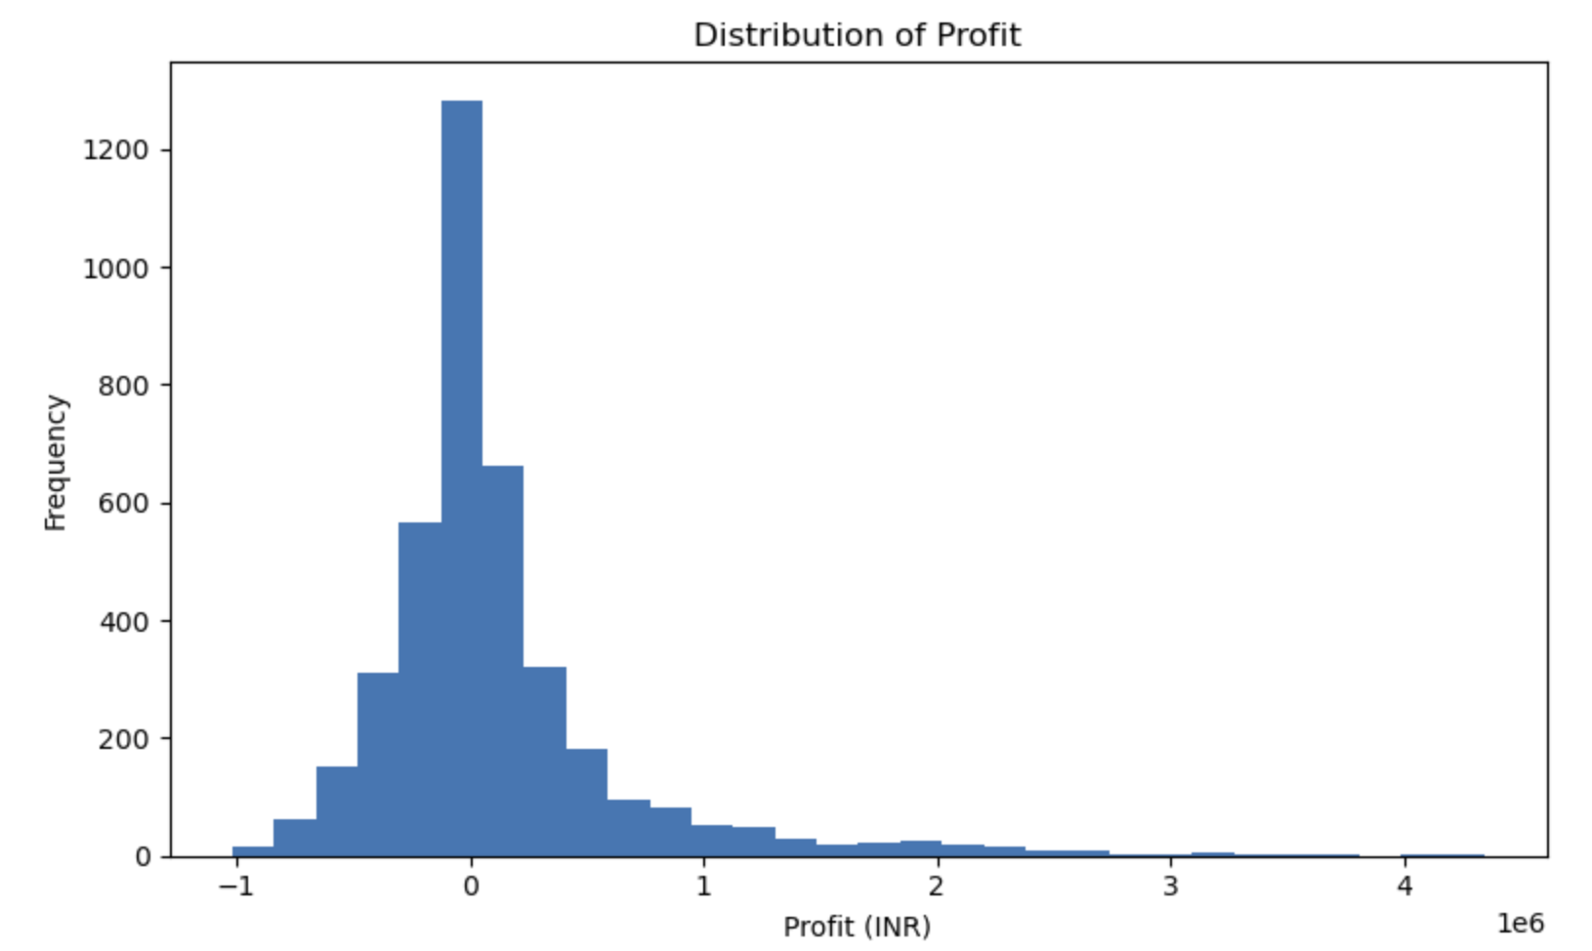
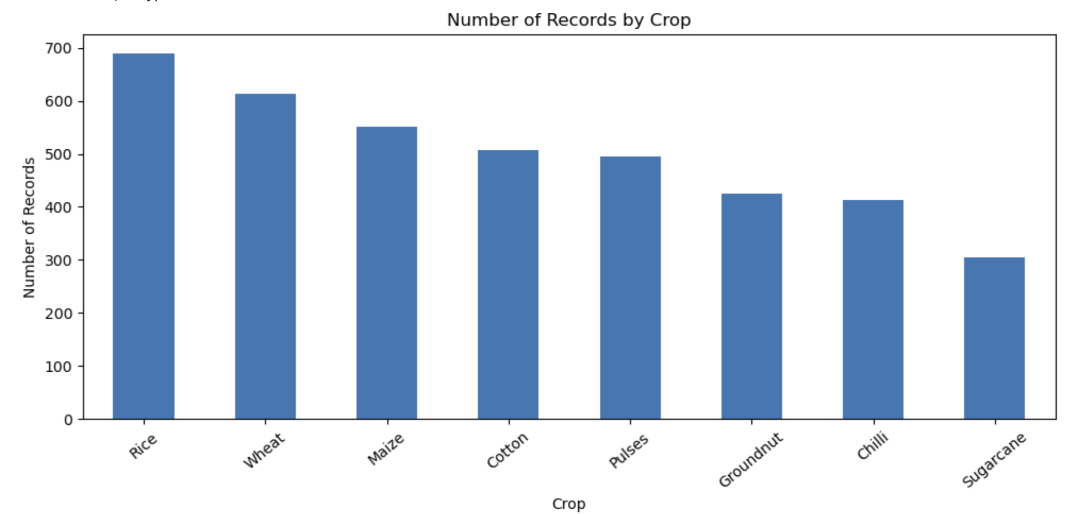
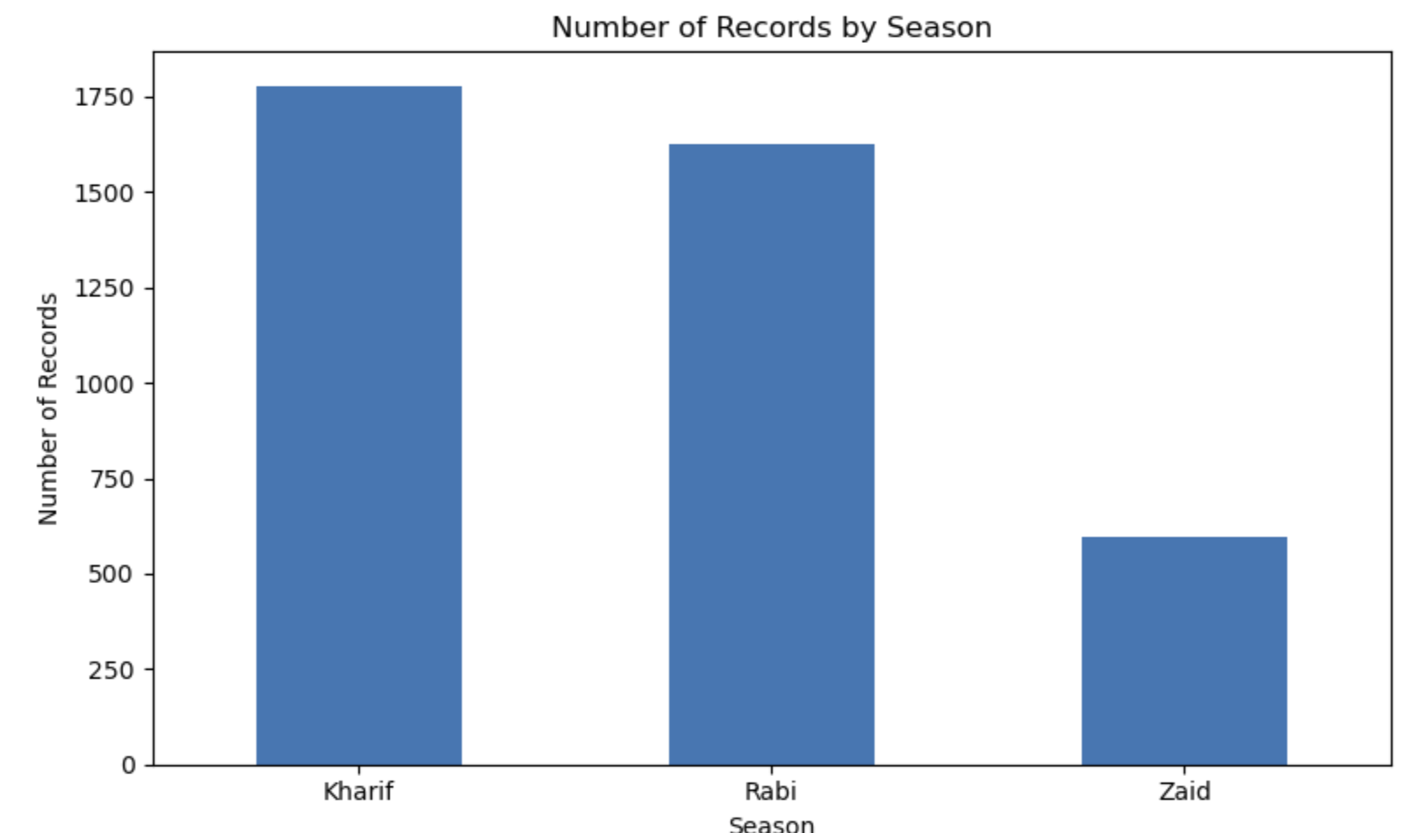
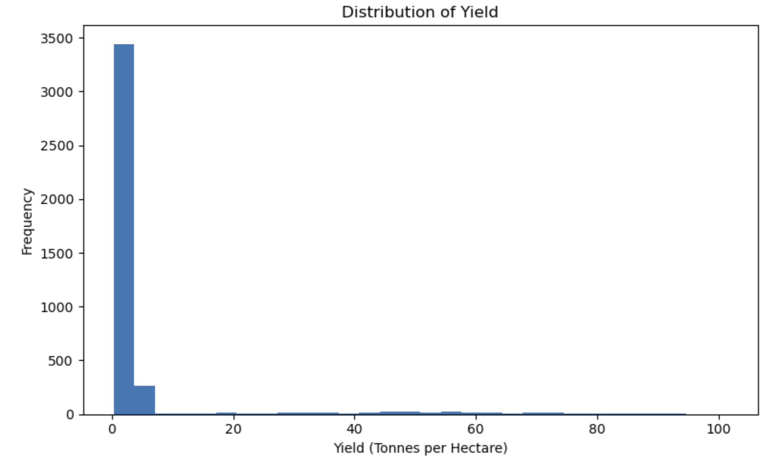
RESULTS
Dataset Overview

Slide 7
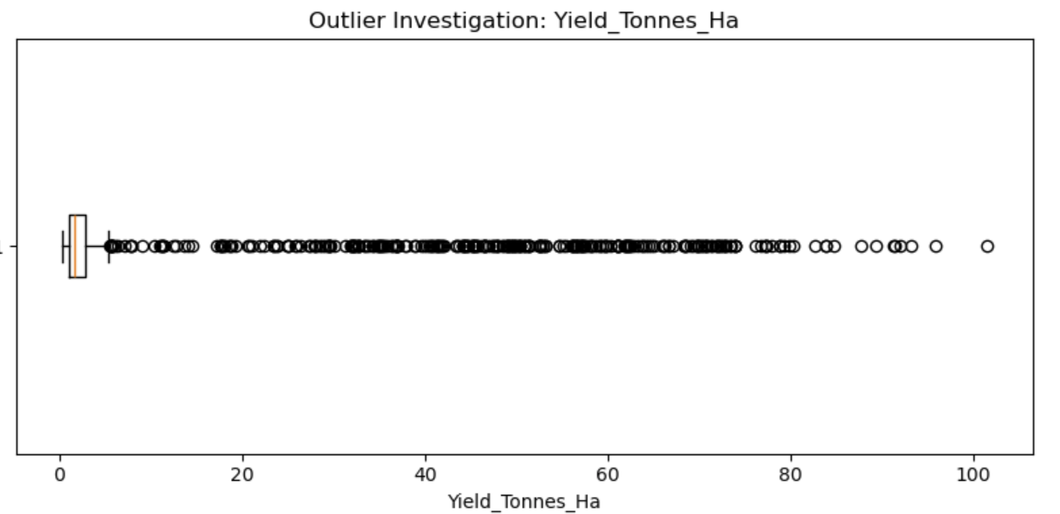
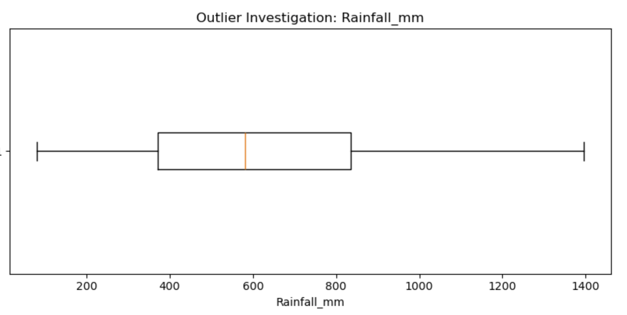
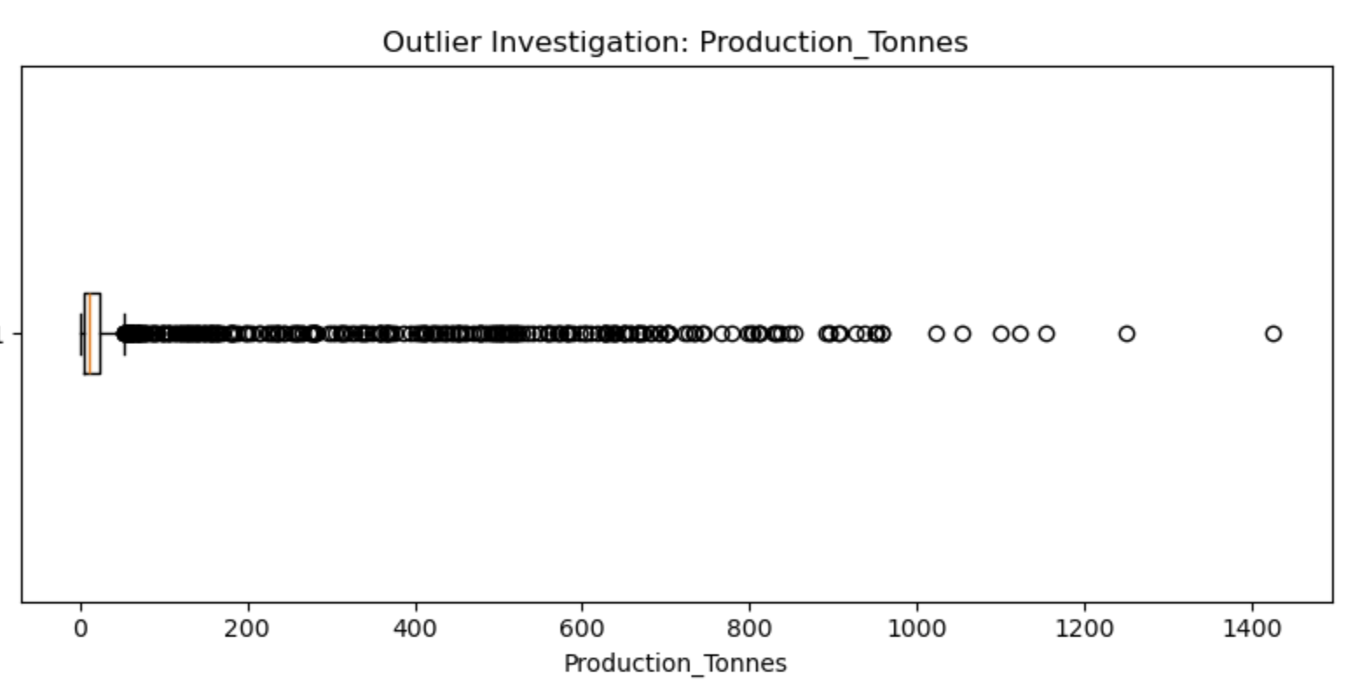
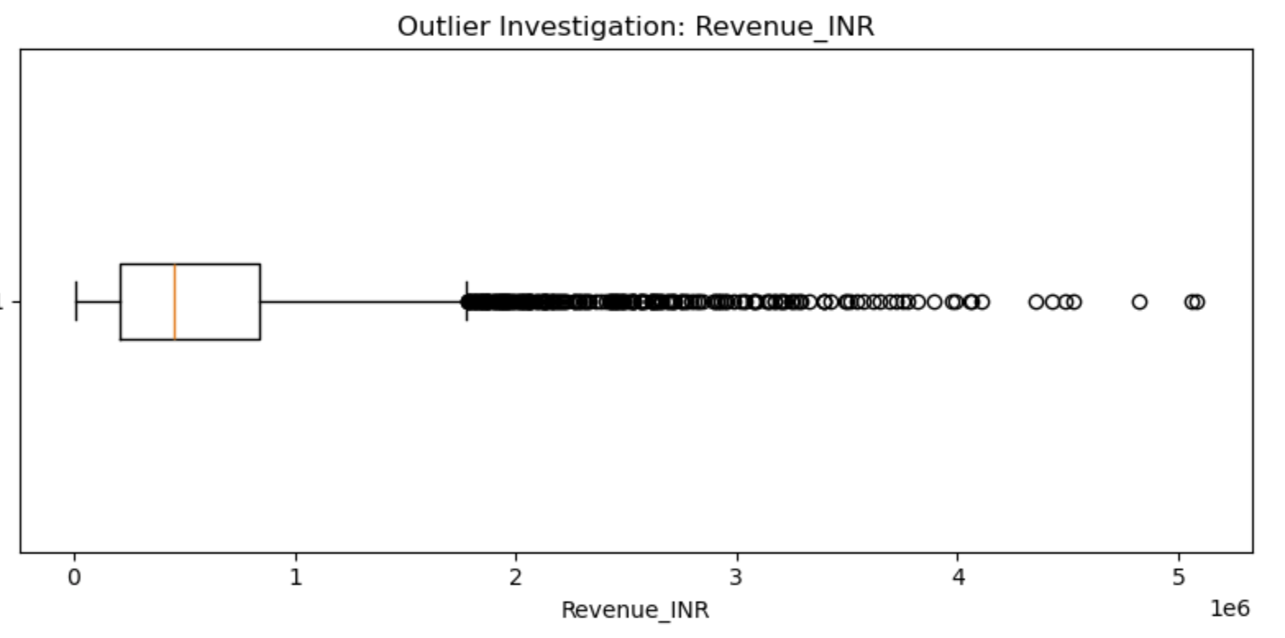
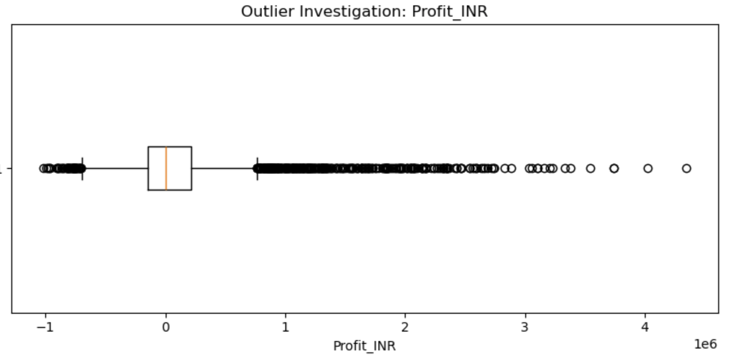
RESULTS
Seasonal Comparison

Slide 8
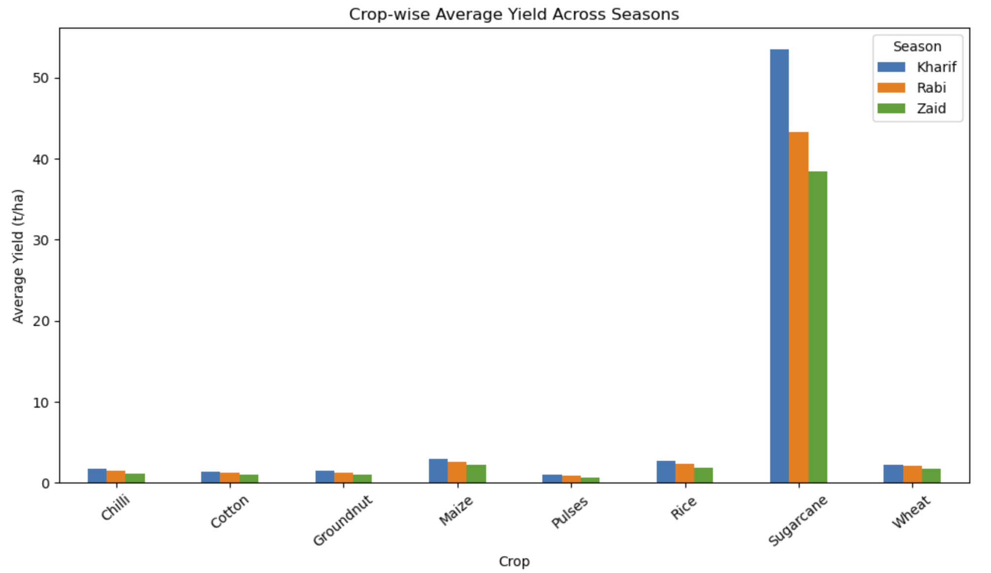
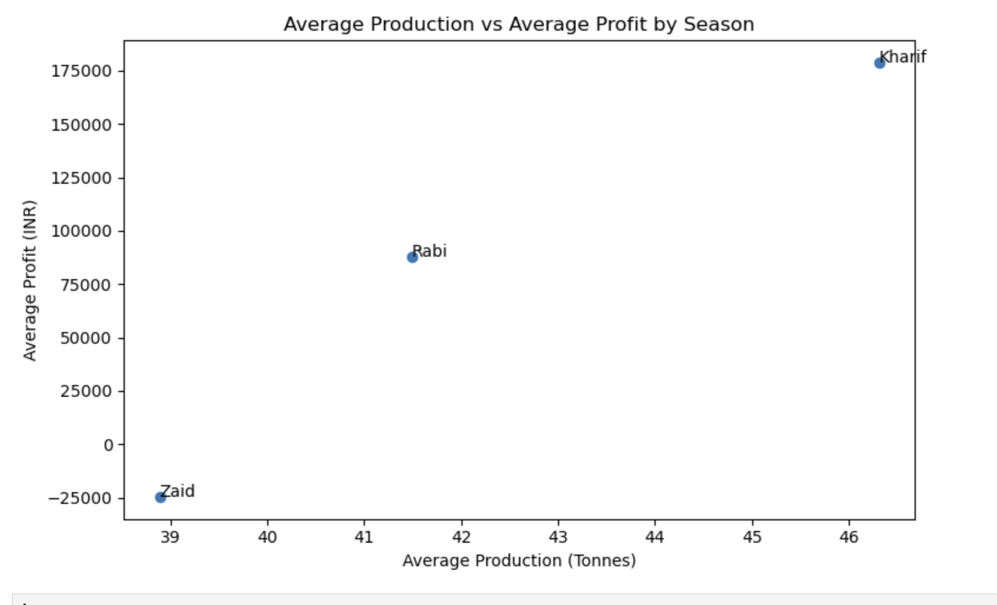
RESULTS
Crop x Season Yield and State x Season Profit

Slide 9
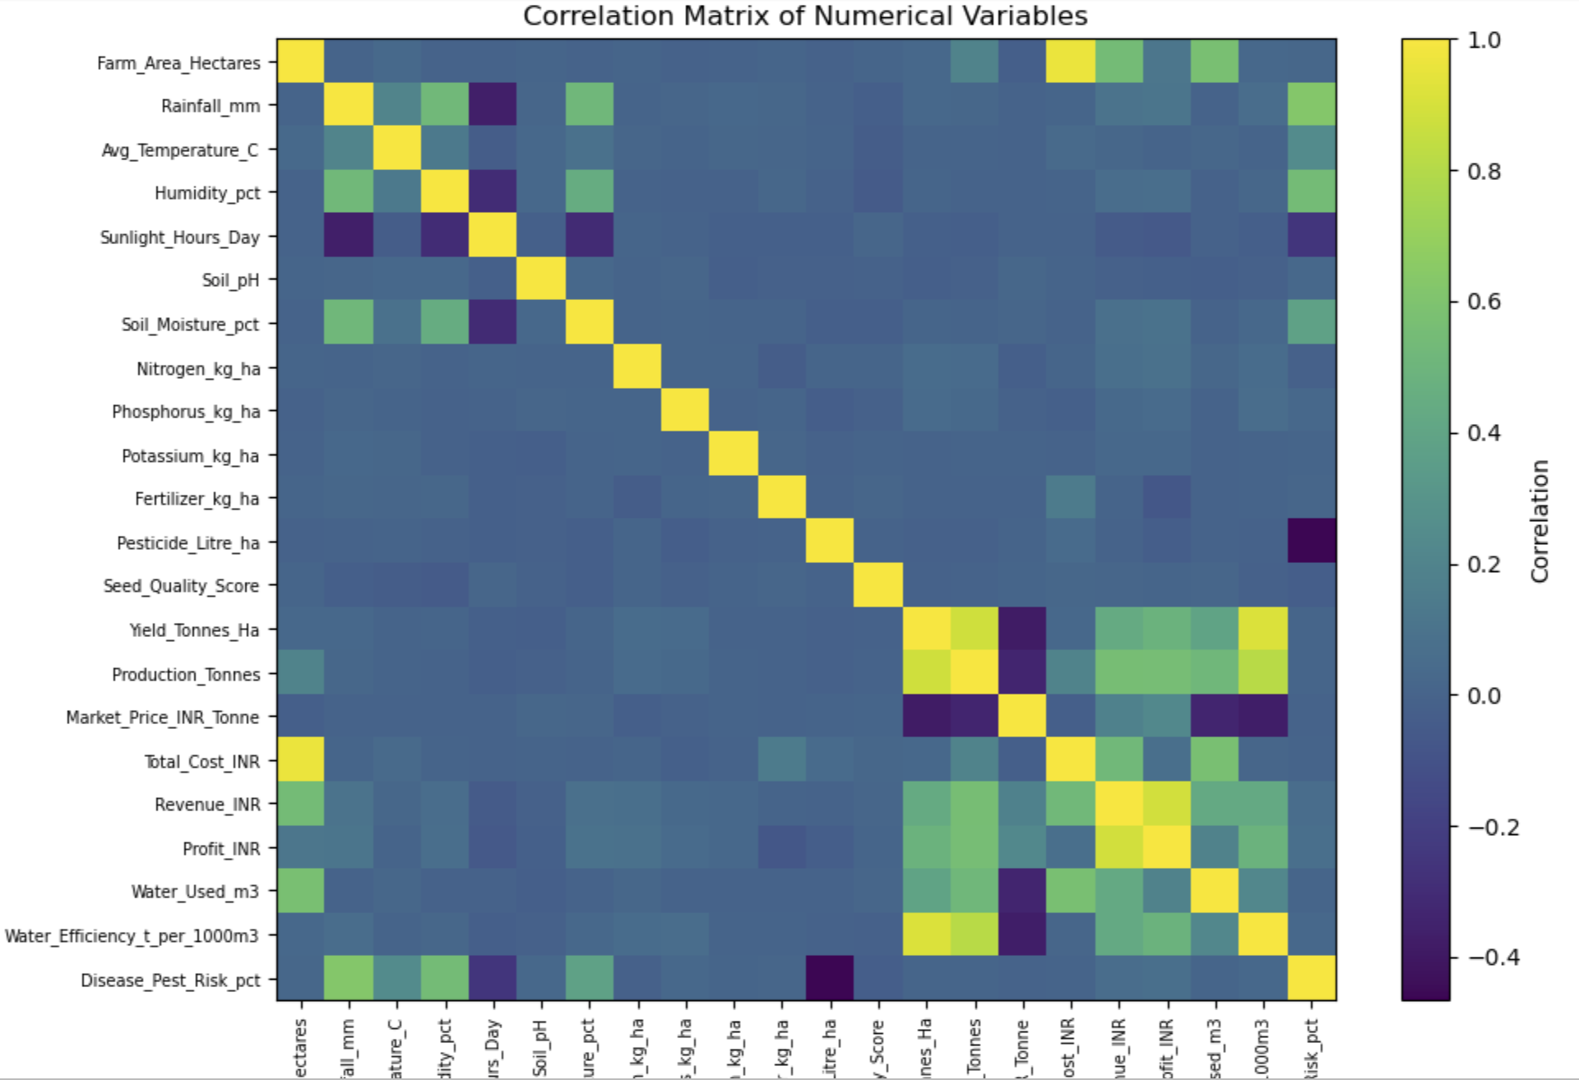
RESULTS
Correlation Heatmap of Numeric Variables

Slide 10
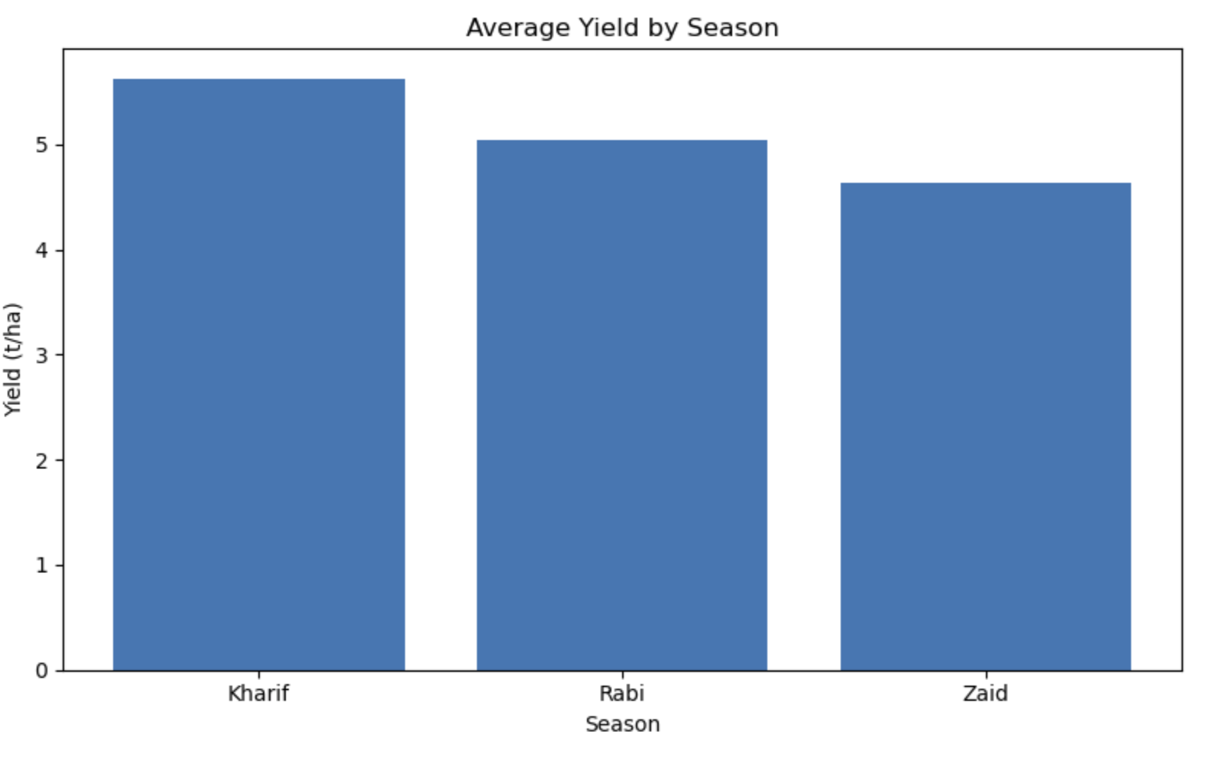
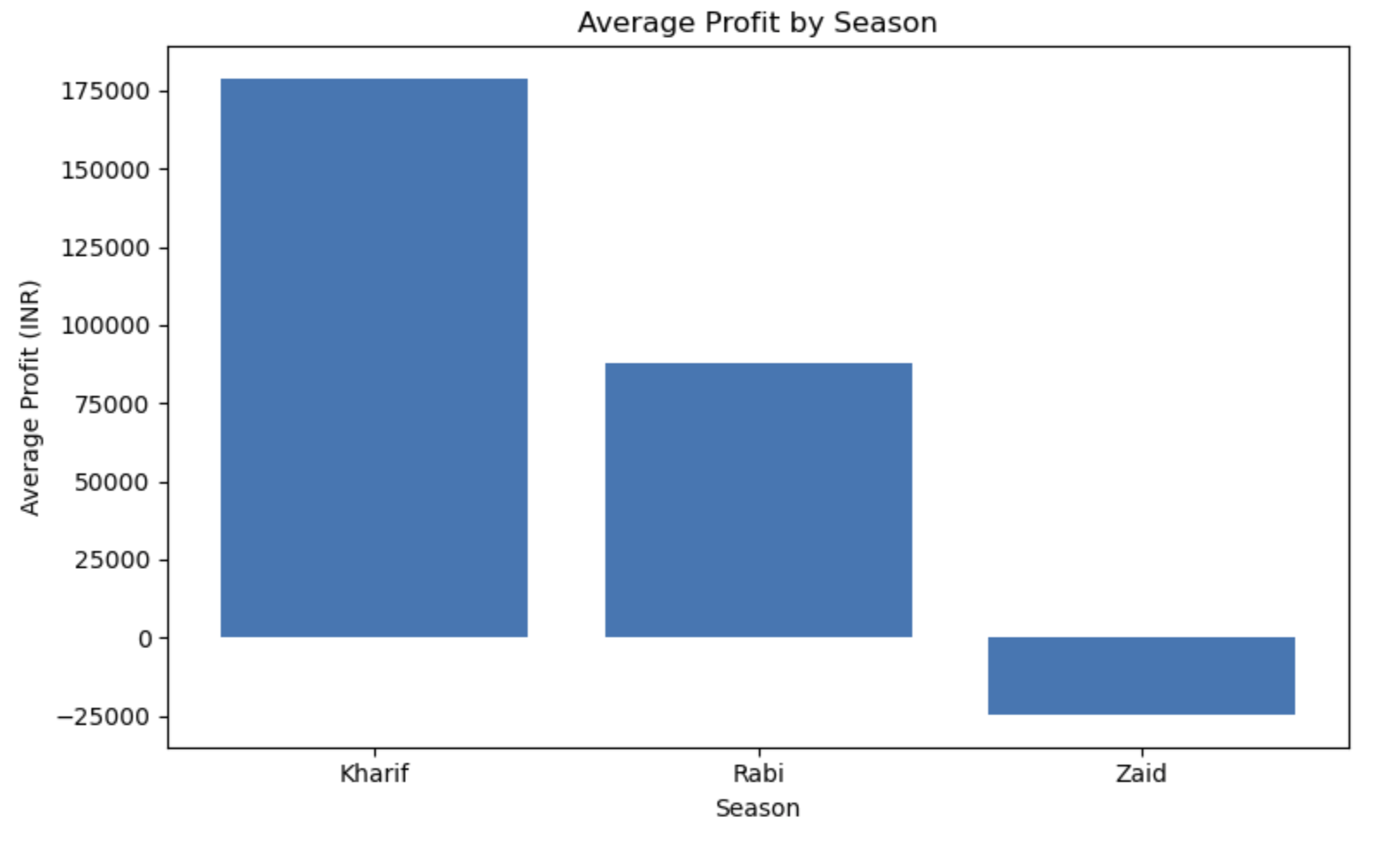
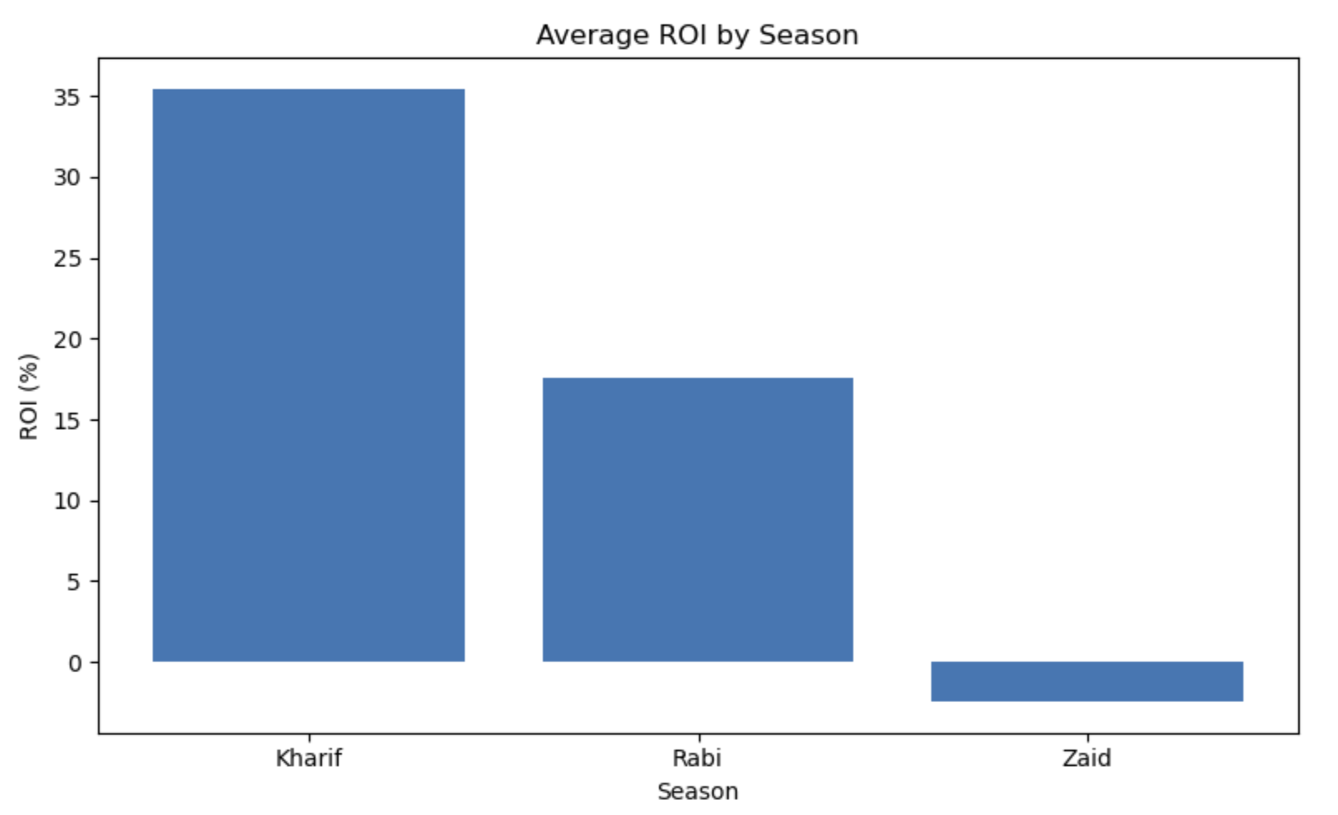
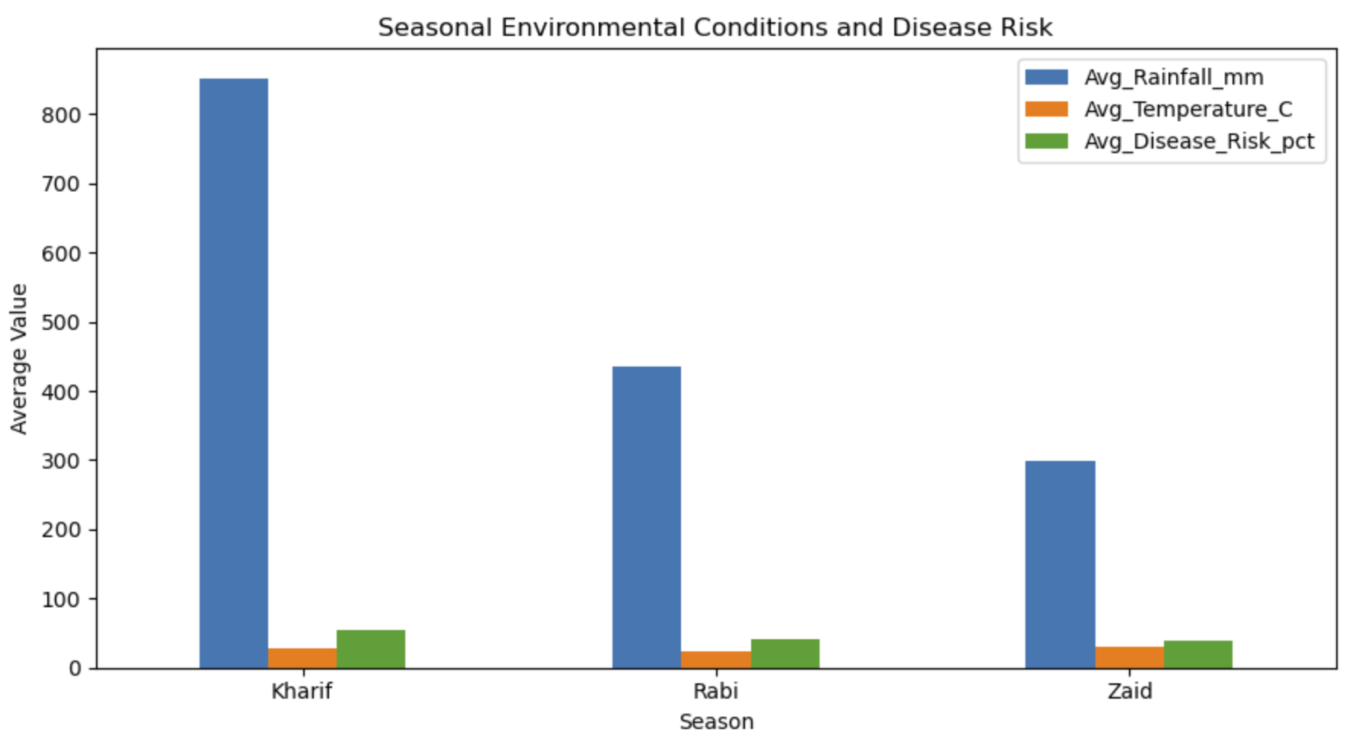
RESULTS
Profit & Loss-Making Farms by Season

Slide 11
Future scope
Extend to a multi-year time series to study year-over-year and climate-change effects
Incorporate market/mandi price data at finer granularity for cost-benefit modelling
Build a predictive (ML) model for yield/profit once causal drivers are validated
Add district-level granularity to refine the state-season findings
Develop an interactive dashboard for real-time seasonal monitoring
Study Drip vs Rainfed irrigation trade-off with a controlled field study

Slide 12
GitHub Link
GitHub Repository:
https://github.com/viku123-lol/seasonal-agriculture-performance-analysis

Slide 13
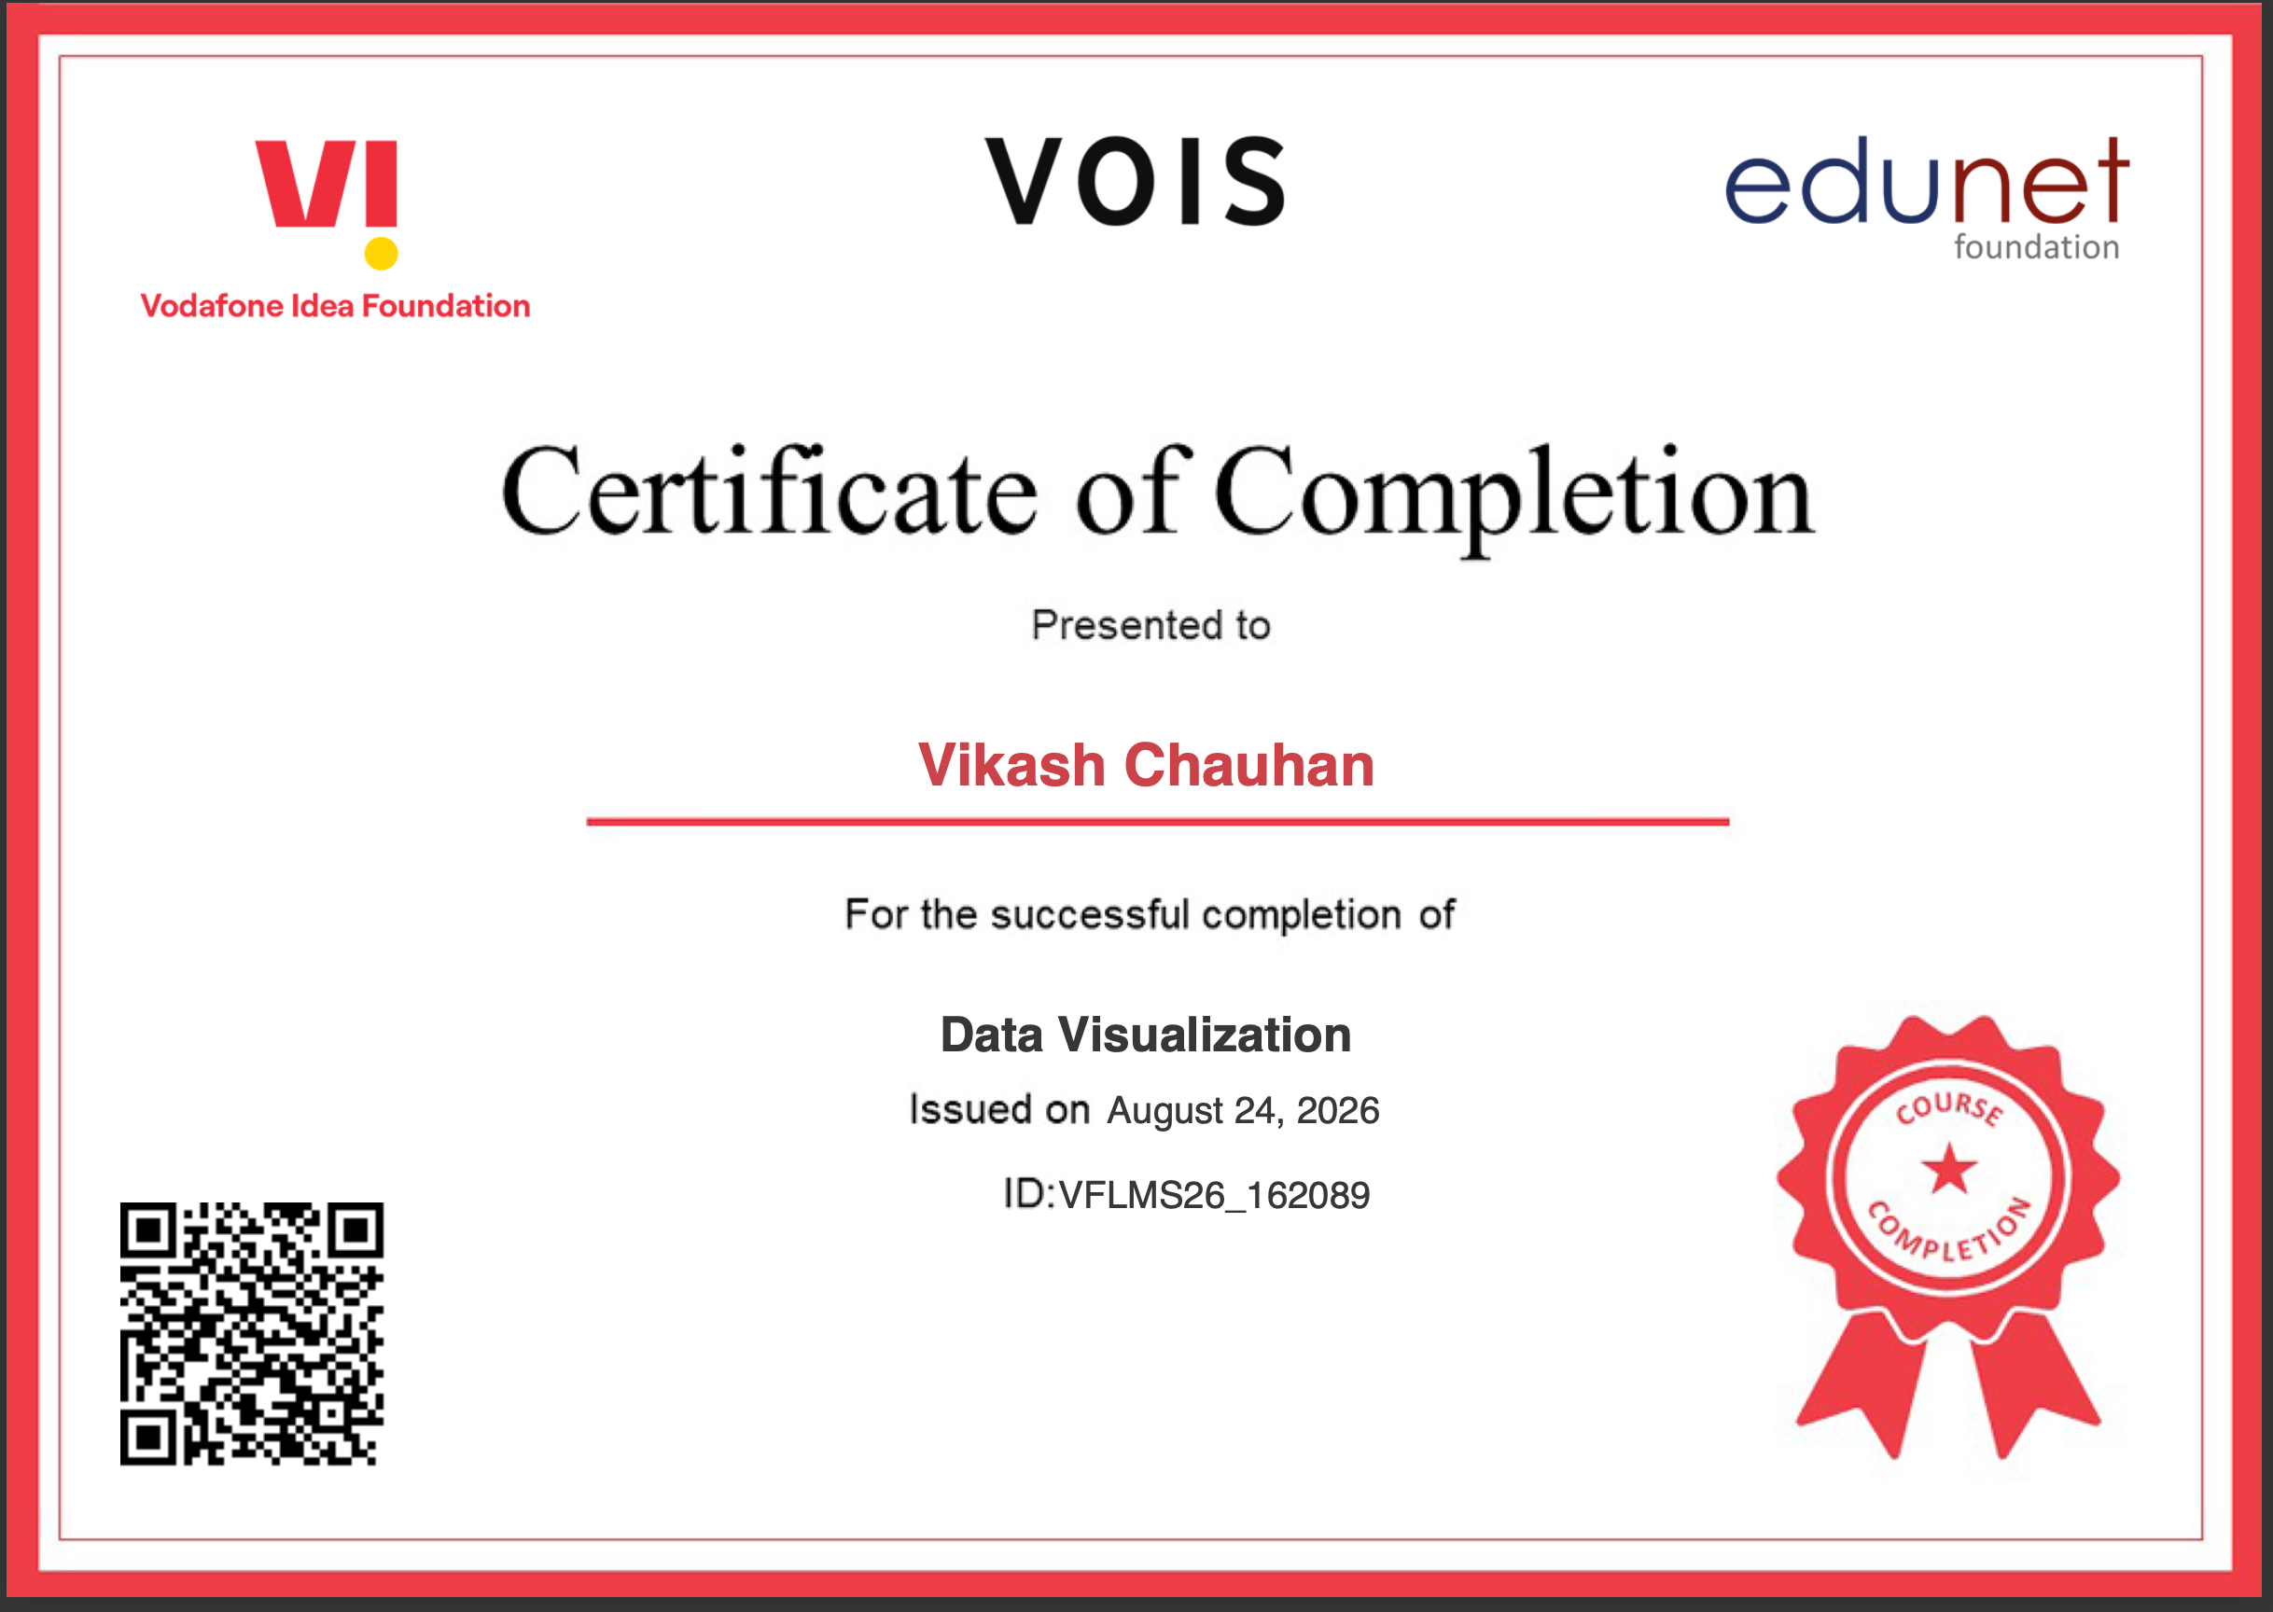
VOIS Course completion certificate -
Course name- Data Visualization

Slide 14
Thank you
Vikash Chauhan
.
.

