Slide 1






Assesment
PRE
Tokapal 100.0
Bastanaar 100.0
POST
Tokapal 80.0
Bastanaar 68.9

Slide 2
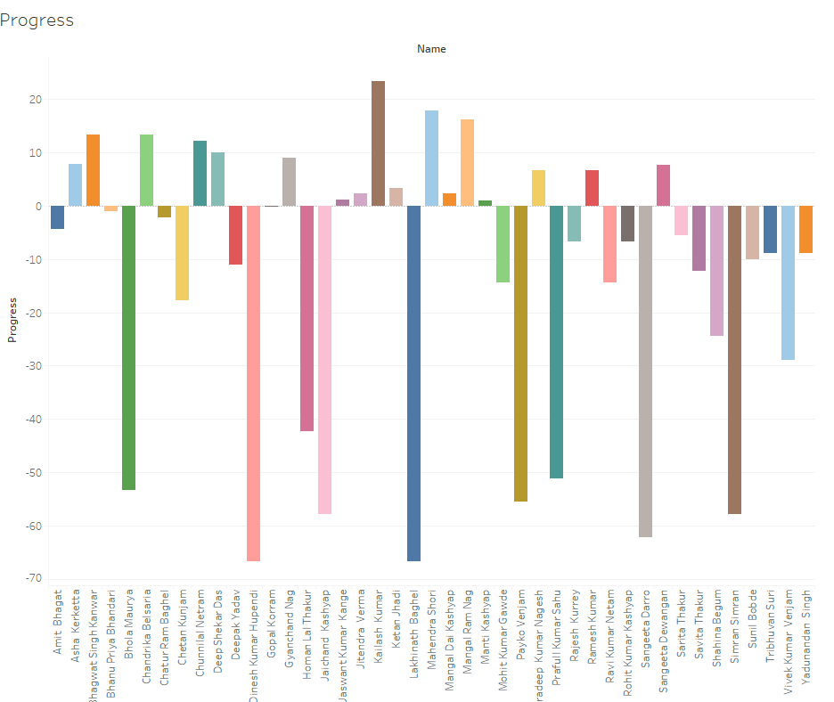
Progress
Tokapal -62.2 to 23.3
Bastanaar -66.7 to 12.2

Slide 3
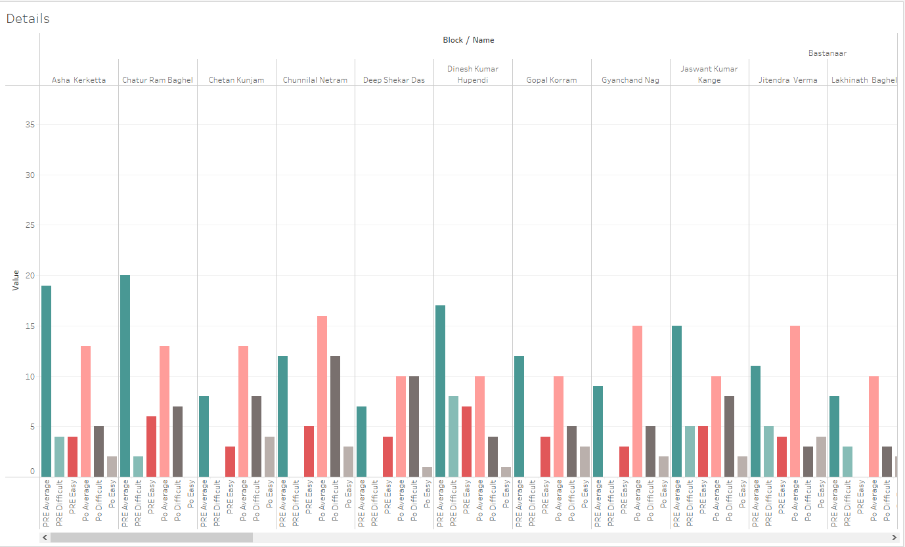
Complexity
Easy
Average
Difficult

Slide 4
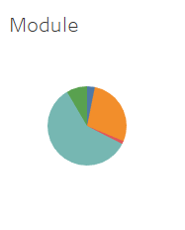
Modlues
Common Errors in English
Enhancing English Language Skills
Grammar
Reading and Comprehension Skills
Understanding Grammar
Vocabulary

Slide 5
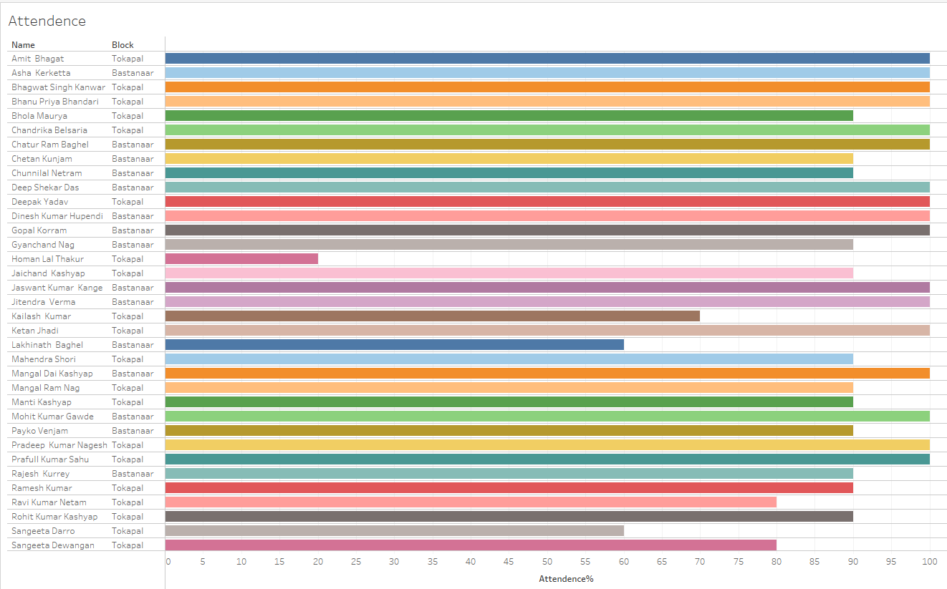
Attendence

Slide 6
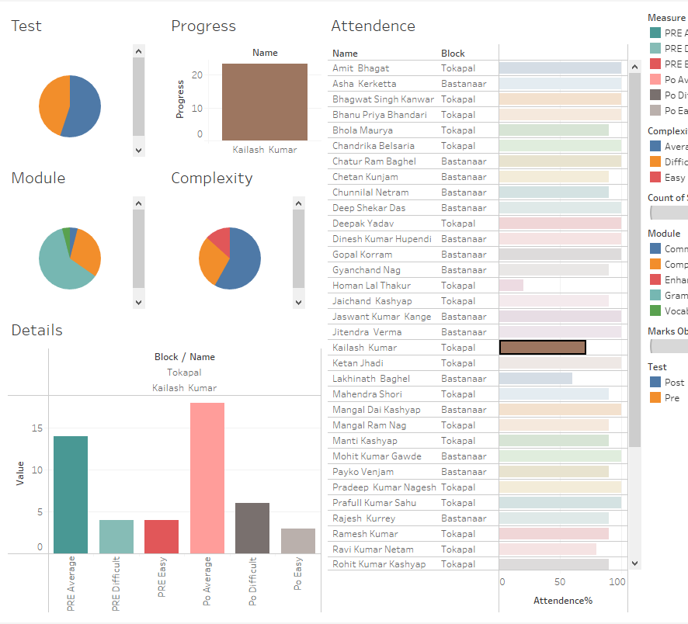
Conclusion
Best Performer

Slide 7
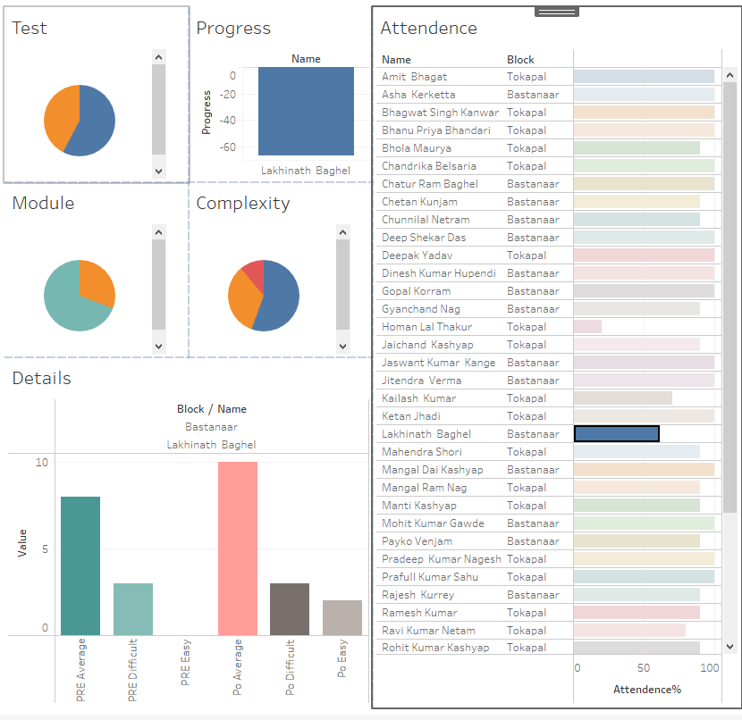
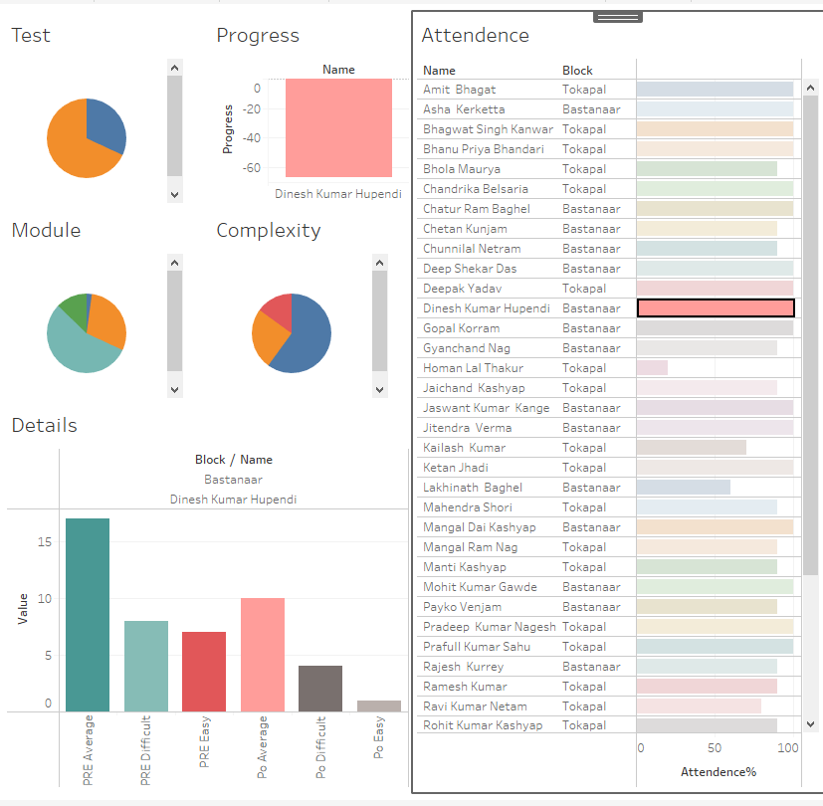
Need To Improve

