Slide 1
CAPSTONE PROJECT : ELECKART MODEL MIX MODELLING
MID –TERM SUBMISSION
Submitted By:
VIKUL AGGARWAL
ANKIT SAHU

Slide 2
BUSINESS OBJECTIVE & DATA UNDERSTANDING
Eleckart, e-commerce company based out of Canada, needs insight to optimally reallocate the budget optimally across the marketing levers.
Analysis of Data from July 2015 to June 2016.
Product categories – Camera Accessory, Game Accessory and Home Audio
Sub – Goals:
Performance driven
ROI of marketing spend – Impact Analysis
Optimization of Marketing spend.

Slide 3
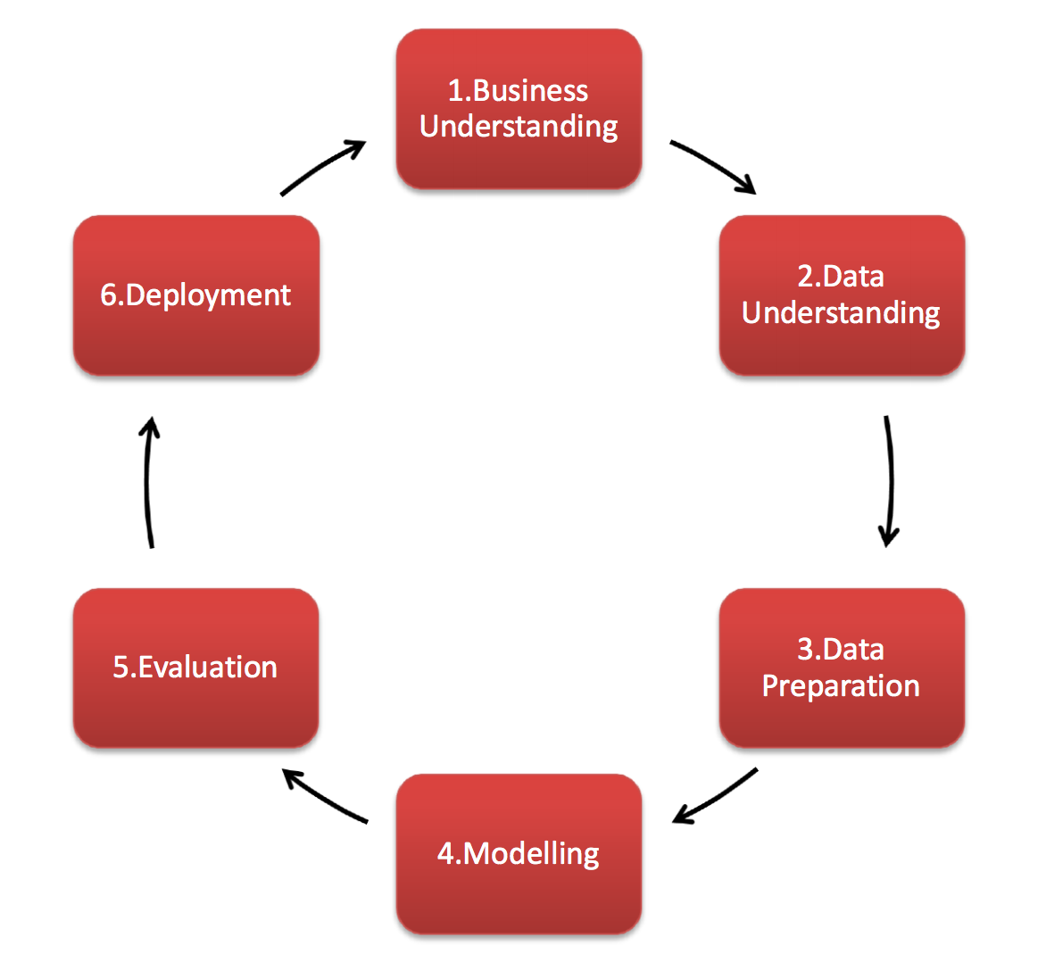
PROBLEM SOLVING METHODOLOGY
The methodology for analysis is in accordance with the CRISP DM Framework.
Business Understanding – Help the CFO decide the marketing budget on different levers.
Data Understanding – Understanding the monthly spend on advertisements, online campaigns, days of special sale, Stock Index of the company, Monthly NPS score
Data Preparation – Remove discrepancies in data to build effective models.
Modeling – Build various Market Mix models with the help of data prepared. Find the best model on basis of factors like Adjusted R-Square, MSE, etc.
Evaluation - Using the best model, evaluate the important variables that effect the ROI and make recommendations.
Deployment – Final Phase of the cycle. Use the model in real time for business.

Slide 4
DATA PREPARATION
Found and treated white spaces in Orders data GMV Column
Handled negative values in columns like product_procurement_sla, deliverybdays and deliverycdays
Handling extreme large values for product_procurement_sla.
“\N” values in deliverybdays and deliverycdays were imputed with 0.
Incorrect GMV values (gmv>product_mrp*units) have been treated by dropping the records.
Duplicate records were dropped.
Some ‘id’ columns which did not bring significance to the analysis were dropped.
Selected data of the time period July 2015 – June 2016 to conform to the need of the problem statement.
Binary encoding for categorical variables with two levels.
One hot encoding for categorical variables with more than 2 level.

Slide 5
DATA PREPARATION – CONTD.
Column with single unique value has been dropped.
Three separate dataframes for three product sub-categories : Camera Accessory, Home Audio and Gaming Accessory.
Convert daily order data to Weekly Level by aggregation of the numeric variable based on the week number of the year.
Merge of order dataset with other secondary dataframes.
Split of data into train and test for all the three product sub-categories.

Slide 6
FEATURE ENGINEERING
List Price → GMV/Units (Gross Merchandise Value/Units)
Discount → MRP - List Price
Discount_Percentage → (Discount / List Price) * 100
Mov. Average of List Price, Discount and MRP
payDayWeek : If Payday falls in that week, payDayWeek = 1 else 0.
holidayWeek : If any holiday in that week, holidayWeek = 1 else 0.
ProductType – Luxury / Mass-market
Exponential Moving Average for 8 weeks for Advertising Media Channels.
AdStock values for all Advertising Media.
paymentModeIndicator : Created from original feature for the algorithm to understand.

Slide 7
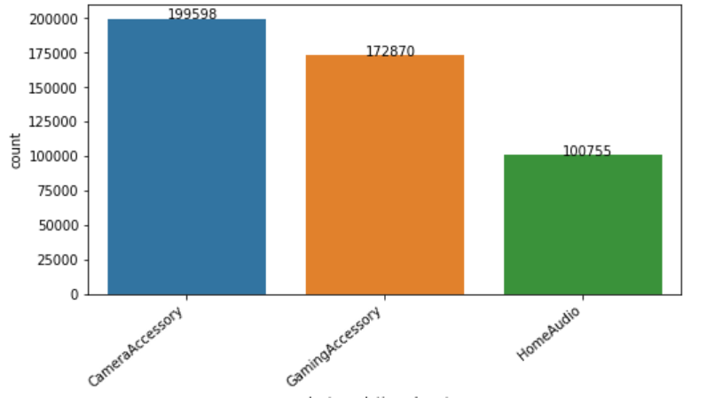
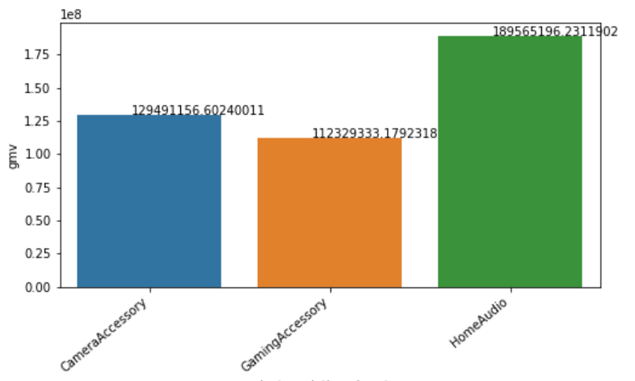
EXPLORATORY DATA ANALYSIS
Fig 1. → Finding the number of transactions by each Category
Camera Accessory>Gaming Accessory > Home Audio
FIG 2. Total GMV by Product subcategory.
Home Audio > Camera Accessory > Gaming Accessory

Slide 8
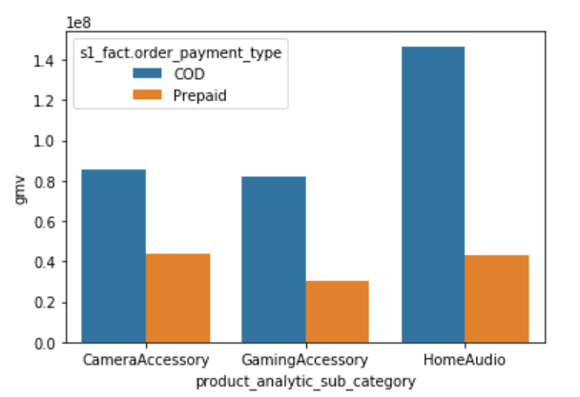
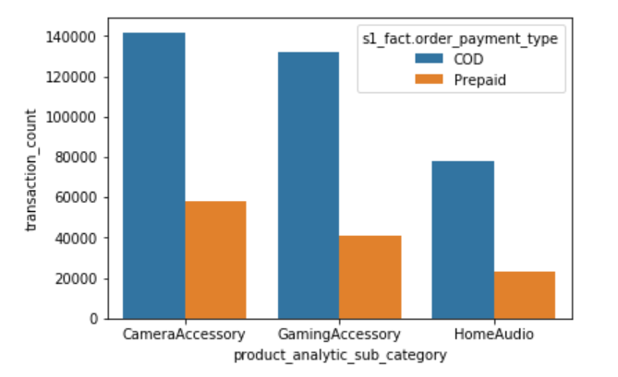
EDA CONTD.
Total GMV vs Payment Type
For COD – Max revenue from Home Audio
For Prepaid - - Max revenue from Camera Accessory
Order Count v/s Payment Type
Max Orders are through COD mode for all the product subcategories.

Slide 9
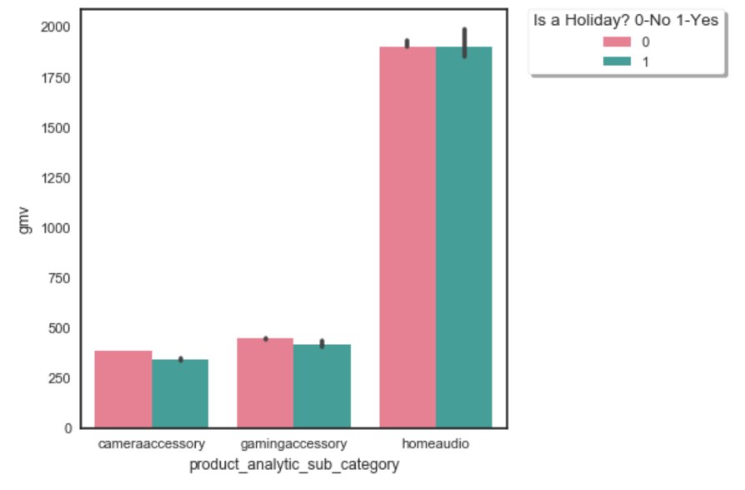
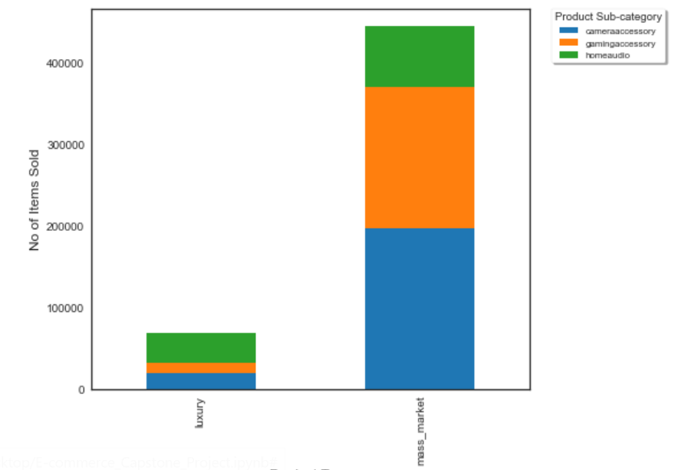
Average Revenue on Holidays/non holidays for three product subcategories
Number of Items(Luxury/Mass-market) sold per 3 product sub-categories

Slide 10
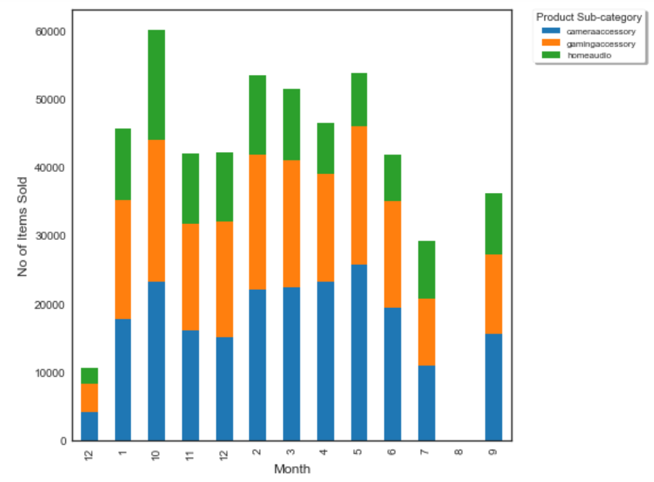
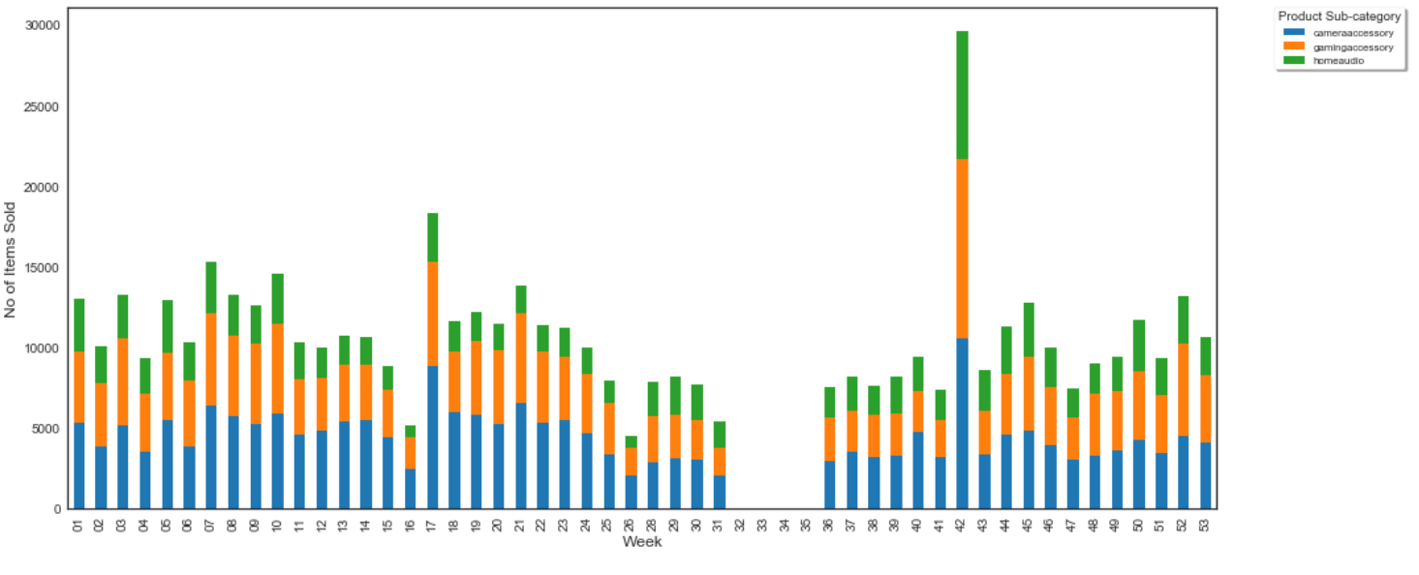
Number of Items sold per subcategory per month
Number of Items sold per subcategory per Week

Slide 11
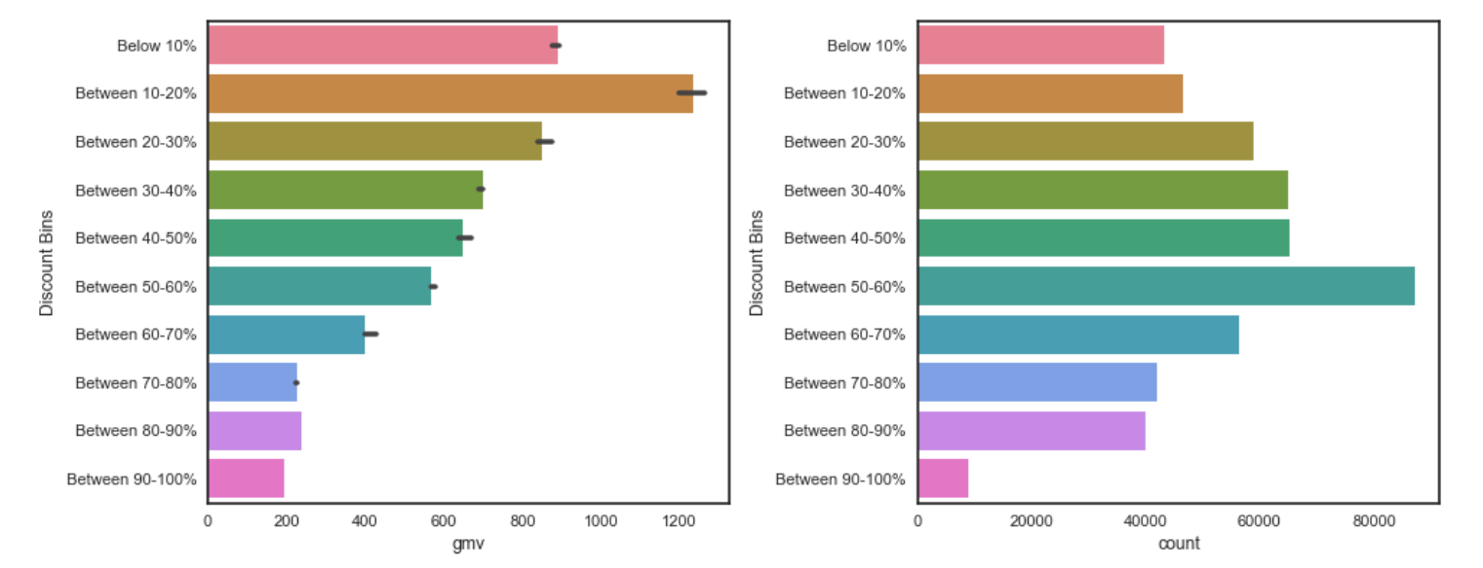
Variation of sales amount and revenue based on percentage of Discount

Slide 12
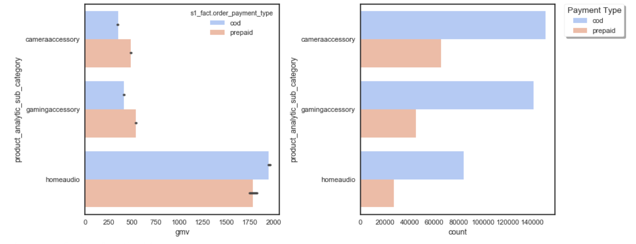
Variation of sales amount and revenue based on Payment Types.
Analysis – Median revenue from prepaid accounts is more than from COD products for all categories except Home Audio. This is observed even after the number of products sold is way higher in case of COD for all the sub-categories.

Slide 13
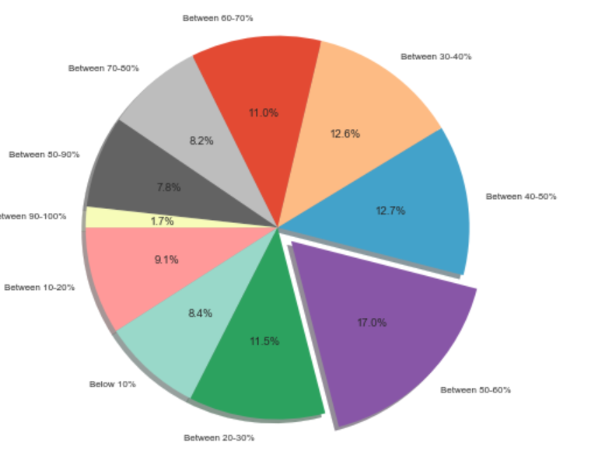
Number Of Items sold at different Discount Percentage.
Analysis – Most of the sale happens when the discount percentage is between 50-60 %.

Slide 14
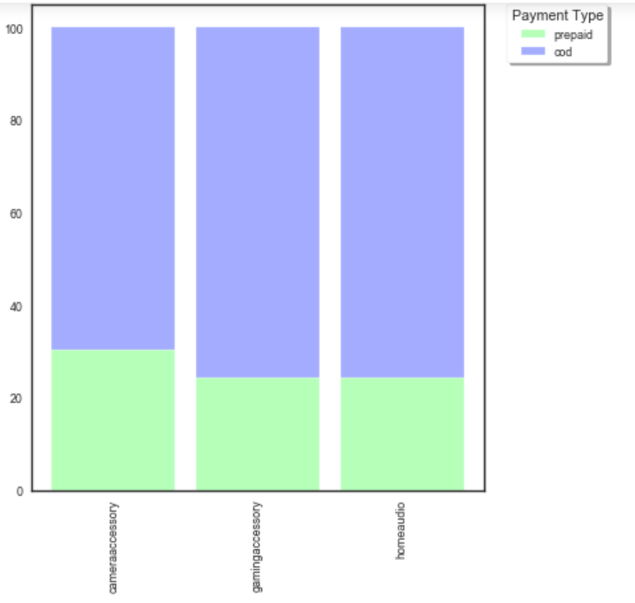
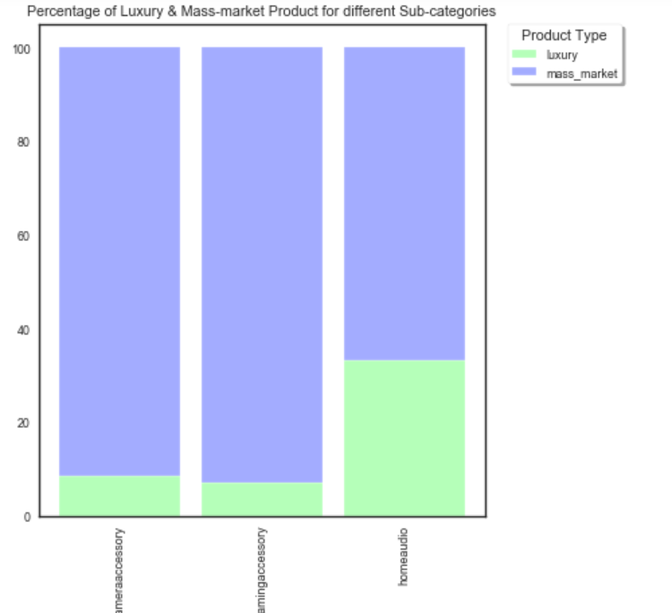
Percentage of COD and Prepaid transaction type for all the sub categories.
Analysis – Percentage of prepaid payments under camera accessory was observed to be slightly higher when compared to other categories.
Percentage of Luxury and Mass market products for all the sub categories.
Analysis – Percentage of luxury product in home audio is comparatively higher when compared to others

Slide 15
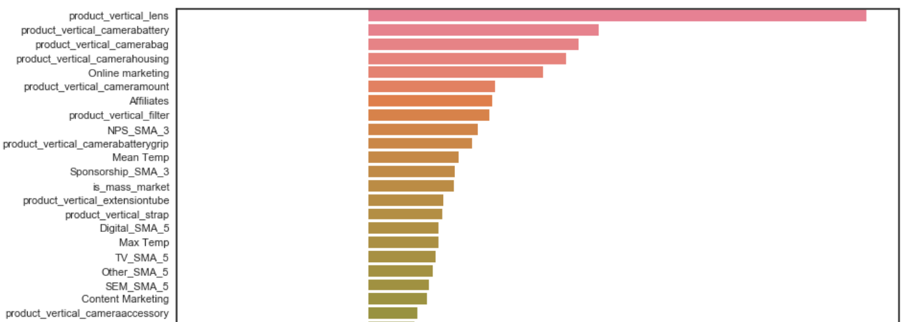
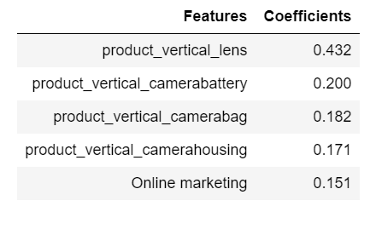
LINEAR REGRESSION MODEL – CAMERA ACCESSORY
R2 SCORE → 0.83
MSE → 0.17
FIVE MOST IMPORTANT VARIABLES AFFECTING GMV FOR CAMERA ACCESSORY

Slide 16
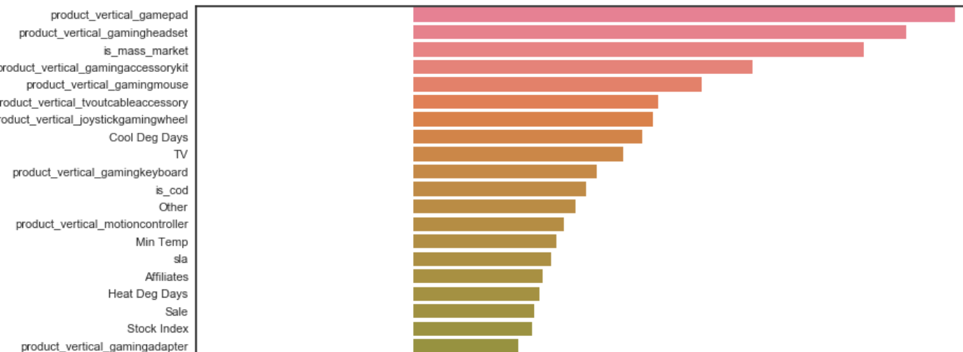
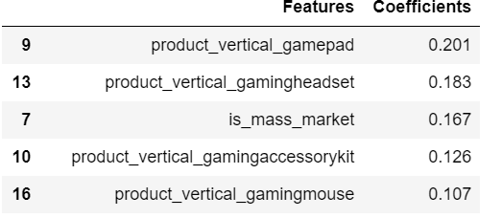
LINEAR REGRESSION MODEL – GAMING ACCESSORY
R2 SCORE → 0.51
MSE → 0.49
TOP 5 FEATURES AFFECTING THE REVENUE IN GAMING ACCESSORIES

Slide 17
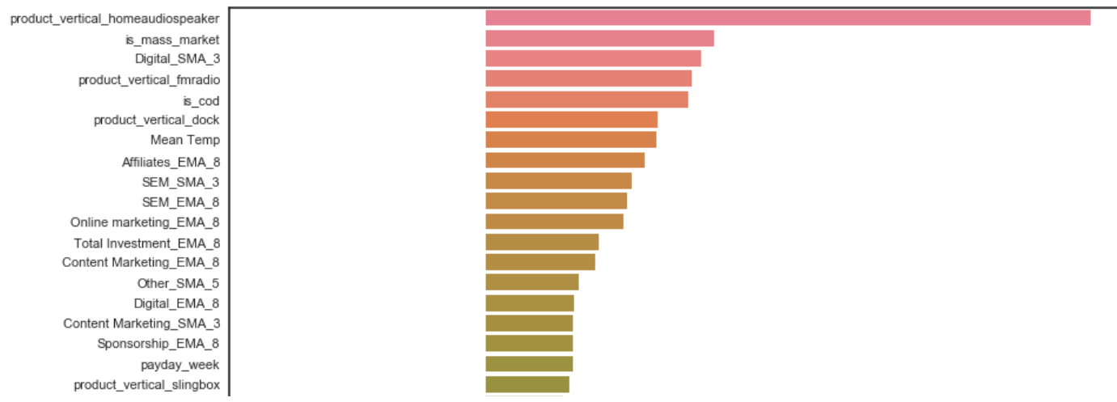
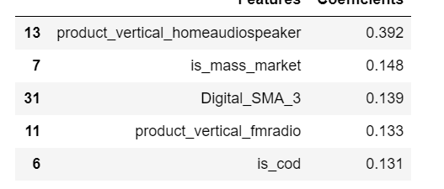
LINEAR REGRESSION MODEL – GAMING ACCESSORY
R2 Square → 0.73
MSE → 0.27
TOP 5 FEATURES FOR REVENUE GENERATION IN HOME AUDIO

