Slide 1
CS7NS2 Internet of Things
Smart Irrigation System
Aditya Vishnu
Ashish Kannur
Himanshu Gupta
Mayur Mahajan
Shubham Dhupar
Vivek Kumar
Group 10

Slide 2
Smart Irrigation System
Automating the agriculture irrigation process.
By continuously monitoring parameters like moisture of soil and weather.
Functioning of motor controlled using real-time data processed in the cloud.
Saves water, reduces human-labour and is cost efficient.
Notes:
Motivation – Field of agriculture requires continuous human monitoring. If this fails, there is a chance that produced yields are at high risk and many resources may get wasted, specially water.
What?
Monitor the temperature and humidity along with the moisture of the soil
Data will be transmitted to the cloud and will be displayed on dashboard
Based on certain rules when the water is required, motor will start
Saves water wastage and human intervention. One time cost, so cost efficient.

Slide 3
Challenges
Security
Sending the collected data to the cloud securely so that data integrity is maintained
Communication
Incase of failure or interruptions of data transmission, how to manually over-ride the system
Duty Cycle
Operational times for machines?
Power
Maintaining the backup power supply during interruptions in power
Notes:
Challenges –
Security – Security in data transmission
Communication - What if the data transmission is interrupted or late, how will the water be supplied to the soil?
Duty Cycle – Operating the machine continuously ?
Power – System should work even if power supply is interrupted

Slide 4
Challenges (cont.)
Scalability
Managing scalability in terms of multiple instances and multiple sensors.
Limited knowledge on cloud technologies.
Difficult to figure out the port to be used as an I/O pins in ESP32.
Covid 19 pandemic: meetings, hardware got divided.
Actuator part was stuck for few days.
Notes:
Scaling is important as many plants are yielded at the same time
Have a little experience working with cloud so integration of cloud with the microcontroller is going to be a bit tough.

Slide 5
Solutions
Secure data transmission via MQTT to AWS Cloud using SSL/TLS connection.
Option for the user to schedule the duty cycle of the motor manually when needed.
Manual options available on the web application.
Temporary power backup in case of failure.
Having unique IDs for every instance of the sensor/motor for managing large scale implementation.
Notes:
OpenSSL with MQTT Command line interface for digital certificates. Transport encryption is tackled with TLS.
Operational times can be setup manually. It reduces the power consumption and gives flexibility while using the system.
In case of failure of data, motor can be automatically turned on manually from the web application.
Use of power bank as this is small scale, to store battery. So that even if the power goes, system will work. Inverter or generators will be required for larger scale.
IDs to identify different instances in large scale.

Slide 6
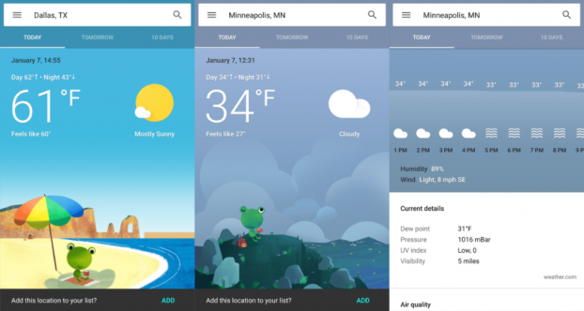
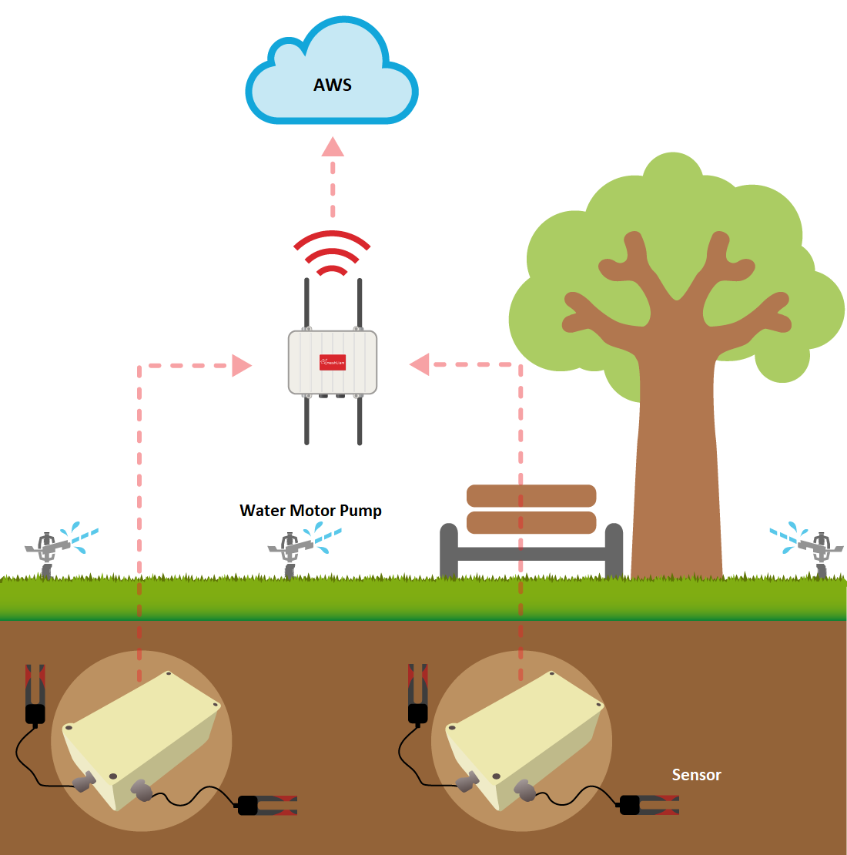
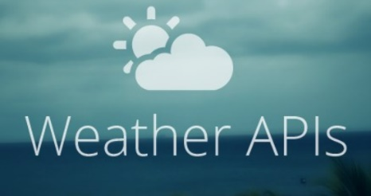
Smart Irrigation Model
Dashboard for Monitoring Weather

Slide 7
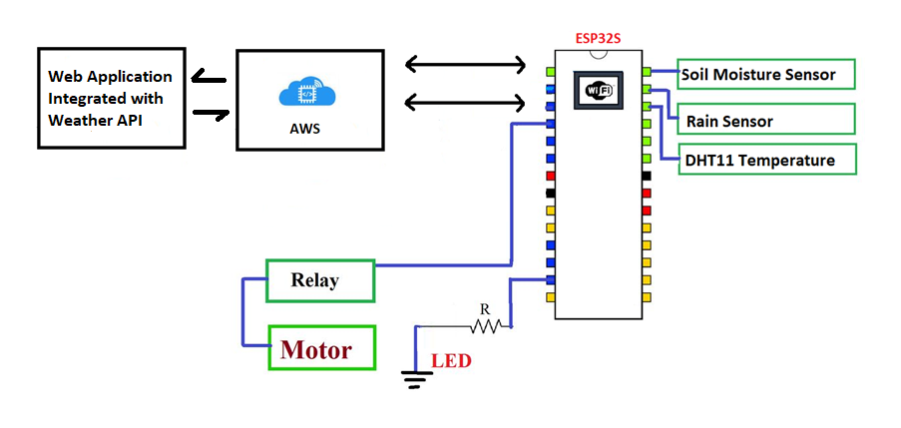

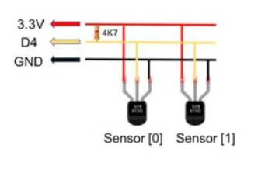
Circuit Diagram
MQTT
Sample Sensor Connection

Slide 8
Lesson Learnt
Well defined process can save time.
Got to learn about ESP32 interfacing using Arduino IDE.
Learnt secure transmission via MQTT to AWS cloud using SSL/TLS.
Trust Your Device .
Importance of Teamwork and project management.
Integration with weather API.

Slide 9
What Worked Well
Thought of switching to Arduino, but later interfacing in ESP32 worked.
Transmission of data and signals to and fro between ESP32 and AWS(cloud) via MQTT was the critical part.
Tried various combinations to find relevant ports w.r.t sensors. Some pins of ESP32 do not work for sensors when connected to WiFi.
Sensors were not responding with +3V, switched to +5V worked.

Slide 10
Future Work
Incase of failure or interruptions of data transmission, how to manually over-ride the system
Use of solar panels to power the ESP32.
Build a scaled model where multiple sensors and controllers(ESP32) will be configured
Could have used water pump instead of servomotor.
Notes:
Challenges –
Security – Security in data transmission
Communication - What if the data transmission is interrupted or late, how will the water be supplied to the soil?
Duty Cycle – Operating the machine continuously ?
Power – System should work even if power supply is interrupted

Slide 11
Conclusion Drawn From Project
The objective of this project is to avoid the wastage of water and increase irrigation efficiency by using ESP32 and AWS cloud based irrigation system with help of soil moisture, humid and temperature sensor.
Smart irrigation control technology using AWS is easily deployable and can be controlled manually or automatically without human presence in the field.
Also, the weather API integrated with AWS helps user to look at the weather conditions on the application and accordingly can decide to control it manually.
Based on the data received from the sensors and weather API, AWS computes ON or OFF signals for motor and sends it to the ESP32.

Slide 12
Summary
An efficient irrigation system which is not time crucial.
Devices used – Sensors, ESP-32S, Actuator
Communication – MQTT protocol implemented on AWS cloud
Project Management- Jira
Others – Web Application integrated with weather API
Use of AWS cloud and weather API increases the efficiency of irrigation system and helps user to monitor weather conditions on the application.

Slide 13
Thank You!

