Slide 1

An In-Depth Guide to Google Ads
Course: Digital Marketing

Slide 2
What We'll Cover Today
● Section 1: Google Ads Fundamentals (what it is, when to use it, how it works)
● Section 2: Core Terminology — one concept per slide (Keywords, Quality Score, Ad Rank, CTR, etc.)
● Section 3: Costs & Budgeting
● Section 4: Campaign Types (Search, Display, Shopping, Video, App, Performance Max)
● Section 5: Bidding Strategies
● Section 6: Conversion Tracking, Getting Started & Best Practices

Slide 3
What Is Google Ads?
DEFINITION: A paid online advertising platform where businesses bid to display ads across Google's properties (Search, YouTube, Gmail, Play, partner sites).
● Launched October 2000 as 'Google AdWords'
● Renamed 'Google Ads' in July 2018 to reflect its expanded ad formats
● Advertisers only pay when specific actions happen (e.g., a click) — not just for being shown
Search Ads (Most Common)
Appear on SERP above organic results
Labeled 'Sponsored'
Notes:
Start with the formal definition boxed at the top: Google Ads is a paid advertising platform, not a free traffic source — advertisers must bid for placement. Give the history: it launched in October 2000 under the name Google AdWords, and was rebranded to 'Google Ads' in July 2018 to better reflect the expanded range of ad formats beyond just search (Display, Shopping, Video, App). Clarify the payment model: most commonly, advertisers pay per click (CPC) — meaning they are NOT charged just for the ad being displayed (an impression), only when a user takes the desired action. Explain the three-box visual: Search ads are the most common and recognizable format, they physically appear on the Search Engine Results Page (SERP) — often above the organic (unpaid) listings — and are always marked with a 'Sponsored' label so users can distinguish paid from organic results. Ask students: has anyone noticed the 'Sponsored' label while searching on Google? This helps ground the concept in something they've already seen.

Slide 4
When Should You Use Google Ads?
Start a New Business
Increase Lead Generation
Boost Sales & Revenue
Promote Time- Sensitive Content
Reach New Audiences
Win Back Site Visitors (Remarketing)
Rule of thumb: if organic (SEO) traffic alone can't meet your timeline or reach goal, Google Ads fills the gap.
● Example: A new bakery wants local customers this week, not in 6 months (SEO timeline) → Google Ads gives instant visibility
Notes:
Walk through the six scenarios where Google Ads is the right tool. 1) Starting a new business — organic traffic (SEO) takes months to build; Google Ads gets a brand in front of customers immediately. 2) Increasing lead generation — target users actively searching for a service and funnel them to a lead form. 3) Boosting sales/revenue — Search, Shopping, and Video ads can directly drive e-commerce transactions. 4) Promoting time-sensitive content — flash sales, events, or seasonal promotions need immediate visibility that only paid ads can provide fast. 5) Reaching new audiences — Google's detailed targeting (demographics, interests, geography) helps find niche or previously untapped customer segments. 6) Winning back visitors — remarketing campaigns re-engage users who visited the site but didn't convert, often the highest-ROI campaign type. Use the bakery example at the bottom to make this concrete. Ask students to think of a business idea and identify which of these six goals applies to it.

Slide 5
How Google Ads Works: The Auction
1. User Searches a Keyword
2. Google Runs a Real-Time Auction
3. Ad Rank Decides Who Shows & Where
● Pricing model 1 — CPC (Cost-Per-Click): pay only when someone clicks your ad
● Pricing model 2 — CPM (Cost-Per-Mille): pay per 1,000 impressions, used for awareness campaigns
● Advertisers set a 'maximum bid' — the most they're willing to pay, not necessarily what they'll be charged
Example: You bid a maximum of $3.00 for a click, but Ad Rank math may only charge you $1.80
Notes:
Explain the three-step auction process shown in the diagram: a user types a search query (step 1); Google instantly runs an auction among all advertisers who bid on that keyword (step 2); Ad Rank determines which ads appear and in what order (step 3) — this all happens in a fraction of a second. Introduce the two pricing models: CPC is the default for most campaigns — advertisers pay only when a user actually clicks. CPM is used mainly for brand awareness campaigns where the goal is visibility, not clicks. Clarify the concept of 'maximum bid' — this is a common student misconception; the bid is a ceiling, not a fixed price. Use the concrete example: bidding a maximum of $3.00 doesn't mean paying $3.00 every time — actual cost depends on what's needed to beat the competitor below you, which might land at $1.80. This is a good moment to explain that a well-optimized ad (better Quality Score) can win a higher position for a lower cost than a competitor with a higher bid but poor relevance.

Slide 6
Section 2: Core Terminology
Notes:
Transition slide announcing the terminology section. Tell students that the next set of slides will each cover exactly one Google Ads term in depth — definition, concrete example, and an accompanying visual before moving to the next. There are 11 terms covered in this section.

Slide 7
TERM 1 of 11
Keyword — Broad Match
DEFINITION: The default match type. Your ad can show for searches related in meaning to your keyword — even without shared words.
SYNTAX:
MOCK SEARCH RESULT (SERP):
running shoes
Sponsored athleticsneakers.com
Best Athletic Sneakers & Jogging Footwear - Free Shipping
● Query typed: 'athletic sneakers' or 'jogging footwear' — no exact word match, but same intent
● Widest reach, lowest control — highest risk of irrelevant clicks
● Best used with Smart Bidding, which uses signals to keep matches relevant
Notes:
Broad match is Google's default keyword setting since no special syntax is used — just type the keyword plainly like 'running shoes'. Explain the core mechanic: broad match doesn't require the searched words to match your keyword at all — Google uses the search's overall meaning and intent, so 'running shoes' could show for searches like 'athletic sneakers' or 'jogging footwear', as shown in the mock SERP result. This is the widest-reaching match type but also the riskiest — it can trigger your ad for tangentially related or even irrelevant searches, wasting budget if not monitored carefully. Recommend pairing broad match with a Smart Bidding strategy since Google's machine learning uses additional signals to keep matches relevant. Tell students: broad match is powerful for discovering new relevant search terms, but it requires an active negative keyword strategy to prevent wasted spend.

Slide 8
TERM 2 of 11
Keyword — Phrase Match
DEFINITION: Your ad shows for searches that include the meaning of your keyword phrase, keeping word order intact, plus close variants.
SYNTAX:
MOCK SEARCH RESULT (SERP):
"running shoes"
Sponsored bestrunningshoes.com
Buy Running Shoes Online - Running Shoes Near Me | Free Returns
● Query typed: 'buy running shoes online' or 'running shoes near me' — the phrase's meaning is preserved
● Won't show for unrelated terms where the meaning changes
● The balanced 'sweet spot' — moderate reach with moderate control
Notes:
Phrase match uses quotation marks around the keyword, e.g. "running shoes". The key rule: the core meaning and word order of the phrase must be preserved in the user's search, but extra words can appear before or after it. So 'buy running shoes online' and 'running shoes near me' both trigger the ad because the meaning of 'running shoes' stays intact. Contrast with what it will NOT match: if the words are rearranged in a way that changes meaning, it won't trigger. Most practitioners consider phrase match the best balance between broad match's wide reach and exact match's tight control — many businesses run the majority of their keywords as phrase match. Quick check: ask students whether 'red running shoes' would match the phrase "running shoes" (yes, because the core phrase is still intact with an extra word before it).

Slide 9
TERM 3 of 11
Keyword — Exact Match
DEFINITION: The tightest match type. Your ad shows only for searches with the same meaning or intent as your exact keyword.
SYNTAX:
MOCK SEARCH RESULT (SERP):
[running shoes]
Sponsored premiumrunningshoes.com
Running Shoes - Shop the Official Collection Today
● Query typed: 'running shoes' or 'running shoe' (close variants only)
● Highest relevance, highest control — but the smallest search volume
● Ideal for high-intent, high-value or branded keywords
Notes:
Exact match uses square brackets, e.g. [running shoes]. Despite the name 'exact', Google still allows very close variants — same meaning, singular/plural forms, common misspellings, or reordered words that don't change intent. This gives advertisers the highest level of control and typically the highest relevance and Quality Score, but delivers the smallest search volume of the three match types. Recommend exact match for high-value, high-intent, or branded keywords where precision matters more than volume. Summarize the three match types together: Broad = widest reach/least control, Phrase = balanced, Exact = narrowest reach/most control.

Slide 10
TERM 4 of 11
Negative Keywords
DEFINITION: Words or phrases you exclude so your ad does NOT show for irrelevant searches — protecting your budget.
KEYWORD: running shoes NEGATIVE: 'free'
BLOCKS searches like: "free running shoes" "running shoes for free"
● Build a 'catch-all' negative list at the account level for consistently irrelevant terms (e.g., 'jobs', 'free', 'reviews')
● Build a branded negative list to prevent overlap between brand & non-brand campaigns
● Mine new negatives weekly from the Search Terms Report — search behavior constantly evolves
Notes:
Negative keywords prevent your ad from showing, protecting budget. Example: bidding on 'running shoes' but adding 'free' as negative stops the ad showing for 'free running shoes' searches. Explain the two-list strategy: a catch-all negative list at account level catches consistently irrelevant terms; a branded negative list applied to non-brand campaigns prevents brand vs non-brand cannibalization. Stress this isn't a one-time task — review the Search Terms Report weekly. Ask students why showing ads for 'free running shoes' wastes a premium brand's budget.

Slide 11
TERM 5 of 11
Quality Score
DEFINITION: A 1-10 diagnostic score estimating the quality of your ads, keywords & landing pages, versus other advertisers.
THE 3 COMPONENTS OF QUALITY SCORE:
Expected Click-Through Rate (CTR)
Ad Relevance (does ad match search intent?)
Landing Page Experience (speed, relevance)
● Each component is rated: Above Average / Average / Below Average
● Higher Quality Score → lower CPC and better ad position
● Found in the 'Status' column of the Keywords view in Google Ads
Notes:
Quality Score rewards relevant ads over simply the highest bidder. Explain the three components: Expected CTR (likelihood of a click vs competitors), Ad Relevance (does the ad match search intent), Landing Page Experience (relevance, speed, navigability). Each rated Above Average/Average/Below Average. A higher Quality Score can lower CPC and improve position because Ad Rank factors quality, not just bid — a relevant $2 bid can outrank an irrelevant $5 bid. Found in the Status column of the Keywords tab in Google Ads.

Slide 12
TERM 6 of 11
Ad Rank
DEFINITION: The calculated value that determines your ad's position — or whether it shows at all — in each auction.
AD RANK IS CALCULATED FROM:
Bid Amount
Quality Score (CTR, relevance, landing page)
Ad Rank Thresholds
Competitiveness of Auction
Context of the Search
+
+
+
+
● Higher Ad Rank = better position on the page (or shows at all)
● A well-optimized $2 bid can beat a poorly-optimized $5 bid
Notes:
Ad Rank is the master formula deciding an ad's fate. Five factors: bid amount, Quality Score, Ad Rank thresholds, auction competitiveness, and search context. Reiterate: a well-optimized ad with a lower bid can outrank a poorly optimized ad with a higher bid. Of these five factors, advertisers directly control only bid amount and Quality Score — the other three are outside their control, so optimization should focus on what's controllable.

Slide 13
TERM 7 of 11
Click-Through Rate (CTR)
DEFINITION: The percentage of people who saw your ad (impressions) and clicked on it.
CTR = Clicks ÷ Impressions
Example: 50 clicks ÷ 1,000 impressions = 5% CTR
● Search ads typically have higher CTR than Display ads (search = active intent)
● High CTR signals relevance to Google → boosts Quality Score → can lower CPC
● Low CTR is a red flag: ad copy may not match what users are searching for
Notes:
CTR = Clicks ÷ Impressions. Example: 50 clicks / 1,000 impressions = 5% CTR. Search ads generally see higher CTRs than Display ads because search represents active intent. Since Expected CTR is a Quality Score component, a consistently high CTR can improve Quality Score and lower CPC. A low CTR signals ad copy or targeting misalignment with what users searching that keyword want to see.

Slide 14
TERM 8 of 11
Conversion Rate
DEFINITION: The percentage of clicks on your ad that result in a desired action (purchase, signup, call, etc.).
Conv. Rate = Conversions ÷ Clicks
Example: 10 purchases ÷ 200 clicks = 5% Conversion Rate
● Unlike CTR, this measures what happens AFTER the click — on your website/landing page
● A high conversion rate signals strong ad-to-landing-page relevance
● Low conversion rate + high CTR = your ad copy is great, but landing page needs work
Notes:
Conversion Rate = Conversions ÷ Clicks. Example: 10 purchases from 200 clicks = 5%. Unlike CTR (ad-to-search relevance), conversion rate measures the landing page/website experience. Diagnostic framework: high CTR + low conversion rate usually means the ad is fine but the landing page needs work. Ties back to Quality Score's Landing Page Experience component.

Slide 15
TERM 9 of 11
Ad Assets (Extensions)
DEFINITION: Extra content added to a search ad — like sitelinks, phone numbers, or forms — to take up more space and add value.
MOCK SEARCH AD WITH SITELINKS:
Sponsored www.yourstore.com
Shop Our Summer Collection - Free Shipping Over $50
New arrivals, top sellers, and exclusive online-only deals.
New Arrivals Best Sellers Sale Items Contact Us
Sitelinks = the 4 blue links at the bottom (extra pages users can jump to)
● Other asset types: Call, Location, Callout, Price, App, Lead Form
● Charged at the SAME CPC as a normal click — no extra cost per asset
Notes:
Ad Assets (formerly 'extensions') attach extra clickable content to search ads. Mock SERP shows Sitelinks - the 4 underlined blue links letting users jump to specific pages. Other asset types: Call, Location, Callout, Price, App, Lead Form. Important: these don't cost extra - a click on a sitelink is charged the same CPC as the main headline. More assets mean more SERP real estate, pushing down competitors.

Slide 16
TERM 10 of 11
Impression
DEFINITION: Counted every single time your ad is displayed to a user — regardless of whether they click it.
● 1 impression = 1 ad shown, even if it's the same user seeing it twice
● Impressions matter most for awareness goals (measured via CPM bidding)
● Impression Share = the % of eligible auctions where your ad actually appeared
● Example: if your ad was eligible for 1,000 auctions but showed in 700, your Impression Share = 70%
1,000 Eligible Auctions → Ad Shown 700 Times → 70% Impression Share
Notes:
An impression is counted every time your ad is rendered, whether or not clicked. If the same user sees your ad twice, that's two impressions. Impressions matter most for CPM-billed awareness campaigns. Impression Share = % of eligible auctions where your ad appeared. Example: 700/1000 = 70%. Low Impression Share signals either budget too small or low Ad Rank.

Slide 17
TERM 11 of 11
Landing Page
DEFINITION: The webpage a user arrives at after clicking your ad — it must deliver on the ad's promise.
● Must match ad intent — an ad for 'red running shoes' should NOT land on a general homepage
● Needs fast load speed, especially on mobile — slow pages lose users before they even see content
● Needs a clear call-to-action (CTA) — 'Buy Now', 'Get a Quote', 'Sign Up'
● Directly affects Quality Score (Landing Page Experience component) and Conversion Rate
GOOD: Ad links to specific product page
BAD: Ad links to generic homepage
Notes:
The landing page is the final piece of the customer journey. Requirements: relevance (matches ad promise), speed (especially mobile), clear CTA, and it directly affects both Quality Score and Conversion Rate. Use good vs bad comparison boxes to reinforce relevance. Class discussion: ask students about a recent ad they clicked where the landing page did or didn't match expectations.

Slide 18
Section 3: Costs & Budgeting
Notes:
Transition into the cost and budgeting section. Students now have vocabulary (Quality Score, Ad Rank, CTR) needed to understand Google Ads pricing.

Slide 19
TERM 1 of 2
Average Daily Budget
DEFINITION: The amount you're willing to spend per day, on average, over a month — set by the advertiser.
● Daily spend CAN reach up to 2x your average daily budget on high-traffic days
● Monthly spend CAN reach up to 30.4x your average daily budget
● This is normal — Google balances it out over the billing cycle, never overcharging monthly
● Set budgets based on your industry's average CPC — too low a budget limits algorithm learning
Set: $50/day budget
Possible single day: up to $100
Notes:
Average Daily Budget is the first cost lever. Google's flexible spending rule: daily spend can reach up to 2x average daily budget on high-traffic days; monthly spend up to 30.4x — but never exceeds the monthly cap, balancing higher and lower spend days. Advise researching industry average CPC before setting budget; too small a budget relative to competitive CPCs severely limits Smart Bidding's ability to learn.

Slide 20
TERM 2 of 2
Cost = Budget + Ad Rank
DEFINITION: Total cost isn't fixed — it's a function of your daily budget setting AND how well you compete in the Ad Rank auction.
Average Daily Budget (what YOU set)
Ad Rank (Bid × Quality Score + auction factors)
+
● Advertisers directly control: bid amount + ad/keyword/landing page quality
● Advertisers do NOT control: competitor bids, auction volume, search context
Notes:
This slide ties the two cost drivers together. Total advertising cost is shaped by Average Daily Budget (fully controllable) combined with Ad Rank competitiveness (partly controllable). Advertisers directly control bid amount and ad/keyword/landing page quality; they do NOT control competitor bids, auction volume, or individual search context. Strategy should focus on the controllable side.

Slide 21
Section 4: Campaign Types
Notes:
Transition into campaign types. Each major Google Ads campaign format gets its own slide with a visual mockup of how the ad looks to a user.

Slide 22
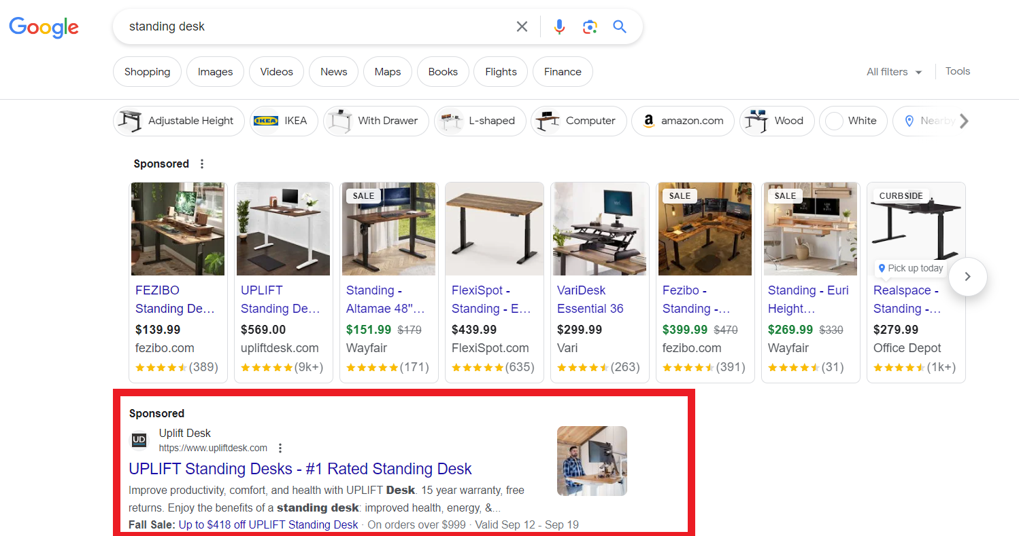
TERM 1 of 6
Search Campaigns
DEFINITION: Text ads shown directly on the Google Search results page (SERP) when users type a matching query.
● Uses Responsive Search Ads (RSAs) — up to 15 headlines & 4 descriptions, Google mixes & tests combinations
● Best for: high-intent users actively searching for your product/service
Notes:
Search campaigns are the classic Google Ads format — plain text ads on the search results page. Explain Responsive Search Ads: up to 15 headlines and 4 descriptions, Google's ML tests and serves the best combinations to each user. Best suited for high-intent users actively searching for a product/service.

Slide 23
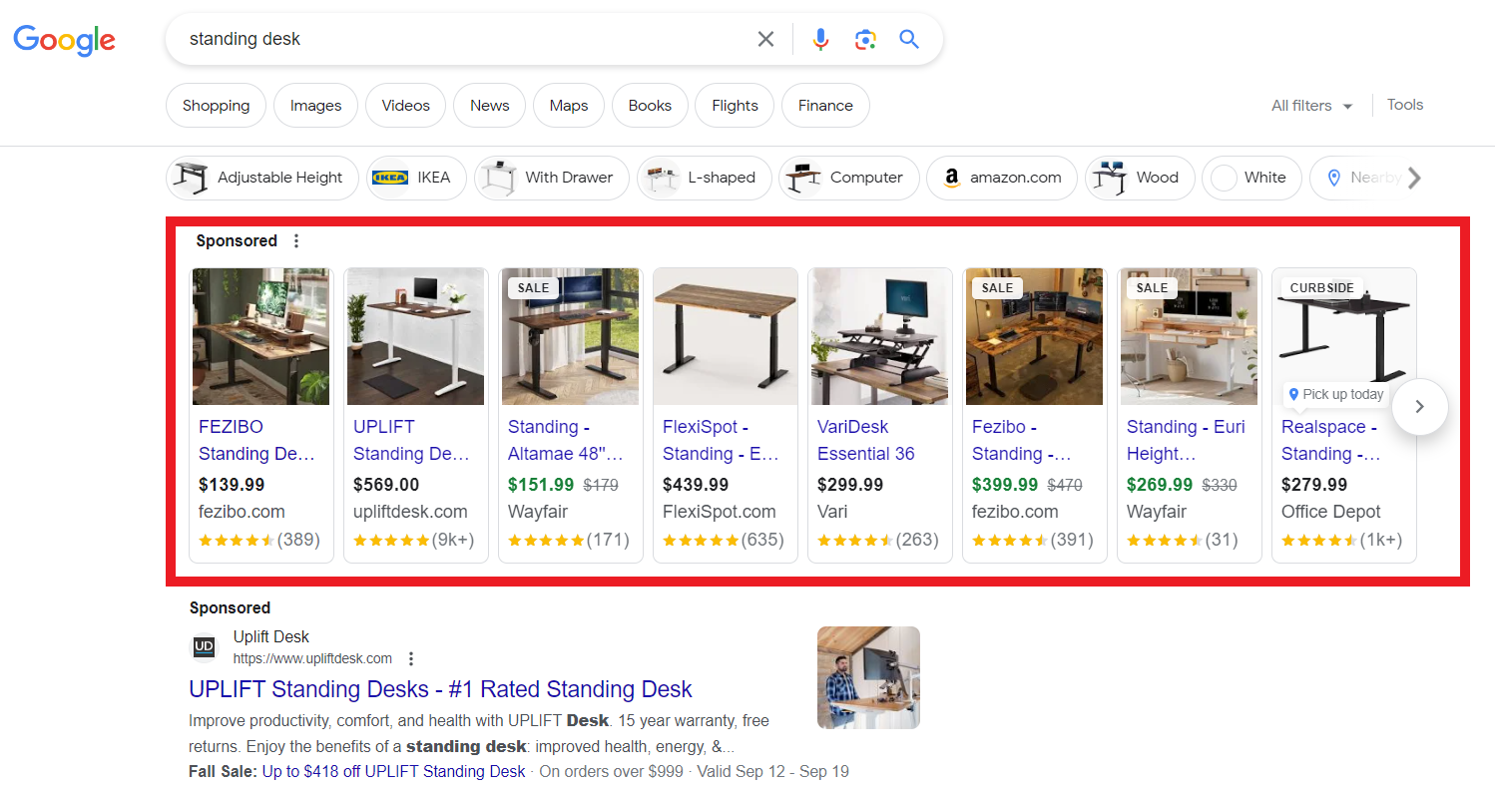
TERM 2 of 6
Shopping Campaigns
DEFINITION: Product ads showing image, title, price & store name — pulled from your Google Merchant Center feed.
● No need to write ad copy — Google generates the ad from your product feed data
● Best for: e-commerce businesses with a product catalog
Notes:
Shopping campaigns are built for e-commerce, pulling directly from a Google Merchant Center feed — no traditional ad copy needed; image, title, price, and store name are auto-formatted. Appears on Shopping tab, Search, Google Images, partner sites. Best for businesses with a structured product catalog.

Slide 24
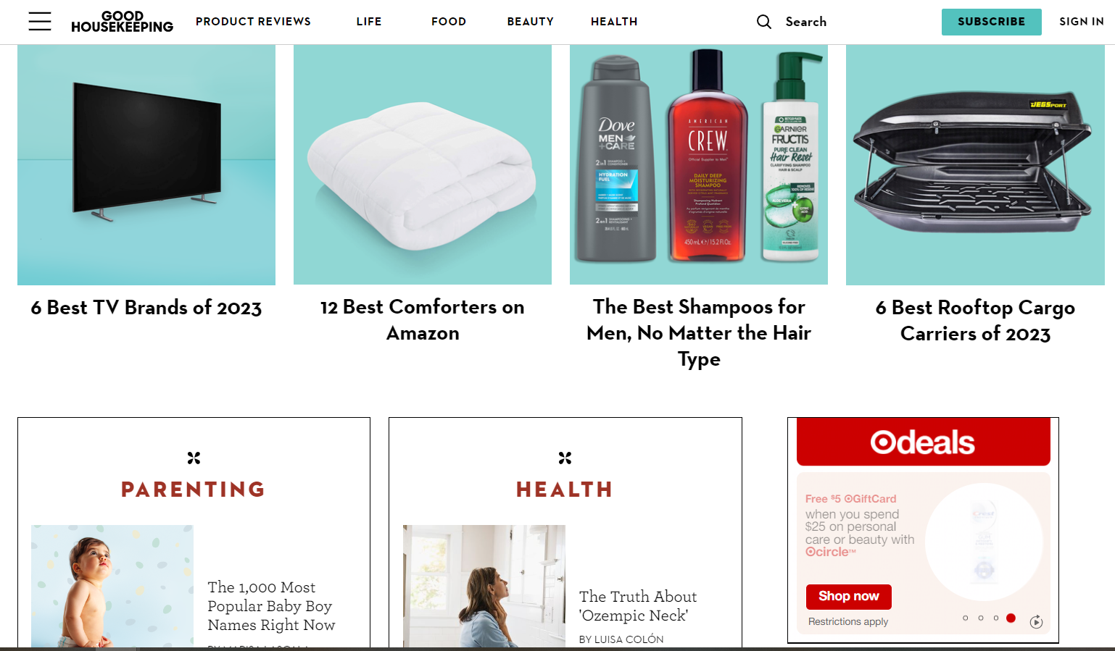
TERM 3 of 6
Display Campaigns
DEFINITION: Visual (image + text) ads shown across millions of websites, apps, and YouTube in the Google Display Network.
● Great for: brand awareness and remarketing to past website visitors
● Uses banner-style image ads rather than text
Notes:
Display campaigns place image-based banner ads across the Google Display Network (millions of partner sites/apps) plus YouTube. Effective for brand awareness and remarketing to past visitors. Unlike Search, users aren't actively searching when they see a Display ad — it's passive placement.

Slide 25
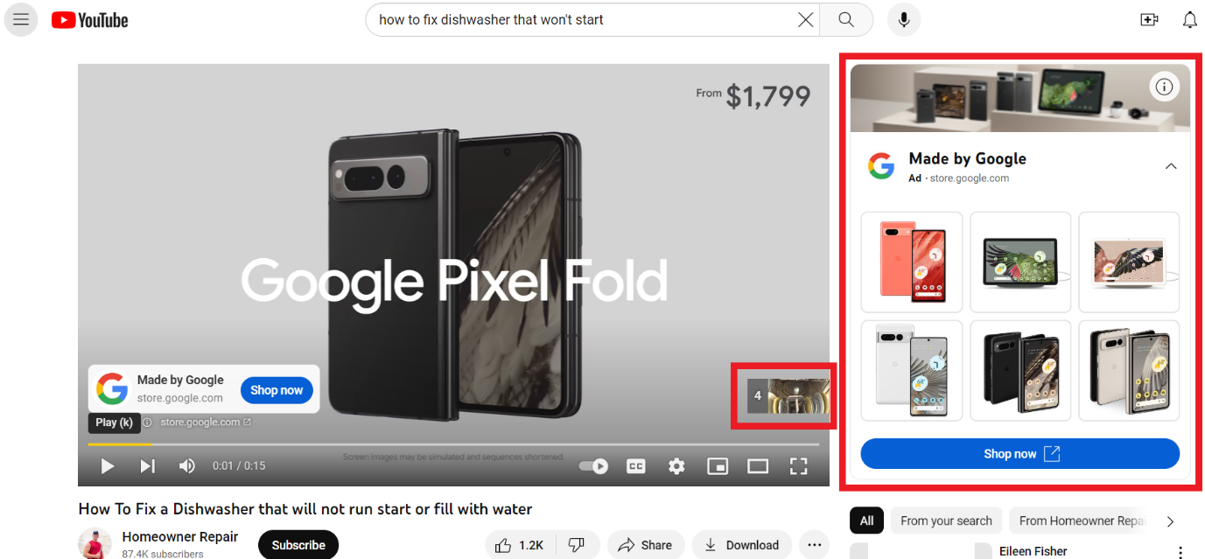
TERM 4 of 6
Video Campaigns
DEFINITION: Ads that run on YouTube and video partner sites, in 5 formats: skippable, non-skippable, bumper, in-feed, outstream.
● Non-skippable ads max out at 15 seconds; bumper ads are only 6 seconds
● Best for: storytelling, brand awareness, and reaching younger audiences
Notes:
Video campaigns run on YouTube and video partners in 5 formats: skippable in-stream, non-skippable (max 15 sec), bumper (6 sec, unskippable), in-feed, and outstream (mobile/tablet only, outside YouTube). Best for storytelling and reaching younger audiences who spend time on YouTube.

Slide 26
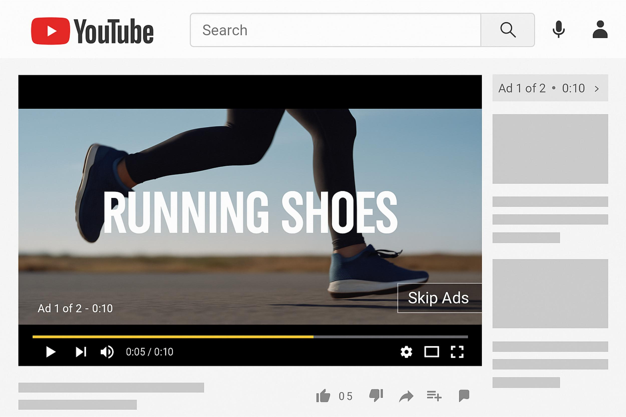
Skippable video ads

Slide 27
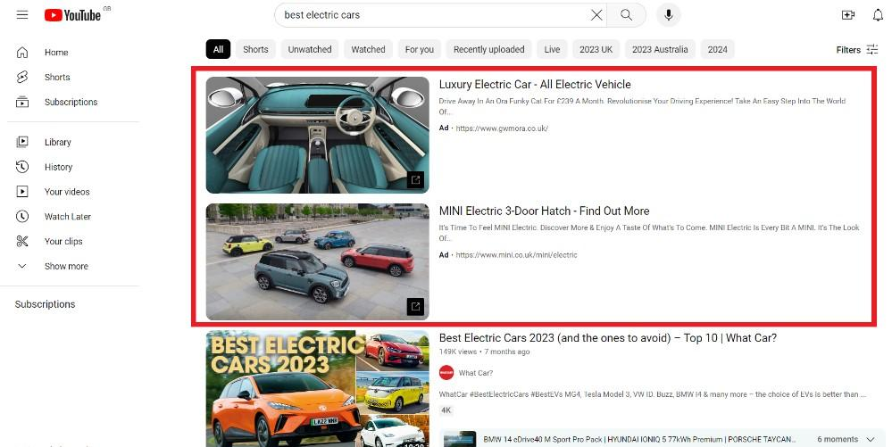
In-feed video ads

Slide 28
Outstream video ads

Slide 29
TERM 5 of 6
App Campaigns
DEFINITION: Promotes app installs or in-app actions across Search, Play Store, YouTube, Gmail & Display Network simultaneously.
● You provide text, images, and video — Google's AI assembles and places the ads automatically
● Best for: mobile app developers driving installs or engagement
Example: A fitness app promoting installs across platforms
Notes:
App campaigns are unique: advertiser provides raw creative assets (text, images, video) and Google's AI assembles and places ads across Search, Play Store, YouTube, Gmail, and Display Network automatically — no manual ad-by-ad creation. Designed for mobile app developers driving installs or in-app actions.

Slide 30
TERM 6 of 6
Performance Max
DEFINITION: One single campaign that spans ALL Google ad inventory (Search, Display, YouTube, Gmail, Maps, Discover) using AI.
● Uses your conversion goals + audience signals + creative assets to optimize automatically across every channel
● Best for: advertisers wanting maximum reach with minimal manual channel management
Example: A shoe store letting Google auto-optimize across every channel
Notes:
Performance Max spans ALL Google ad inventory — Search, Display, YouTube, Gmail, Maps, Discover — in one campaign. Advertiser feeds conversion goals, audience signals, and creative assets; Google's AI decides in real time which channel/format/audience combo performs best. Best for maximum reach with minimal manual channel management, though it sacrifices some manual control.

Slide 31
Section 5: Bidding Strategies
Notes:
Transition into bidding strategies. Tell students to think about which category (conversion, traffic, or visibility) matches their hypothetical campaign's goal.

Slide 32
Before selecting a bidding strategy, seek out the answer to some of these questions:
What does the company view as success? Is it a specific ROAS, CPA, or conversion rate?
What is the average lifetime value (LTV) of a user?
What is the typical cost per acquisition (CPA) for a new user?
Does a user purchase just once? Or are most customers repeat purchasers?
When it comes to selecting a bidding strategy in Google Ads, choose one that aligns most with that particular campaign goal:
Conversions ----------------------------- Traffic ------------------------------- Visibility

Slide 33
TERM 1 of 4
Target CPA
DEFINITION: Smart Bidding strategy that automatically sets bids to get as many conversions as possible at your target Cost-Per-Acquisition.
Goal: Conversions
Example: Set Target CPA = $20 → Google bids to average $20 per conversion
Best when you have enough conversion history (Google recommends 30+ conversions in the last 30 days)
Notes:
Target CPA is a Smart Bidding strategy: set a target cost-per-acquisition (e.g. $20) and Google automatically adjusts bids across auctions to average that CPA while maximizing conversion volume. Best used once you have enough conversion history — Google recommends at least 30 conversions in the last 30 days for the algorithm to learn effectively.

Slide 34
TERM 2 of 4
Target ROAS
DEFINITION: Smart Bidding strategy that sets bids to maximize conversion VALUE at your target Return On Ad Spend.
Goal: Conversions
Example: Target ROAS = 400% → for every $1 spent, aim for $4 in revenue
Best for e-commerce with varying product values/margins
Notes:
Target ROAS optimizes for conversion VALUE rather than volume — set a target return (e.g. 400%, meaning $4 revenue per $1 spent) and Google bids to hit that ratio while maximizing total value. Ideal for e-commerce businesses selling products with varying prices/margins, where not all conversions are equally valuable.

Slide 35
TERM 3 of 4
Maximize Clicks
DEFINITION: Automated bidding that gets the most clicks possible within your set budget — no CPA/ROAS constraint.
Goal: Traffic
Example: $100/day budget → Google spends it all chasing the highest possible click volume
Best for driving website traffic/awareness when conversions aren't yet the priority
Notes:
Maximize Clicks is a simple automated strategy: Google spends your full daily budget to get as many clicks as possible, without any CPA or ROAS constraint. Best used for early-stage traffic or awareness campaigns where conversions aren't yet the primary KPI — e.g. driving visits during a website launch.

Slide 36
TERM 4 of 4
Target Impression Share
DEFINITION: Automated bidding that aims to show your ad in a specific position (e.g., top of page) a set % of the time.
Goal: Visibility/Awareness
Example: Target = 90% Top of Page → Google bids to appear at the top for 9 out of 10 eligible searches
Best for brand awareness campaigns, e.g. branded search terms
Notes:
Target Impression Share aims for visibility rather than clicks or conversions — you set a target like '90% Top of Page' and Google bids aggressively enough to hit that visibility goal. This is ideal for brand awareness campaigns, especially defending branded search terms where you want near-total dominance of the results page regardless of click volume.

Slide 37
Section 6: Tracking, Setup & Best Practices
Notes:
Final section transition. Cover conversion tracking (crucial before launch), the account setup process, and universal best practices, closing with a recap.

Slide 38
Google Ads Conversion Tracking
● Conversion tracking lets you analyze data to make informed optimizations
● Method 1 — Google Analytics Linking:
– Go to Tools & Settings > Setup > Linked Accounts
– Link Conversions, Apps, Customer Match, Lead Export, Store Sales
– Import conversions once linked to start measuring
● Method 2 — Google Tag:
– Only ONE tag needed — avoid duplicate tags (causes false conversion counts)
– Install via website builder/CMS (Wix, Shopify) or manually
– Create Conversion Actions for purchases, signups, demo requests, etc.
Notes:
Launching campaigns without conversion tracking wastes ad spend. Method 1, linking Google Analytics: go to Tools & Settings > Setup > Linked Accounts, link Conversions/Apps/Customer Match/Lead Export/Store Sales, then import conversions. Method 2, the Google tag: only ONE tracking tag should ever be installed — having both a Google tag and separate Analytics tag can duplicate conversion counts and feed false optimization data. Install via Wix/Shopify or manually; then create Conversion Actions for purchases, signups, demo requests. Choose whichever method suits the business, but never skip this step.

Slide 39
Getting Started with Google Ads
1. Set Up Account
2. Add Business Name & Website
3. Link Accounts (Optional)
4. Choose Advertising Goal
5. Write Ad or Build from Scratch
6. Input Billing Information
● Goal options: get calls, sales/leads, store visits, or YouTube views/engagement
● Option A: Google's guided 'Smart' campaign (easy, less control)
● Option B: Click 'View more goal types' → 'Leave Campaign Creation' to build from scratch
Notes:
Six-step account setup: 1) sign in at ads.google.com; 2) enter business name and website URL; 3) optionally link Analytics now or later; 4) choose primary goal (calls, sales/leads, store visits, or YouTube views); 5) two paths — Option A follows Google's guided Smart campaign (less control, good for beginners), Option B (recommended for experienced marketers) clicks 'View more goal types' then 'Leave Campaign Creation' for full manual control; 6) input billing information as the final step. Seasoned marketers often prefer the manual route.

Slide 40
Google Ads Best Practices
● Keep user intent in mind with ad copy — mirror search queries to boost CTR & Quality Score
● Maximize ad space on the SERP — use sitelinks, lead forms, phone numbers to crowd out competitors
● Create a stellar landing page experience — fast load speed + clear call-to-action (CTA)
● Have a negative keyword strategy — use 'catch-all' & branded negative lists at account level
● Review the Search Terms Report weekly to mine new negative keywords
Notes:
Five universal best practices. 1) Ad copy mirroring user intent improves CTR, Quality Score, and Ad Rank, keeping CPCs competitive. 2) Ad assets like sitelinks/lead forms/phone numbers increase SERP real estate, crowding out competitors. 3) Landing pages must load fast (especially mobile) with a clear CTA. 4) Build catch-all and branded negative keyword lists at the account level. 5) Review the Search Terms Report weekly — this is ongoing, not one-time.

Slide 41
Key Takeaways
● Google Ads = paid platform reaching users across Search, Display, Shopping, Video, App
● Works via real-time auction using CPC/CPM pricing, driven by Ad Rank
● Cost depends on your daily budget + Ad Rank (bid + Quality Score)
● Choose bidding strategy based on goal: conversions, traffic, or visibility
● Set up conversion tracking BEFORE launching any campaign
● Success = ad relevance + landing page experience + continuous optimization
Notes:
Recap the entire lesson. Google Ads spans Search, Display, Shopping, Video, App formats. Every ad shown results from a real-time auction priced via CPC/CPM, position decided by Ad Rank. Cost is driven by daily budget and Ad Rank inputs. Bidding strategy should map to campaign goal — conversions, traffic, or visibility. Conversion tracking must be set up before launch. Success comes from ad relevance, matching landing page experience, and ongoing optimization. Consider assigning students an exercise: pick a hypothetical business and identify the best campaign type and bidding strategy for it.

