Slide 1
CIMNE
Centro de Excelencia Severo Ochoa 2019-2023
Ciencia de datos aplicada a consumos energéticos en edificios
Benedetto Grillone
Gerard Mor

Slide 2
Contents
The transformation of BEE Group
Data gathering
Data preparation
Clustering
Classification
Modelling
Optimisation
Applications

Slide 3
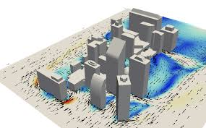
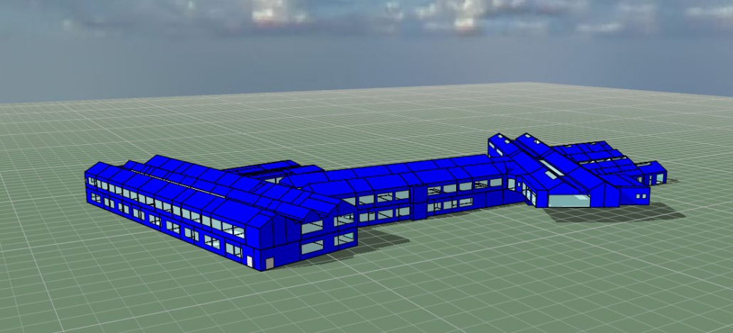
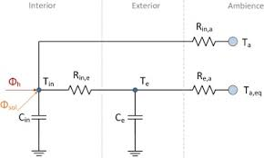
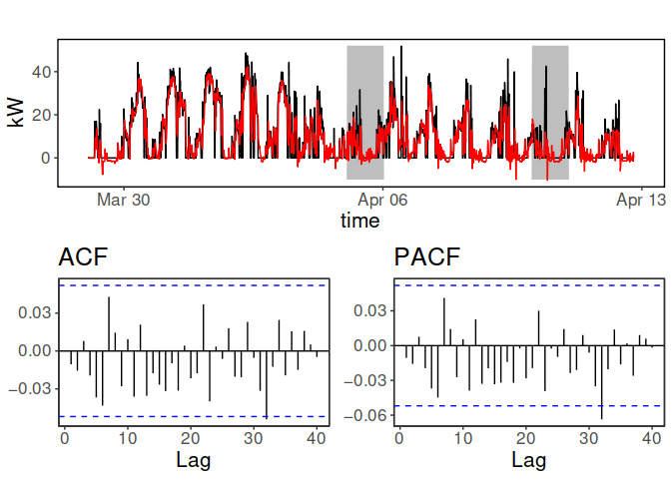
The transformation of BEE Group
CFD & FEM
Dynamic Empirical methods
Grey box models: Reduced order
Navier Stokes differential equations
Control volume analysis
Energy and mass ballances
Physically based models
Statistical learning and AI models
Simplified differential dynamic differential equations
Parameters identification from data
Regression based models
Pure data driven models
ANNs, linear, non-linear..

Slide 4
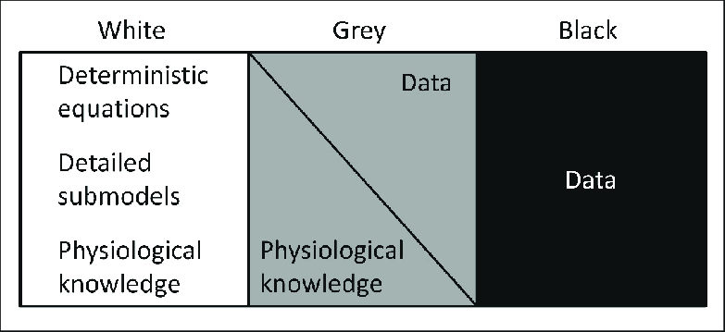
From White to Black
Dynamic Energy Performance modelling
CFD
Reduced order models
Statiscally and data driven models
AI, Deep learning...

Slide 5




Data gathering
Consumption meters
Heat
Gas
Electricity
Water
Cadaster
Weather
Building type
Solar radiation
Area
Temperature
Year
Wind speed
Orientation
Wind direction
National statistics
Energy Behaviour
Internal gains
Setpoints schedules
Occupancy behaviour
Energy Performance
Building fabric
Location & weather
Building systems
ECM
Building tipology
Economic level
Culture
Energy resources
Energy consumption =
Energy behaviour + Energy performance
Job

Slide 6
Data gathering
Weather data
Darksky
Meteogalicia
OpenWeather
Copernicus Atmosphere Monitoring Service
Building description
General information (location, id, …)
ECM
BIM
Gathered though ENMA API
National statistics
Gathered through INE API
Consumption meters
High frequency raw data
Whole-consumption vs. disaggregated by uses
Gathered through ENMA API
Aggregated consumption by districts or regions
Gathered through DATADIS
Cadaster data
INSPIRE data harmonized
Gathered through ATOM files

Slide 7
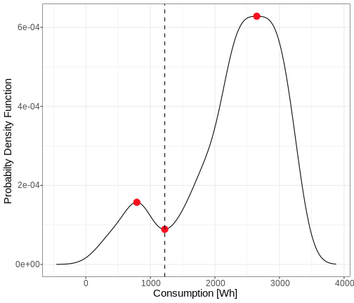
Data preparation \\ cleaning
Raw data is NEVER clean, so:
Data redundancy: What data is more accurate? Example of building area.
Time series:
Padding data gaps.
Normally, assign NA values when data is unknown.
Consumption time series:
Detect outliers instant consumption:
Density based filtering, to detect days without usage →
Cumulative filtering when on-change meters

Slide 8
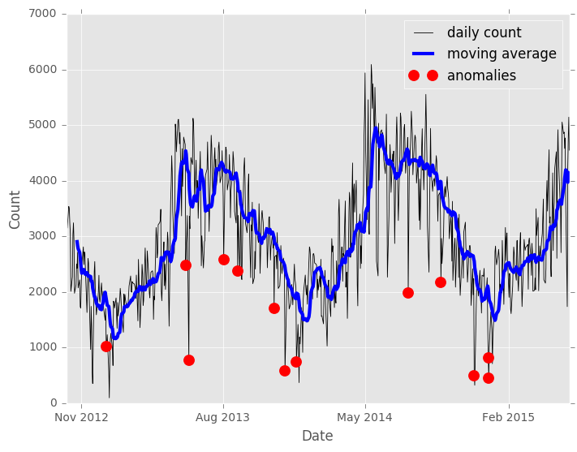
Data preparation \\ cleaning
Continuous variables (e.g. temperatures):
Detect outliers using Z-normalization (static or rolling).
Data interpolation could be done if data gaps are small. (Linear, non-linear, …)

Slide 9
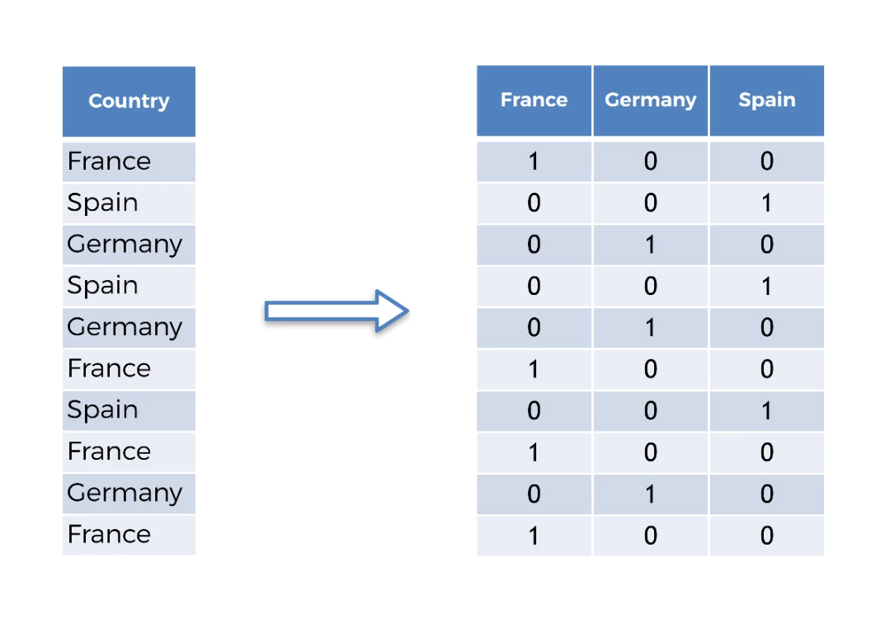
Data preparation \\ transformation
Sometimes, data used by AI models is transformed in order to smooth, linearise or enhance its representativity.
Categorical data:
Nomenclature standarisation
Encode the variables
One hot encoding
Transform categorical variables to
binary columns representing each
level
Wide variety of methods
https://towardsdatascience.com/all-about-categorical-variable-encoding-305f3361fd02

Slide 10
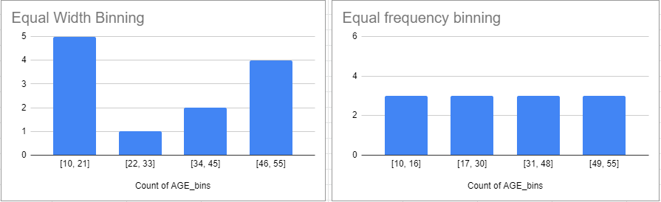
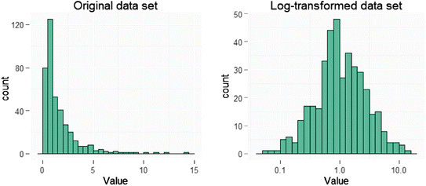
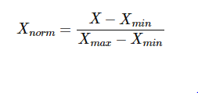
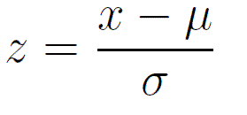
Data preparation \\ transformation
Numerical data
Discretization using equal-width or equal-frequency binning
Log-transformation
Normalization
Min-max scalar
Z-normalization
Robust scalar

Slide 11
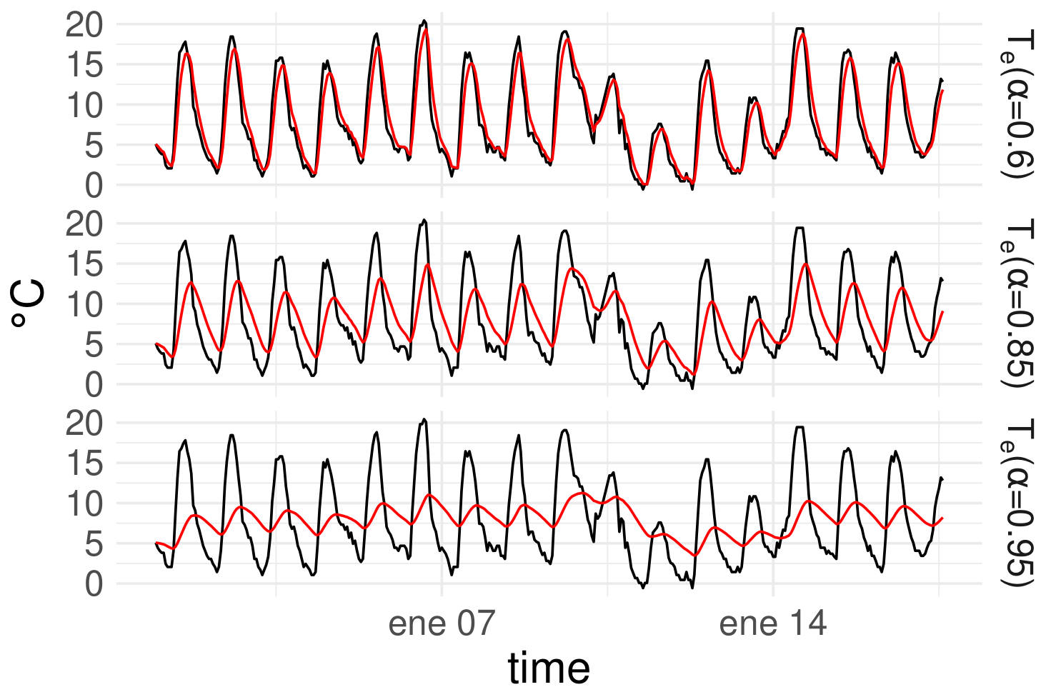

Data preparation \\ transformation
Moving average
Wide variety of window widths, aligns and weights.
Most used aggregation function tends to be the average.
Could be used also for detecting outliers (Rolling Z-norm).
First order low pass filter of weather variables
Slow dynamics (signals with frequency low) pass undisturbed, while the fast variations are damped (filtered).

Slide 12
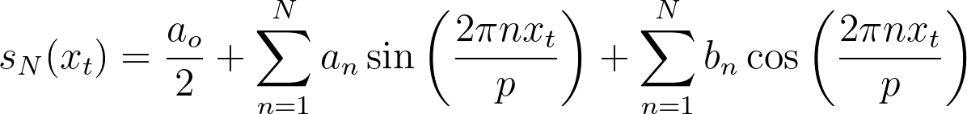
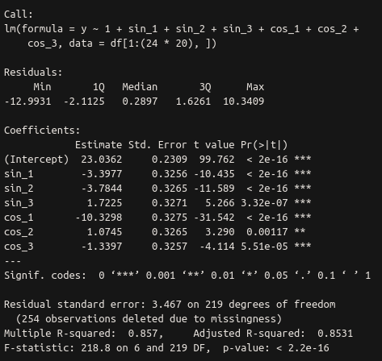
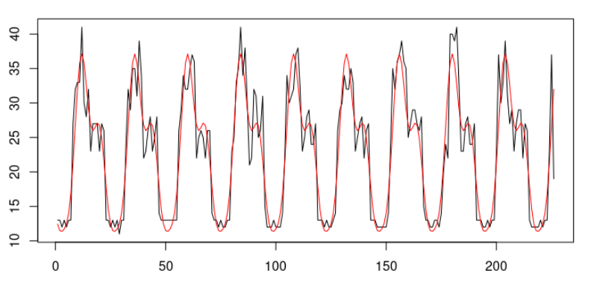
Data preparation \\ transformation
Fourier series (Modeling of responses to cyclic time series. e.g. hour of day)
where: sN is the Fourier series of order N, xt
represents a time series at time t,
n is the number of harmonics, p is the period,
an bn is the Fourier coefficient.

Slide 13
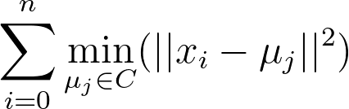
Clustering
Objective:
Obtain the representative daily load curves / most common patterns of occupants activity
Cluster groups of similar buildings → Benchmarking
Input for classification models of occupants behaviour
Major techniques used:
K-means
Iterative algorithm that choose centroids to minimise
Optimize nºclusters with Silhouette index or Davies-Bouldin
Gaussian Mixture Model:
Model-based → BIC or ICL for optimize nºclusters
All points are generated from a mixture of normal distribution with unknown parameters
Generalise k-means, it adds information about the covariance structure of the data

Slide 14
Clustering
Input data: Building characteristics, daily load curves, yearly load profiles, weather indicators
Example of daily load curves clustering:
Subset load curves by representativity
Avoid days with standby consumption
Avoid days with outstanding consumption
Normalization:
Z-normalization
Multiple customers vs. Single customers
Evaluate several types of models
Diagonal, spherical, tied and full covariance

Slide 15
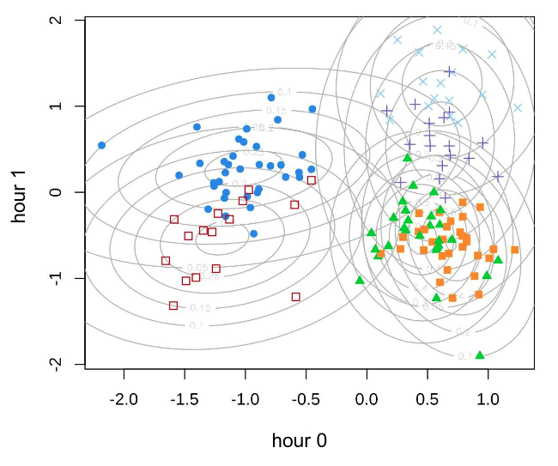
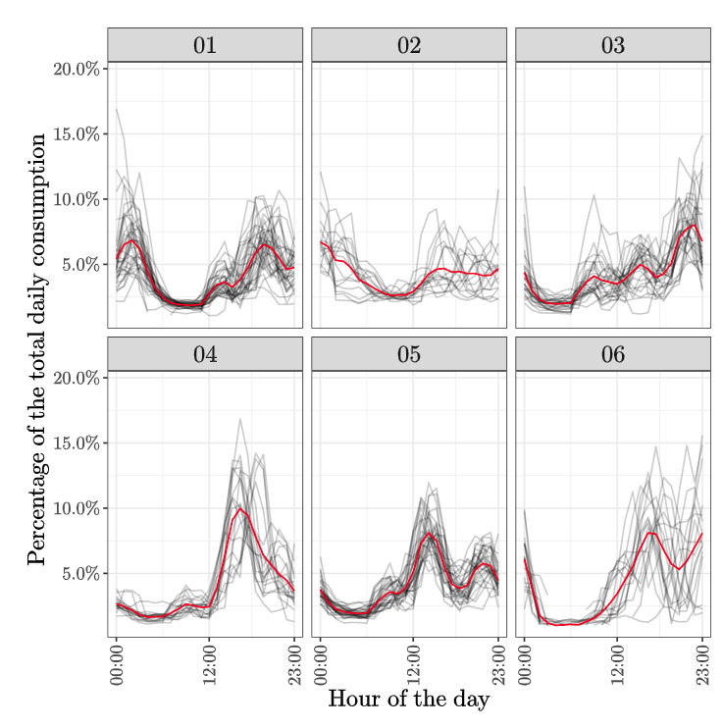
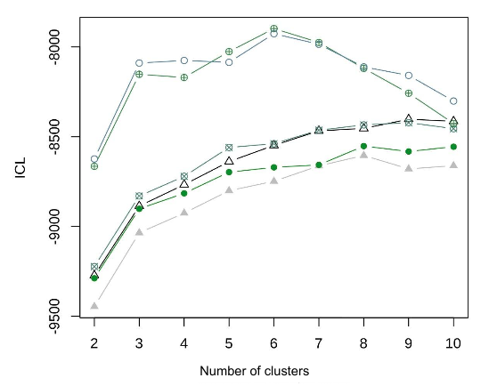
Clustering
Daily load curves clustering:

Slide 16
Classification
Daily load curves classification:
Input:
Representative load curves
+
Consumption time series
Classification minimizing the euclidean distance
No filtering for representative days is needed
Output:
Input for other forecasting models

Slide 17
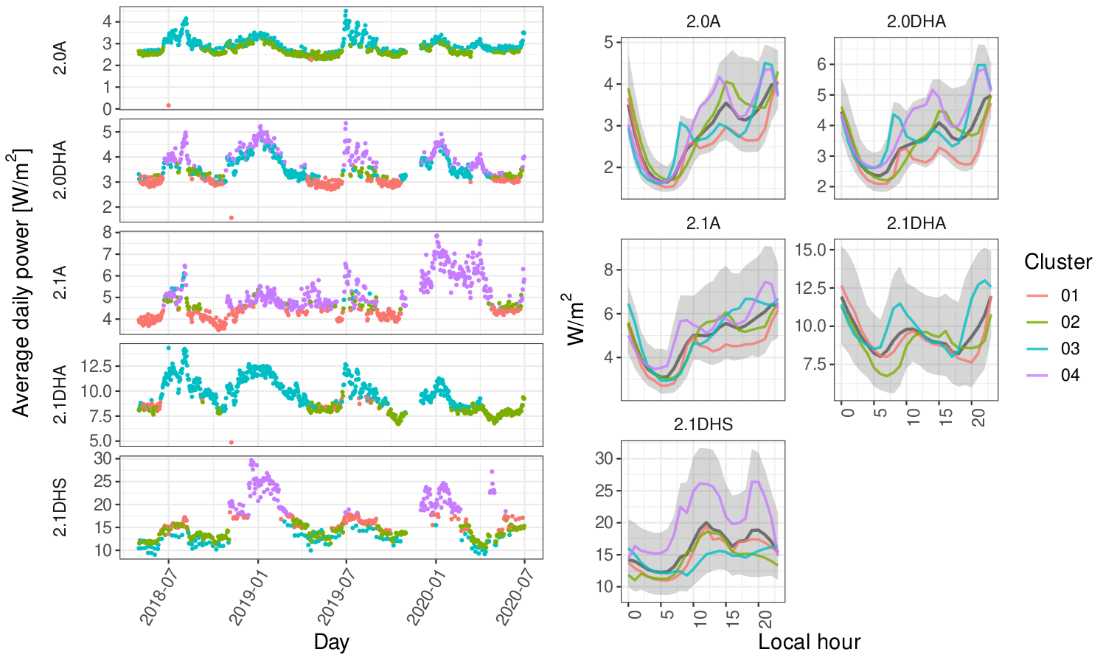
Classification
Daily load curves classification:

Slide 18
Modeling
Objective:
Predict one-step ahead or multiple-step ahead some variable of interest (e.g. electricity consumption)
Characterize some variable of interest against other exogenous variables. (e.g. estimate the heat transfer coefficient of a building, the solar gains, air leakage,...)

Slide 19
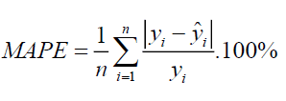

Modeling
Residuals evaluation
MAPE
Mean Average Percentage Error
Very intuitive, lacks when there are real measurements close to 0.
Not recommended for high frequency consumption time series
RMSE
Root Mean Squared Error
Quadratic error: Avoids the
problems when an element of the residual is ~0.
Absolute error, so it has the unit of the residual in evaluation

Slide 20

Modeling
Residuals evaluation
CV(RMSE)
Relative error, which is interesting to compare against other evaluations
It solves MAPE drawbacks
Autocorrelation functions
Used to detect correlations in model residuals
Existance of autocorrelation → The model is incorrectly specified
ACF depicts how an error at one point in time travels to a subsequent point in time.
PACF is the correlation that results after removing the effect of any correlations due to the terms at shorter lags.

Slide 21
Modeling
Time series regression models:
Linear models
Fast training (Least Squares method)
Simple, which does not mean inaccurate.
Easy interpretability of results
Could deal with non-linearities when using B-splines or fourier series as inputs.
Deals with categorical and numerical data as inputs
Normally trained along an optimisation method to optimise input tuning parameters of the model (Balance point temperature, low pass filters 𝛂’s, ...)
Recursive least squares
Time-variant coefficients
Lambda (forgetting factor) needs to be optimised

Slide 22
Modeling
Regression models:
ARX (Auto-Regressive with eXogenous)
Dynamic model
The output variable is correlated to its own lags and multiple exogenous variables
A process to optimise the correct order of lags is needed (BIC, ACF, PACF and CCF should be used)
When used for prediction: One step-ahead vs. Multiple step-ahead
Impulse responses normally provides good inference about the data

