Slide 1
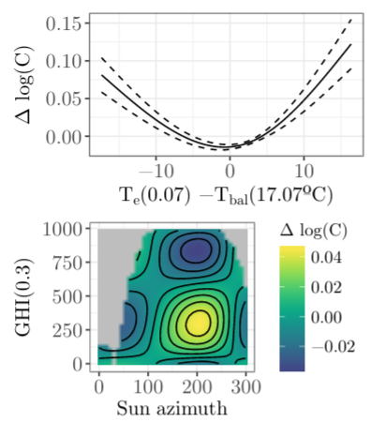
Modeling
Regression models:
GAM (Generalized Additive Models)
It is a generalized linear model in which the linear response variable depends linearly on unknown smooth functions of some predictor variables
It deals natively with non-linearities
Could integrate autoregressive
terms, if needed (GAMAR models)
Computational time is higher
compared to ordinary linear
regression.

Slide 2
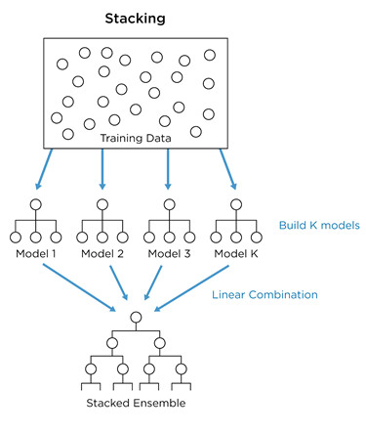
Modeling
Black-box models:
Gradient Boosting
XGBoost for classification
Random forest
Neural networks
Hyperparameters tuning
High computational time
Stacked ensembles

Slide 3
Optimisation
Genetic Algorithm:
Used to optimise:
Model parameters (autoregressive orders, low pass filters, harmonics, splines degrees of freedom, balance point temperatures)
Control scenarios (setpoint temperatures)
Normally, binary optimization is used
It discretises the possible solutions to the problem
Encode-decode representations for float, integer and categorical data
Major reason: Flexible technique to be used with all kind of modelling algorithms (Regression, black box,...)

Slide 4
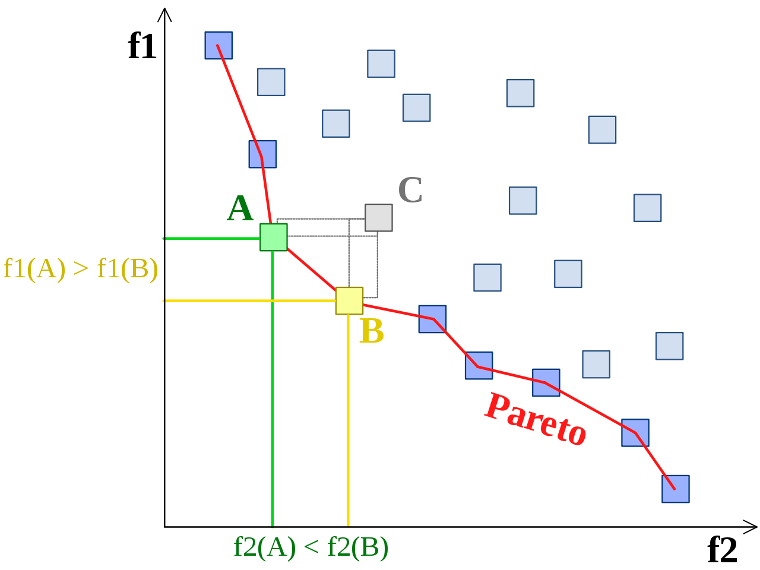
Optimisation
Genetic Algorithm:
Minimization objective:
Single-objective
Simpler, but the optimisation should account for soft-restrictions
Multi-objective:
More computational-effort
Examples:
Cost and thermal comfort
Cost and emissions
Operational cost and
mantainance cost

Slide 5
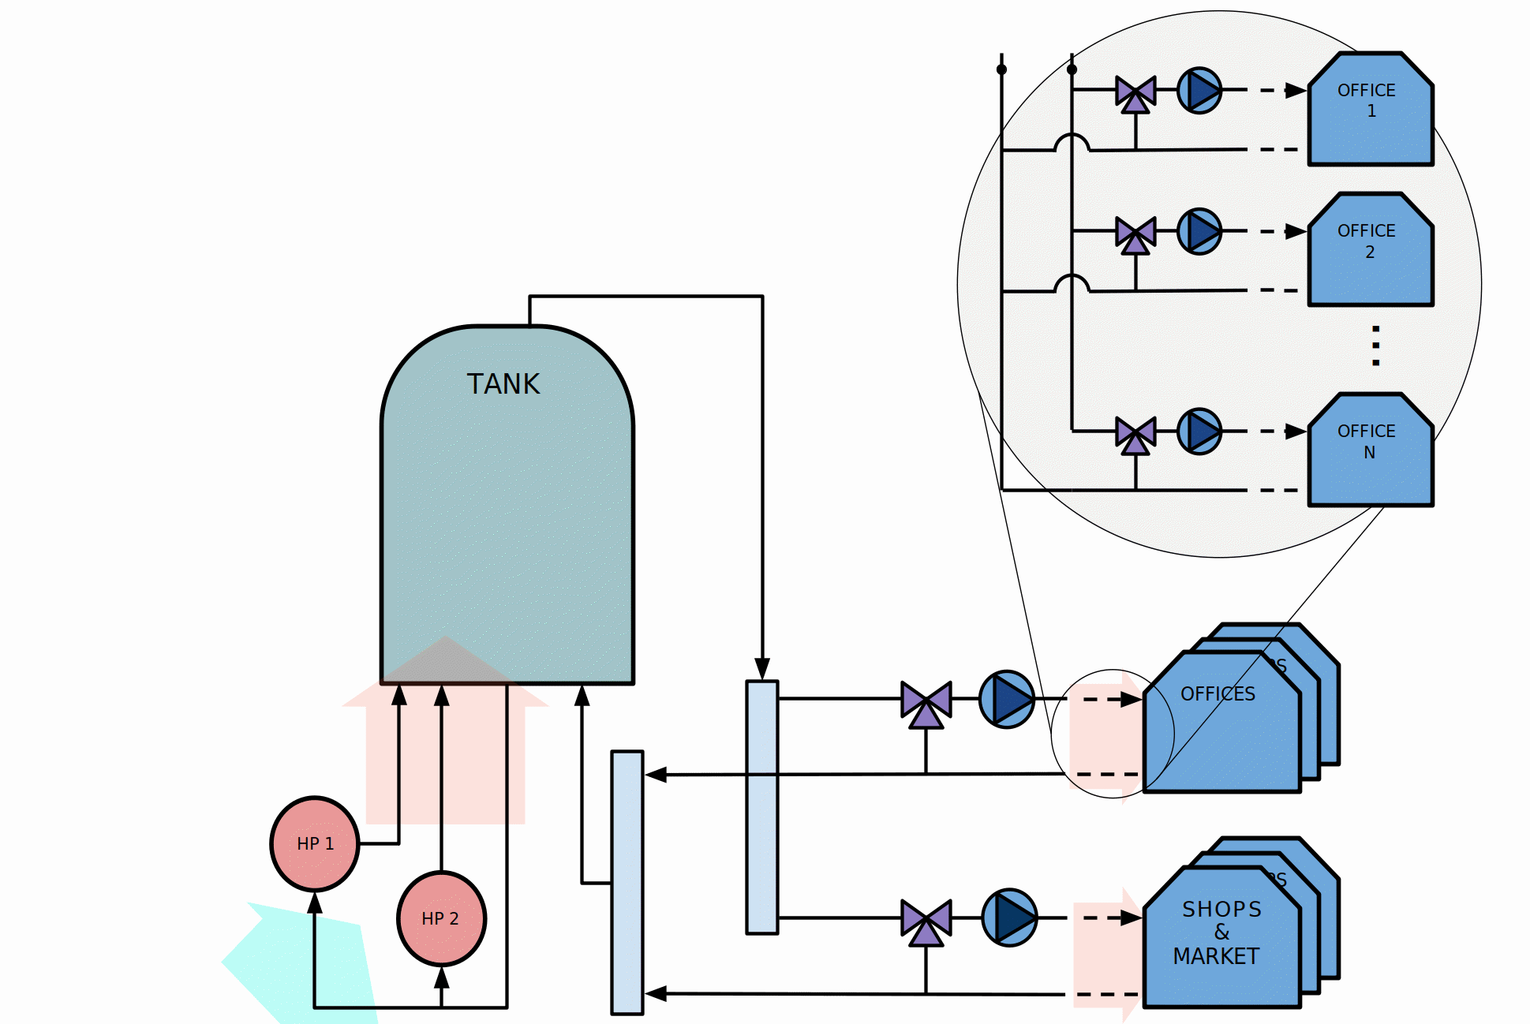
Applications
SIM4BLOCKS: Direct load control of heat pumps
V= 3,500 l.
33 offices
4 shops
1 local food market
P HP = 60 kWe

Slide 6
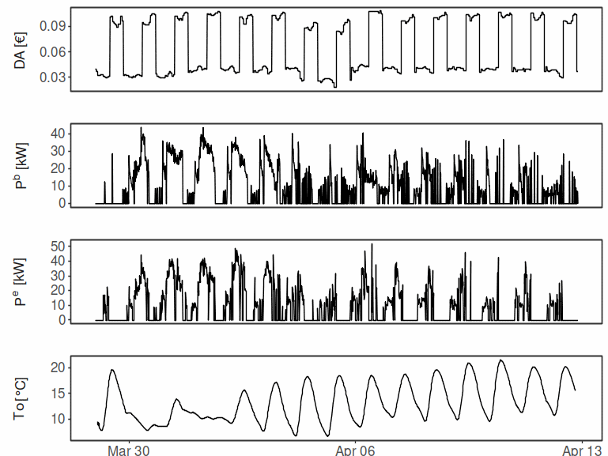
Applications
SIM4BLOCKS: Direct load control of heat pumps

Slide 7
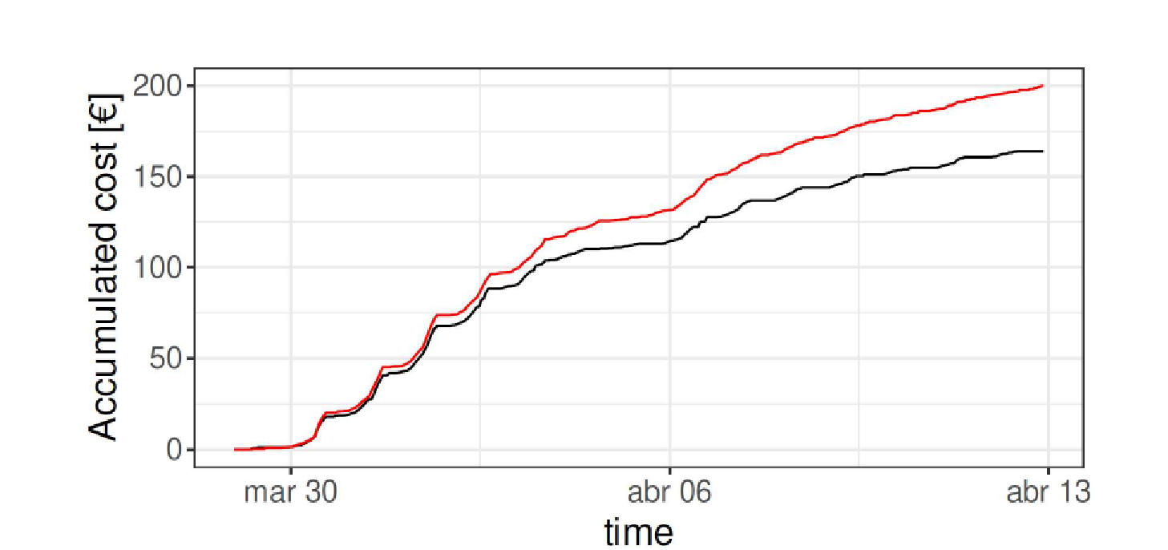
Applications
SIM4BLOCKS: Direct load control of heat pumps
18 % costs saving
Baseline
Optimized

Slide 8
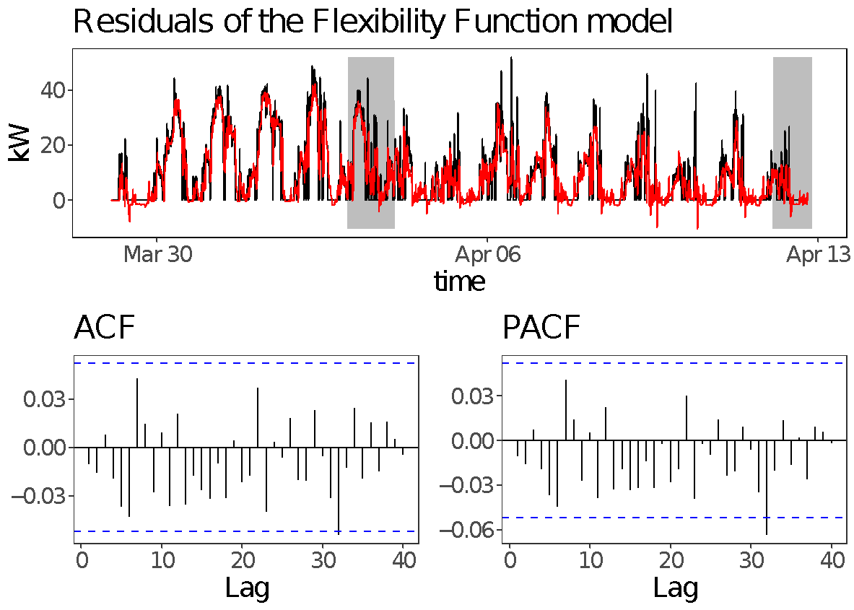
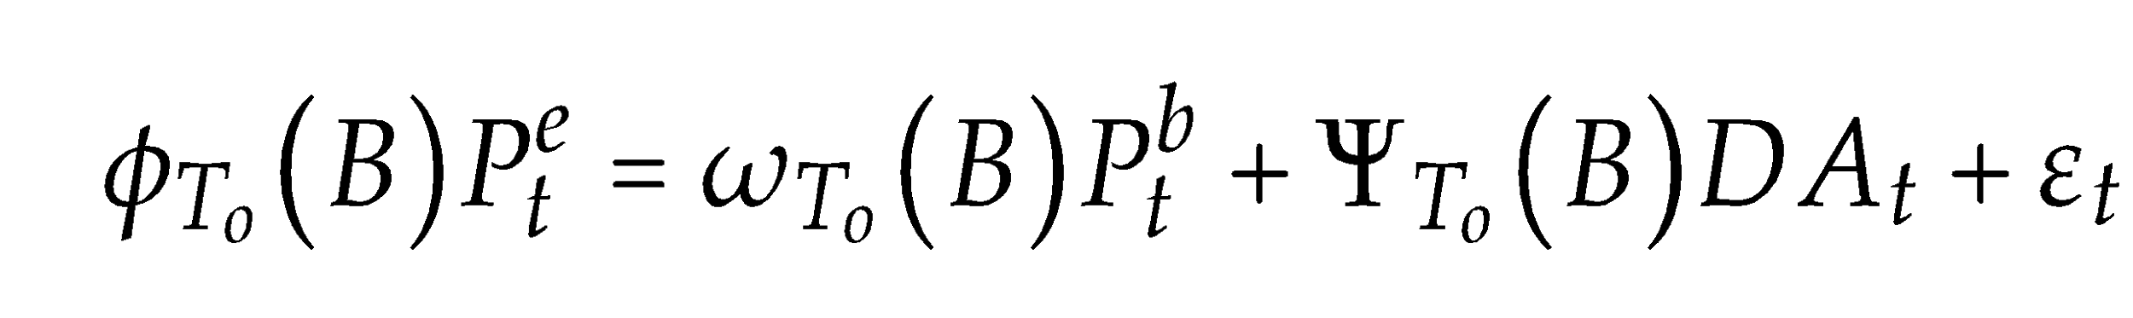
Applications
SIM4BLOCKS: Direct load control of heat pumps
ENERGY FLEXIBILITY MODEL
Regression model to fit:
P activated
(kW)
P baseline forecasting
(kW)
Day ahead electricity
prices (€)

Slide 9
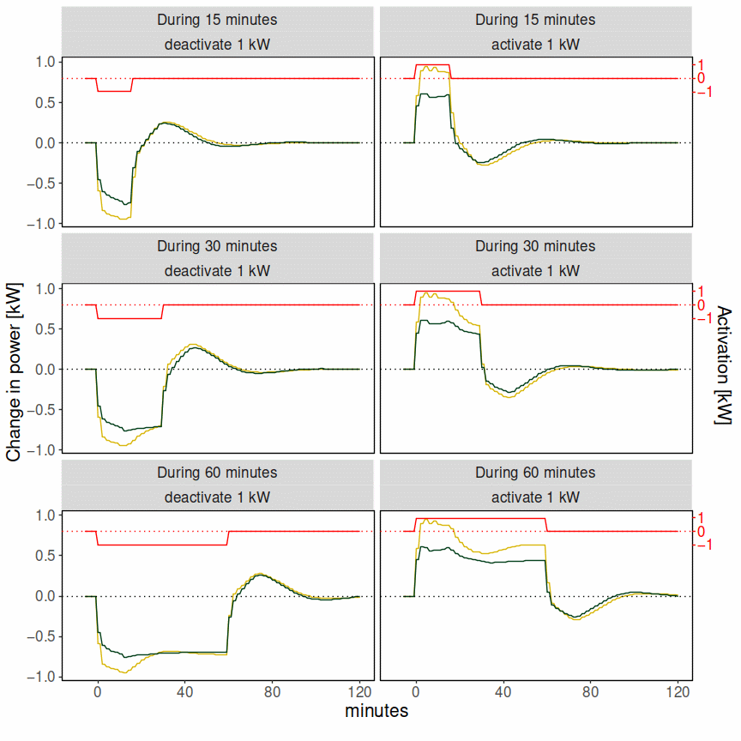
Applications
SIM4BLOCKS:
ENERGY FLEXIBILITY FUNCTION

Slide 10
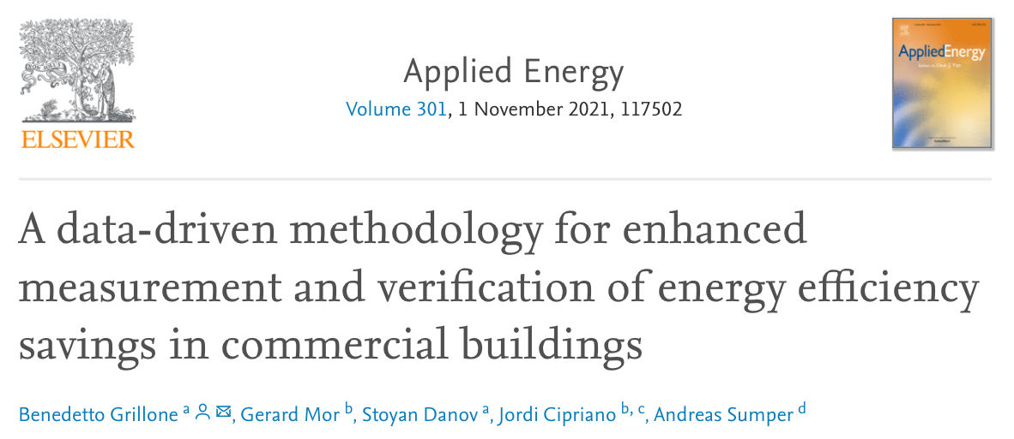
Data-driven model for enhanced Measurement & Verification
Notes:
There is a significant limitation to develop data-driven methodologies for prediction and recommendation which is the need to collect relevant data regarding building characteristics and the impact of energy renovation measures.
We could say that compared to the measurement and verification field it is a quite new and immature field, as we will see in the chapter dedicated specifically to the recommendation techniques developed in this thesis.

Slide 11
Measurement & Verification
The common approach to estimate energy savings is by comparing the energy consumption after the implementation of the EEMs to a baseline that represents what the consumption would have been without these measures (counterfactual).

Slide 12
Data-driven model for enhanced M&V
Why research in baseline models for Measurement and Verification?
Measuring the absence of consumed energy is not possible, the only way to verify achieved energy efficiency savings is to use counterfactual consumption models.
The accuracy and uncertainty of the savings estimation will depend on the goodness of the consumption models built.
Having more accurate estimations will increase confidence and boost private investments in energy efficiency.
Notes:
This is just to remind why do we actually need accurate models for M&V

Slide 13
Data-driven model for enhanced M&V
Obtaining accurate estimations of the baseline energy consumption of a building is not trivial, since energy consumption time-series are influenced by several factors:
Weather variables
Building occupancy patterns
User behaviour changes
Major non-routine events (pandemics, natural disasters…)
The actual effect of the implemented EEMs

Slide 14
Proposed methodology
The M&V solution proposed is based on a daily baseline model that estimates consumption as the sum of a baseload that depends on the consumption pattern of the day, and several weather related variable terms.
Once the EEM implementation date is marked, the model attempts to quantify the effect of the measure on both the baseload and the weather dependence of the building.
This methodology, together with the estimated savings, also provides users with insights into the energy usage of the analysed building, most notably consumption profiles and temperature dependence.

Slide 15
Methodology flowchart
Notes:
Explain the flowchart, don’t use too much time
We will analyse one by one the techniques used

Slide 16
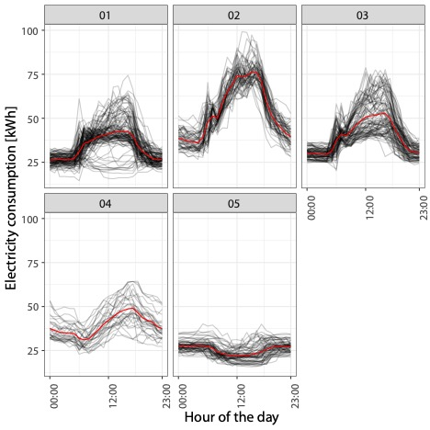
Clustering of electricity consumption profiles

Slide 17
Time-series partitioning according to the EEM implementation date

Slide 18
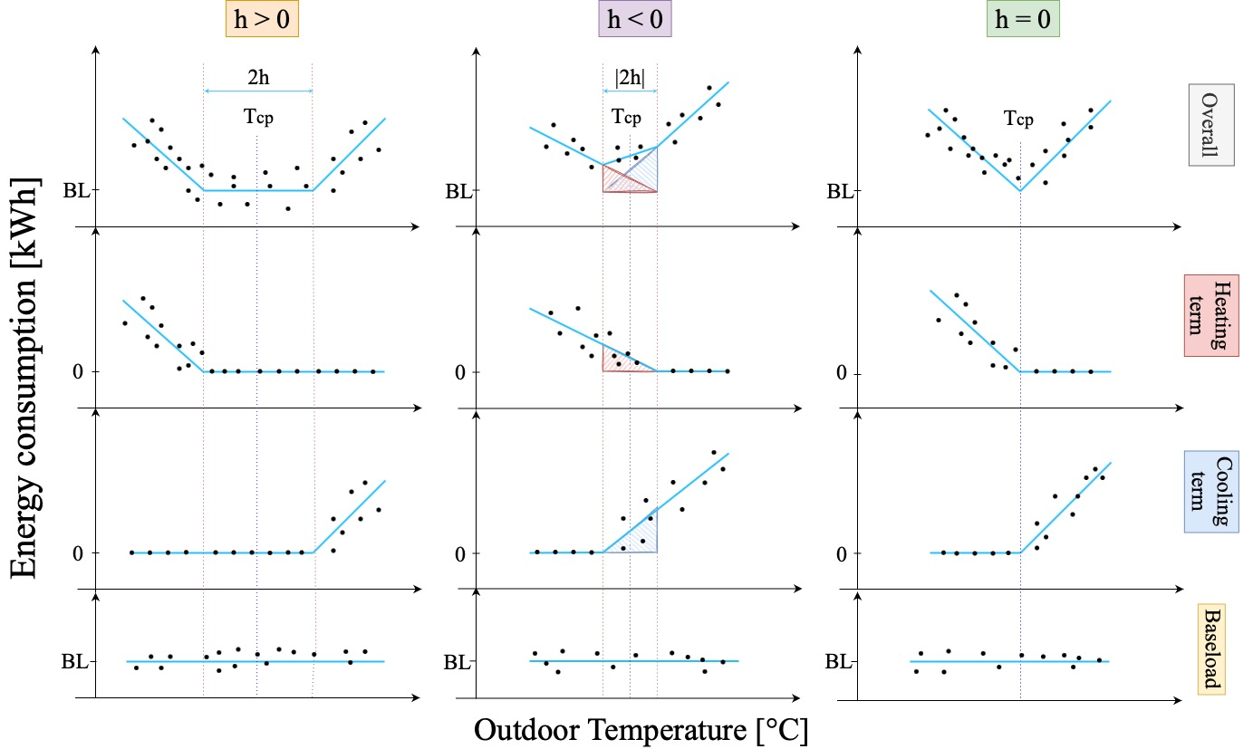
Identification of the change-point temperatures
Notes:
3 different buildings

Slide 19
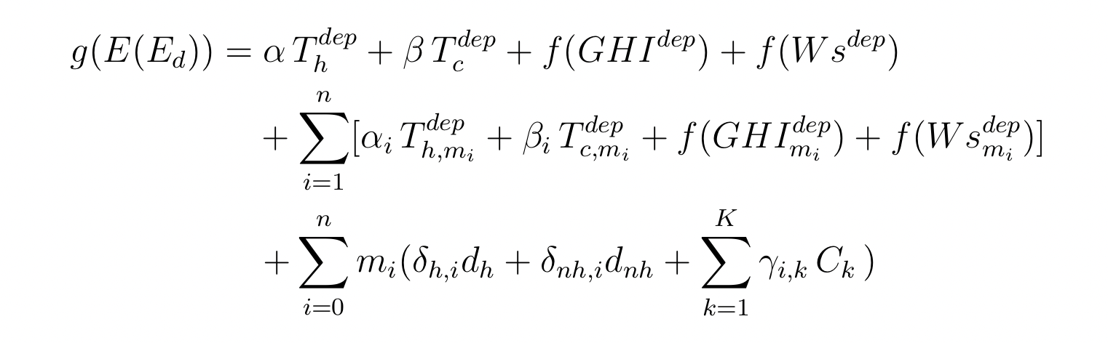
Energy baseline model (GAM)
Temperature linear terms
Solar radiation and wind speed splines
Measure effect term
Baseload and holiday term
Notes:
g(E(Ed) is the estimator of the link function of the consumption.
Gams use inlk funcions, in this case it was a normal distribution
Two linear terms terms depending on heating and cooling temperatures
Two terms describing the GHI and wind speed splines

Slide 20
Real building nergy baseline example

Slide 21
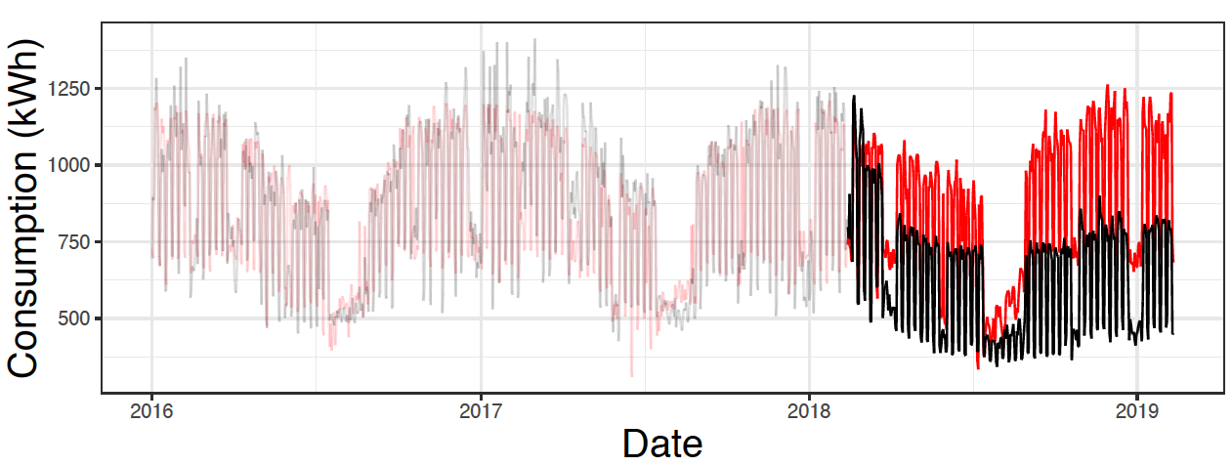
Real building savings estimation example

Slide 22
Thanks for your attention!
Questions?

