Slide 1
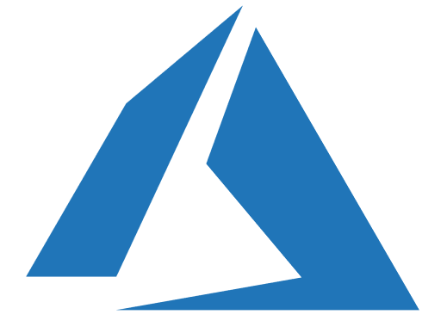

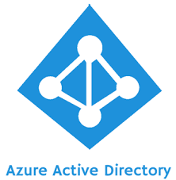
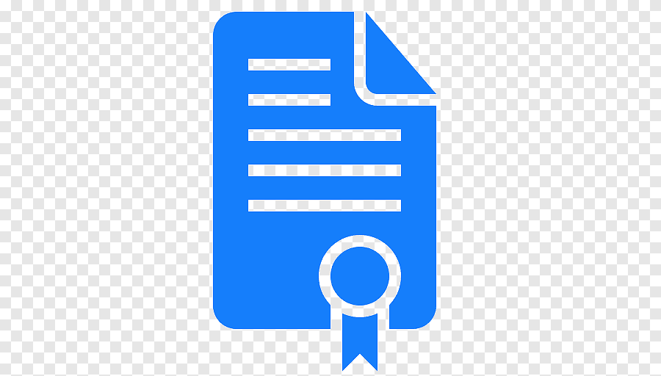


Azure AD token Authentication approach
Azure
Azure Key Vault
2
Proof DXC
Certificate based authentication for KV
3
Token Service + Authorization
Retrieve client secret based on Tenant’s Functional ID
Generate Azure AD token
( ClientID + Client Secret)
Azure AD
5
Acquire token
6
Authorize tenant + Request token
Return token to tenant
Validate Azure AD token
7
9
Tenant DXC
1
GRID DAL API
Validate Azure AD token
and provide access
Tenant API
8
Invoke GRID API call with token

