Slide 1
Distributed Edge-Chasing Algorithm
A probe is sent by a blocked
process to the process holding the resource.
- Probe is a triplet (I, J, k)
I: ID of blocked process
J: ID of process sending the message
K: ID to which message is sent
If probe is received by a blocked process, it edits and forwards the probe to the processes holding the resource it requires
If initial blocked process receives back its probe; it declares deadlock
Chandy Misra Haas Algorithm

Slide 2
Distributed Edge-Chasing Algorithm
Chandy Misra Haas Algorithm
To determine if a blocked process is deadlocked
if P_{i} is locally dependent on itself
then declare a deadlock
else for all P_{j} and P_{k} such that
(a) P_{i} is locally dependent upon P_{j}, and
(b) P_{j} is waiting on P_{k}, and
(c) P_{j} and P_{k} are on different sites,
send probe (i, j, k) to the home site of P_{k}

Slide 3
On the receipt of probe (i, j, k), the site takes the foll. actions:
if (a) P_{k} is blocked, and
(b) dependent_{k}(i) is false, and //Pk knows of I’s dependency on it.
(c) P_{k} has not replied to all requests of P_{j},
then begin
dependent_{k}(i) = true;
if k = i then declare that P_{i} is deadlocked
else for all P_{m} and P_{n} such that
(i) P_{k} is locally dependent upon P_{m}, and
(ii) P_{m} is waiting on P_{n}, and
(iii) P_{m} and P_{n} are on different sites,
send probe (i, m, n) to the home site of P_{n}
end.
Notes:
Why do we need to keep track of dependencies?
Suppose there is a cycle involving k and say m but not involving i, then the probes sent out by k will come back to it. It need not forward probes again as this will go on in cycles where probes keep on moving btwn k and m endlessly. A probe for initiator i need not ever be sent out again unless its a new probe by i. hence first time it receives a probe from initiator I then dep_k(i) marked as true. So if again it sees a probe from initiator I , it need not forward it.

Slide 4
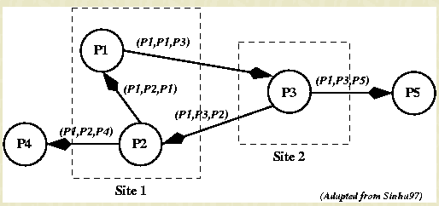

Slide 5
Other Edge - Chasing Algorithms
The Mitchell – Merritt Algorithm
Sinha – Nataranjan Algorithm

Slide 6
Mitchell and Merritt’s Algorithm for single resource model
Works on the single resource model Belongs to the class of edge-chasing algorithms where probes are sent in opposite direction of the edges of WFG.
Each node has two labels- Private and Public where initially both has same values
Private is unique but might change
Has four nondeteministic state transitions
- Block, Transmit, Detect, Activate
Notes:
https://groups.csail.mit.edu/tds/papers/Merritt/podc84.pdf

Slide 7
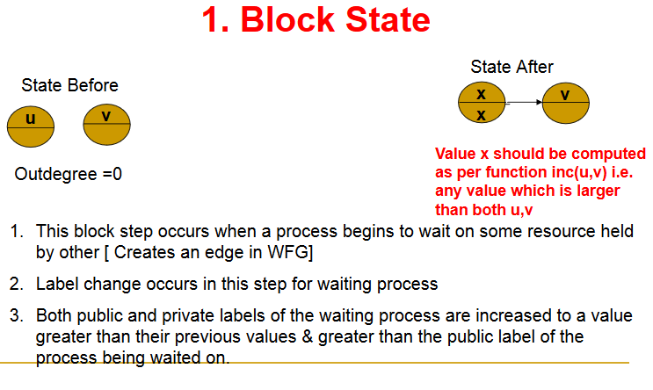

Slide 8
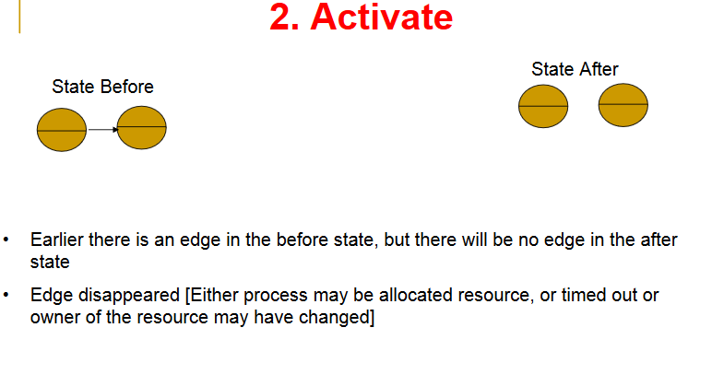

Slide 9
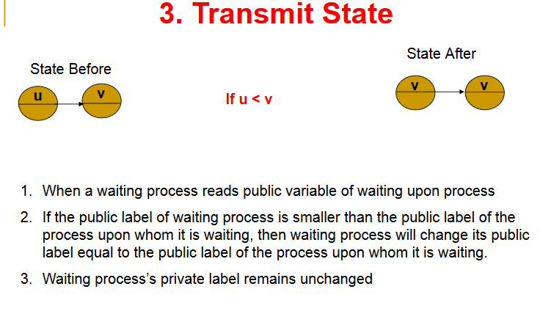

Slide 10
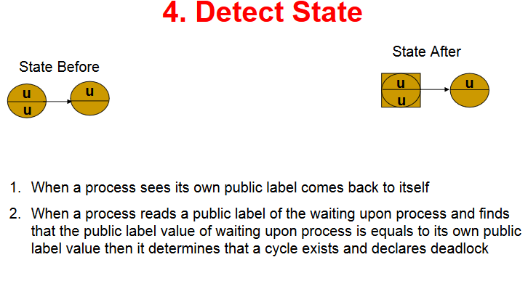

Slide 11
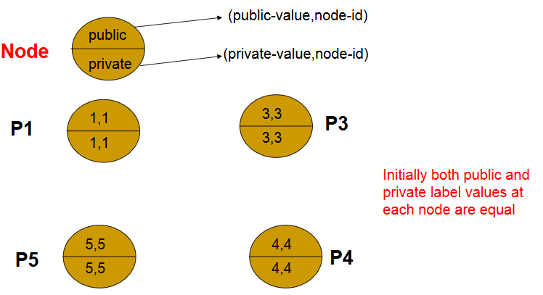

Slide 12
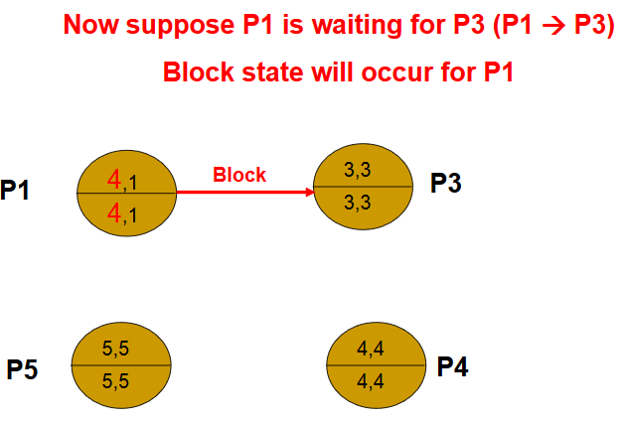

Slide 13
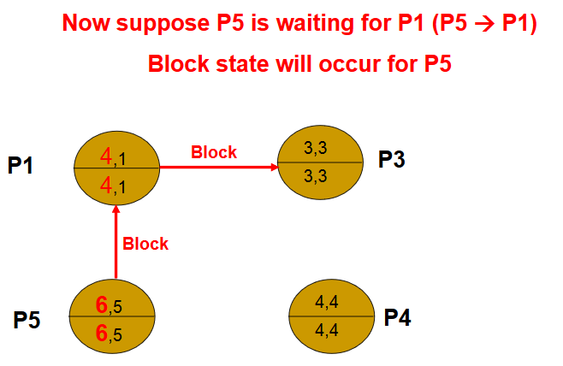

Slide 14
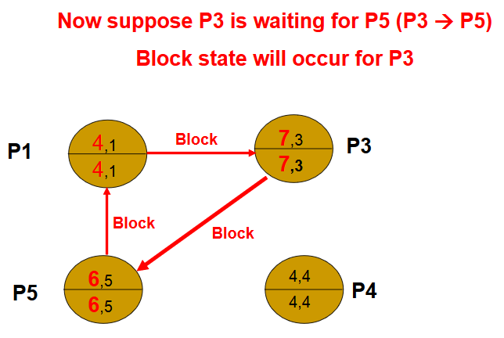

Slide 15
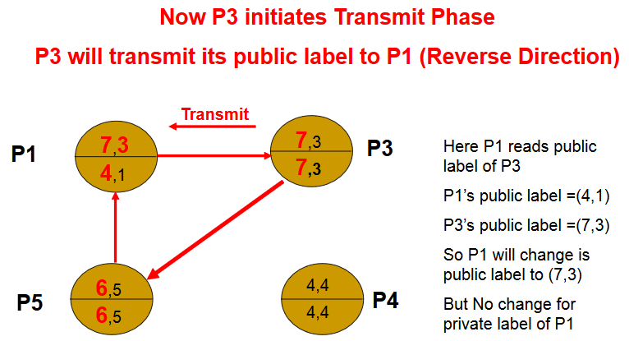

Slide 16
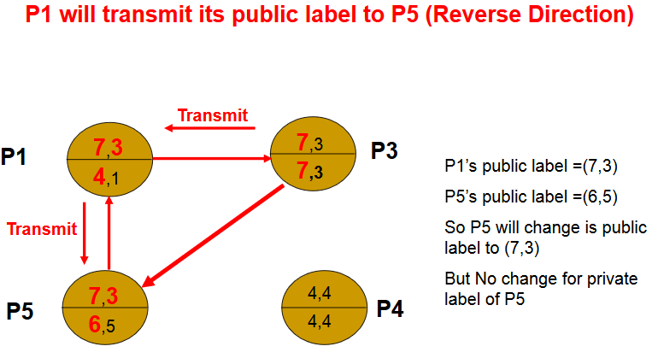

Slide 17
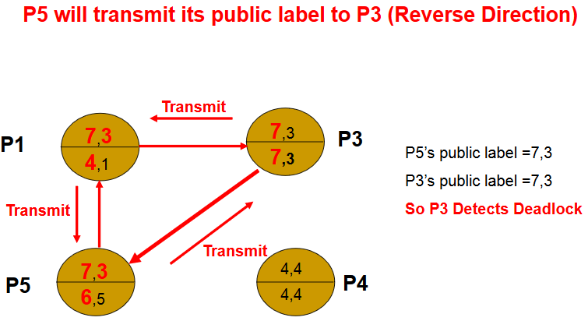

Slide 18
Mitchell and Merritt’s Algorithm
When a probe initiated by a process comes back to it, the process declares deadlock.
Only one process in a cycle detects the deadlock. This simplifies the deadlock resolution – this process can abort itself to resolve the deadlock.
The site with the highest public label finally aborts itself (turns out to be the latest one that resulted in the deadlock).

Slide 19
Mitchell and Merritt’s Algorithm
A blocked transaction periodically reads the public label of the blocking transaction and replaces its own public label with it.
In case of a deadlock a cycle exists. When each process keeps updating its public label, cyclically all processes will land up with the same label .
The process whose public and private label is the same and the public label is also same as the blocking process will abort (as he added the latest dependency).

Slide 20
If we assume that process’ can fail, then can there be phantom deadlocks? HW
Can we modify the algorithm further to allow the process with lowest priority to abort HW

Slide 21
Mitchell and Merritt’s Algorithm
Message Complexity
If we assume that a deadlock persists long enough to be detected, the worst-case complexity of the algorithm is s(s -1)/2 Transmit steps, where s is the number of processes in the cycle.

Slide 22
the value transmitted being larger than your public label is a necessary but not sufficient condition for deadlock.

